Slide 1
Local Planning Systems in Practice
(an illustration from Cambodia)

Slide 2
Sub- National Planning Policy Components
Key issues to be addressed by a national policy on sub-national planning include the definition of :
  Planning Territorial Systems (the where)
  Planning Institutions (the who)
  Planning Instruments (the what)
  Planning Process (the how)
  Planning Timeframe (the when)
  Planning Support Mechanisms

Slide 3
1. Territorial Systems
Identify the territorial sub-systems where sub-national planning should be carried out and recognize their different requirements.
IN CAMBODIA this meant:
  To move beyond the administrative subdivisions of the State and recognize the existence of 4 Territorial Systems for integration and/or coordination of plans, programs and budgets (PPB) of multiple SNA, requiring 4 types of planning :
    Regional Planning (Coordinated Provinces/D/M PPB)
    Metropolitan Planning (Integrated Capital/Khan/Sangkat PPB)
    Urban Planning (Integrated Municipalities/Sangkats PPB)
    Rural Planning (Coordinated Districts/Communes/Sangkat PPB)
  To develop specific guidelines/manuals and related Capacity building programs for the 4 systems, adapting to each one a general planning approach (see next slides)

Slide 4
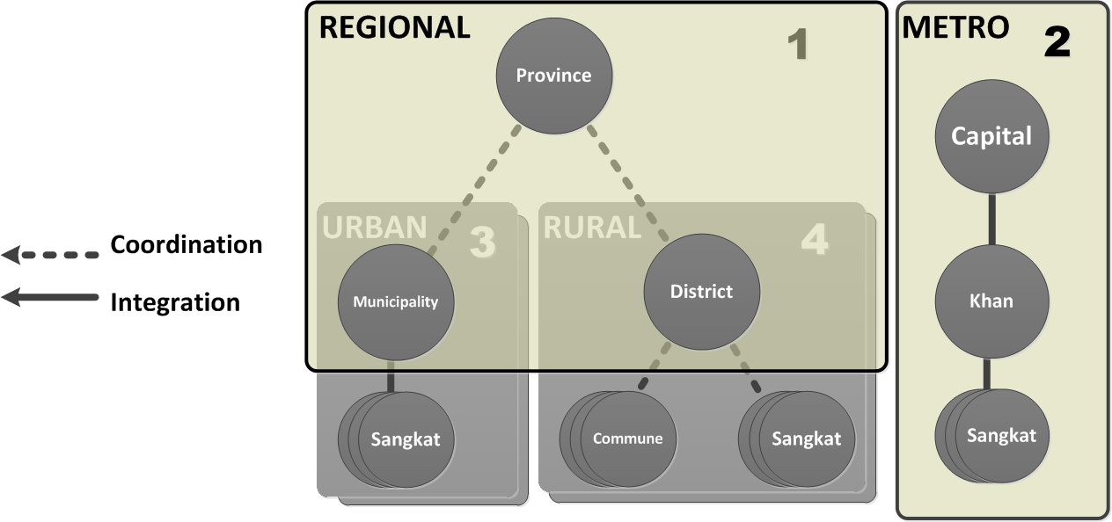
Territorial Systems (the Cambodia case)

Slide 5
2. Planning Institutions
Set up and develop the capacity of the institutions responsible for actual preparation of development plans , including the organizations and procedures to support political deliberation, people’s participation and inter-governmental coordination
IN CAMBODIA this meant
Establish Planning and Budgeting Committees - PBC of the SNA Councils (in line w/ international good governance practices and Cambodian C/S experience)
Establish local Planning Forums as broad-based mechanisms for consultation and participation of multiple stakeholders [requires a re-conceptualization of the TFC ] articulated in sectoral sub-committees (Social, Economic, Environmental, Physical Infrastructure, Institutional)
Clarify roles and responsibilities of the Provincial Department of Planning (MOP) and of the Planning Divisions/Offices of the sub-national administrations (Provinces, Districts, Khans, Municipalities)

Slide 6
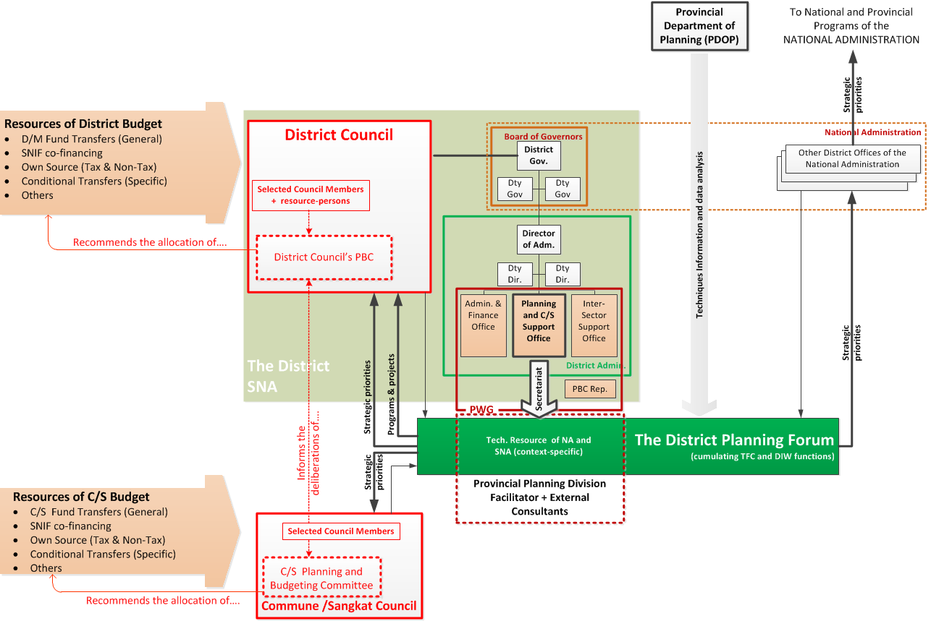
the Cambodia case: the Rural (District) system

Slide 7
3. Planning Instruments
Define the nature and scope of the planning , programming and budgeting instruments to be developed and adopted by the SNA.
IN CAMBODIA this meant
Pilot physical planning instruments (see next slides) starting with Urban and selected District systems and develop:
  Spatial development Frameworks(SDF) and
  Land Use Management Plans (LUMP)
Distinguish and develop, in a single planning process, two sectoral planning instruments:
  A Strategic Development Plan (SDP) to guide program development and resources allocation of multiple actors (SNA, De-concentrated State Administrations, NGOs and Private sector) operating in the jurisdiction
  A Local Development Agenda (LDA) as the “political program” of the elected Council and “corporate strategic plan” of the SNA as autonomous legal entity.
Redefine the SNA Investment Programs and complement it with a “rolling” Services Operations Program (SOP) defining what the SNA’s own Divisions/Offices are expected to do to deliver administrative and socio-economic services

Slide 8
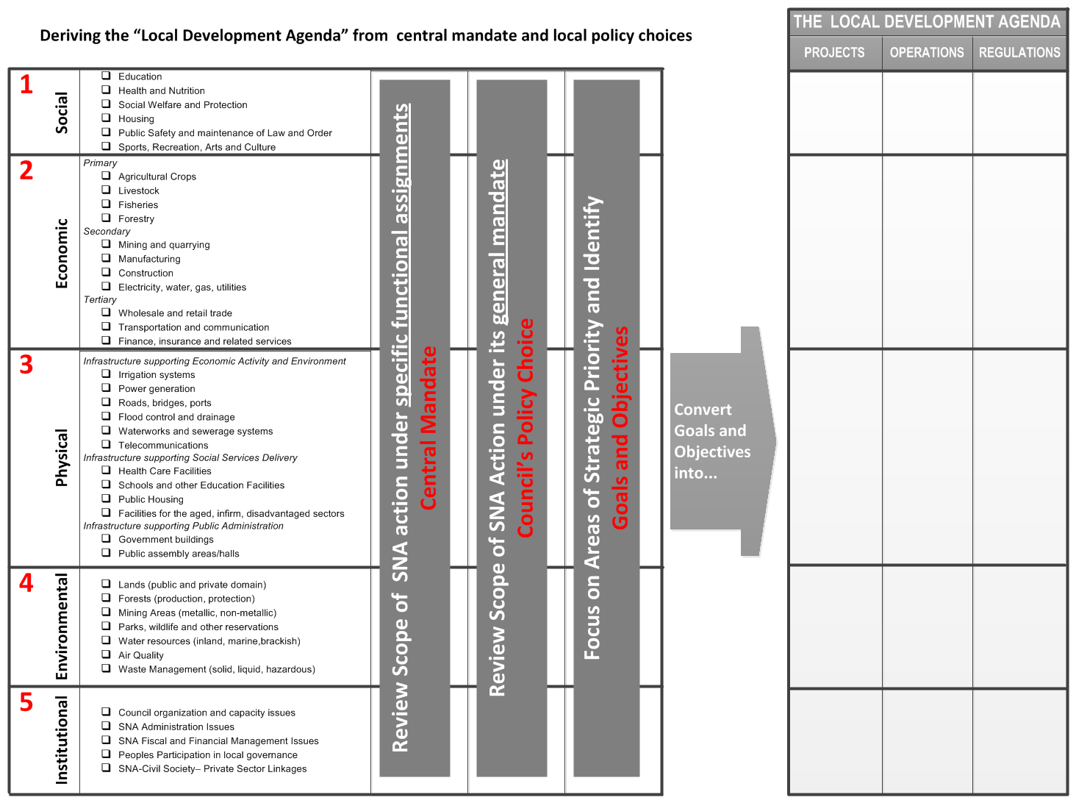
the Cambodia case : Defining the scope of Local Planning

Slide 9
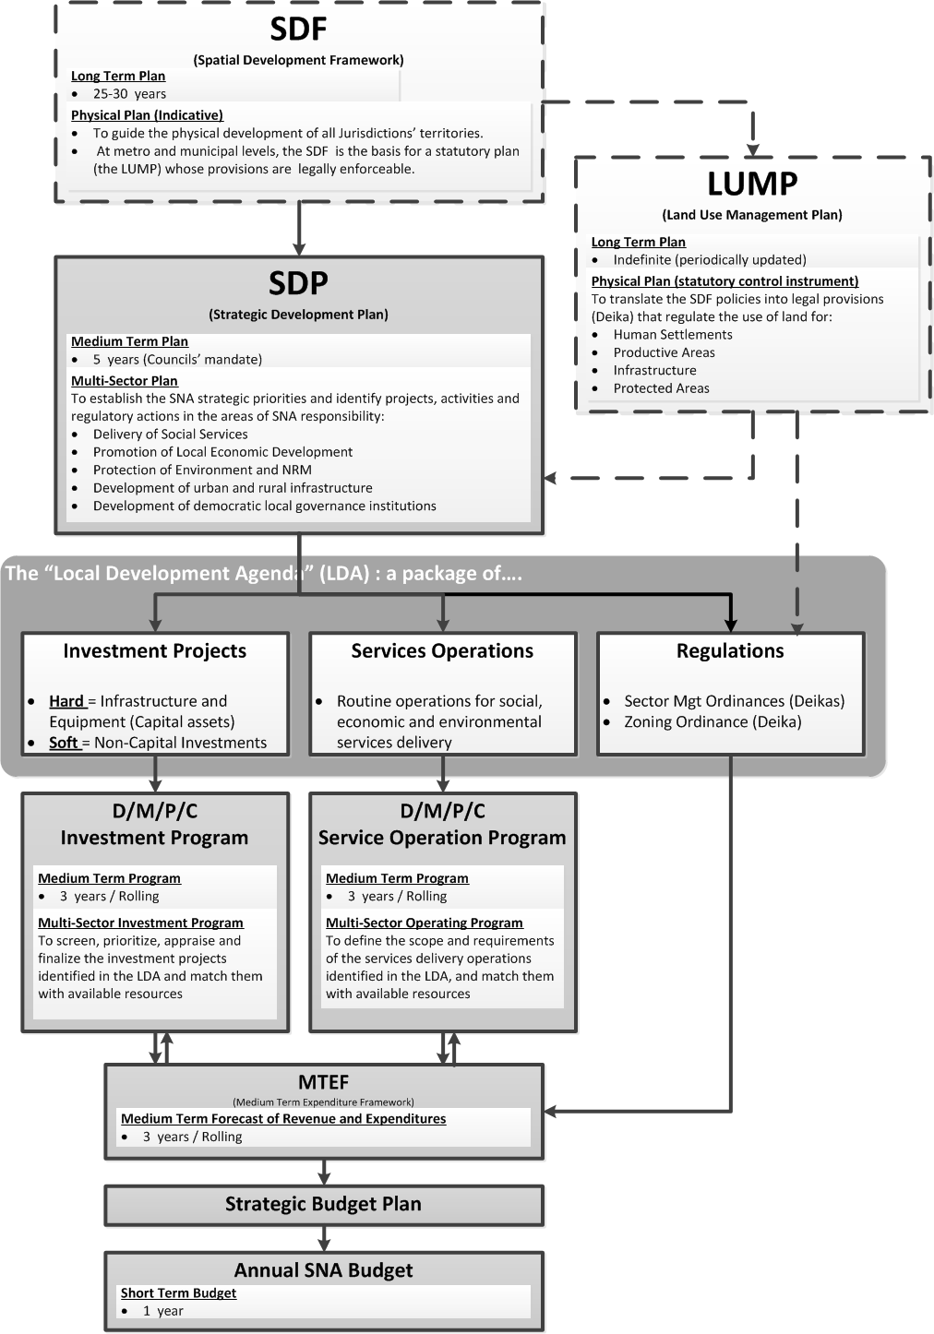
the Cambodia case : hierarchy of instruments of S/N PPB

Slide 10
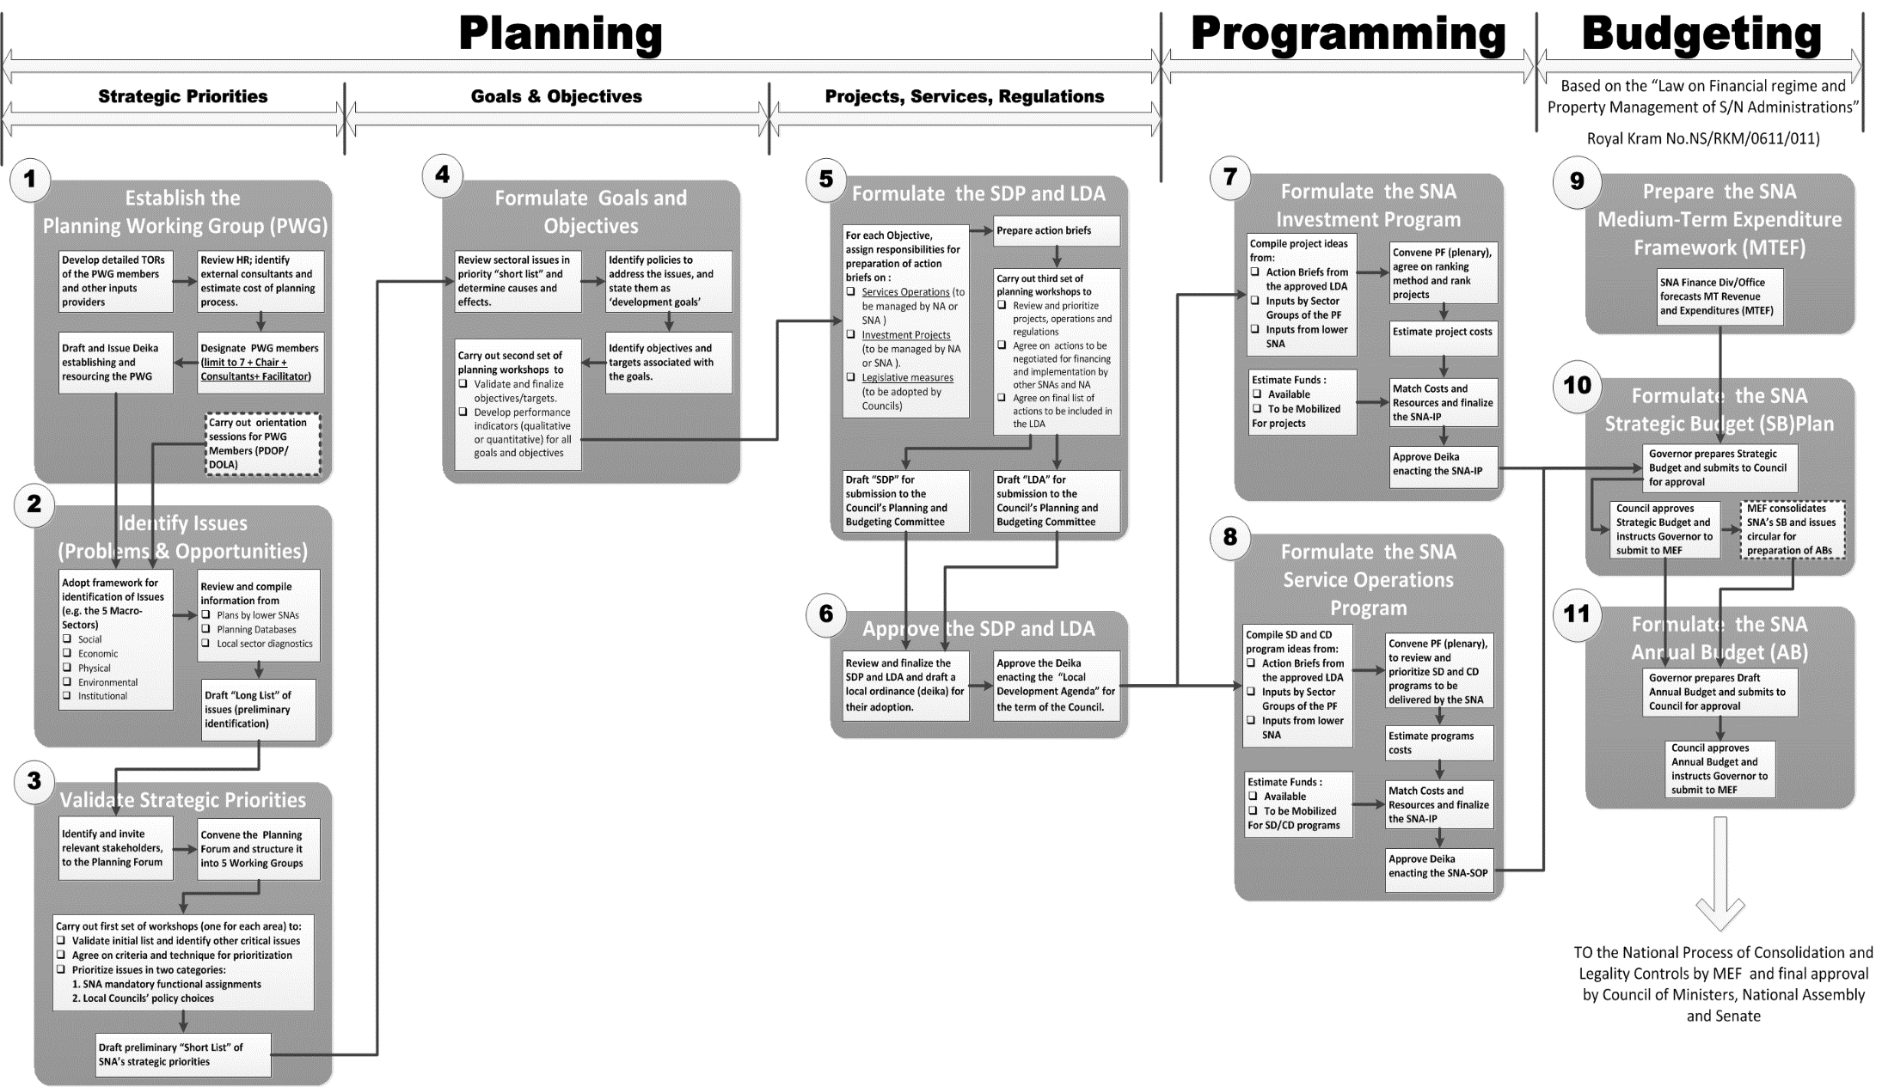
the Cambodia case : proposed PPB process

Slide 11
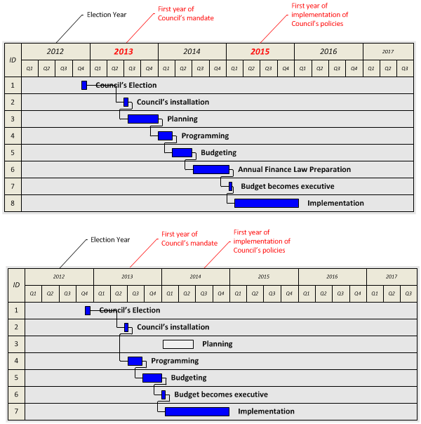
5. Planning Timeframes
Align the timeframes of national and sub-national planning to facilitate negotiations and coordination.
IN CAMBODIA this meant:
Align the C/S PPB timeline with that of the higher level SNAs and National Administration and develop a synchronized PPB calendar to facilitate the coordination and integration processes of the new multi-level planning system.

Slide 12
6. S/N Planning Support System
Four entities of the National Administration have a main role in supporting and overseeing the SNA Planning system. They are (1) the Ministry of Planning (MOP) (2) the Department of Local Administration in the MOI (MOI/DOLA), (3) the Local Finance Department (MEF/LFD) in the MEF and (4) the General Directorate of National Treasury (MEF/GDNT) in the MEF
 | MOP | MOI/DOLA | MEF/LFD | MEF/GDNT
Role
Relevant Aspect of the Mandate | Develop and disseminate good planning practices across all levels of govt. Ensure that sub-national plans are informed by national policies and coordinated with national plans and PIP. | Build capacity of SNA for Local Development Planning, Programming and Budgeting and monitor their performance | Develop and disseminate good SNA budgeting practices Promote the efficient and effective management of public expenditures by SNA. | Provide cash management and public accounting services to SNA Support resources mobilization and collection efforts by SNA (jointly with MEF Tax Dept.)
Specific Responsibilities
Regulation | Jointly develop S/N Planning Legislation and regulations |  | Jointly develop Sub-National Finance Legislation and Regulations
Production of Guidelines & Manuals | Issue Guidelines and Manuals for Regional and Metro level Planning and Investment programming Assist MOI/DOLA to formulate Guidelines and Manuals for Urban and District level Planning and Investment programming | Issue Guidelines and Manuals for Urban and District level Planning and Investment Programming | Issue Guidelines and Manuals for SNA (all levels) on Budget Operations (preparation, authorization, execution and accountability) | Issue Guidelines and Manuals for (i) payment and cash management and (ii) assessment and collection of local revenue
Facilitation | Train and Assign Planning Facilitators to Regional and Metro level PWG | Train and Assign Planning Facilitators to Urban and District level PWG | ____ | ___
Technical Assistance | Provide Data and Data analysis, based on MOP-managed databases | ____ | ____ | ____
Oversight | ____ | Perform legality controls of Councils’ deliberations on planning process and instruments Monitor SNA performance in implementation of local plans, programs and budgets | Perform (directly or by delegation to Provincial Governors) legality controls on SNA budgets | Control the regularity of budget execution (revenue & expenditure ) by SNA

Slide 13
Summary of policy choices to reform s/n planning in Cambodia
Territorial systems : 4 systems (Metro/Regional/Urban/Rural)
Institutions : Reform PWG, Create PBC and create Planning Forums
Instruments : Introduce LDA and SOP
Process : Adopt Integrated PPB (11 steps) and simplify techniques
Timeframe : Align C/S to D/M timeframe
Support System : Create a 4-Agencies task-force in NCDD and share CD responsibilities by having MOP focus on Metro/Regional, MOI focus on Urban/Rural systems

