Slide 1
Session 2.6. Unlocking the potential of the thematic line CSO-LA to promote TALD
Jorge Rodriguez Bilbao
“Civil Society & Local Authorities"
European Commission-DG DEVCO B2
Workshop on Territorial Approaches to Local Development
What does it entail and how can it be fostered
in Asian and Pacific countries?
Jakarta, 23 to 25 February 2016

Slide 2
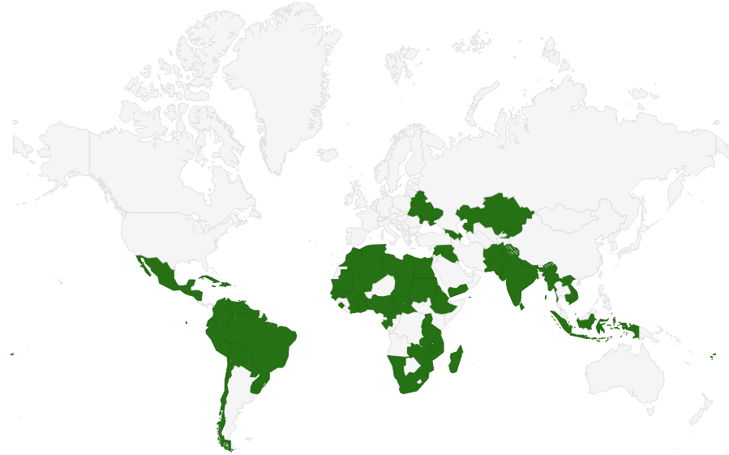
CSO-LA 2014-2017
One of its objectives “testing pilot actions promoting LD through a territorial approach (TALD)
LA-CSO led projects!!
MAAP (2015-2017):
  LA-led actions : 144.040 M€
  CSO-led: 423.075 M€
  Support measures: 2,5-5%
Notes:
The Multi-annual Indicative Programme
Annual Action Programme (AAP)

Slide 3
Testing pilot actions promoting LD
through a territorial approach (TALD)
We don’t want just to finance actions led by CSO-LA We want to test pilot actions promoting LD!!!
Questions you need to answer:
What are the features on any actions led by LA and/or CSO to be labelled as “LD”
How can we “promote” (and not just “finance”) those actions?
Notes:
The Multi-annual Indicative Programme
Annual Action Programme (AAP)

Slide 4
The DNA of TALD: contribution of autonomous and accountable LAs through interaction with other actors (civil society and private sector)
People outside the public sector
Citizens helping themselves
Volunteers
People working in charities, private organisations
New assets
Making use of non-public assets (e.g., church halls, local materials, communal property)
Handing public assets over to communities, charities, private groups
Communities
People
Business
CSO
Local government
Funding
Assets
New sources of funding
Private philanthropy
Corporate social responsibility
Community contributions
Local governments have the :
Mandate for the economic and social welfare of the local community,
Legitimacy for coordination and integration of different actors;
Normative capacity;
Responsive to local demands
State resources
Non-state resources
Adapted from the Institute for Government. “The Big Society: A framework for policymakers”. April 2011. UK

Slide 5
Notes:
The Multi-annual Indicative Programme
Annual Action Programme (AAP)

Slide 6
Notes:
The Multi-annual Indicative Programme
Annual Action Programme (AAP)

Slide 7
THANKS

