Slide 1

Free fundraising with 0% Indiegogo fees
Personalized support by Indiegogo’s expert fundraiser strategists
Seamless and optimized social media integration
Option to display and raise funds on third party sites via API
Promotion opportunities to full Indiegogo community, the largest global crowdfunding platform with 15 million monthly visits from more than 200 countries
Thousands of fundraisers created and millions of dollars raised

Slide 2
Why Crowdfund?
Activate existing community
Source new donors via secondary networks and beyond
Increase concept awareness
Inform marketing and pricing strategies
Notes:
More than $330K from more than 7K donations

Slide 3
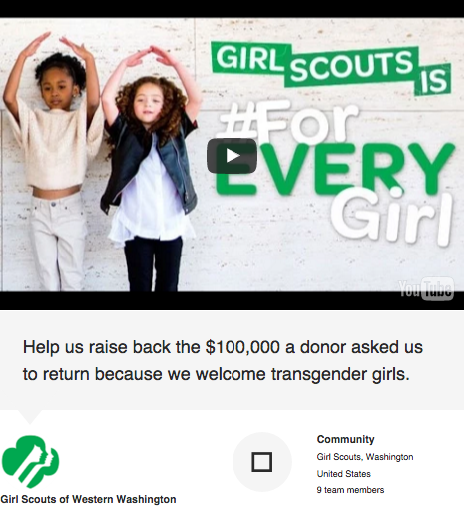
Notes:
More than $330K from more than 7K donations

Slide 4
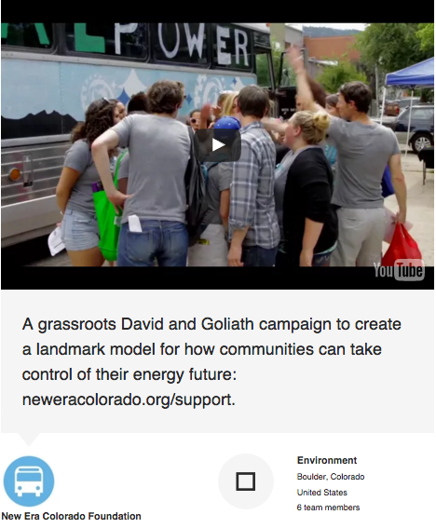
Notes:
More than $330K from more than 7K donations

Slide 5
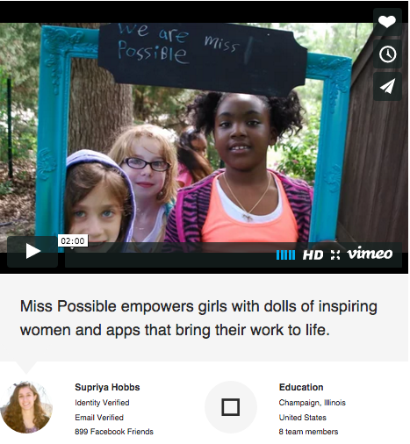
Notes:
More than $330K from more than 7K donations

Slide 6
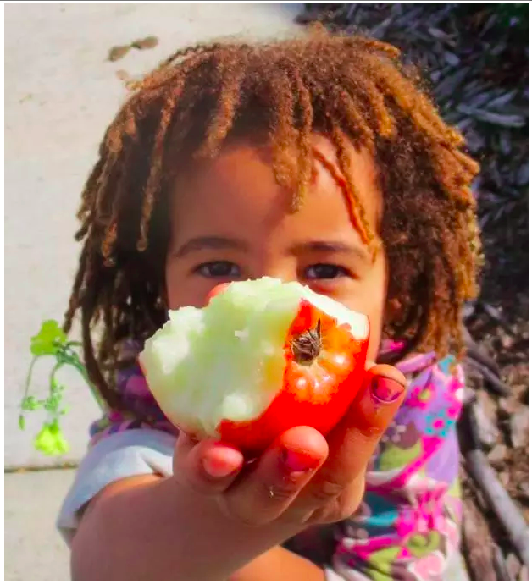
Make it personal
Who is running the fundraiser (e.g. staff, board member, donor, volunteer…) and why
Who is the beneficiary of the fundraiser and how does it help them
Notes:
People give to people
Organizer: Founder, ED, staff member, board member, donor, volunteer
Beneficiary

Slide 7
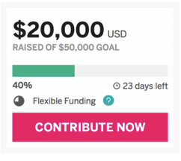
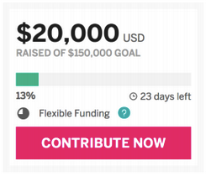
Raise 30% of goal in first 48 hours after launch
Notes:
Goals: Financial, awareness, program
Define: Specific, inspiring, attainable

Slide 8
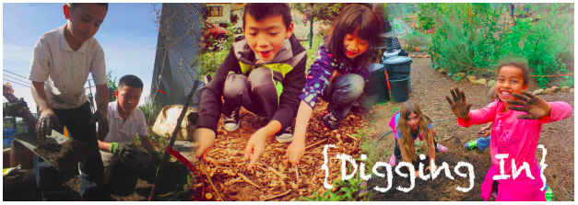
Plan roles & responsibilities
Writing
Design
Video
Donation levels
Social media, PR
Customer service

Slide 9

Put together your story
Summary
Problem
Context
Solution
Budget
Involvement
Notes:
Summary – first 30 seconds in video / first three lines in text will dictate
Problem
Solution
Discrete
Achievable yet Ambitious
Inspiring

Slide 10
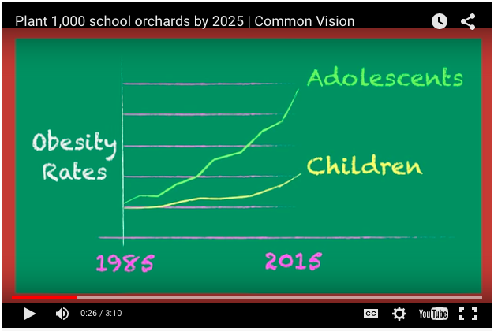
Create your video
1st 30 sec matter most w/ max 3 min
Personal
Specific to fundraiser
Grateful
Notes:
Have one – campaigns with videos raise 115% more than those without
Doesn’t have to be fancy
Similar content
First 30 seconds count most
No more than 3 min
For fundraiser, not copied

Slide 11
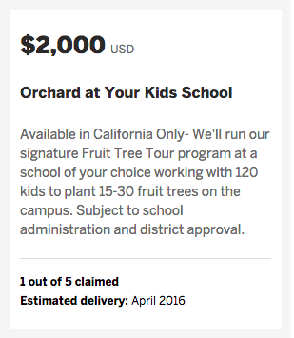
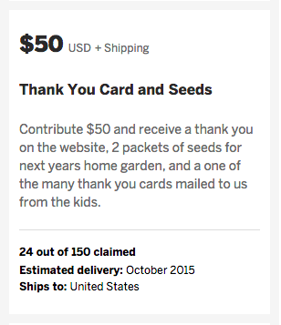
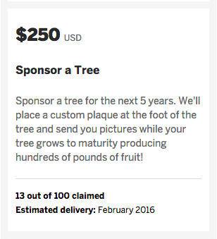
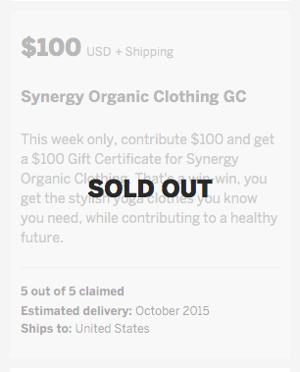
Suggest donation levels
Impact unit
Physical item
Digital reward
Experience
Notes:
Why ppl donate: person, purpose, perk
How much do ppl donate: $25 most common, $100 most revenue
What to consider: Personalize to campaign and work, Offer variety so can learn

Slide 12

Prepare & use all community touch points
Telephone
Email
Social media
Updates
PR
Offline sharing and events
Notes:
Marketing template to follow

Slide 13
Keep engaged with community via updates and social media
Post personal and impact stories
Share fundraiser status updates
Continue to cultivate close community
Roll out and promote incentive donations
Notes:
Common Vision success at sourcing additional donors via social media

Slide 14
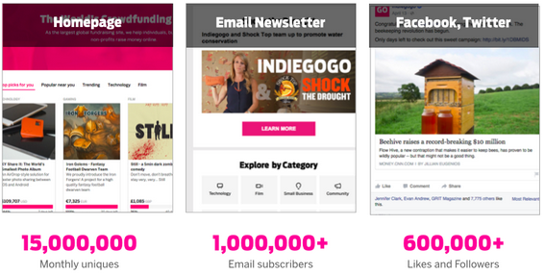
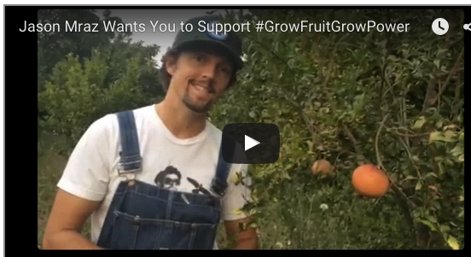
Rally additional audiences
Indiegogo community
Industry and local press
Relevant on & offline groups (e.g. neighborhood, alumni, interest area, etc)
Celebrities
Notes:
Amplification toolkit to follow

