Slide 1
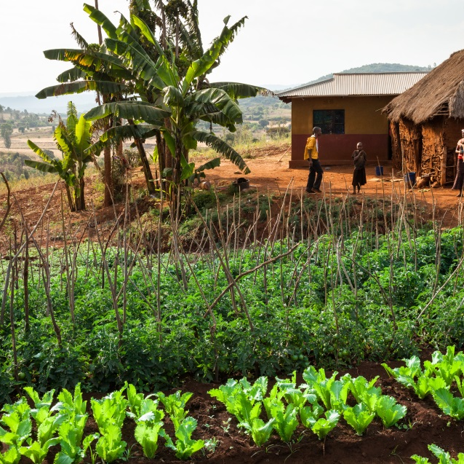
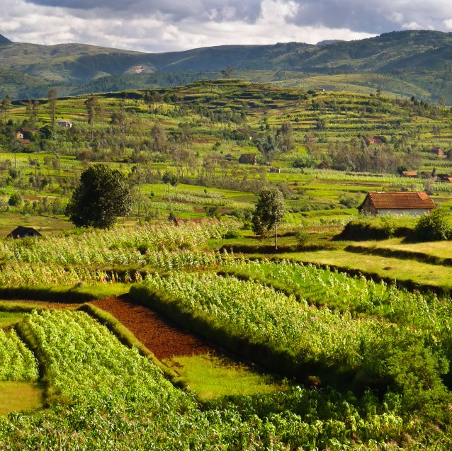

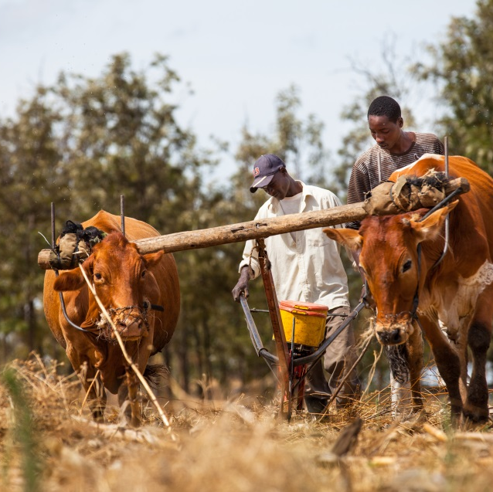
Agroecology and ecological intensification – what potential and how to unlock it?
Hot Topics in Sustainable Agriculture and Land Policies and Development, Brussels, 15-16 February 2016
Walter Rossing, Farming Systems Ecology

Slide 2
Outline
Origins of agroecology
Agroecology examples at different scales
Evidence on achieving growth, resilience and food security
Institutional barriers

Slide 3
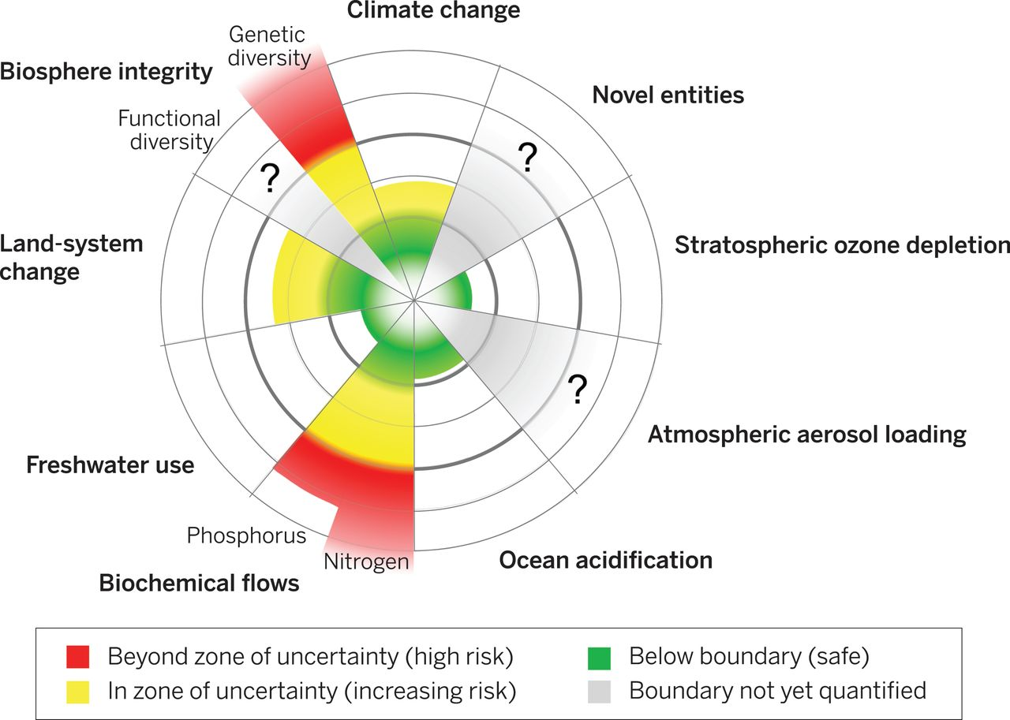

Biophysical planetary boundaries
Will Steffen et al. Science 2015;347:1259855

Slide 4
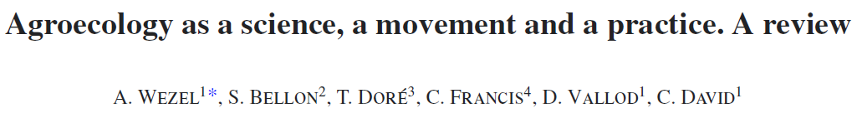
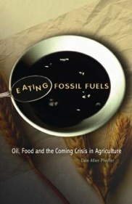
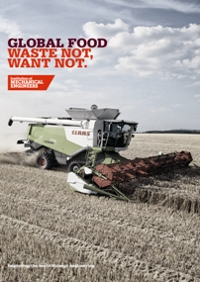


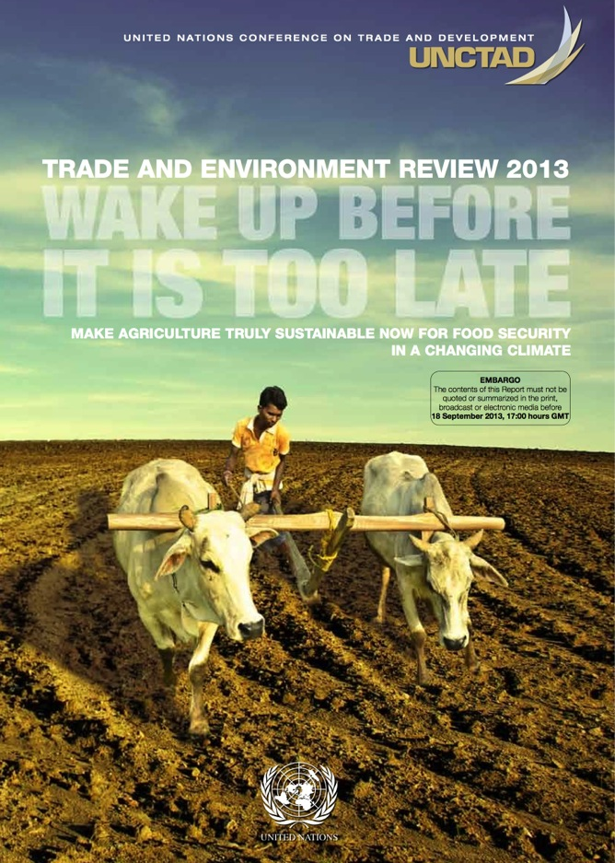
An untenable agricultural model
Disconnection between producers and consumers
Disconnection between outputs and inputs of production
Disconnection between production and ecosystem services

Slide 5


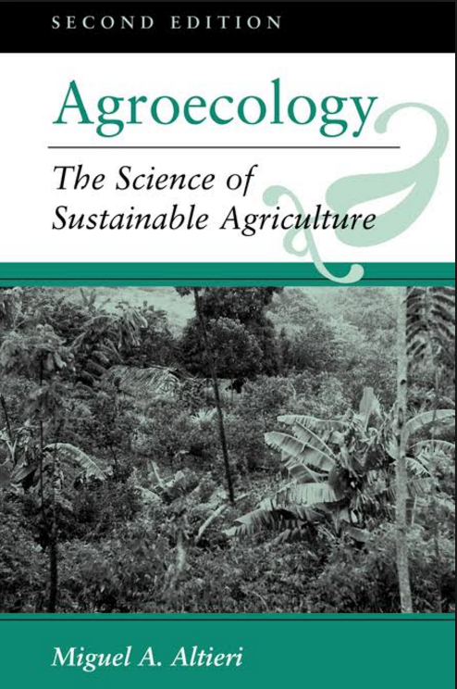
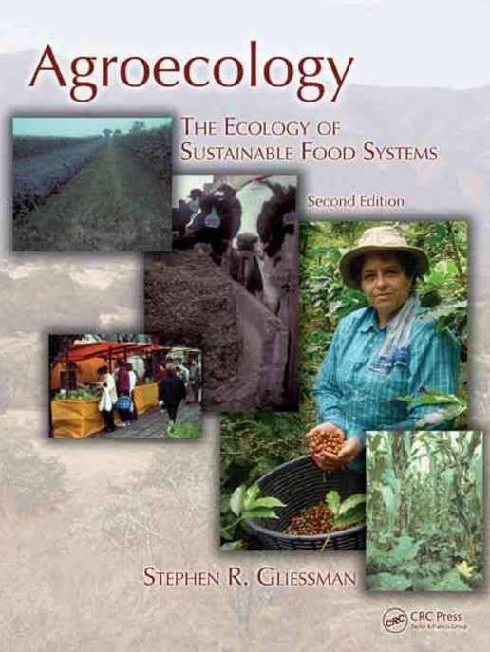

An untenable agricultural model
Agroecology as movement and practices
Agroecology as a science

Slide 6
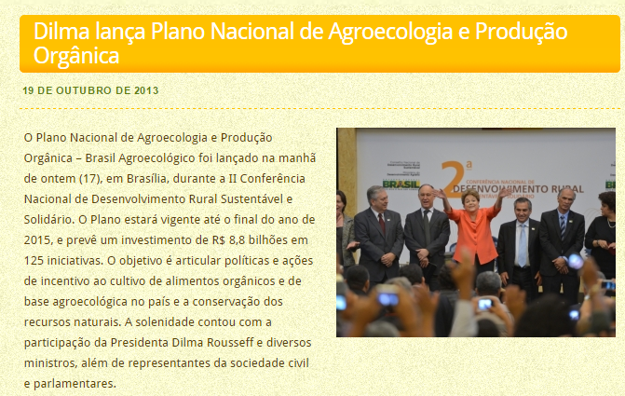
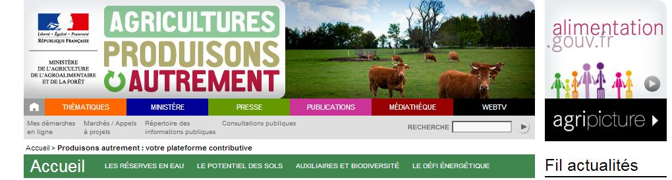
An untenable agricultural model
Agroecology as movement and practices
Agroecology as a science

Slide 7
Transition to agroecology
Specialized System
Yield
Input
Other ecosystem services
Ecologically-intensive
Externalities
Agro-diverse System
Yield
Input
Other ecosystem services
Externalities

Slide 8
Agro-ecological landscapes & food systems
Critical transition zone (vulnerability)
Access to markets
Legal framework
Logistic opportunities
Capital availability
Farmer learning
Advisory services
Systems re-design
Institutional innovation
Input substitution
Eco-efficiency
Current
systems
Crop rotation & management
Crop diversity in space
Functional biodiversity
Including livestock
Closing NPK cycles: farm/region
Source: Tittonell, 2014
Technical innovation

Slide 9
Characteristics of agro-ecological production
Principles taken from natural systems:
Positive interactions - Benefit from diversity: time, space and genotypes
Systemic approaches - Manage interactions for system-wide productivity rather than individual species productivity
Integrate crops and livestock
Stimulate cycling of nutrients and energy on-farm to avoid external inputs
Knowledge-intensive, local, profitable

Slide 10
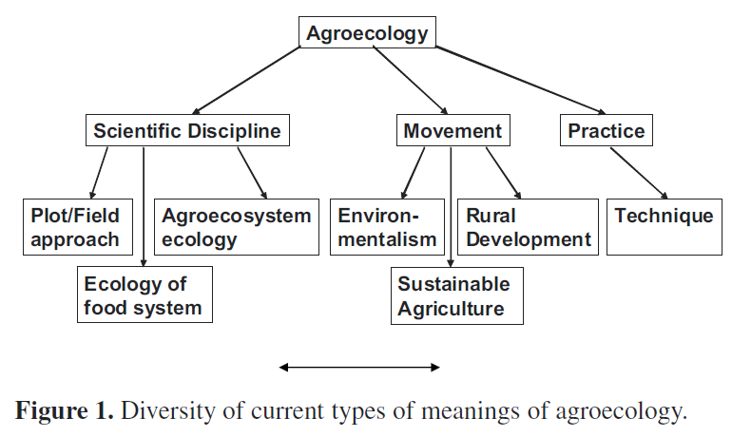
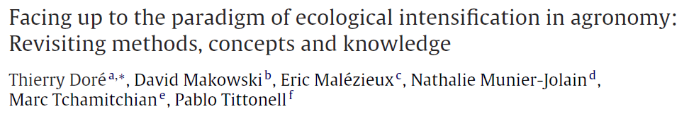
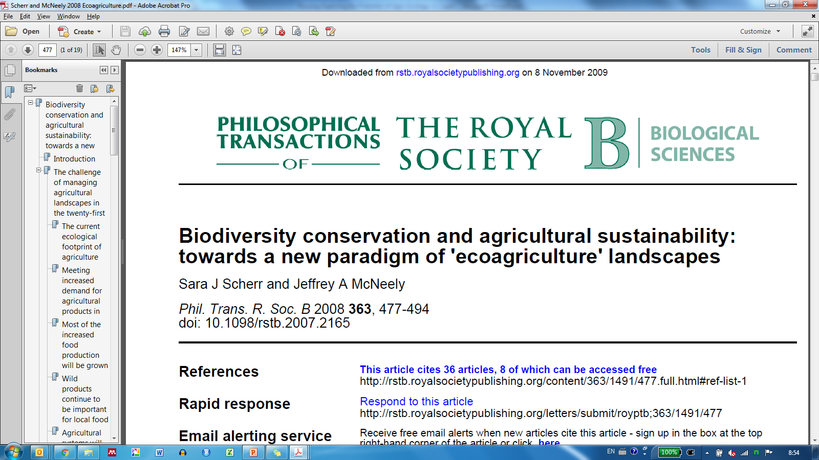
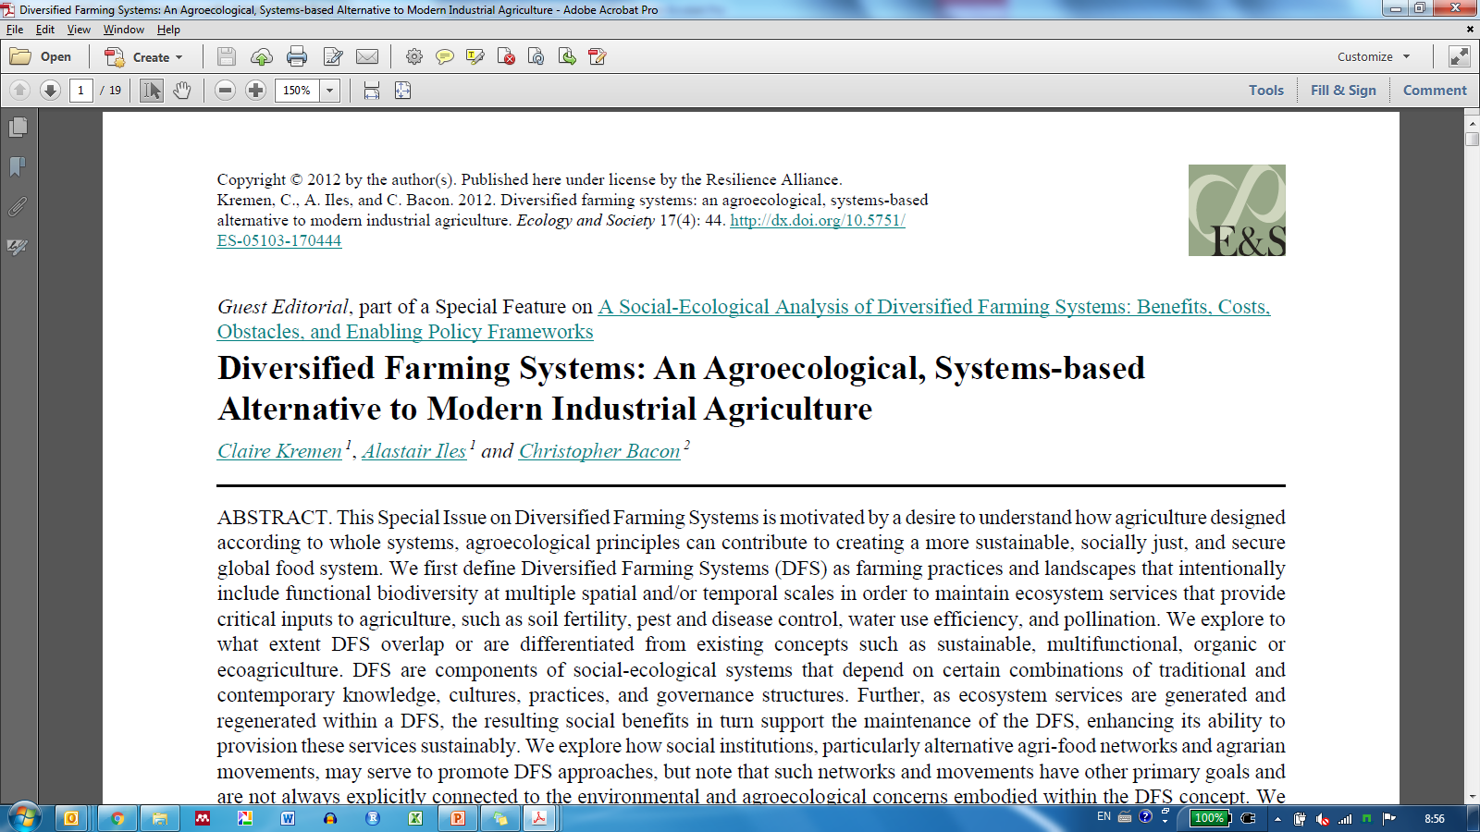
Diversity in terminology
Wezel et al., 2009. Agron. Sust. Dev.

Slide 11
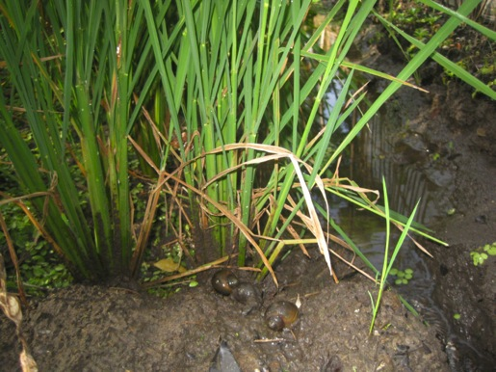
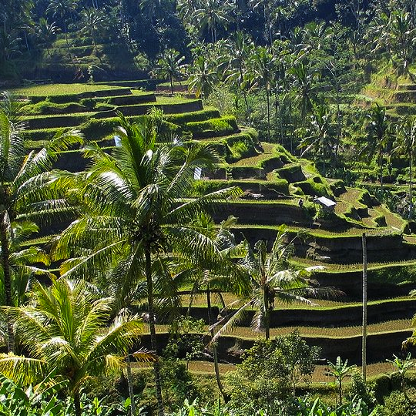
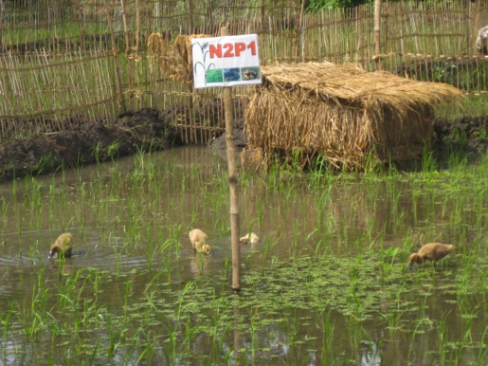
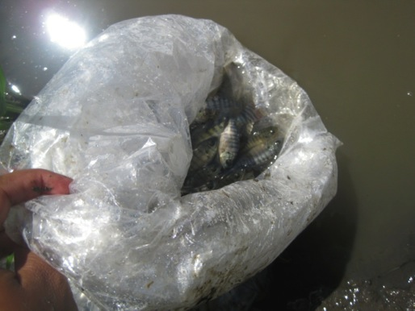
Rice-ducks-fish-azolla - Indonesia
Building upon local agroecological knowledge
Rice yield (t ha⁻¹) at increasing levels of complexity
Khumairoh et al., 2012 Ecol. Evol.

Slide 12
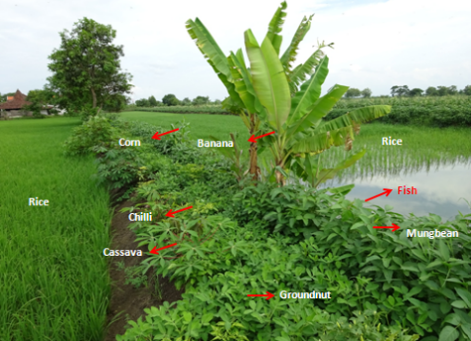
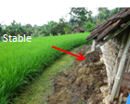
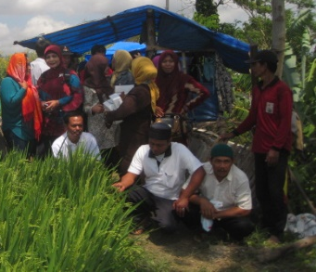
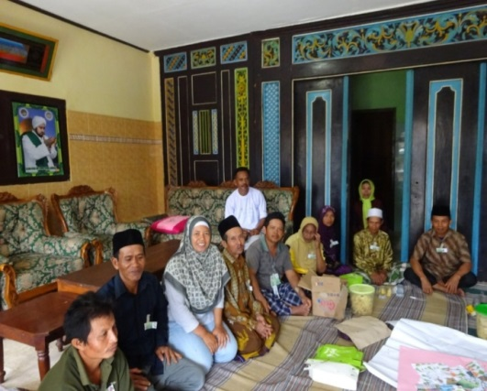
Rice-ducks-fish-azolla - Indonesia
Building upon local agroecological knowledge
Farm character-isation
Workshop & validation
Districts Agri. Bureaus
Farmers
Implemen-tation
Experiments in 4 districts
FFS
Transect walks
Interviews
Researchers
FGD
Rice yield (t ha⁻¹) at increasing levels of complexity
Data from PhD Uma Khumairoh
Khumairoh et al., 2012

Slide 13
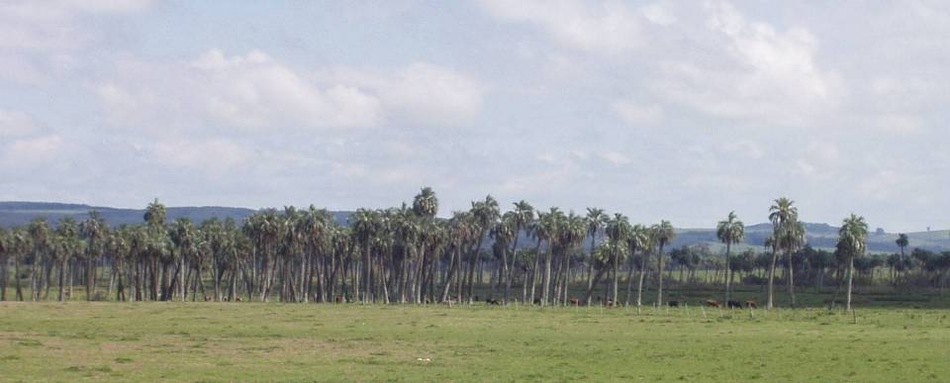
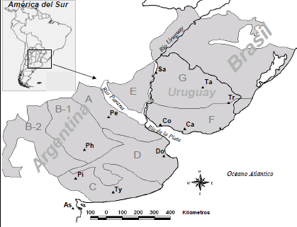
Ecological intensification of Pampas grazing systems
Theses:
Andrea Ruggia (INIA)
Pablo Modernel (UR)
500,000 km²
65 million heads of cattle
430,000 farms
800 grasses and 200 legumes species
Regional economic relevance

Slide 14
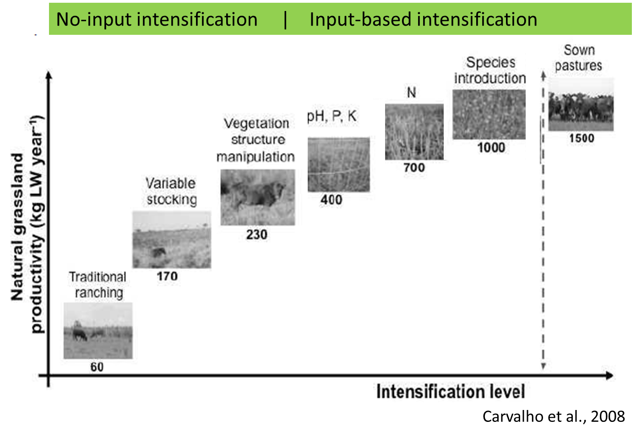
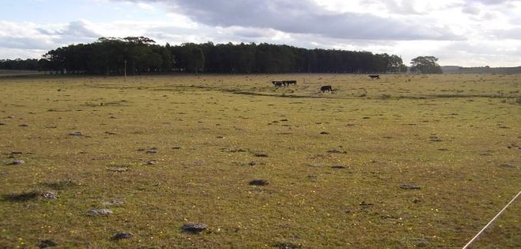
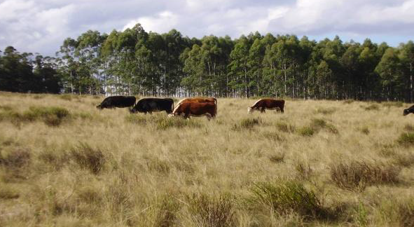
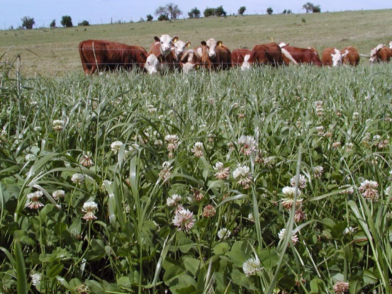
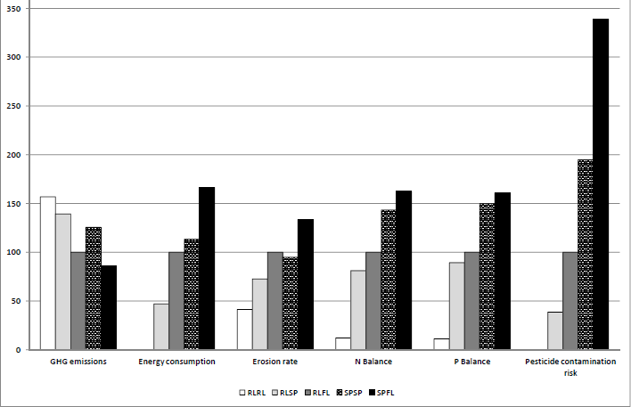
Ecological intensification of Pampas grazing systems
Environmental impact of different intensification pathways
Modernel et al., 2013
Increasing Ecosystem Services
Traditional system
Decreasing Ecosystem Services
Feedlot
Theses:
Andrea Ruggia (INIA)
Pablo Modernel (UR)
500,000 km²
65 million heads of cattle
430,000 farms
800 grasses and 200 legumes species
Regional economic relevance
GHG emissions
Energy consumption
Soil erosion
N surplus
P surplus
Pesticide contamination

Slide 15
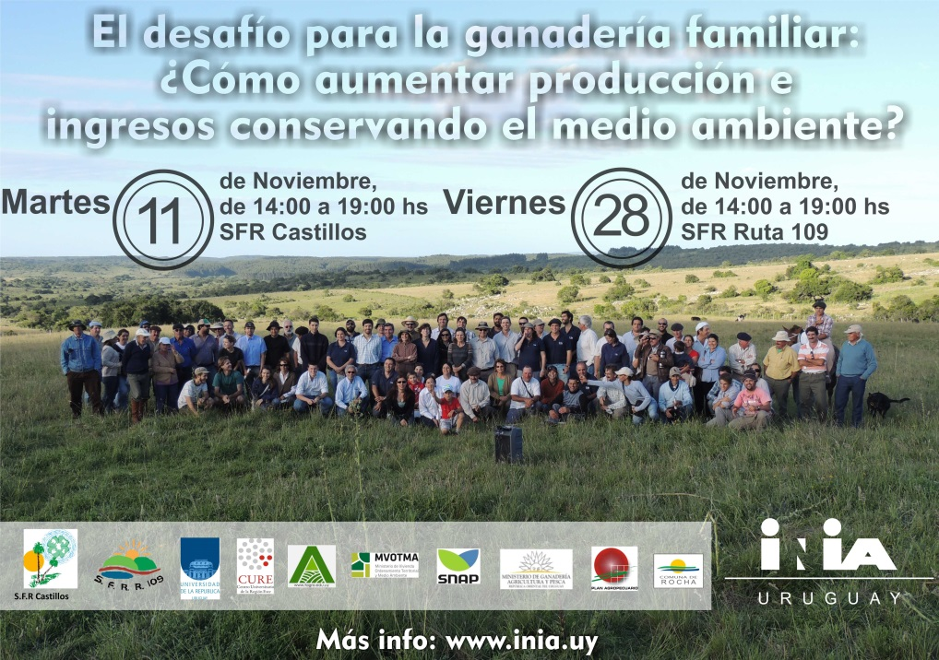
Co-innovation of Pampas grazing systems
Andrea Ruggia (INIA)

Slide 16
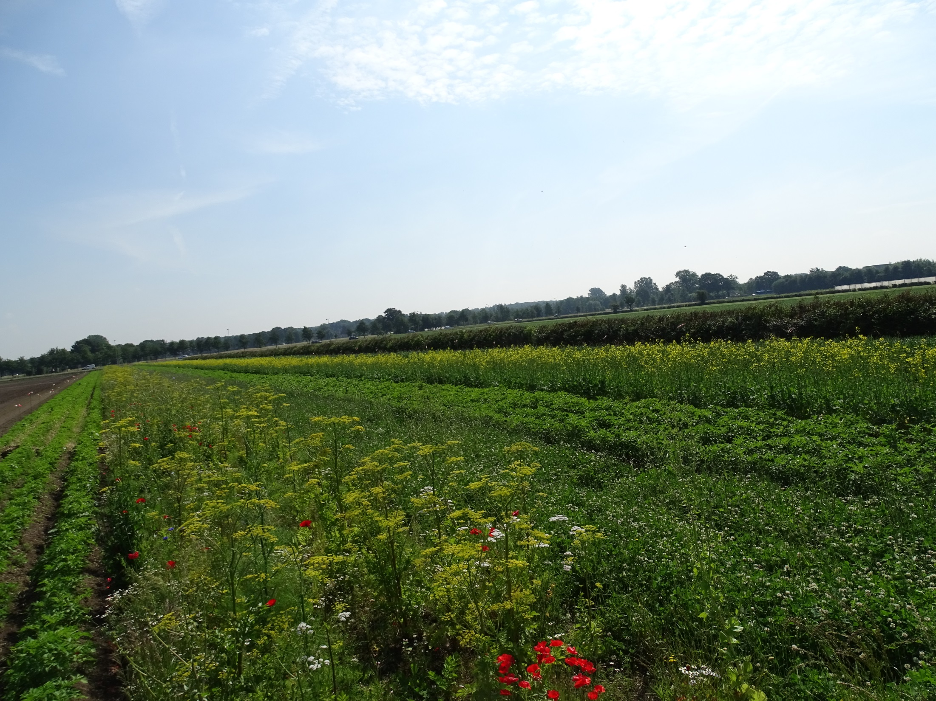
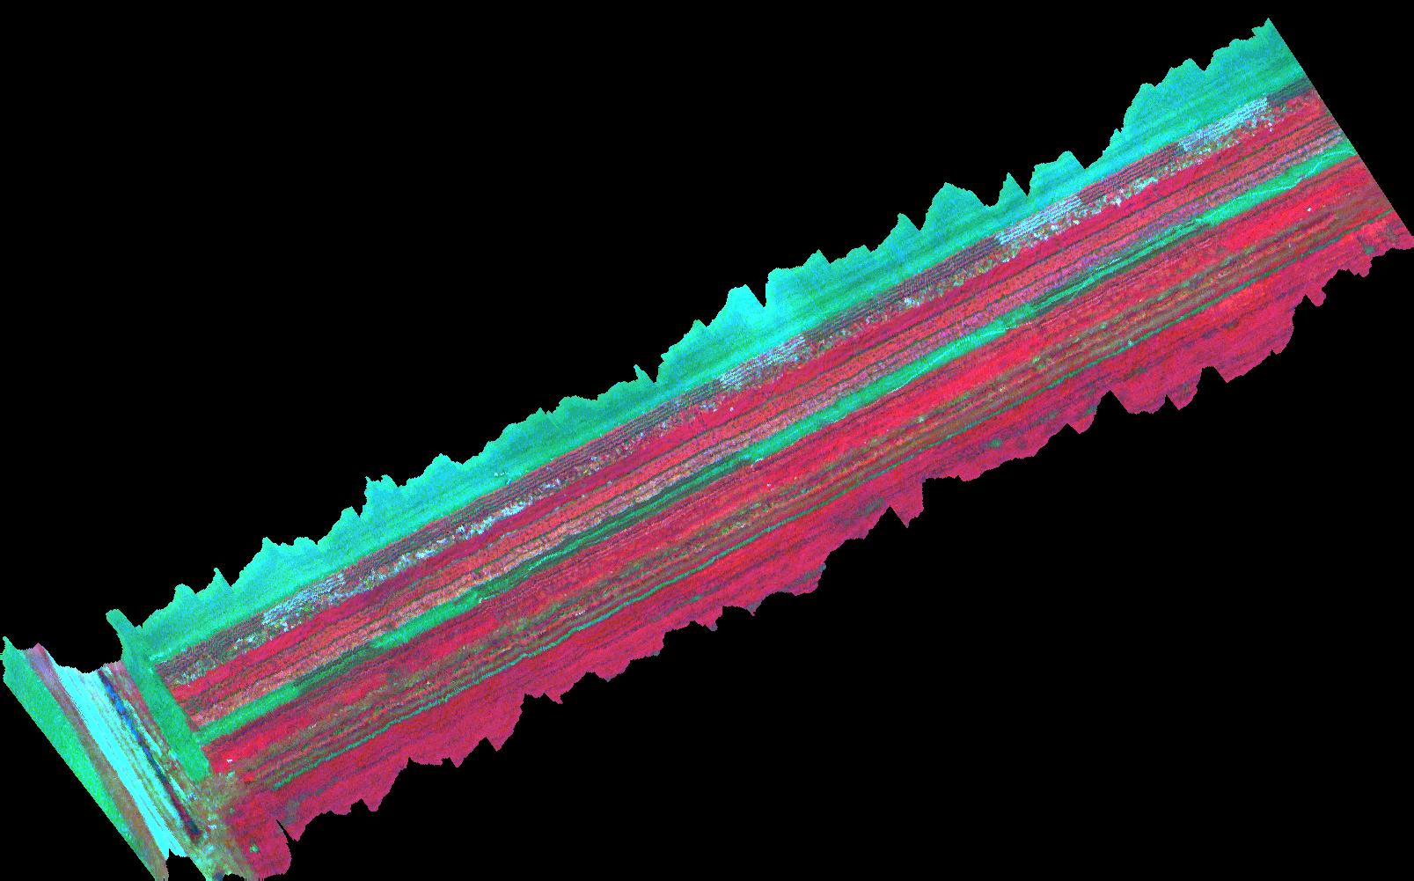
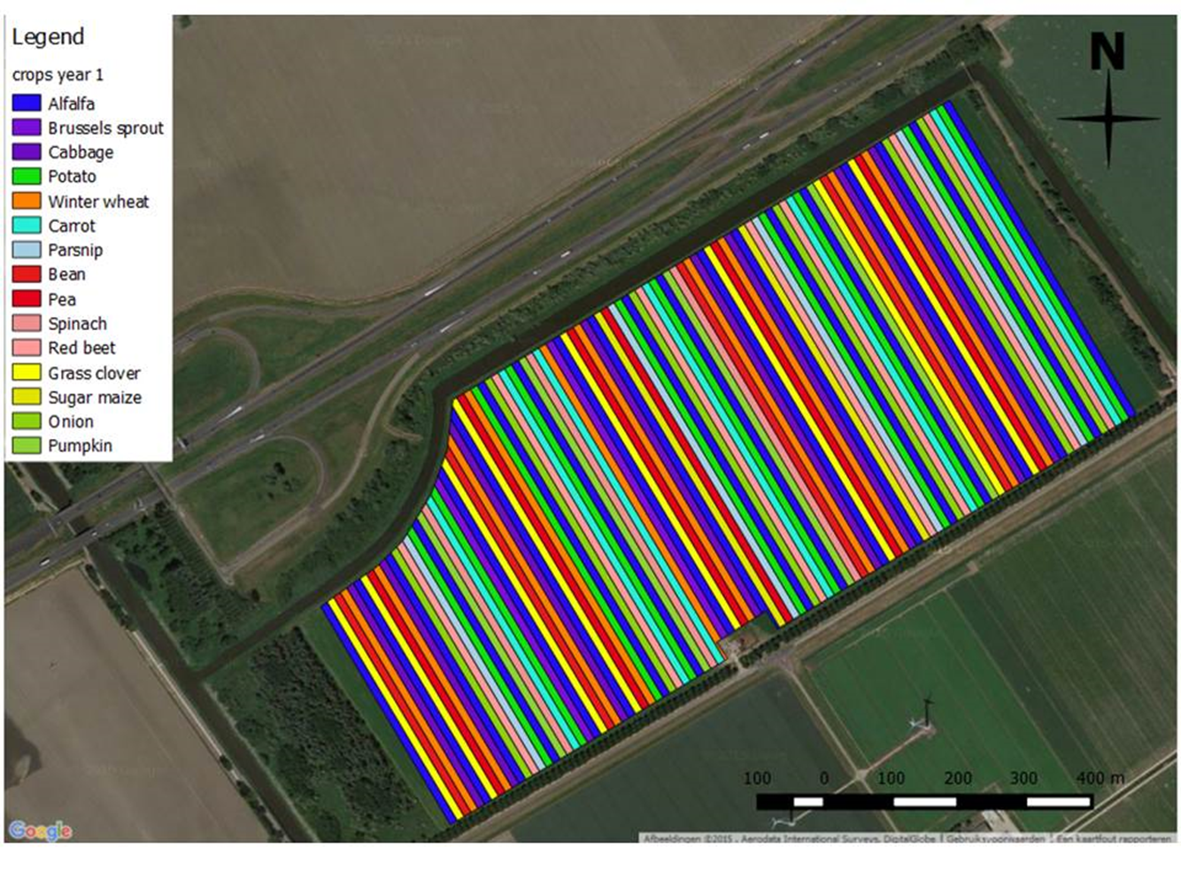
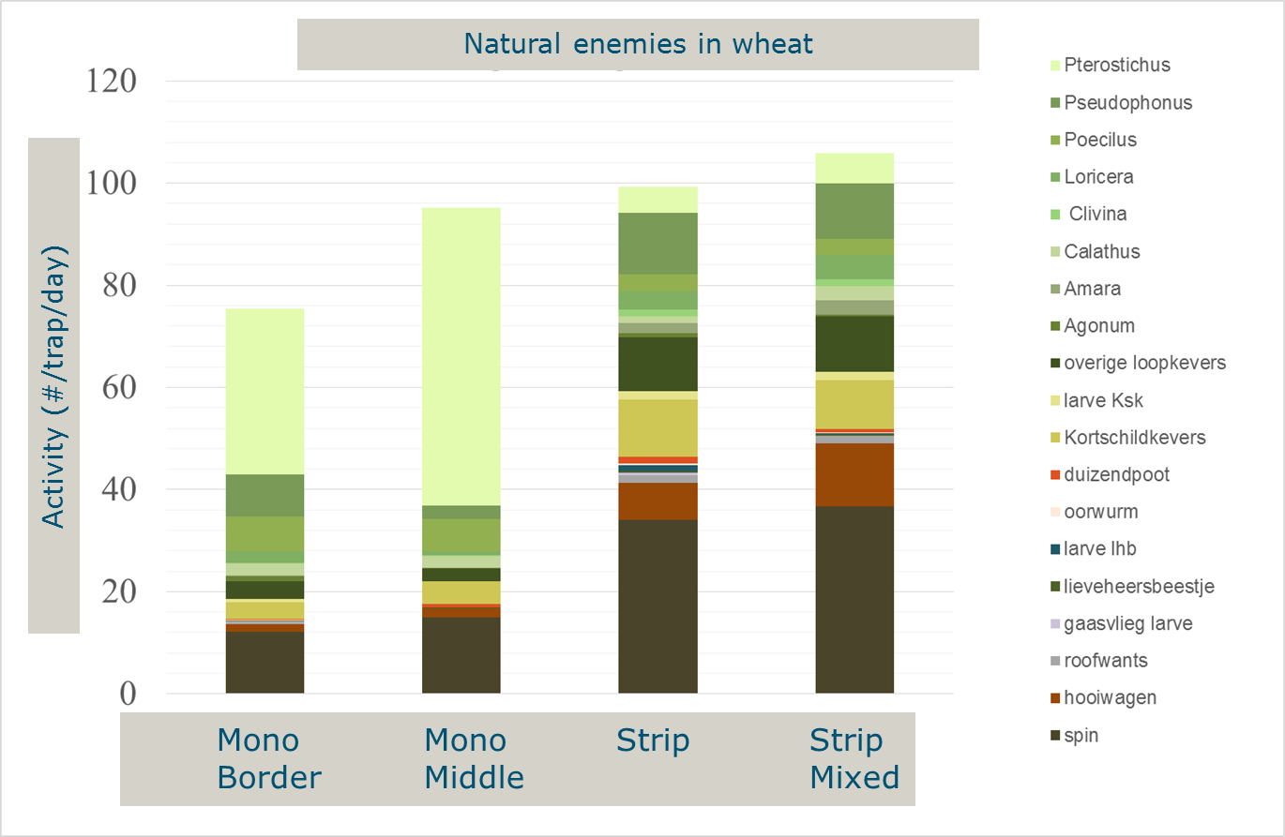
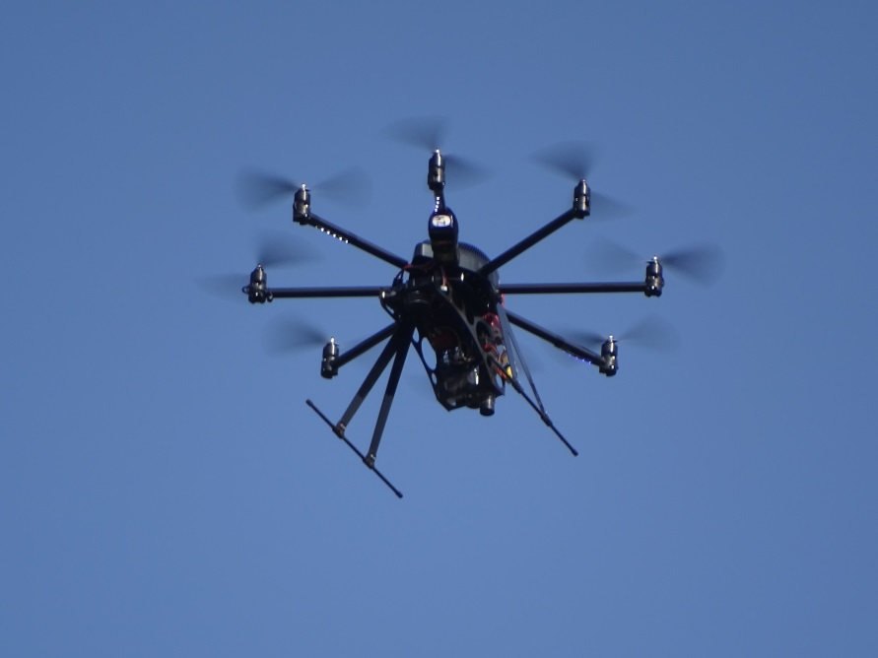
Diversity in time & space & genes
Diversity in time & space & genes

Slide 17
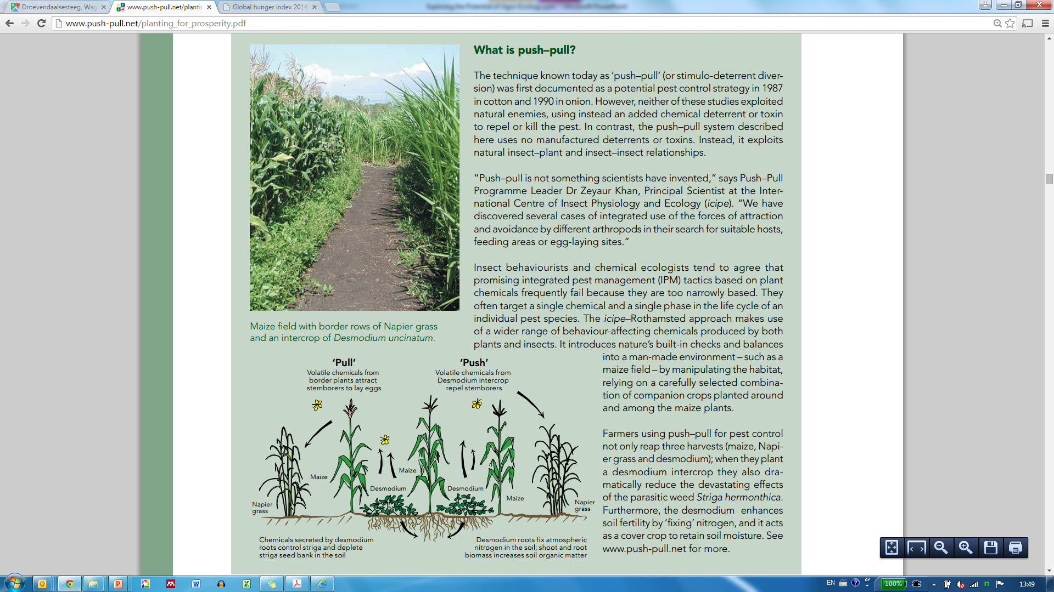
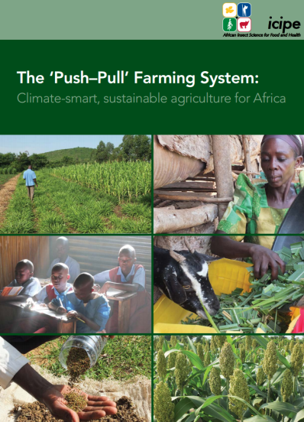
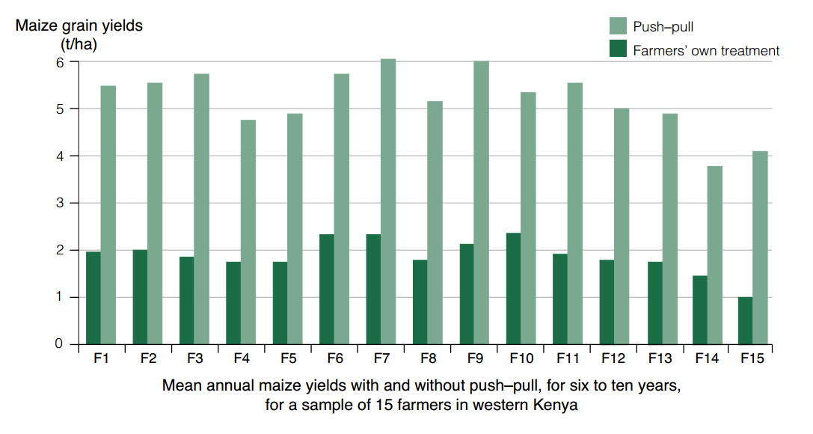
Push-pull in maize
Building upon research-driven agroecological knowledge

Slide 18
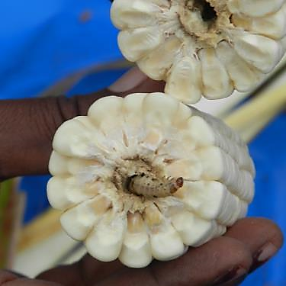
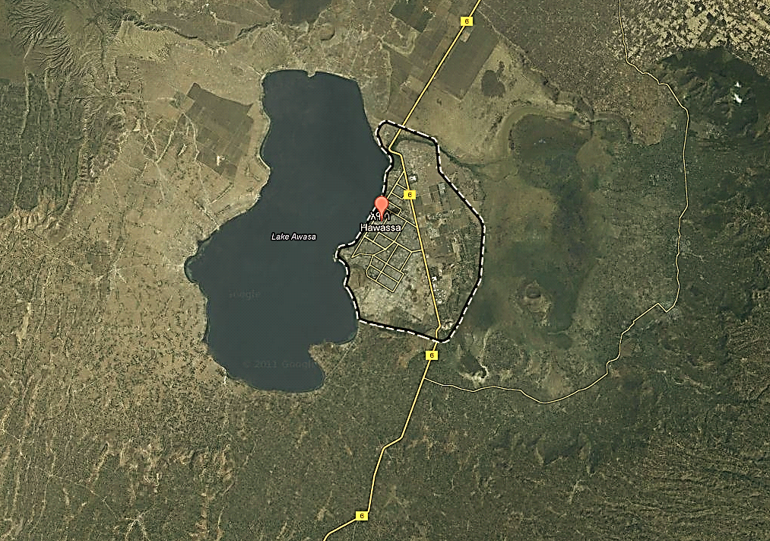
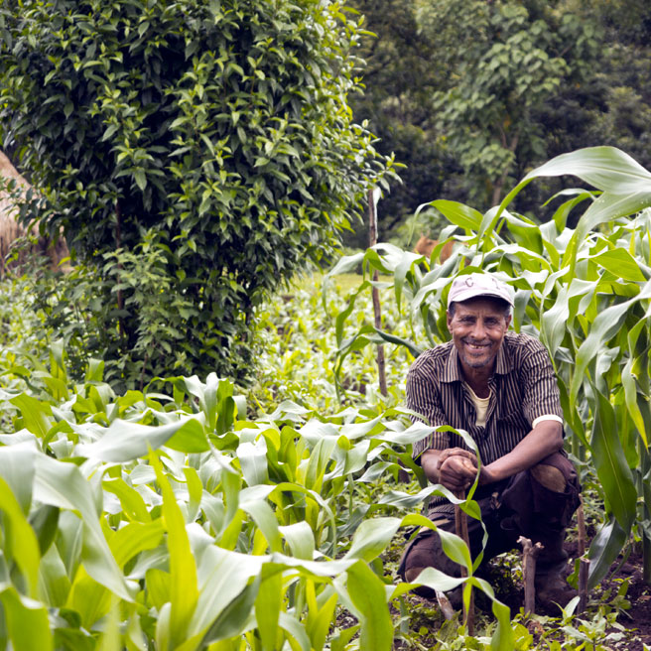
Designing pest suppressive landscapes
15 km
Landscape diversity
High
Medium
Low
Push-pull systems
Hawassa area, Ethiopia
Maize-based smallholder systems
40 km
PhD research Yodit Kebede

Slide 19
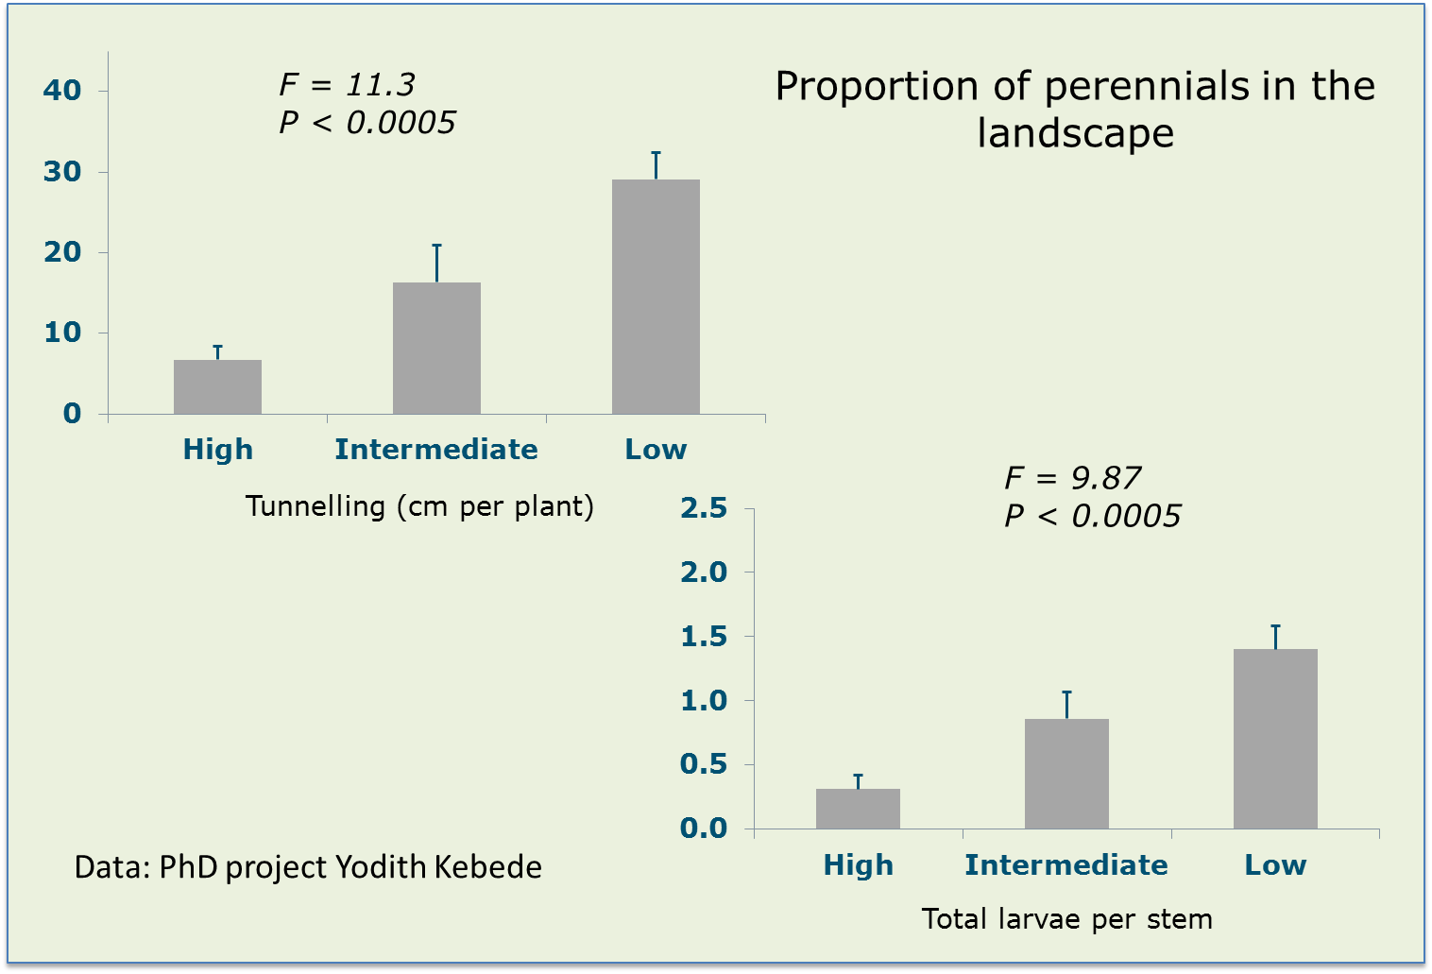
Designing pest suppressive landscapes
15 km
Landscape diversity
High
Medium
Low
Push-pull systems
Hawassa area, Ethiopia
Maize-based smallholder systems
40 km

Slide 20
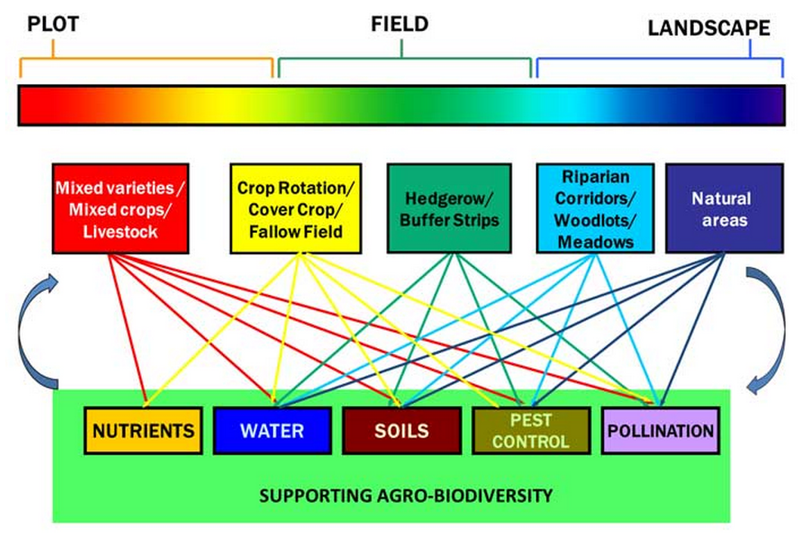
Agro-ecology at different scales
Kremen et al., 2012; Ecology and Society

Slide 21
Agroecological systems: do they deliver? - 1
Indicator/ES | Effect size | Evidence strength
Biodiversity | Medium to large + | Strong
SOM | Small to large + | Strong&,#
Soil quality (phys., biol., erosion) | Small to large + | Strong
C-sequestration <30cm | Large + | Strong&,#
Water holding capacity | Small to large + | Strong
Nutrient management | Small to medium + | Strong
N, P leaching | Small to large + | Weak-strong
&Gattinger et al., 2012. PNAS
#Tuomisto et al. 2012. J. Envir. Manag.
Kremen and Miles, 2012. Ecology and Society

Slide 22
Agroecological systems: do they deliver? - 2
Indicator/ES | Effect size | Evidence strength
Weed control | + | Moderate to strong
Plant pathogen control | Large + | Strong
Pest control ~ yield | None to large + | Weak
Pollination ~ yield | Small + | Weak
Energy use efficiency | Large + | Strong&
Global warming potential |  | Equivocal
Resilience to environmental disturbance | Small to large + | Strong
&Tuomisto et al. 2012. J. Envir. Manag.
Kremen and Miles, 2012. Ecology and Society

Slide 23
Agroecological systems: do they deliver? - 3
Indicator/ES | Effect size | Strength of evidence
Yield – all countries
Organic - conventional | Small to medium - | Strong&
Yield – developing countries
Organic - conventional | Small to medium - | Equivocal&,#
Resource conserving - subsistence | Large + | Weak$ (no control)
&Ponisio et al., 2015. Proc. R. Soc. B
#Seufert et al. 2012. Nature
$Badgley et al., 2007. Renew. Agric. Food Syst.
Kremen and Miles, 2012. Ecology and Society

Slide 24
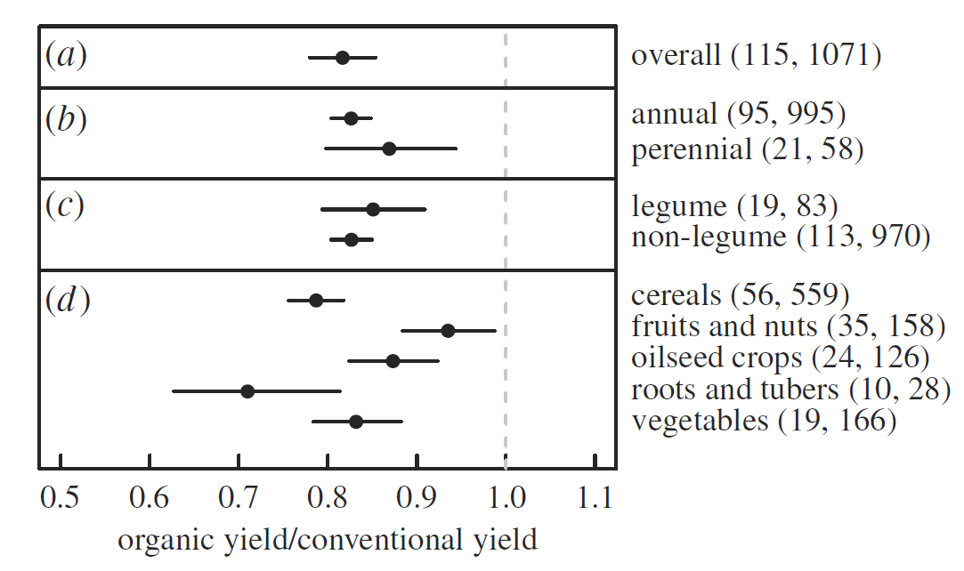
Productivity organic versus conventional
#studies, #data points
Ponisio et al., 2015. Proc. R. Soc. B
Ponisio et al., 2015. Proc. R. Soc. B

Slide 25
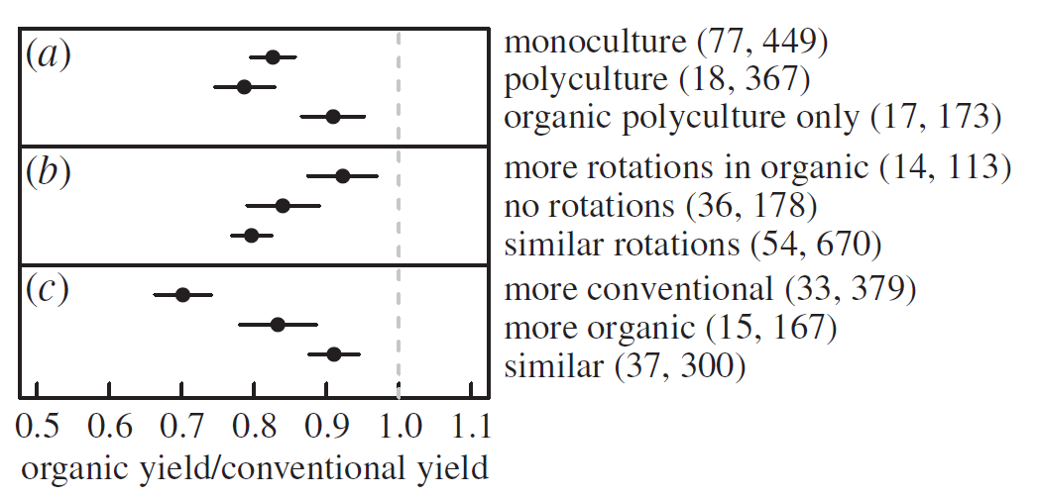
Productivity organic versus conventional
Cropping system
Rotation
Nitrogen input
Ponisio et al., 2015. Proc. R. Soc. B

Slide 26
Institutional constraints to agro-ecology
Lock-in in current paradigm
  Organization breeding, services, collectors, contractors, value chains, business models, science

Slide 27
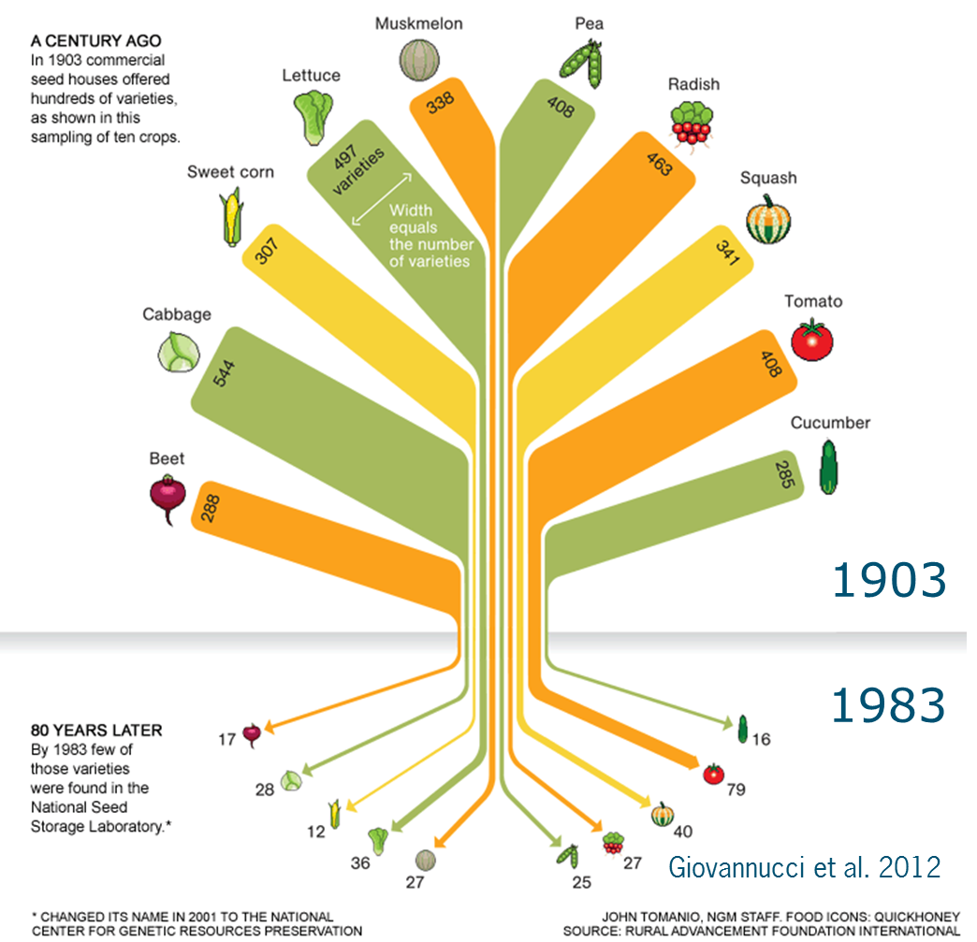
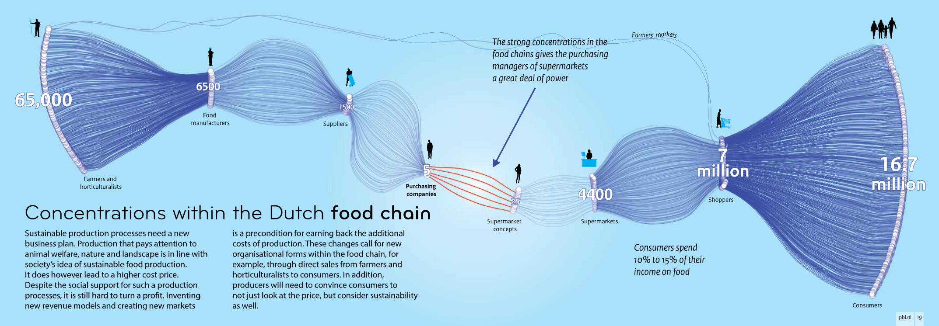
Institutional constraints to agro-ecology
Farmer leaflets France
Source: PBL, 2014
Meynard et al., 2013

Slide 28
Institutional constraints to agro-ecology
Lock-in in current paradigm
  Organization breeding, services, collectors, contractors, value chains, business models, science
Benefits of change accrue over time; changes in multiple components are needed simultaneously
Lack of knowledge on functional agro-biodiversity
  Need for combining generic and local wisdoms
  Need for experimentation and local learning: e.g. Farmer Field Schools
Research funding favours conventional models
  Amounts, procedures

Slide 29
Wrapping up
Diversified / organic / agro-ecological production systems have similar or better ecosystem service provisioning and are more resilient than industrial systems
Diversified / organic has ~ 20% lower yield at field level, with major difference between crops (8-28%)
Hardly any data from the South
Important lock-in and research investment gap
Priorities:
  Develop technologies and institutions for diversity
  Engage in sustained co-innovation (FFS)
  Generate evidence on positive examples to accelerate scaling out
  Develop policy on food system

Slide 30
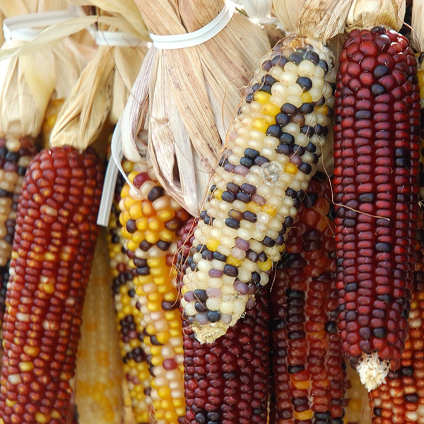
Thank you for your attention
Thanks to Pablo Tittonell, Jeroen Groot, Felix Bianchi and other colleagues from Farming Systems Ecology
walter.rossing@wur.nl
www.wageningenur.nl/fse

