Slide 1
Introduction and background to this regional seminar
Jorge Rodriguez Bilbao
“Civil Society & Local Authorities"
European Commission-DG DEVCO B2
Workshop on Territorial Approaches to Local Development
What does it entail and how can it be fostered
in Eastern and Southern African countries?
Dar Es Salaam, 04 to 6 April 2016

Slide 2
Why a seminar on Territorial Approach to
Local Development?
Middle-90’
2000-2014
Local development programs
Decentralisation
reform support programs
Promoting joint action with newly emerging LAs
micro-projects
Programs
Decentralisation as a public sector reform process intended to transfer responsibilities, resources and general authority from higher levels to newly empowered lower levels of government
Progressive recognition of LAs as the pivotal actor for LD process
TALD
Recently
Territorial Development
Unleashing the potential of the territories to promote growth, social cohesion and environmental sustainability

Slide 3

A paradigm shift in DEVCO!
The term “Local” refers not just to a where (which is ultimately a matter of standing of the observer), but, more importantly to a specific how and by whom development is promoted.
The leveraging of place-specific resources through enabling political and institutional mechanisms of Governance and administration, constitutes the critical difference between:
  genuine Local/Territorial Development and
  the simple “localization” of regional, national, or global development objectives and programs.
Recognise that LAs are political actors (i.e. self-government mechanisms of a local political constituency) and not just managerial entities for delivery of a specific set of services;
Notes:
3

Slide 4
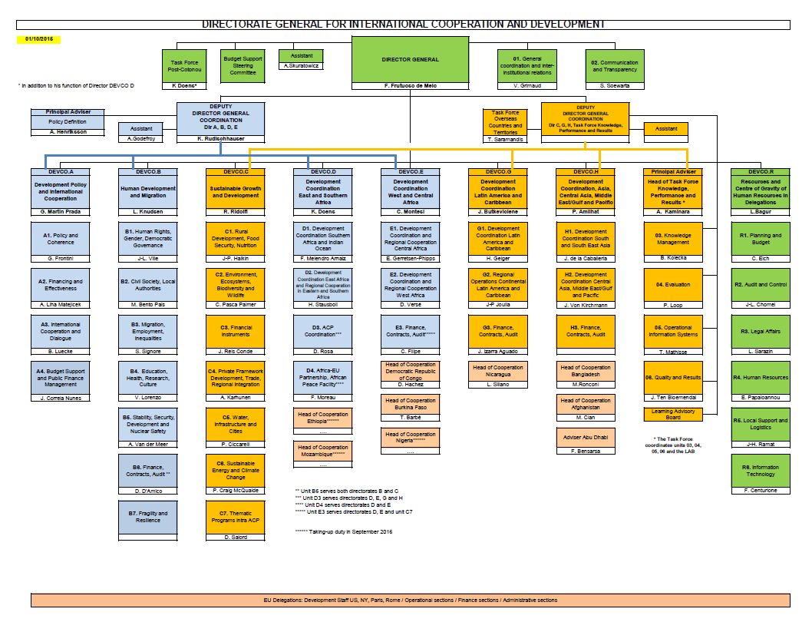

Slide 5

EDF 30,506 M EUR
CSO-LA 1.907 M EUR
DCI 23,295 M EUR
LA 450 M EUR
(ENI 18,182 M EUR)

Slide 6
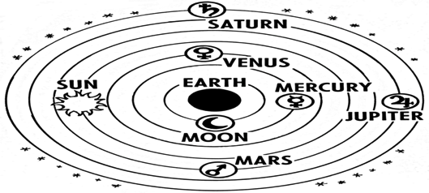
CHALLENGES
Developing a framework: TALD (Territorial Approach to Local Development)
Supporting the mainstreaming of TALD within EU supported programs;
Supporting piloting experiences through the thematic program
MILESTONES:
Concept Paper (March-June 2014)
Internal Brainstorming involving different units at DG DEVCO, DG AGRI, Committee of Regions (December 2014): http://capacity4dev.ec.europa.eu/article/what-territorial-approach-local-development
Presentation of the TALD framework during a Brussels Seminar on DLD involving more that 65 people from EUDs
Regional TALD seminars: Bogota (June 2015), Cotonou (November 2015), Jakarta (February 2016), Dar-es-Salaam (April 2016)
Notes:
Develop and implement their own policies and mobilize additional resources (involving civil society and private actors)
Improve the design and local implementation of central policies and public spending efficiency

Slide 7
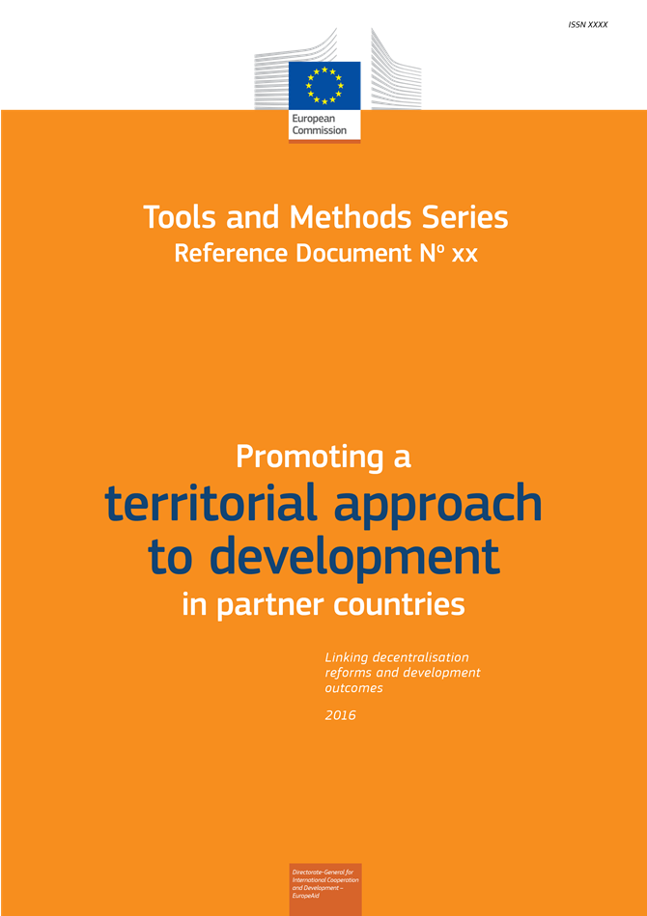
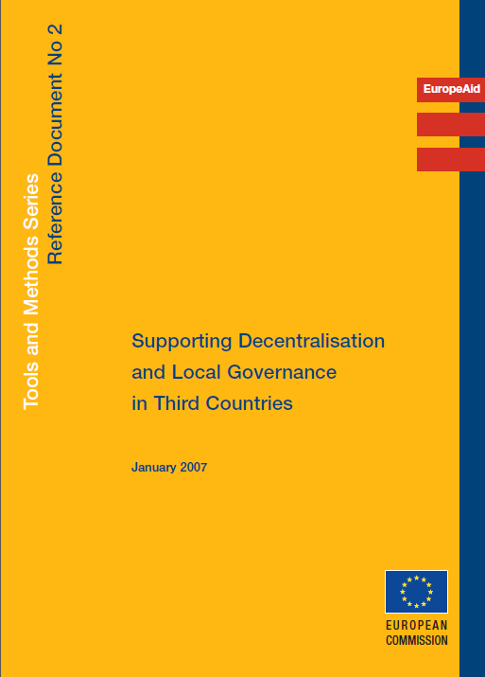
Notes:
7

Slide 8
Added value of this workshop………
Methodology
Combine presentations to frame a topic with panels to give live to the ideas
We keep it interactive, mixing field experience and academic background
We avoid long PPT presentations

Slide 9

The ‘fil rouge’ of the seminar
Part 2:
Part 1:
RED THREAD:
How to support the local-territorial development and the developmental role of LAs in partner countries
Clarifying the notion of “territorial approach to local development” in the context of Asian countries
TALD is about partnership!
The « multi-actors » perspective in promoting TD
Promoting TD through different instruments and aide modalities (BS, project approach) in a creative manner
Part 3:
Notes:
Séminaire destinnée aux personels des délégations
Mais ouvert à personnes provenant d’autres horizons

Slide 10
Thank you!!

