Slide 1
The paradigm shift towards territorial approaches to local development (TALD) – Implications and emerging EU responses
Jorge Rodriguez Bilbao
“Civil Society & Local Authorities"
European Commission-DG DEVCO B2
Workshop on Territorial Approaches to Local Development
What does it entail and how can it be fostered
in Eastern and Southern African countries?
Dar Es Salaam, 04 to 6 April 2016

Slide 2
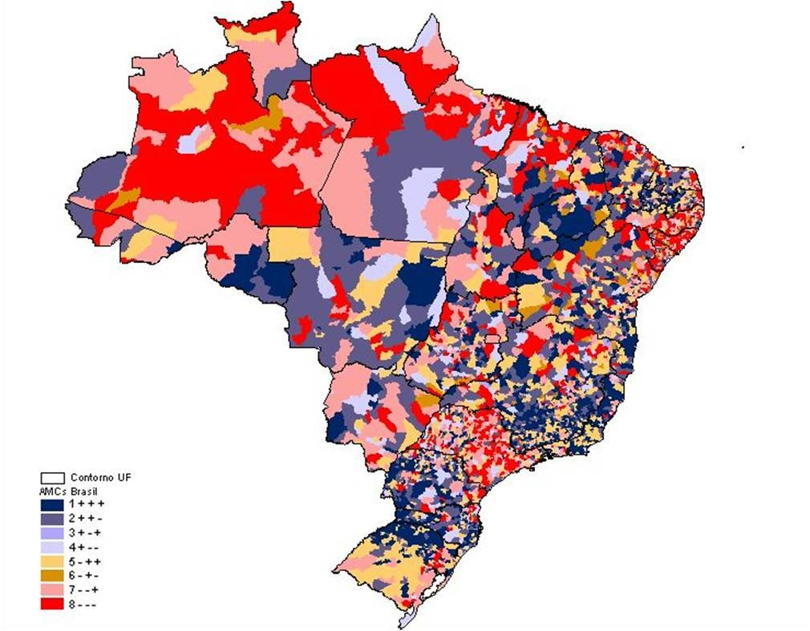
Spatially uneven development
Notes:
2

Slide 3

Spatially uneven development
Territorial dynamics, 9064
municipalites, 9 countries
Outcome over one decade | Municipalities %
Growth but no improvement in poverty or inequality | 6
Growth and reduced poverty and/or inequality | 37
No growth but reduced poverty and/or inequality | 29
No improvement in any dimension | 29
Source: Julio Berdegue (RIMISP)
Notes:
3

Slide 4
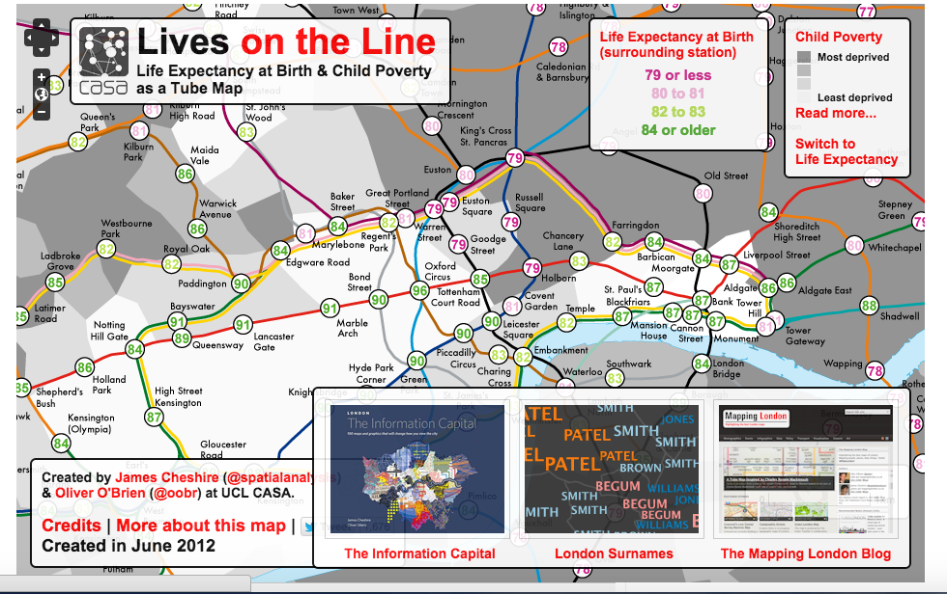
Spatially uneven development
Life expectancy varies from station to station where children are born 20-year difference in life expectancy between those born near Oxford Circus and others born close to some stations on the Docklands Light Railway (DLR). Newborns around Star Lane are predicted to live, on average, for 75.3 years in contrast to 96.4 years for those near Oxford Circus
Source: Julio Berdegue (RIMISP)
Notes:
4

Slide 5
Urbanisation of Rural Regions
100%
45%
45%
90%
40%
40%
80%
35%
35%
70%
30%
30%
60%
25%
25%
50%
20%
20%
40%
15%
15%
30%
10%
20%
10%
10%
5%
5%
0%
0%
0%
1950
1960
1970
1980
1990
2000
2010
2020
2030
2040
2050
1950
1955
1960
1965
1970
1975
1980
1985
1990
1995
2000
2005
2010
2015
2020
2025
1950
1955
1960
1965
1970
1975
1980
1985
1990
1995
2000
2005
2010
2015
2020
2025
AFRICA
LAC
ASIA
AFRICA
LAC
ASIA
AFRICA
LAC
ASIA
Deep rural
Large cities
Small and medium cities
Source: UN World Urbanization Prospects

Slide 6
Why Territorial Development?:
Growing inequalities and ineffective responses
GROWING INEQUALITIES
Between urban and rural areas and within urban areas threatening political stability, social cohesion and economic growth.
Notes:
Develop and implement their own policies and mobilize additional resources (involving civil society and private actors)
Improve the design and local implementation of central policies and public spending efficiency

Slide 7
Why Territorial Development?:
Growing inequalities and ineffective responses
Limits of Traditional policies that have aimed at correcting territorial disparities, through
  A variety of regional development programs (mostly focused on infrastructure spending in less developed areas)
  Spending for upgrading housing and sanitation conditions in fast growing slum areas.
Problems with these policies are both conceptual and practical.
  strictly top-down, sectoral logic, instead of integrated packages and lack of strategic spatial focus in public investments planning
  Resources required beyond the possibilities of public spending under fiscal discipline constraints
Notes:
Develop and implement their own policies and mobilize additional resources (involving civil society and private actors)
Improve the design and local implementation of central policies and public spending efficiency

Slide 8

Wide agreement on basic features of
territorial development
The concept of Territorial Development (TD) is not new!!
Is about expanding the overall potential of the territories
Is a place-based approach: Territory as an active ingredient, not a passive receptacle of development;
Is not about improving a single objective: is not about achieving economic growth only or improving infrastructure, or improving education…by strategically managing the relations (trade-offs and synergies) between economic growth, social inclusion and environmental sustainability
By providing the conditions for a genuine, bottom up development piloted by the actors of the territory, that moves the way they prefer…
To achieve improvements in social inclusion, economic growth and environmental sustainability.
Notes:
8

Slide 9

Territorial approach to Local Development: Back to local development
The term “Local” refers not just to a where (which is ultimately a matter of standing of the observer), but, more importantly to a specific how and by whom development is promoted.
The leveraging of place-specific resources through enabling political and institutional mechanisms of Governance and administration, constitutes the critical difference between:
  genuine Local/Territorial Development and
  the simple “localization” of regional, national, or global development objectives and programs.

Slide 10
Territorial approach to Local Development: Back to local development
The adjective “territorial” typically refers to either, or both
Development which is spatially integrated
[it stresses the importance of integrating physical/environmental and social/economic considerations and go beyond sector fragmentation
Development of specific places at multiple scales
    [This points at the multiplicity of scales) at which local development can be promoted (local, urban, metropolitan, regional, national, or supra-national) and the interdependence of them]
Notes:
10

Slide 11
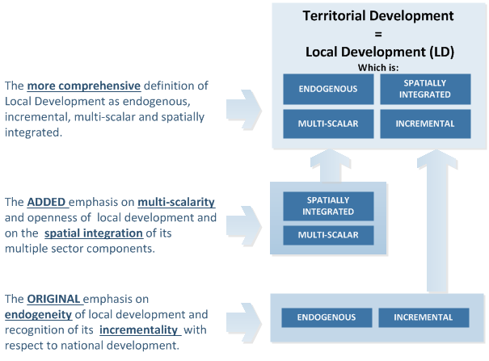
Territorial Development as better understood
local development
Ho
Spatially coordinated local development that leverages the interaction of actors operating at multiple scales of development planning and administration

Slide 12
Territorial Development as better understood
local development
Ho
Spatially coordinated local development that leverages the interaction of actors operating at multiple scales of development planning and administration

Slide 13
Territorial Development as better understood
local development
Ho
Spatially coordinated local development that leverages the interaction of actors operating at multiple scales of development planning and administration

Slide 14
Territorial Approach to Local Development (TALD)
What is the TALD (“Territorial Approach to Local Development”)?
Multi-dimensional national policy that national governments in decentralizing States may want to adopt, and international development partners may want to support/promote, in order to unleash the full potential of Local Development for national economic growth and social cohesion
.
Notes:
Develop and implement their own policies and mobilize additional resources (involving civil society and private actors)
Improve the design and local implementation of central policies and public spending efficiency

Slide 15
Understanding Local/Territorial Development (2)
TALD does three things:
  Understands territorial development as defined above
  Values Territorial Development as a critical component of the National Development policy
  Recognizes the primary responsibility of autonomous and accountable LAs for promoting territorial development, and empowers them to plan, finance and manage it
Notes:
15

Slide 16
Territorial Development is about partnerships
People outside the public sector
Citizens helping themselves
Volunteers
People working in charities, private organisations
New assets
Making use of non-public assets (e.g., church halls, local materials, communal property)
Handing public assets over to communities, charities, private groups
Communities
People
Business
CSO
Local government
Funding
Assets
New sources of funding
Private philanthropy
Corporate social responsibility
Community contributions
Local governments have the :
Mandate for the economic and social welfare of the local community,
Legitimacy for coordination and integration of different actors;
Normative capacity;
Responsive to local demands
State resources
Non-state resources
Adapted from the Institute for Government. “The Big Society: A framework for policymakers”. April 2011. UK

Slide 17
Territorial Development and SDGs
Autonomous and accountable local authorities may in fact:
Directly improve the overall efficiency of national SDG-based programs through matching of resources to local demands and increasing the value-for-money in their use, as well as
Directly and indirectly promote the SDGs by mobilizing a wide range of local resources (first and foremost local social capital) to supplement and complement national efforts and deliver genuine development of the territory.

Slide 18

The TALD framework
Territorial Development
Local service delivery
Local environment management
Local economic development
Improved Local Development Management System
Comprehensive scope of local development
Improved systems of local development planning
Improved institutions & capacity for local development implementation
Enhanced & diversified instruments of local development financing
National Level Policies
Sub-National level institutions & capacity
Decentralisation policy enhancing autonomy and accountability of LA
National urban agenda supportive of LA
National rural development policy supportive of LA
Effective institutions of inter-governmental cooperation
Active citizenship & Public-Private Partnership
Local leadership & administrative capacity development

Slide 19
The “missing link”” between decentralization reforms and local development outcomes.
A navigation tool or a GPS that should enable EUDs to identify relevant entry points for EU support geared at achieving a diversity of outcomes through a smart combination of approaches, instruments and aid modalities.
Improved Local Development Management System
Comprehensive scope of local development
Improved systems of local development planning
Improved institutions & capacity for local development implementation
Enhanced & diversified instruments of local development financing
National Level Policies
Sub-National level institutions & capacity
Decentralisation policy enhancing autonomy and accountability of LA
National urban agenda supportive of LA
National rural development policy supportive of LA
Effective institutions of inter-governmental cooperation
Active citizenship & Public-Private Partnership
Local leadership & administrative capacity development

Slide 20
Successful territories in this mosaic:
They manage to articulate six sets of relations:
Four Caveats
There is not optimum solution: each territory figures out his own combination;
Rural-urban arrangements and relations
Linkages with markets
Economic structure
Governance of natural ressources
Governance of public and private investissments
Social coalitions
There is not way in a technocracies or a burocracie could engineer this type of process.
It takes a lot of time!: if you are not prepared to going for the long term, please, stay out!
its extremely difficult to try to put this within the boundaries of single well prescribed project;
.
Notes:
Develop and implement their own policies and mobilize additional resources (involving civil society and private actors)
Improve the design and local implementation of central policies and public spending efficiency

Slide 21
THANKS

