Slide 1
Lessons from two decades of international experience in supporting DR, LG and LD
    The decentralisation-development nexus
Jorge Rodriguez Bilbao
“Civil Society & Local Authorities"
European Commission-DG DEVCO B2
Workshop on Territorial Approaches to Local Development
What does it entail and how can it be fostered
in Eastern and Southern African countries?
Dar Es Salaam, 04 to 6 April 2016

Slide 2
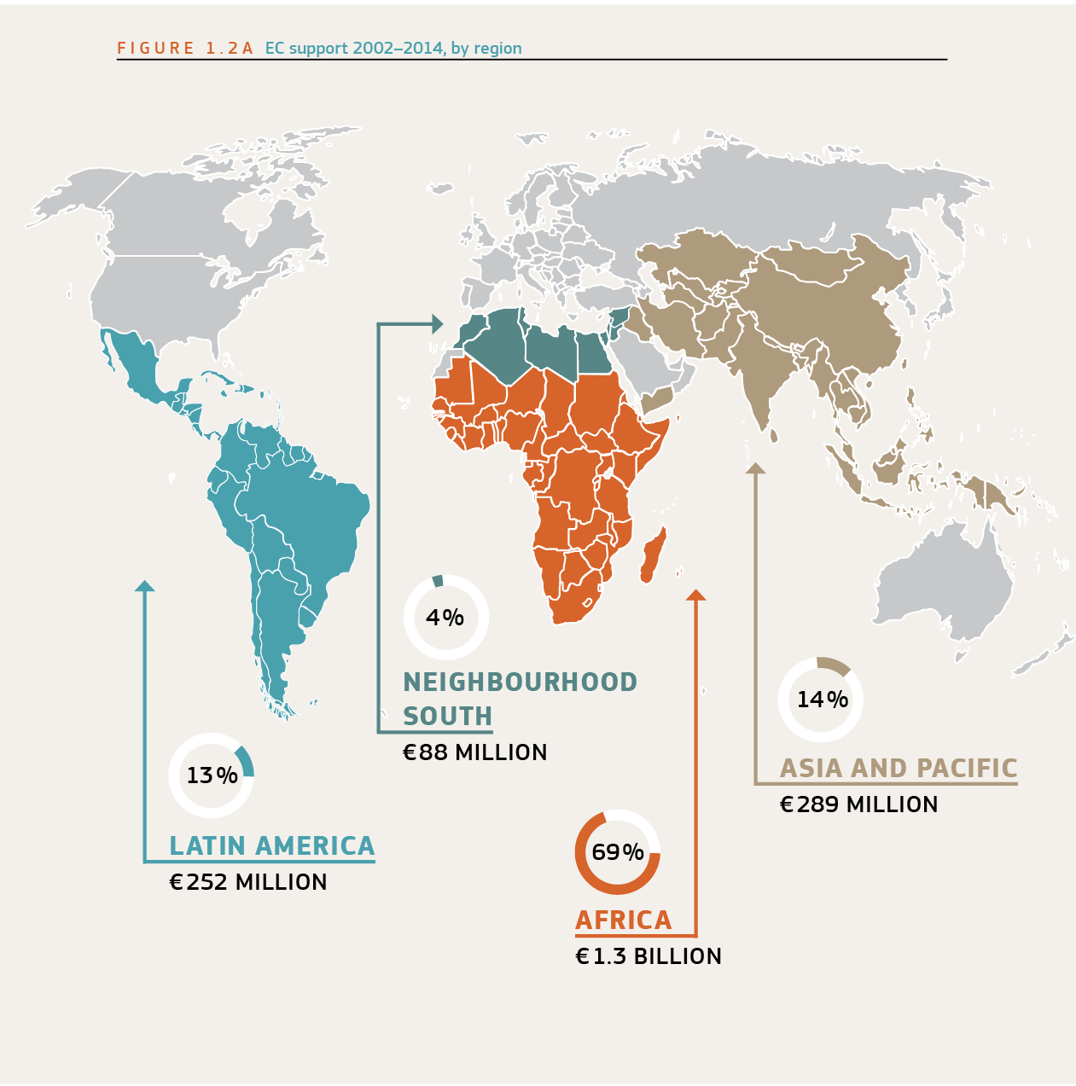
EU Supported programs to DLGTD
Notes:
2

Slide 3
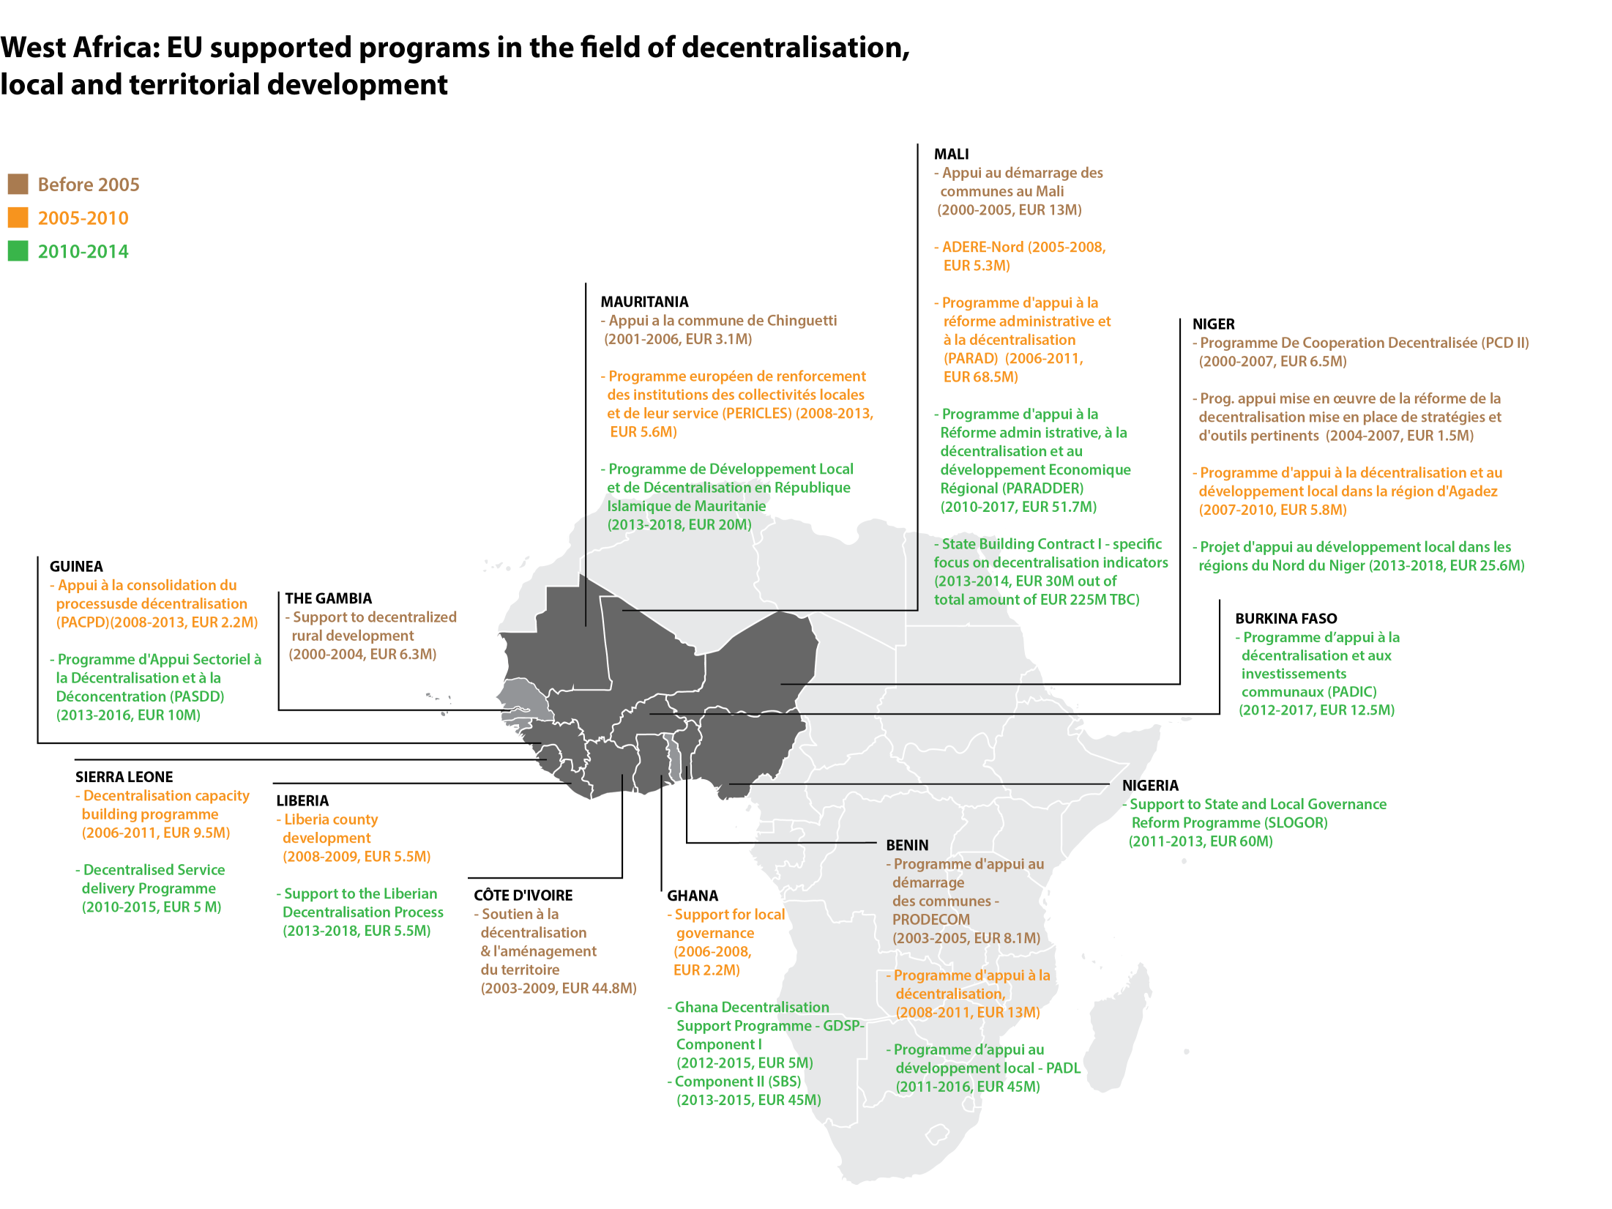
EU Supported programs
West Africa
(539 m€ or 26,62%
Notes:
3

Slide 4
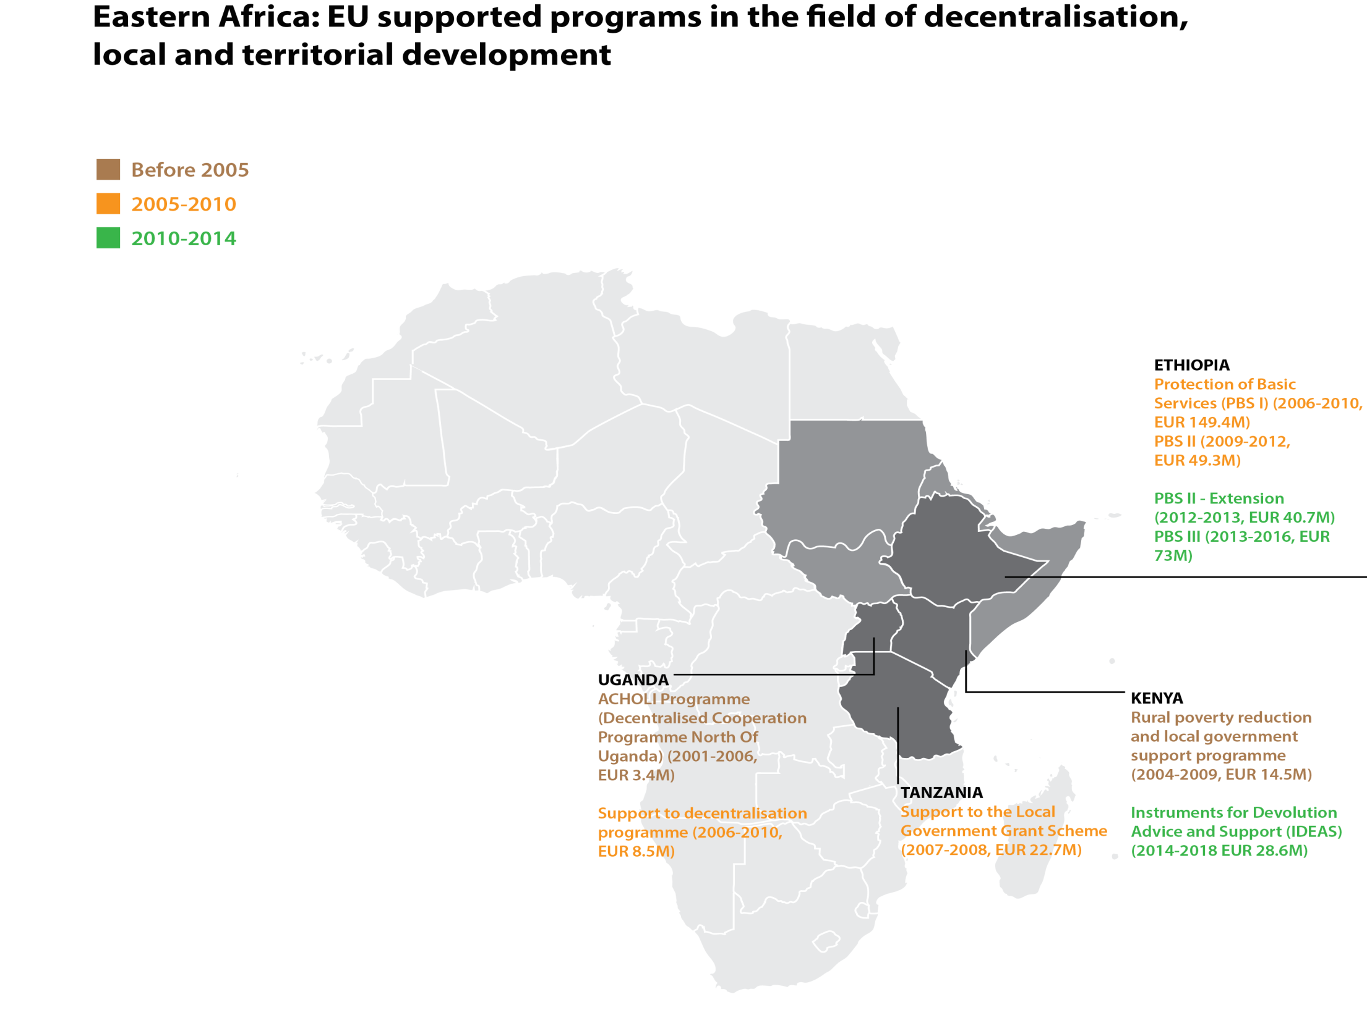
EU Supported programs
East Africa (532,6 m€ or 26,33%).
Notes:
4

Slide 5
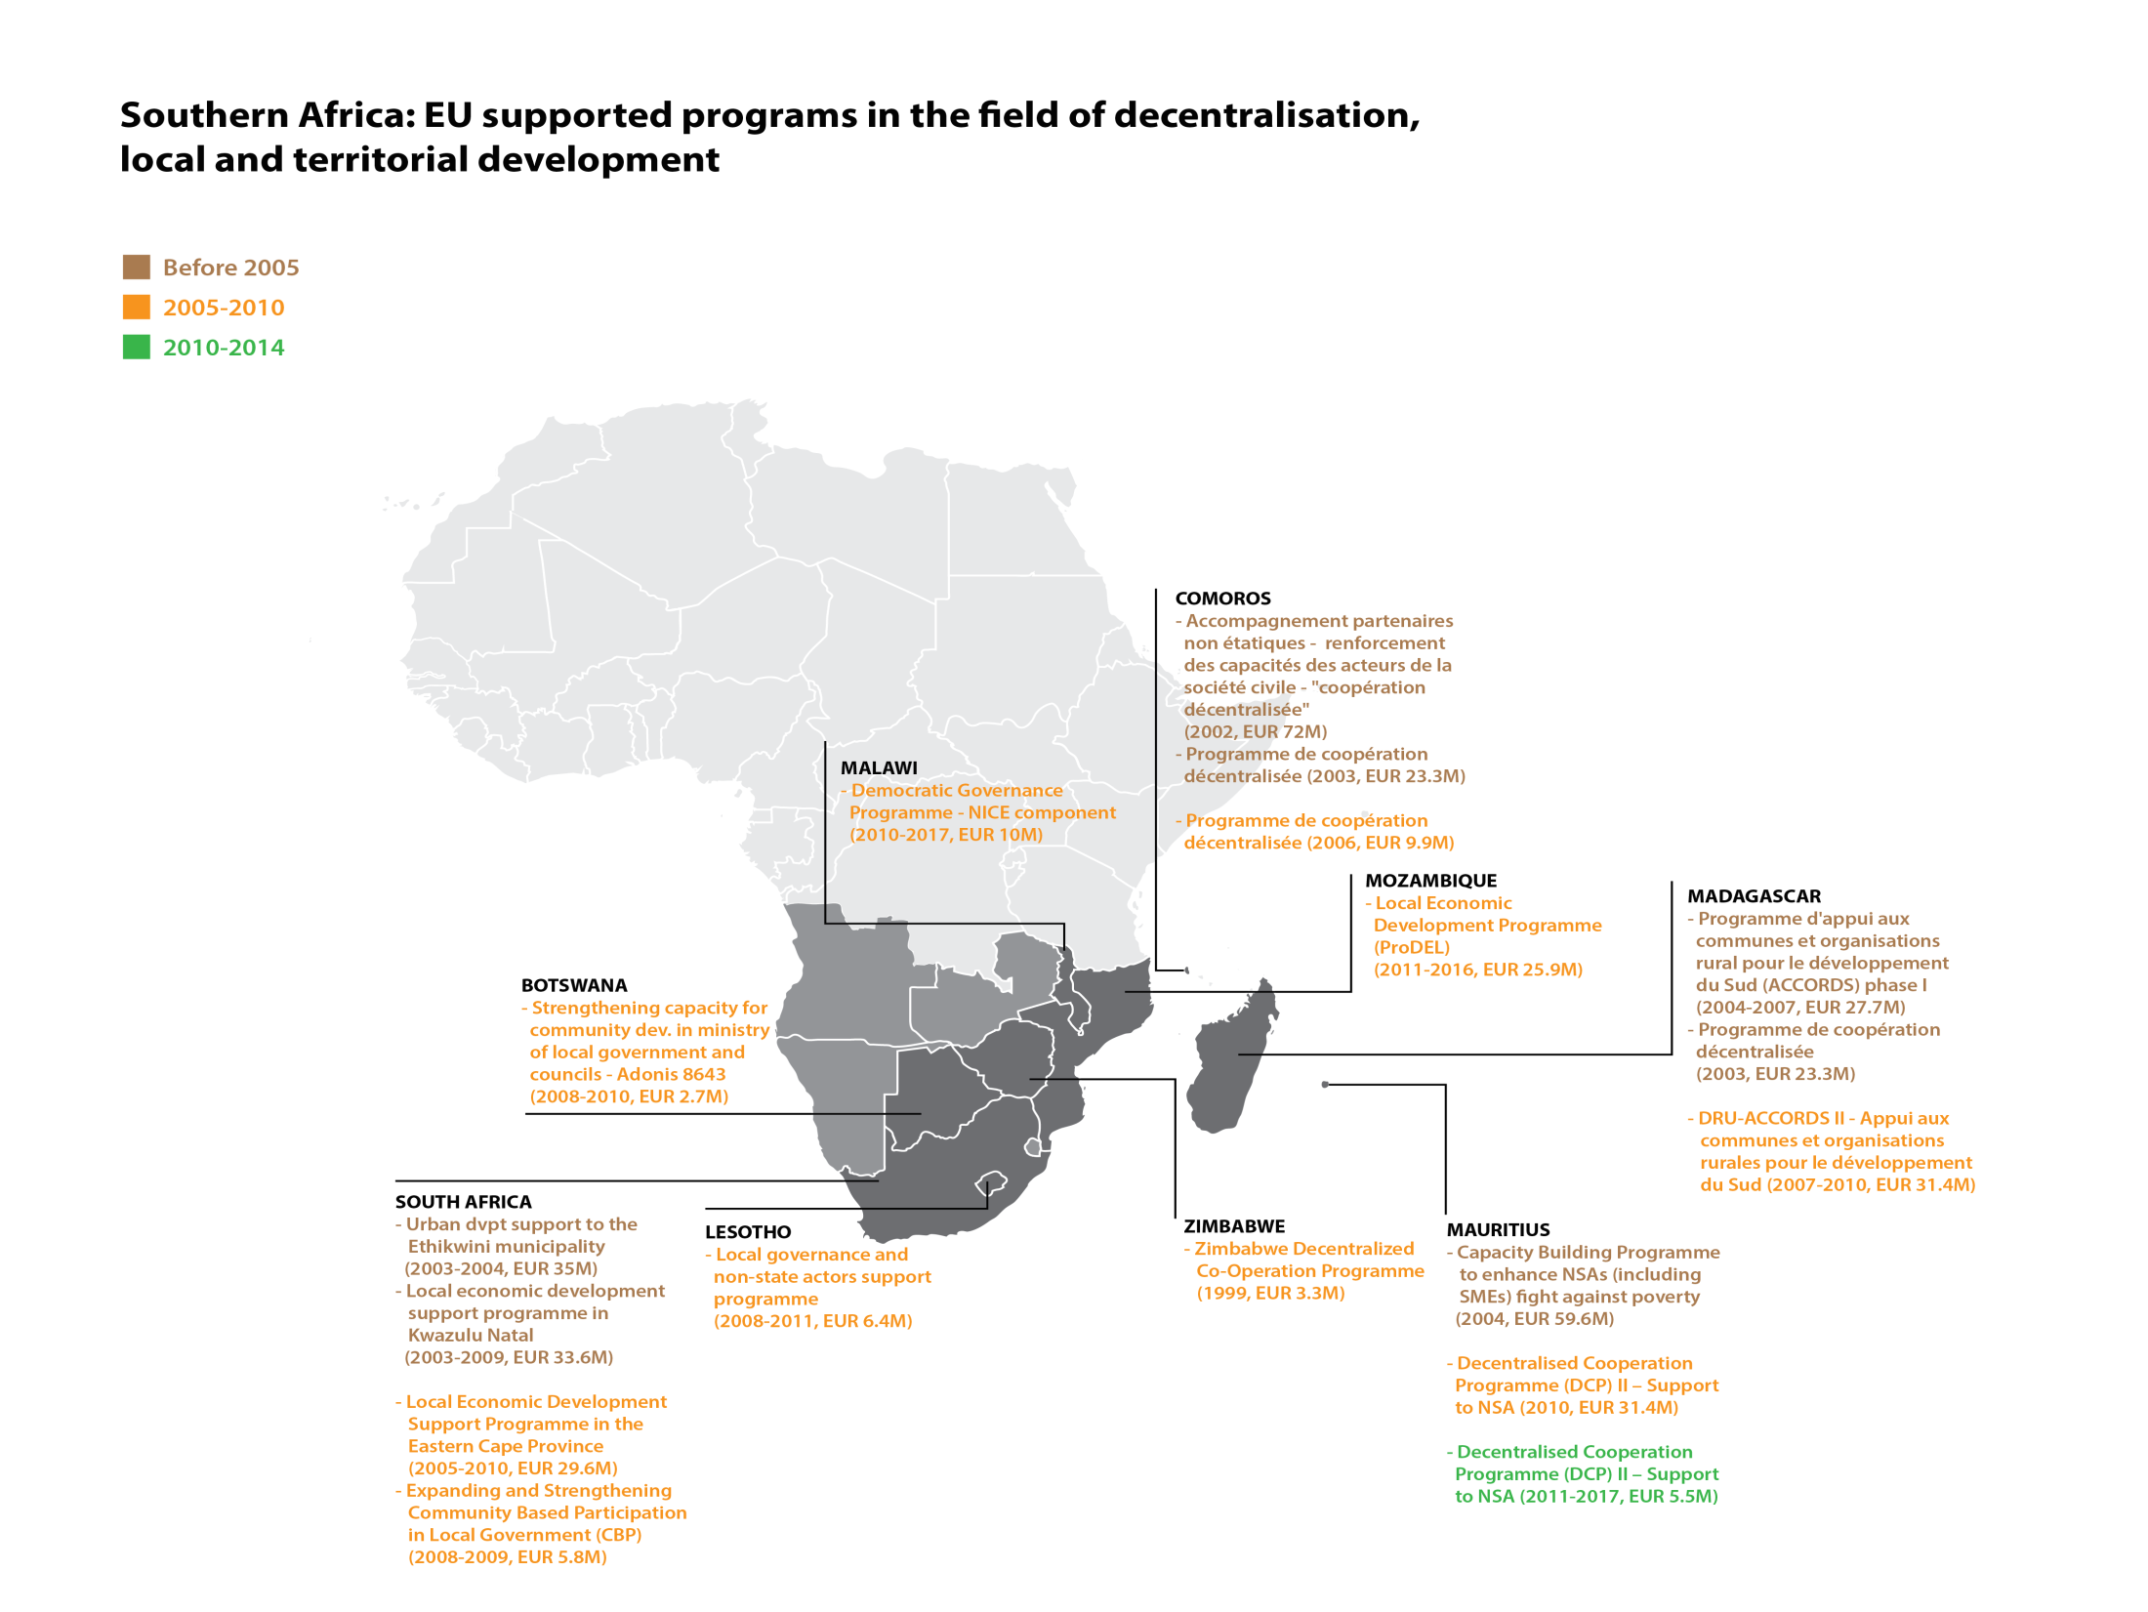
EU Supported programs
Southern Africa (230 m€ or 11,36%)
Notes:
5

Slide 6
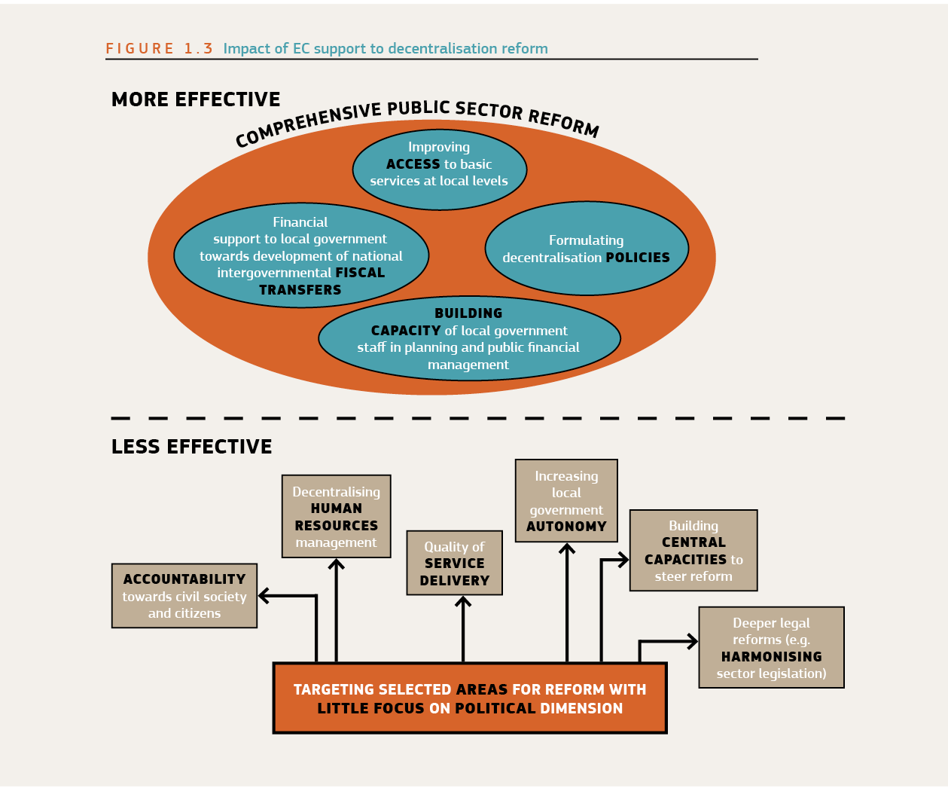
Evaluation of EU Support to DLGLD (2000-2009)
CONCLUSSION
the EC has “a unique, but largely unrealised, potential for global support to decentralisation in partner countries”.
In order to tap into that potential, the central recommendation invites the EU to :
Embeds future support for decentralisation reforms within a wider public sector reform agenda”;
Intensifying efforts to better understand the politics of the reform process,
Broadening country ownership and
Ensuring concrete development outcomes (such as qualitative and sustainable local services).
Notes:
6

Slide 7
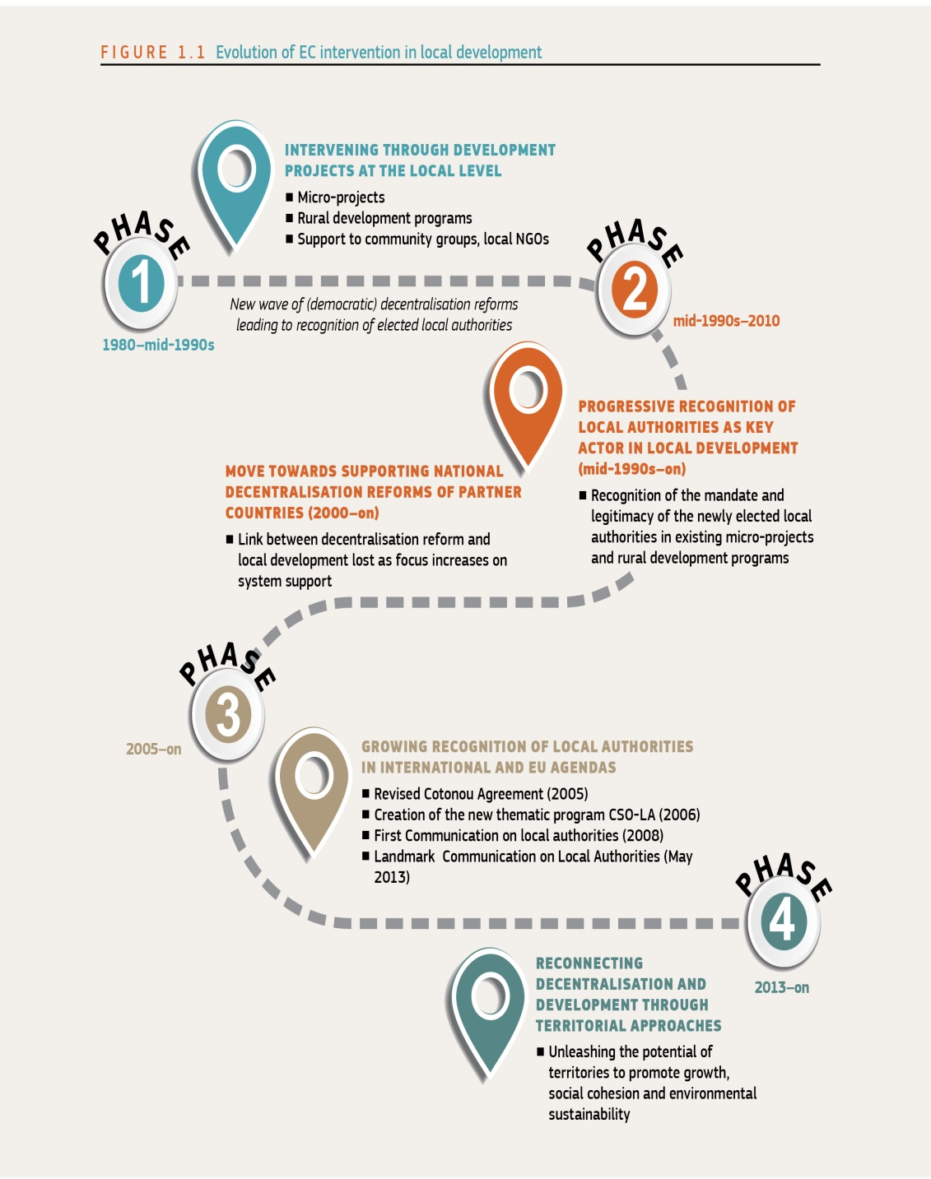
The learning curve of the EC regarding decentralisation, local development and local authorities
Notes:
7

Slide 8
The learning curve of the EC regarding decentralisation, local development and local authorities
The middle of 90’ are characterised by a new wave of decentralisation reforms in developing countries.
In response to this new reality, the EC began to specifically involve this new player in a new generation of micro-projects and rural development programs focused in promoting joint action between citizens, civil society and Local Authorities while respecting the institutional mandate of the latest.
Notes:
8

Slide 9

The learning curve of the EC regarding decentralisation, local development and local authorities
LAs are part of a system!
People inside the EU discovered that LAs are not a free electron (are not like local NGOs!).
They are part of a network of institutions.
Their ability to promote development depends on how this network works.
Growing complexity of EU Supported
Lost in translation!
Programs EU supported programs become more and more complex by the integration of
a) The institutional dimension (support to the sub-national systems (rules, procedures…) of Governance and public administration in which LAs are embedded and
b) The political framework (decentralisation reforms) that "creates" the above mentioned subnational system of Governance and public administration
This first generation of EU decentralisation support programs were framed by the classical vision of decentralisation that has dominated the international community in the last 20 years (focus on supporting "the system", with a focus on the administrative and fiscal dimension)
In this transition from supporting local development programs to supporting decentralisation reforms EUDs have lost the connection
Notes:
9

Slide 10
The learning curve of the EC regarding decentralisation, local development and local authorities
The Growing recognition of the role of LAs as developmental actors.
Many of the effects of different crises ( global warming, energy shortages and food security concerns) are experienced locally and local adaption mechanisms need to be implemented.
As a consequence Local Authorities are increasingly seen as critically important partners of central governments, who could both implement and supplement national development efforts.
.
This recognition of the developmental role of LAs means that they have a role that goes beyond what is suggested by the classical vision of decentralisation as off loading of functions towards passive LAs
Notes:
10

Slide 11

The EU vision of LAs as developmental actors
“Empowering Local Authorities in partner countries
for enhanced governance and more effective development outcomes
A paradigm shift in DEVCO!
Recognise that LAs are political actors (i.e. self-government mechanisms of a local political constituency) and not just managerial entities for delivery of a specific set of services;
Commits EU to promote territorial development;
Recognise that LAs are the pivotal actor of genuine, a bottom-up territorial development process involving communities, CSO and the private sector
Notes:
11

Slide 12
    EU Communic on Local Authorities as developmental actors: General mandate and specific fonctions
Local Authorities must be recognized as political actors (i.e. self-government mechanisms of a local political constituency) and not just managerial entities for delivery of a specific set of services, and…
Accordingly, Local Authorities must be recognized as having both:
  A general mandate enabling then to undertake , within the frame of national Law, any activity deemed to contribute to the welfare of their communities as well as
  A specific responsibilities for functions devolved or delegated to them.

Slide 13
    The decentralisation-development nexus
This recognition of the developmental role of LAs means that they have a role that goes beyond what is suggested by the classical vision of decentralisation as off loading of functions towards passive LAs
In fact, LAs can contribute to development, as partners of national Governments, in two complementary ways:
Improve what the economist calls the allocative and productive efficiency of public expenditures in a locality.
Mobilize additional resources from the people and from their interaction with communities and private sector, and bring those resources to bear on the national development effort
To promote genuine Local/Territorial Development– see below – both processes must be supported by decentralization reforms

Slide 14
Rethinking decentralisation
For both this processes to take place you need a real empowerment of localities.
A broader development-oriented definition of decentralisation
The classical definition
Process of State Reform composed by a set of public policies that intended to transfer responsibilities, resources and general authority from higher levels to newly empowered lower levels of government
  A political process of empowerment of people over the public sector through the empowerment of their local governments
  Stressing the administrative/ fiscal dimensions of the reforms
  Stressing the political/social dimensions of the reforms

Slide 15
Decentralisation as empowerment
If the empowerment of genuine local authorities must be seen not as an end in itself, but as a mean for empowering people with greater choice and control over the delivery of public services and local development at large, it follows:
First, that better local governance and local development results, rather than conformity to normative standards of functional and resources assignments are the criteria by which the success of the reforms should be assessed
  Second, the empowerment of LAs cannot be limited to a greater role in direct provision of public services, but must extend to their ability to influence, and cooperate with, other public sector actors operating in the locality. This brings to the fore the need for effective mechanisms of inter-governmental cooperation (for consultation, coordination and mutual contracting).
  Third, success of DR depends on local governance mechanisms that enable people to effectively interact with their own local government at all stages of formation and implementation of local public policies. This requires not just mechanisms for people to participate in local policy-making and hold accountable local officials, but also enhanced forms of active citizenship including civic engagement in co-provision and co-production of services.

Slide 16
Decentralisation in the real world
Many real-world decentralization reforms, do not promote local development Why?
  First, because they are designed for political and not for development. Decentralization reforms (DR) are driven by politics …while their developmental potential is shaped by policy
  Second, because the space that they can nevertheless open for local/territorial development depends:
    on the very nature of the decentralizing State (developmental ?) and
    on the role assigned to LA in national development policy and related understanding of LA autonomy and accountability requirements

Slide 17
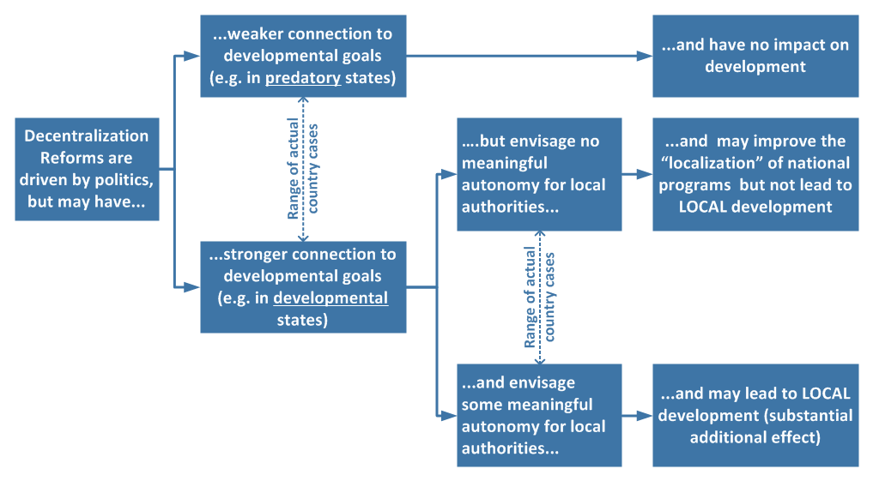
Decentralisation and
Development
Many decentralization reforms don’t promote Development because they were neither initiated nor designed to do that

Slide 18
Decentralisation and
Development
Many decentralization reforms don’t promote Development because they were neither initiated nor designed to do that

Slide 19
Decentralisation and
Development
Many decentralization reforms don’t promote Development because they were neither initiated nor designed to do that

Slide 20
LINE MINISTRIES
Education
Health
Infrastructure
LG
Telecommunications
Environment
Cooperation
FEDERATE?
LGs

Slide 21



Slide 22
Territorial Development is about partnerships
People outside the public sector
Citizens helping themselves
Volunteers
People working in charities, private organisations
New assets
Making use of non-public assets (e.g., church halls, local materials, communal property)
Handing public assets over to communities, charities, private groups
Communities
People
Business
CSO
Local government
Funding
Assets
New sources of funding
Private philanthropy
Corporate social responsibility
Community contributions
Local governments have the :
Mandate for the economic and social welfare of the local community,
Legitimacy for coordination and integration of different actors;
Normative capacity;
Responsive to local demands
State resources
Non-state resources
Adapted from the Institute for Government. “The Big Society: A framework for policymakers”. April 2011. UK

Slide 23
Autonomy and Accountability
Key to create a link between decentralization to development is the national understanding of the nature and developmental role of Local Authorities.
Decentralization as empowerment means national policies and a legal framework that:
  Support both LA’s autonomy and accountability
  Recognize LA as political actors and entrust them with both a general mandate for local development, and specific services delivery functions

Slide 24
‘Additional Resources’ for TD and mobilization mechanisms

Slide 25
THANKS

