Slide 1
Session 2.1. The role of CSO in promoting TALD
Introduction and framing
Jorge Rodriguez Bilbao
“Civil Society & Local Authorities"
European Commission-DG DEVCO B2
Workshop on Territorial Approaches to Local Development
What does it entail and how can it be fostered
in Eastern and Southern African countries?
Dar Es Salaam, 04 to 6 April 2016

Slide 2
Territorial Development is about partnerships
People outside the public sector
Citizens helping themselves
Volunteers
People working in charities, private organisations
New assets
Making use of non-public assets (e.g., church halls, local materials, communal property)
Handing public assets over to communities, charities, private groups
Communities
People
Business
CSO
Local government
Funding
Assets
New sources of funding
Private philanthropy
Corporate social responsibility
Community contributions
Local governments have the :
Mandate for the economic and social welfare of the local community,
Legitimacy for coordination and integration of different actors;
Normative capacity;
Responsive to local demands
State resources
Non-state resources
Adapted from the Institute for Government. “The Big Society: A framework for policymakers”. April 2011. UK

Slide 3
Two interlinked outcomes of joint action CSO-LA

Slide 4
Two interlinked outcomes of joint action CSO-LA

Slide 5
Two interlinked outcomes of joint action CSO-LA

Slide 6
Two interlinked outcomes of joint action CSO-LA

Slide 7
Two interlinked outcomes of joint action CSO-LA

Slide 8
Two Communications: One single message!
Notes:
8

Slide 9
TALD framework
CSOs
Notes:
The Multi-annual Indicative Programme
Annual Action Programme (AAP)

Slide 10
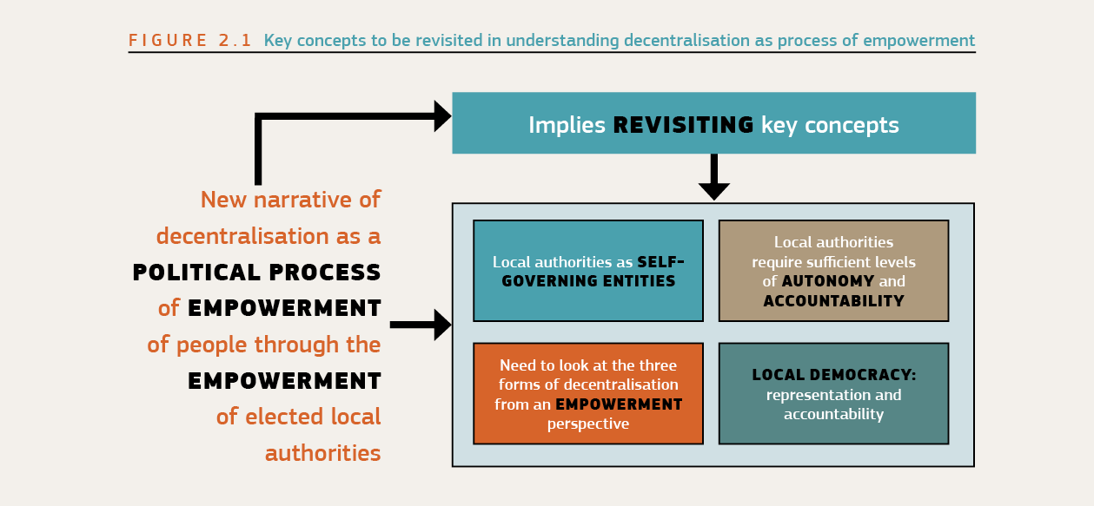
Notes:
10

Slide 11
THANKS

