Slide 1
Session 2.4. Unlocking the potential of the thematic line CSO-LA to promote TALD
Jorge Rodriguez Bilbao
“Civil Society & Local Authorities"
European Commission-DG DEVCO B2
Workshop on Territorial Approaches to Local Development
What does it entail and how can it be fostered
in Eastern and Southern African countries?
Dar Es Salaam, 04 to 6 April 2016

Slide 2
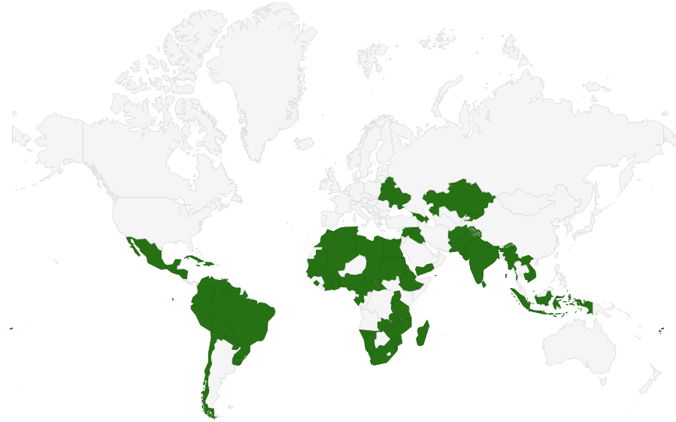
CSO-LA 2014-2017
Overall budget of 2 billion, 75% in-country (2014-2020)
One of its objectives “testing pilot actions promoting LD through a territorial approach (TALD)
LA-CSO led projects!!
MAAP (2015-2017):
  LA-led actions : 144.040 M€
  CSO-led: 423.075 M€
  Support measures: 2,5-5%
Notes:
The Multi-annual Indicative Programme
Annual Action Programme (AAP)

Slide 3
Allocations in Eastern and Southern African countries (2015-2017)

Slide 4
Testing pilot actions promoting LD
through a territorial approach (TALD)
We don’t want just to finance actions led by CSO-LA We want to test pilot actions promoting LD!!!
Questions you need to answer:
What are the features on any actions led by LA and/or CSO to be labelled as “LD”
How can we “promote” (and not just “finance”) those actions?
Notes:
The Multi-annual Indicative Programme
Annual Action Programme (AAP)

Slide 5
TALD is about partnership CSO-LA

Slide 6
Testing pilot actions promoting LD
through a territorial approach (TALD)
One line of work targeting subnational and local levels through
  Promoting joint actions/partnerships between LAs and civil society organizations to leverage the respective resources and effectively address local development and services delivery needs, through a range of innovative mechanisms that may go from appropriate regulation and facilitation of CSO activities in the jurisdiction, to co-financing and co-production of infrastructure and services;
  Promoting social accountability and the institutionalization of mechanisms for participatory planning and social auditing of local public policy making and implementation.
Notes:
The Multi-annual Indicative Programme
Annual Action Programme (AAP)

Slide 7
Testing pilot actions promoting LD
through a territorial approach (TALD)
One line of work targeting national level policies:
Promoting a wider and better informed societal dialogue on decentralization, involving LAs’ associations, government, legislators, academics, professional organizations, political parties, the media and civil society at large.
Strengthening the ability of Local Government Associations (LGA) to advocate for the expanded autonomy and effective accountability arrangements that may enable their members to play a developmental role, and to build LAs’ capacity through mutual learning.
Notes:
The Multi-annual Indicative Programme
Annual Action Programme (AAP)

Slide 8
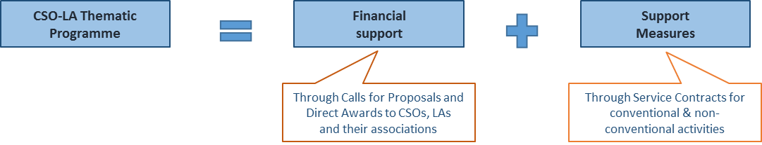
Thematic Programme CSO-LA: Main components
The Thematic Programme: financial support to actions led by CSOs and/or LAs with “Support + Measures” covering a wide range of “soft” activities (Evaluations, identifications, studies, meetings, information sessions, special awareness-raising events, publications, training activities…

Slide 9
Tailoring the Call for Proposals

Slide 10
Tailoring the Call for Proposals
Tailoring a Call for Proposals through lots and ring-fencing
EUDs can decide to target:
a geographical area (poorest regions, most isolated areas, uplands territories, peri-urban villages)
a type or a level of LAs (metropolis, districts, village councils, provinces)
a category of CSO (cooperative, CBO, research institute, NGO)
a sector, public service or activity (in line with bi-lateral or not, when appropriate)
a scope of partnership (formal involvement of communities, inclusion of the private sector)
a nationality of applicants (EU vs local)

Slide 11
Tailoring the Call for Proposals

Slide 12
Tailoring the Call for Proposals
Tailoring a Call for Proposals through the combination of various stakeholders
Combination in a smart way the different roles (main applicant, co-applicants, affiliated entities, associates, beneficiaries of financial support to third parties, target groups, etc.) endorsed by various stakeholders, and coordinated by a CSO or a LA;
EUD can impose a type of partnership, through a lot for instance, explaining the coalition sought, and then specified with the eligibility criteria.

Slide 13
Tailoring the Call for Proposals
Tailoring a Call for Proposals through the eligible actions (type of activities, location and duration)
Some strategic activities can be made compulsory in a CfP.
The financial support to third parties can be made either compulsory, optional or to exclude.
Location of the action(s) can also be adapted to the country’s situation or to the Delegation’s strategy, whether it is specific districts or regions, or category of towns for instance.
The duration of an action ranges between 24 and 60 months,

Slide 14
Support measures
Conventional uses of Support Measures are generally devoted to the capacity building of potential applicant’s ability to present quality proposals and to ensure that the beneficiaries of the LAs and CSO grants are able to adequately administrate resources and present reports in accordance with European Commission standards.

Slide 15
Non-conventional uses of Support Measures
Connection between local experiences and national platforms for lobby and advocacy
Support to the organisation and operation of the National Table for Management of the Solid Waste (Mesa Temática de Residuos Solidos).
The EUD saw an opportunity to mobilise local and national actors of the environmental sector via the support and organisation and operations of a mechanism for the discussion and analysis of the solid waste management at national level.
The recommendations of this collective body are taken at the highest level of political decision and are creating a favourable environment for the sector as a whole.

Slide 16
Non-conventional uses of Support Measures
Building capacity at local level and supporting decentralisation reforms of national urban and rural policies
EUDs can support national initiatives related to decentralisation reforms (e.g. drafting of a new law for land use and property taxes allowing to increment local tax collection by local governments).
Sometimes national actors have regulatory constraints that limit their capacity to contract external expertise, EUD can use the Support Measures for financing some specialized consultancy or technical assistance for these national initiatives.

Slide 17
Non-conventional uses of Support Measures
Learning and dissemination of experiences gained through the thematic programme
EUDs, with the Support Measures, can develop some knowledge sharing material (e.g. short videos, film & photo exhibition…) on the experiences gained through the implementation of projects from previous calls for proposals—both for LA and CSO.

Slide 18
THANKS

