Slide 1
for the European Commission DG DEVCO B2 Workshop on Territorial Approaches to Local Development Dar es Salaam – April 2016
Building the TALD Toolkit
The Integrated Decentralization Diagnostic Framework
Giuliano Bosi
Local Development International LLC

Slide 2
Principles meet Reality… and your Questions
Under TALD, decentralization is no longer a transfer of functions and resources but a process of ‘empowerment of people through the empowerment of their local governments’, a process aimed at promoting development.
The rationale for EUD interventions becomes to empower local authorities to manage and coordinate a territorial development that contributes to (local and national) sustainable socio-economic growth.
But where do we start, what is politically feasible in a given country?
How do we come up with a context-sensitive, politically smart and problem-focused approach that can support productive, pragmatic and strategic reforms?

Slide 3
Understanding the Context
To identify and support the policy and institutional changes that will empower autonomous and accountable local authorities to become effective developmental actors, we need to understand the constraints and opportunities created by national politics and policy.
Understanding the origins and status of decentralization reforms is a strategic entry point for context analysis, a foundation for any further analytical effort across the other ‘TALD building blocks’.
DEVCO B2 is developing an Integrated Decentralization Diagnostic Framework (IDDF) to be made available online on Capacity4Dev.

Slide 4
Territorial Development
Local service delivery
Local environment management
Local economic development
Improved Local Development Management System
Comprehensive scope of local development
Improved systems of local development planning
Improved institutions & capacity for local development implementation
Enhanced & diversified instruments of local development financing
Entry point for context analysis
National Level Policies
Sub-National level institutions & capacity
Decentralisa-tion policy enhancing autonomy and accountabi-lity of LA
National urban agenda supportive of LA
National rural development policy supportive of LA
Effective institutions of intergovernmental cooperation
Active citizenship & Public-Private Partnership
Local leadership & administrative capacity development

Slide 5
Decentralization – between Politics and Policy
Policy
Decentralization System
Political Economy

Slide 6
IDDF – What and How
What is its main purpose? To serve as an analytical framework to understand the decentralization system and identify political and policy constraints and opportunities (entry points) for improvement/reform.
How does it work? It is centered around a Core Decentralization Diagnostic and a series of interrelated modules (e.g. Accountability, HRM, PFM, Local Economic Development, Development Planning, Food Security, etc.)

Slide 7
Core Diagnostic – The Six Primary Questions
The nature of the decentralization policy framework
The motives and origins underlying the framework
The degree to which the framework has been implemented as officially defined
The results the official framework has produced
The factors that have shaped decentralization as it has unfolded and their relative importance
Viable and strategic opportunities for taking pragmatic steps to make progress in the future

Slide 8
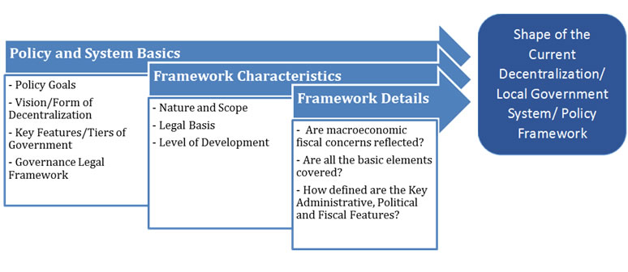
1. Assessing the Decentralization Policy Framework

Slide 9
Policy and System Basics (sample of questions)
What are the officially stated goals of decentralization and are they specifically prioritized? Common overarching goals might include development, democratization, service delivery efficiency, poverty reduction, conflict reduction, etc.)
What primary form does the decentralization take (devolution, deconcentration, delegation, mixed)?
What are the key features of the central and subnational government structures (unitary/federal, number and nature/role of each level, share of total public revenues and expenditures, etc.)?
How developed is the general governance legal framework (rule of law, civil society rights, freedom of association/press/information)?

Slide 10
Framework Characteristics (sample questions)
What is the nature and scope of the decentralization framework (formalized in a single code or the result of a series of ad hoc laws and regulations, is it comprehensive or only limited to a few functions/sectors)?
What is the legal basis of the decentralization framework (Constitutional provisions, one or more local government -ordinary- laws, administrative orders, some combination of constitutional, legal, administrative)
What is the level of development of the framework (states a few general principles or specifically empowers local governments, is the system fully articulated in the framework, or is there a need for nontrivial further development of all or some aspects of decentralization reforms)?

Slide 11
Framework Details (sample questions)
Are the elements of the basic decentralization framework--administrative, political and fiscal—covered and balanced (e.g. local councils appointed rather than elected, elections but limited funds, etc.)?
How defined are the key administrative features of the system (LG internal structures and processes, including HRM, PFM and fiscal accountability provisions)
What are the key political features of the local government system (regular elections—direct vs. indirect, closed party lists vs. open nomination, sound political competition, local decision-making autonomy for expenditures, revenues, and personnel matters, local accountability mechanisms beyond elections, e.g. courts, complaint bureaus, report cards, etc.)?
How defined are the key fiscal features of the system (LG functions clearly specified, LG revenues adequately defined, intergovernmental transfer systems based on clear criteria, mechanisms for borrowing, specific provision for the general mandate of LGs) ?

Slide 12
IDDF as an online platform on Capacity4Dev
The IDDF is conceived to be a standardized but flexible analytical tool to enable policymakers and development partners to better understand how decentralization is structured and why
Using it online will allow to move more freely between interrelated modules and sections
It will allow to include interactive help tools, a more user friendly “manual”, examples from other countries, and the possibility to upload files (relevant legislation, policy papers, etc.)

Slide 13
Work in progress…
Thank You!

