Slide 1
Session 3.3. Politically smart, locally led development programs
Jorge Rodriguez Bilbao “Civil Society & Local Authorities" European Commission-DG DEVCO B2
Workshop on Territorial Approaches to Local Development
What does it entail and how can it be fostered in Eastern and Southern African countries? Dar Es Salaam, 04 to 6 April 2016

Slide 2
In which context ?
“VIRTUAL” decentralisation reforms
In partner countries where there is little or no political drive for a development-oriented decentralization that enhances the autonomy of local authorities,
Context characterised by a policy and systems vacuum and unclarity of institutional mandates
Need to address the deeper gaps and inconsistencies of existing policies and institutions
(revealed by reform goals and development results)
Notes:
2

Slide 3
What do we want to
achieve?
Programs conceived as «policy and systems experimentation» at the scale of a representative geographic-administrative area;
The purpose of experimentation can be:
Supporting national policy development and institutional innovation ‘from below’
Demystify the usual allegations regarding weak local capacity;
Create stronger local constituencies advocating for change;
Inform the national debate and bargaining process on the future of the decentralization reform.
Pilot experiments can also play a key role in providing an alternative model for policy dialogue
Notes:
3

Slide 4
Guiding principles
Explicit linkage to the development of national decentralization policies
Use, although it can be difficult in weak system and institutional environment, country systems to the extent feasible and to increasingly do so as systems and capacities are built and enhanced;
Interactions between program and policy making process in both directions;
Key operational device: constantly asses, learn, reflect, revise, and adapt to the issues and challenges that emerge
Notes:
4

Slide 5
One practical example (Madagascar)
RULES OF THE GAMME: 3 BASIC PRINCIPLES
The “Genetic Code” of a “smart” project approach
The municipality as:
the “main dialogue partner” and “public contracting authority” in the areas of competence transferred by law;
1
The municipality is responsible of the “choices” made
The financing of the actions is registered in the municipal budget
The municipality is accountable
Even if they are weak, unclear and contradictory
Interactions between program and policy making process in both directions;
Flexibility of the approach and tools, in order to adapt (and interact) with the “moving” decentralisation process
2
Application, as far as possible, of the national institutions, procedures and systems
3
Search for linkages with the decentralisation policy in connection with sectoral policies

Slide 6
The "financial facility": A crucial element of the experimentation
Proposed approach:
Directly inject resources into the budget of local authorities in order to allow them to learn by doing and gradually develop their capacity
Capacities will be the result of the action and not a precondition for receiving funds
Classic doctrine: ‘resources follow functions’!!
Funding as a means to build capacities:
LG are in the driving seat:
They will face a steep learning curve in order to translate the financial support into service delivery
The road to change is to directly inject resources into the budget of local authorities in order to allow them to learn by doing and gradually develop their capacity

Slide 7
The three benefit to be derived from directly funding local authorities.
Direct support to LAs allow to to test and (over time) institutionalize:
Procedures for planning, budgeting and implementation of local public sector expenditures;
The structures and procedures through which the state supports and supervises local authorities.
Suitable rules and processes for central-to-local financial transfers
The outcomes of the local test may in particular inspire the development of a more solid fiscal decentralisation system
Strengthening the accountability of local authorities. By making local authorities responsible for their own public policy choices, a different kind of local political process can start to emerge, involving citizens (as stakeholders) and articulated around more transparent and accountable delivery of services.

Slide 8
Basic components of Politically smart, locally led support programs
The establishment of a financial facility as a pilot of a mechanism for regular, sustained, and transparent intergovernmental fiscal transfers to finance local authorities’ development (non- recurrent) expenditures;
Establishment of Development of participatory procedures for local-level planning, programming, budgeting and implementation of local development investment and local public service delivery
Introduction of sustainable mechanism for technical/administrative support to local authorities and effective supervision of their performance, coupled with a capacity building programme
From PIU to
Policy and Institutions Development Facilitity
Accompany different categories of actors up the learning curve through tailor-made and on-the-job training
Support to policy dialogue on decentralization reforms, through the establishment of a specific learning platform (e.g. policy-oriented monitoring and evaluation mechanism) and other policy development support measures (e.g. technical studies, national task forces, drafting of policy papers….).

Slide 9
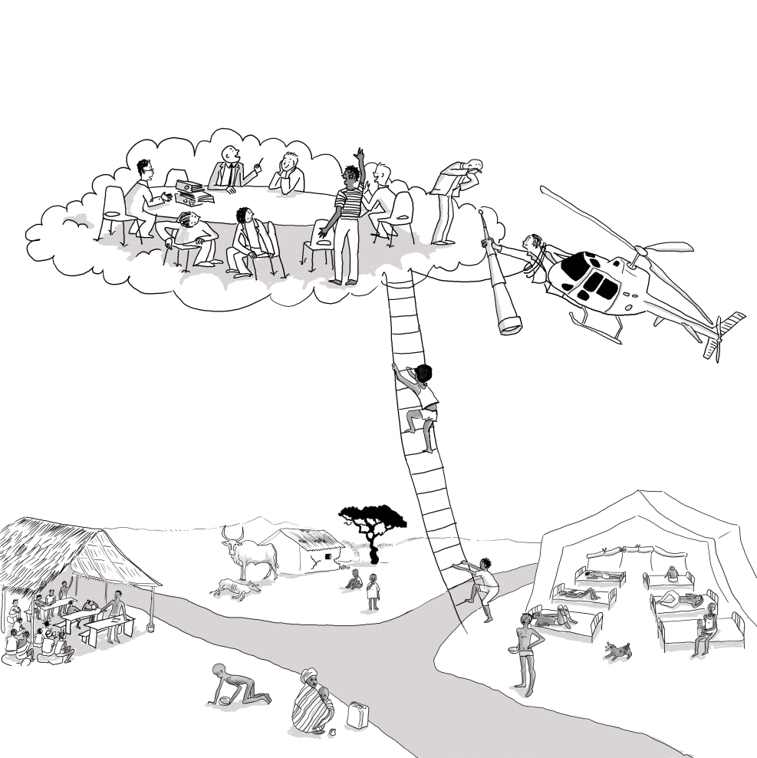
The Program Implementation Units became a "Facilitation Unit ”
A HELICOPTER THAT
Assists the LG up this learning curve through tailor made and on the job training;
Provide Local evidence to inform Policy Dialogue
Feed policy making at national level by providing realistic analysis of what works/doesn’t at grassroots level (PEA) on a day to day basis;
.
Human relationships are at the core of implementation
Facilitating, advising, connecting people, building trust…..:
What really counts is the human skills of the facilitation team (rather than the technical ones)
This is an ART, not just a job!
Notes:
9

Slide 10
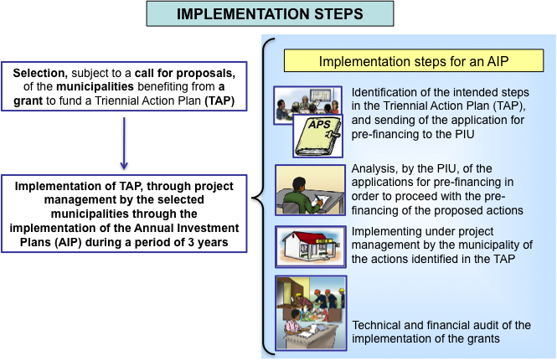
TOOLS PROVIDED AT MADAGASCAR (2)
Rules of the game to translate money into service delivery
.
Notes:
10

Slide 11
TOOLS PROVIDED AT MADAGASCAR (2)
Tailored operational Guidelines
To integrate decentralized level into the design & implementation of sectors (Health, education, public markets, rural roads…) including:
Steps to translate money into service delivery;
Clarification of "Who" (citizens, LG, line ministries at local level) has to do “what” according to decentralisation process in each of these steps;
“Cost grid" providing simple methodology to estimate cost of basic infrastructure foreseen according to key factors (material, labor, accesibilty) in order to support realistic planning and budgeting at local level;
To support line Ministries & Districts in their new role as assistants and supervisors of the elected governments
.
Specific guidelines on Procurement systems tailored to the specificities of LG in rural areas
Notes:
11

Slide 12
TOOLS PROVIDED AT MADAGASCAR (2)
THE “HOW” MATTERS
Endogenous and bottom-up elaboration of tools & methods !: Not by EXTERNAL consultants!
Communicate, communicate, communicate!!!!!
Tailor-made design of tools involving in an interactive manner all stakeholders at local and national level;
Continuous testing & fine-tuning from practice (5 years!);
Guidance using as much as possible national procedures, systems and institutions –even if they are weak, ambiguous and unclear: Ambiguity = Windows of opportunity for creative interpretation….
Using radio (malagasy) for transparency of budget allocation and use, to promote debates at local level, and explain basic concepts about decentralization through fiction stories using comedians (regular radio programs)
Holding public debates on the results of annual audits, involving the local governments executive, Districts and citizens
Using « movies » to feed PD at national level with local evidence;
Organising public debates LG/sector ministries around topics showed in movies
.
Notes:
12

Slide 13
Not shorcuts, not models
The human factor is crucial!!
Attitudinal change can be achieved if given time
It takes vision and willingness to experiment. It takes courage to learn from mistakes and courage to implement necessary and/or controversial changes as implementation moves ahead
Trade-off between exploration and experimentation on one hand and consolidation and predictability on the other.
The transition from an experimental mode to an institutional is a complex issue
What did work once does not necessarily work today
.
We need "artist" with special talents...rather than "technicians"
Notes:
13

Slide 14
Not shorcuts, not models
The human factor is crucial!!
http://labdec-mada.org/
Methods and tools:
http://labdec-mada.org/index.php?option=com_k2&view=itemlist&layout=category&task=category&id=42&Itemid=404
.
Notes:
14

Slide 15
Facilitation Unit: One example

Slide 16
Thank you!!

