Slide 1
TALD SEMINAR
Dar es Salaam, 4-6 April 2016
Overall summary of the seminar

Slide 2

The ‘fil rouge’ of the seminar
Part 2:
Part 1:
RED THREAD:
How to support the local-territorial development and the developmental role of LAs in partner countries
Clarifying the notion of “territorial approach to local development” in the context of Asian countries
TALD is about partnership!
The « multi-actors » perspective in promoting TD
Promoting TD through different instruments and aide modalities (BS, project approach) in a creative manner
Part 3:
Notes:
Séminaire destinnée aux personels des délégations
Mais ouvert à personnes provenant d’autres horizons

Slide 3
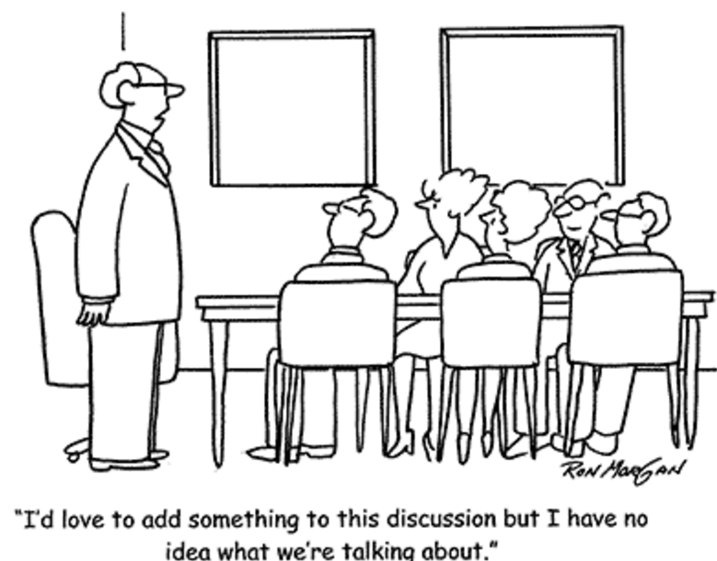

Slide 4
MESSAGE 1
NEW TERRITORIAL DYNAMICS
AND OPPORTUNITIES
TO CREATE ADDITIONAL WEALTH AND JOBS, PROVIDE BETTER SERVICES
REDUCE INEQUALITIES
ETC, ETC, ETC…

Slide 5
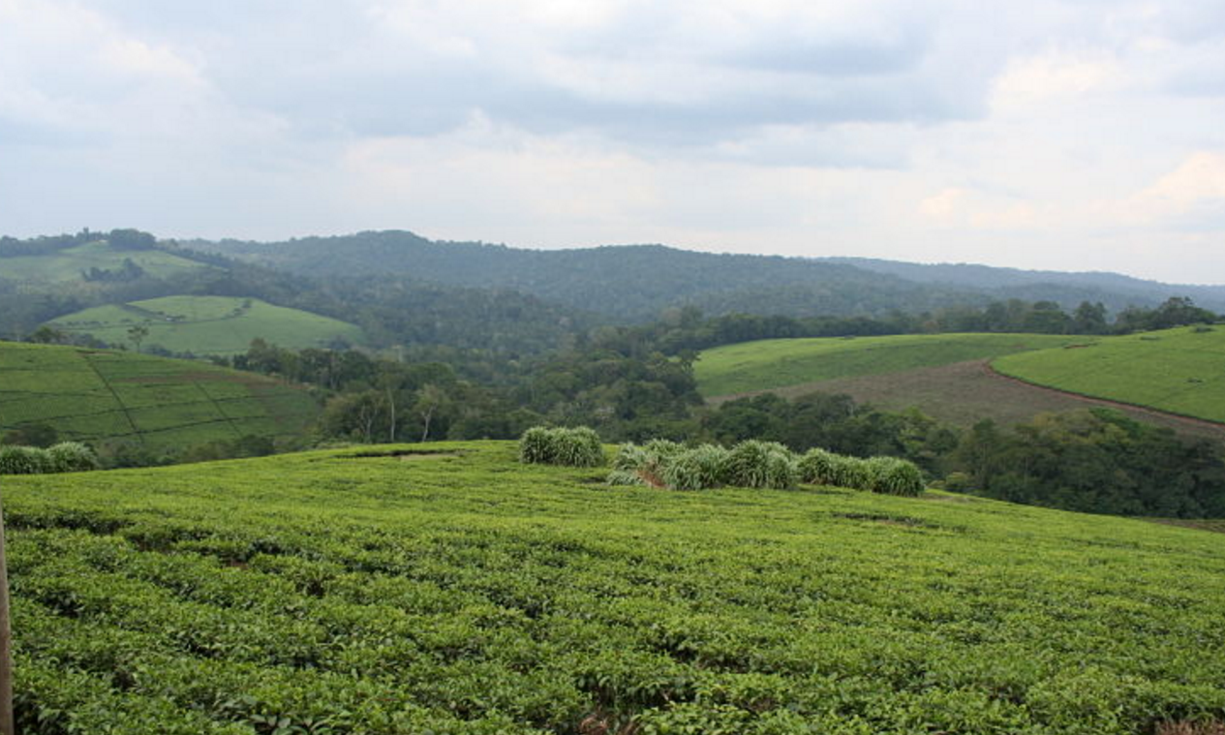
Fertile ground
Inequalities
Good practices
SDGs
Citizen demands
Territories are moving
Localisation development

Slide 6

MESSAGE 2
NOT ALL “TERRITORIAL DEVELOPMENT”
DESERVES THIS NAME …

Slide 7
THINGS “NOT TO DO”
TOP-DOWN / TECHNOCRATIC APPROACHES (e.g. “territorialisation” national policies)
SINGLE SECTOR APPROACHES
SUBORDINATING LOCAL ACTORS (in particular local authorities and citizens)
TOO THIN A KNOWLEDGE BASIS
TOO HEAVY RELIANCE ON FUNDING FROM OUTSIDE
SHORT-TERM TIME PERSPECTIVE

Slide 8
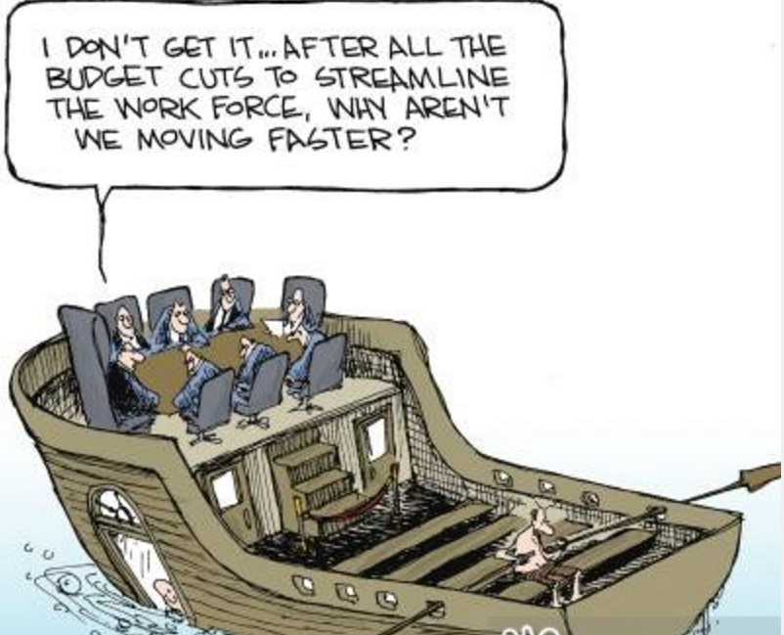

Slide 9
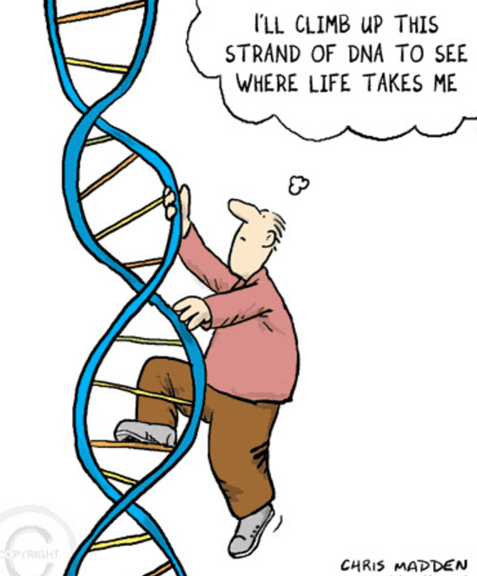
MESSAGE 3:
THE “DNA” OF
TERRITORIAL DEVELOPMENT

Slide 10
5 KEY ELEMENTS OF DNA
Territories as “active agents” not passive recipients…
Multi-actor partnerships among local actors as “drivers”
The catalyst role of LAs (to ensure link with public policy-making process)
Integrated approach
Supportive national policies

Slide 11
Local development programs
Decentralisation
reform support programs
TALD
Recently
Territorial Development

Slide 12

How to use the TALD framework?
Territorial Development
Local service delivery
Local environment management
Local economic development
Improved Local Development Management System
Comprehensive scope of local development
Improved systems of local development planning
Improved institutions & capacity for local development implementation
Enhanced & diversified instruments of local development financing
National Level Policies
Sub-National level institutions & capacity
Decentralisation policy enhancing autonomy and accountability of LA
National urban agenda supportive of LA
National rural development policy supportive of LA
Effective institutions of inter-governmental cooperation
Active citizenship & Public-Private Partnership
Local leadership & administrative capacity development

Slide 13
Territorial Development is about partnerships
People outside the public sector
Citizens helping themselves
Volunteers
People working in charities, private organisations
New assets
Making use of non-public assets (e.g., church halls, local materials, communal property)
Handing public assets over to communities, charities, private groups
Communities
People
Business
CSO
Local government
Funding
Assets
New sources of funding
Private philanthropy
Corporate social responsibility
Community contributions
Local governments have the :
Mandate for the economic and social welfare of the local community,
Legitimacy for coordination and integration of different actors;
Normative capacity;
Responsive to local demands
State resources
Non-state resources
Adapted from the Institute for Government. “The Big Society: A framework for policymakers”. April 2011. UK

Slide 14
Message 4:
Need for politically smart
locally led development processes

Slide 15
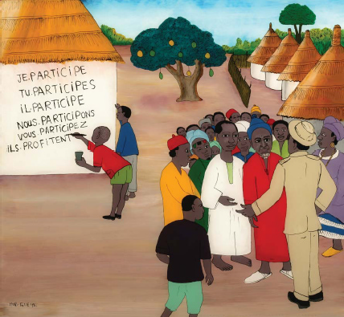
Local authorities
and local democracy
Notes:
Who’s waiting?
Local People
Waiting for Gadot?

Slide 16

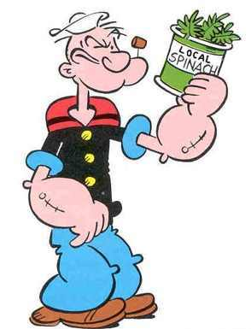

Slide 17


Slide 18

Need to for “political economy analysis”
LOOKING BEHIND THE FAÇADE …

Slide 19

Make the iceberg visible

Slide 20

The visible word: national strategies, action plans, formal institutional structures, etc.
Political processes: contestation and negotiation of power, wealth and goods
Why do reforms fail to take root?
Need for a systemic approach with a specific focus on:
Economic and financial processes, and their link with politics
Formal and informal institutions
Relations, incentives and interests of actors « under the surface »

Slide 21
Example :
The Integrated Decentralisation Diagnostic Framework (IDDF)
FOR USE BY ALL STAKEHOLDERS

Slide 22

A better understanding of the (limited) scope and potential triggers for positive changes

Slide 23

ONCE REFORM ARE LAUNCHED…
YOU OPEN THE BOX OF PANDORA…
UNINTENDED CONSEQUENCES

Slide 24
MESSAGE 4
“ IT ALL DEPENDS WHAT YOU WANT TO DO…”
SO FOCUS FIRST ON
“RESULTS” YOU WANT TO ACHIEVE

Slide 25


  Avoid addressing support primary from the aid modality perspective
The choice of the aid modality is part of the "solution". What is the problem?
  When you only have a hammer, everything looks like a nail ….
Free your mind from the aid modality!!!
Notes:
25
Instead of Conditionality on Allocation of Funds in a FA, such an agreement could be done at inter-ministerial level or between Central gov and SN gov. (See BS to DTI in SA)
Policy dialogue and performance indicators must cover whole sector or gov policy on poverty alleviation (GBS) NOT ONLY OUR OR DONOR ASSISTANCE

Slide 26
New generation of BS programs
Policy outcomes
Improve the policy, constitutional, legal and regulatory framework within which autonomous and accountable local authorities may be able to operate.
sector development outcomes,
Support better resourced and more capable local authorities,
including empowering Local Authorities to both (i) “localize” and implement national sector programs and (ii) deliver their own local development policies.
Institutional outcomes
Improve the institutions of sub-national governance and public administration, to fulfil the potential development role of Local Authorities, under agreed constitutional and legal frameworks.
FINANCIAL AND NON FINANCIAL (TECHNICAL ASISTANCE, POLICY DIALOGUE, CAPACITY BUILDING)
BUDGET SUPPORT + COMPLEMENTARY MEASURES

Slide 27
TALD is about partnership CSO-LA

Slide 28
MESSAGE 5
NO BUSINESS AS USUAL APPROACHES TO IMPLEMENTATION of a “TALD”
“Insanity: doing the same things over and over again and expecting different results”
(A. Einstein)

Slide 29

Notes:
29

Slide 30
Re-thinking decentralisation and the developmental role of local authorities
FROM
TO
  A public sector reform process intended to transfer responsibilities, resources and authority from higher to lower levels of government
  (stressing the administrative/ fiscal dimensions of the reforms)
  A political process of empowerment of people over the public sector through the empowerment of their local governments
  (stressing the political/social dimensions of the reforms)

Slide 31


Slide 32

Extending our perspective on reality…
Notes:
Daprès les engagements internationaux, les agences externes ont un rôle minimal et ne doivent pas interférer. A Accra, principe de “country ownership”, a Busan “democratic ownership”. Mais les PTF ne sont pas juste des acteurs qui donnent un appui financier et technique; ils ne sont pas neutres. Ils ont le potentiel d’être des agents de changement.

Slide 33


Slide 34


Slide 35
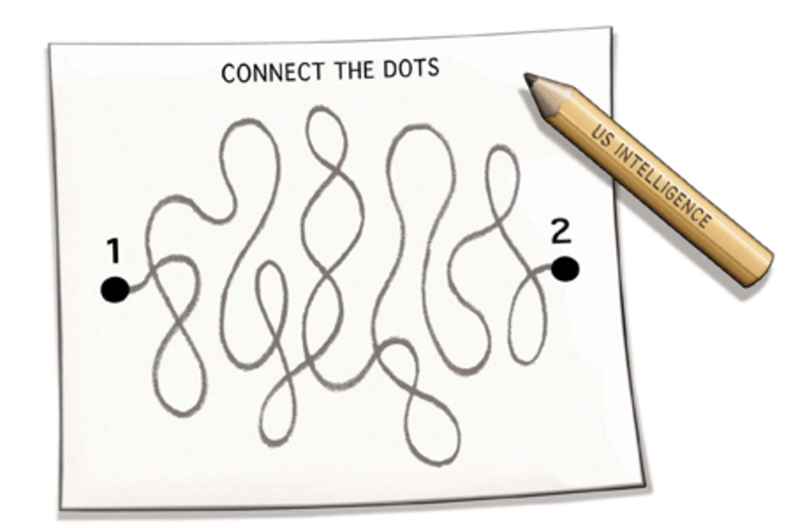

Slide 36


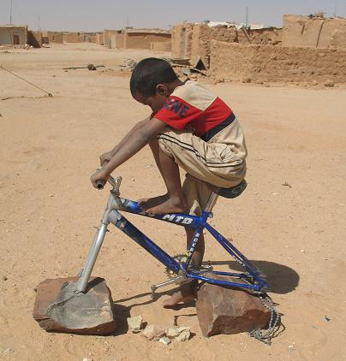
Policies
Institutions

Slide 37


Slide 38
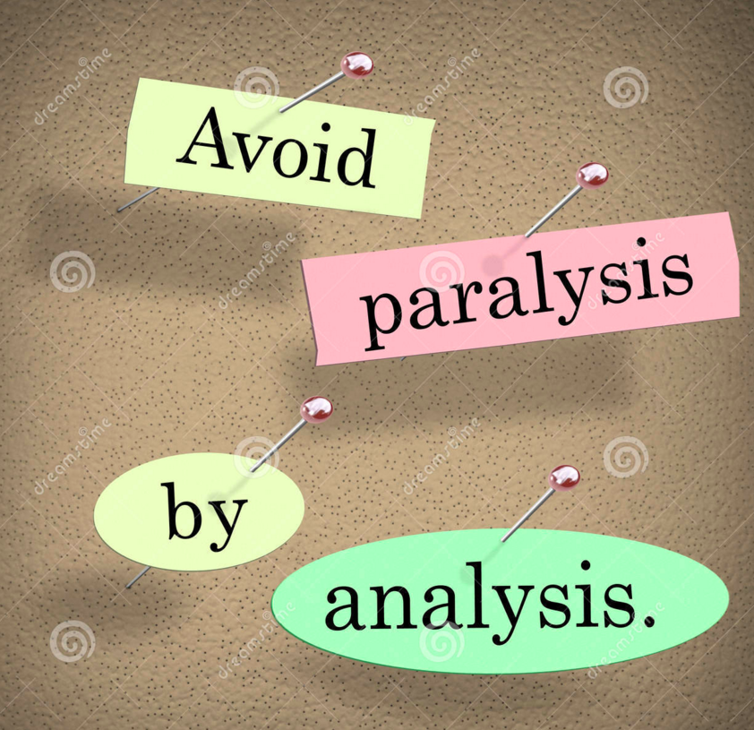

Slide 39

Assessing the risks

Slide 40


Slide 41


