Slide 1
European Union Rural Development Programme
Angus Graham & Omotayo Alabi
2015/362-919
SORUDEV, ZEAT-BEAD and FSTP
Juba,
10 September 2015
South Sudan
Outline
Background
Situation
Structure
Wau resolution
Key elements
Presented to the Donor working group on agriculture and livelihoods

Slide 2
Background
1.
War of Independence.
Comprehensive Peace Agreement.
Referendum and emergence of a New State in 2012.
Facilitated support to new government.
Establishment of new institutions and policies.
Infrastructure development and Livelihoods support.
New crisis in December 2013.

Slide 3
2.
Situation: Three Zones
Equatoria (Green - stable)
Investment led
Greater Bahr el Ghazal (Green - less stable)
Transition
Greater Upper Nile (Emergency – critical)
Life saving support
CONTIGUOUS AND INTEGRATED
AGENDA
Institutional development
Sector transformation
Economic growth
Food and nutrition security
Relief and recovery

Slide 4
3.
Programme Structure
THREE COMPONENTS:
1. Zonal Effort for Agricultural Transformation
2. South Sudan Rural Development
3. Food Security Thematic Programme
ZEAT-BEAD
SORUDEV
FSTP

Slide 5
EU Rural Development Actions
Components | Implementation Arrangements | EU Contribution (EUR)
Food Security Policy, Planning, Programming and Decision Making in Southern Sudan Improved (AFIS) | Contribution Agreement FAO | 7,000,000
Increased smallholders’ agricultural production in selected project areas | Service contracts + Grant Agreements | 12,600,000
Rural Feeder road network and state roads maintenance capacity increased in selected states | Contribution agreement (WFP) | 20,300,000
Support provided to formulation of national policies and standards and enhanced coordination capacities of central and State Governments | Service Contract | 7,000,000
 | Contribution Agreement (FAO) | 1,000,000
Supply of agricultural and livestock inputs and services expanded on a sustainable basis | Contribution Agreement (FAO) | 12,500,000
 | Delegation Agreement (GIZ) | 4,000,000
Enhanced local value addition and strengthened value chains | Contribution Agreement (UNIDO) | 2,000,000
 | Grant Agreement (4 NGOs) | 2,000,000
Improved basic technical, literacy and numeracy skills among small holder, families and community members in agro pastoralist settings | Contribution Agreement (FAO) | 5,000,000
Increased in trades and marketing volume | Contribution Agreement (UNOPS) | 38,000,000
Notes:
.

Slide 6
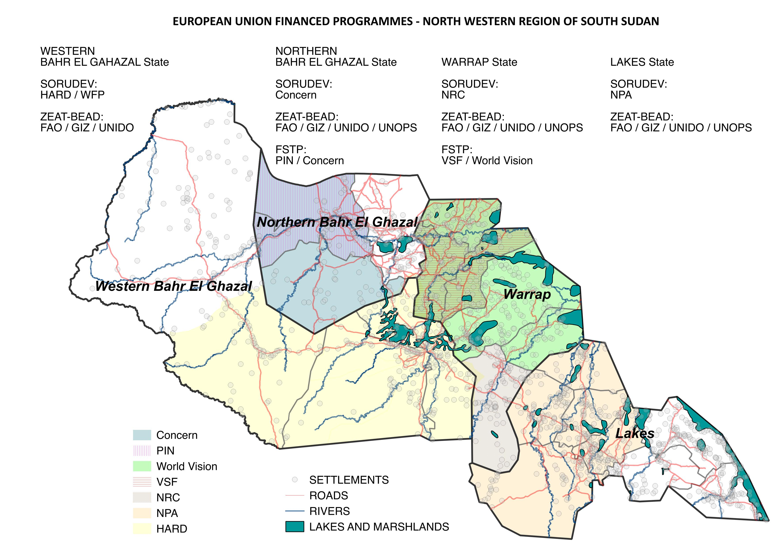
EU Partners in Four States

Slide 7
4.
Wau Resolution (2014)
Among Implementing Partners
Quarterly review Meeting
Issue: Beneficiary dependency
Area based programming coherence
Targeted actions and delivery options
Notes:
Over 30 years of free inputs distribution and interventions by the government have disrupted traditional exchange and trade arrangements, consquently sustainable supply systems need attention for rural development to take place.

Slide 8
5.
Strategy
Focuses is on rural communities.
Intends to increase agriculture production and marketing, and income to famers.
Objectives override all component projects.
Targets farmers with high production or potential.
Is the same in 4 States of Greater Bhar el Ghazal.
Does not have relief or LRRD actions.
Oriented to increasing self sufficiency.

Slide 9
5a.
Increasing production through:
Extension to farmers
(knowledge, skills, technology)
farmer / community contacts
providing extension kits
demonstration / observation
linkages to research / universities
FAO
Strengthen NGO ongoing extension efforts through developing and implementing a system of training, accrediting and licensing of categories of extension (ist) workers.
NGOs
Notes:
The idea is that the extension workers will return to their communities to provide certified services, including as agents of agrodealers. A framework covering the scope, components, cost, progress and performance monitoring, linkages to institutions, options for sustainability and contributions from communities need to be elaborated.

Slide 10
5b.
Increasing production through:
Improving the availability and accessibility of inputs
(suppliers / agro-dealers and their agents)
suitability
variety
availability
terms of trade
quality and specialization
FAO
Support the creation of an expanded network of vetted agro-dealers linked to accredited suppliers of inputs that meet area specific needs of farmers (specification and price) to increase production and marketing.

Slide 11
5c.
Increasing production through:
Stimulating market demand for products
(selected value chain activities)
cereals and grains
groundnuts
livestock
hides and skins
GIZ UNIDO
Raise quality / value of product at source, reduce losses and wastage, and increase farm earnings.
FAO
Support the creation of a rural financing network
that is farmer focused, locally adapted.

Slide 12
6c.
Increasing marketing through:
Reducing cost of access to markets
(key infrastructures)
feeder roads
warehouses
processing facilities
information
UNOPS
WFP
Improve feeder roads that pass through production areas so as to link them to markets close to intersections with trunk roads.

Slide 13
Conclusion
5e.
International community must start to work on sustainability and not only limited humanitarian responses.
Pending a peace agreement, a new political framework needs reactivation with building of institutional resilience.
A supporting environment conducive to collaboration and coordination among multiple agencies is needed.
Forums need to be designed and developed, and information and lessons learned shared.
Coverage and breath of information systems needs to be expanded and records of results improved.
-
-
Thematic evaluation areas?
What questions should we be asking?

