Slide 1



Slide 2



 | RAIN INTERVENTION LOGIC
Overall objectives | To strengthen resilience, food and nutrition security of 6,040 vulnerable, hosting and returnee households (incl. 32,070 women, youth and children) living in conflict affected areas of Northern Bahr el Ghazal State, South Sudan
Specific objective | To improve food production, utilization and marketing capacity of poor, livestock and crop-producing, households achieved through more effective performance of agricultural service and input providers.
Expected results | R1: State and County officials, CAHWs, agricultural extension workers and private sellers have sufficient capacity to effectively respond to the needs of at least 5,600 (agro)pastoral households (incl. 29,700 women, youth & children) R2: 1,000 poor households have the means required for improving the resilience, productivity, diversity, processing and marketing of their crop and livestock-based food production, especially during the lean period R3: 1,000 households with women of reproductive age and children under 2 have improved their hygiene and nutritional practices and reduced the risk of nutrient malabsorption R4: At least 500 poorest households have prevented a deterioration of their food intake and created community assets for strengthening longer-term food security

Slide 3
RAIN Logical Framework - Physical progress against key indicators (1/3)
Ref no. | Objective / Result description | Indicators | Planned target for the reporting period | Achivements/progress/issues | Action required
OO | To strengthen resilience, food and nutrition security of 6,040 vulnerable, hosting and returnee households (incl. 32,070 women, youth and children) living in conflict affected areas of Northern Bahr el Ghazal State, South Sudan | 40% reduction in the proportion of assisted households in the highest Coping Strategy Index score category | No target for this reporting period due to heavy data seasonality. | Data collection possible during end line (November 2016)
SO1 | To improve food production, utilization and marketing capacity of poor, livestock and crop-producing, households achieved through more effective performance of agricultural service and input providers. | 70% of households participating in Farmer Field Schools which started growing at least two or more promoted nutrient-rich crops. | At least 18 out of 25 FFS groups (=450 out of 625 HHs) grow two or more project-promoted crops | All 25 FFS grow at least two promoted crops (on average 6-7 types) Pest affecting most crops Dependency on seeds provided by PIN | Indicator completed. Continue with smaller-scale summer cycle to incorporate IPM and encourage linkages between farmers and agro dealers
SO2 |  | Average increase in the individual dietary diversity of women and children under 5 by score 1 (baseline score 3.2) | Interim monitoring of 200HH sample - target 4.2 | March 2016 data (200HH sample): women 3.9, children 4.4 Seasonality factor substantial. Quality of data collection mediocre. | Need for better training in field data collection Definitive result will be available in December 2016 following the end line study (same season as baseline

Slide 4
RAIN Logical Framework - Physical progress against key indicators (2/3)
Ref no. | Objective / Result description | Indicators | Planned target for the reporting period | Achivements/progress/issues | Action required
R1.1 | R1: State and County officials, CAHWs, agricultural extension workers and private sellers have sufficient capacity to effectively respond to the needs of at least 5,600 (agro)pastoral households (incl. 29,700 women, youth & children) | 70% of trained officials, extension workers and suppliers which passed conducted practical post-test | At least 70% of the 70 trained EWs and CAHWs must pass the post-test after 3-day Refresher Training in December 2015 | CAHWs: After first round, 100% passed, with average score of 71.6% in Aweil North and 73.0% in Aweil West. After second round, 87.5% passed, with an average score of 63%. EWs: After first round, 100% passed, with an average score of 81.4% in Aweil West and of 91.2% in Aweil North. After second round, 100% passed with an average score of 68%. | Indicator completed.
R1.2 |  | Increase of 30% in the average number of clients served by the extension workers | At December 2015 Refresher Training, PIN-supported Ews/CAHWs will report at least 30% increase in clients served compared to December 2014 data. | The average number of clients served by CAHWs and EWs increased by 270%. Average number of clients served over a 3-month period was 50.5 compared to 18.2 in December 2014 Data for 7 EW/CAHW had to be erased for inconsistency | Indicator completed.
R2.1 | R2: 1,000 poor households have the means required for improving the resilience, productivity, diversity, processing and marketing of their crop and livestock-based food production, especially during the lean period | 75% of households which know where to locally purchase seeds and veterinary drugs: 75% | Sample 150 beneficiaries to follow up on the Village Promotion Campaign carried out by PIN-supported agro-/vet-dealers. | 100% out of the 150 respondents asked said they do know where to buy seeds and vet drugs. They were also able to identify name of the shopkeeper in their location. | Will survey again after distribution of bicycles in April with a representative sample of 238.
R2.2 |  | 75% of trained households which passed practical post-test | No target as the gardening season finishes in April. | Post-test prepared and data currently being collected in the field. Will share results at the next QRM | Collect data reflecting two cycles over which PIN supported FFS groups

Slide 5
RAIN Logical Framework - Physical progress against key indicators (3/3)
Ref no. | Objective / Result description | Indicators | Planned target for the reporting period | Achivements/progress/issues | Action required
R3.1 | 1,000 households with women of reproductive age and children under 2 have improved their hygiene and nutritional practices and reduced the risk of nutrient malabsorption | 60% of caretakers reporting to follow at least 3 out of 5 promoted key nutrition practices: | Collect data for 200 HHs in March 2016 to get see current status. Target 60%. | 78.5% reported to follow at least 3 out of 5 nutritional practices. Seasonality factor big. Data collectors sometimes present questionable data | Final data need to be confirmed by endline. . Data collectors need more training.
R3.2 |  | Child caregivers and food preparers with appropriate hand washing behaviour has increased by 20% | 20% increase in appropriate hand-washing behavior on a sample of 278 HHs. | Data collection postponed until May/June due to delays with setting up of tippy-taps (simple hand-washing stations) | Finish with monitoring of tippy taps completed by project beneficiaries Sample 278 HHs for data related to Indicator 3.2
R4.1 | At least 500 poorest households have prevented a deterioration of their food intake and created community assets for strengthening longer-term food security | 90% of households which used 70% or more of the earned cash for purchasing essential food items | No target. Second cycle of CfA to start in May 2016. | Data for 2015: 90.14% | Indicator completed. Comparison data will be available in August 2016.

Slide 6
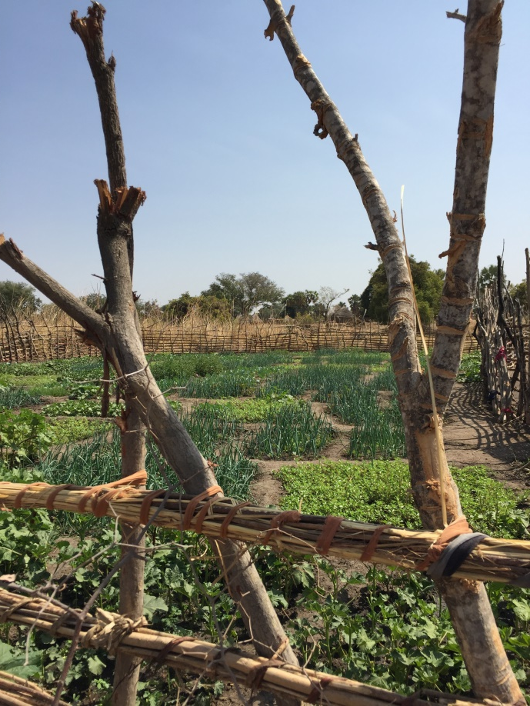
Last Quarter’s Achievements
Farmer Field Schools (R2)
2nd cycle soon to be completed
Production monitoring in full swing
1000 HHs participated in the 2nd cycle
Farmer Field School in Mabior, Aweil West

Slide 10
Last Quarter’s Achievements
Farmer Field Schools (R2 - continued)
  5-day training on Integrated Pest Management for 10 PIN Extension Officers completed in early April 2016, covering:
    Introduction to IPM techniques and phytosanitary protection of PIN-supported vegetables
    Identification of pests and diseases affecting the crops
    Recommended phytosanitary techniques
  5-day training on VSLA led by CWW
    5 PIN Extension Workers participated

Slide 11
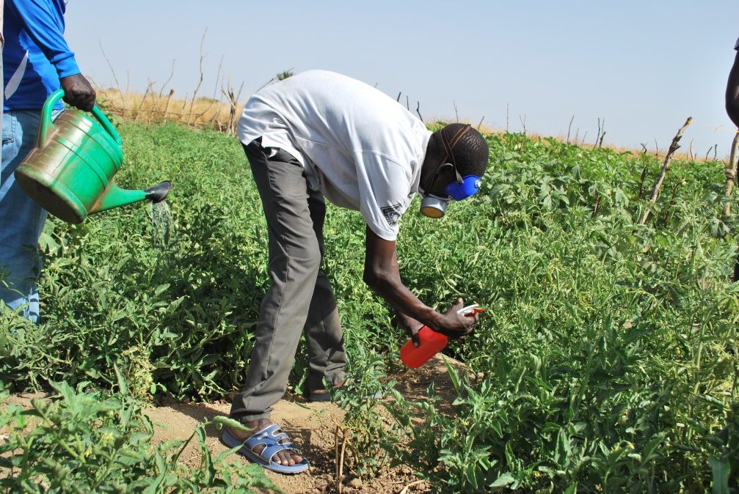
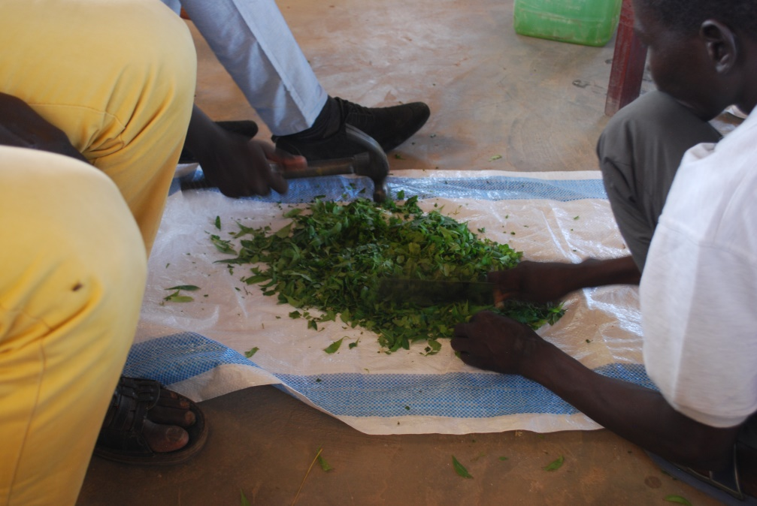
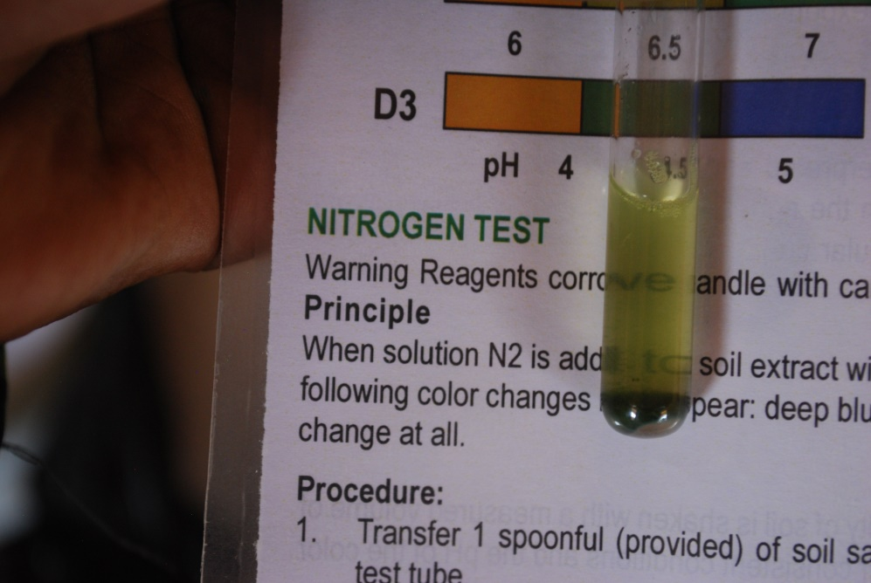
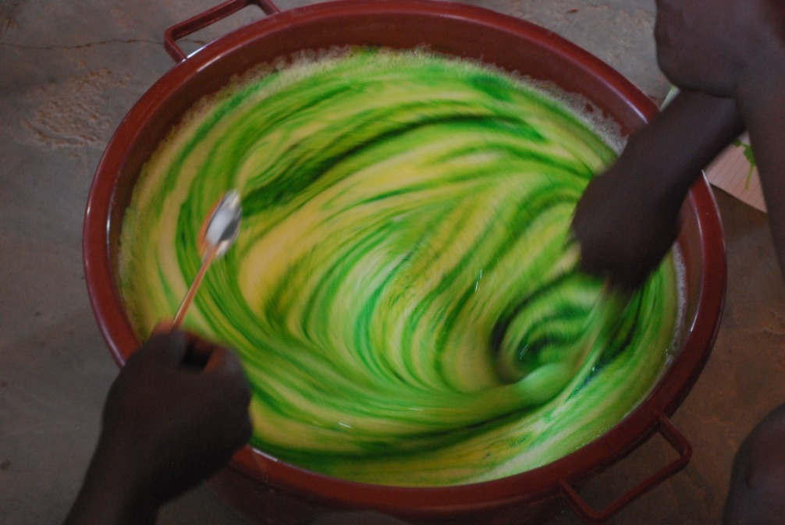

Slide 12
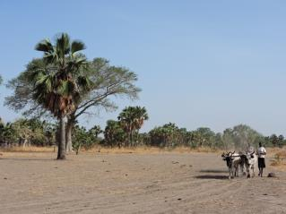
Achievements of last quarter
Pastoralist Field Schools (R2)
  11 days of Refresher Trainings – 600 Pastoralist HHs participating
Support to Animal Traction (R2)
  65 new beneficiaries trained over 21 days in how to handle ox ploughs
  New ox-ploughs distribution in cost-recovery scheme currently ongoing
  The total amount of beneficiaries supported in animal traction is now 200 HHs
Animal traction training in Mapertit, Aweil West

Slide 13
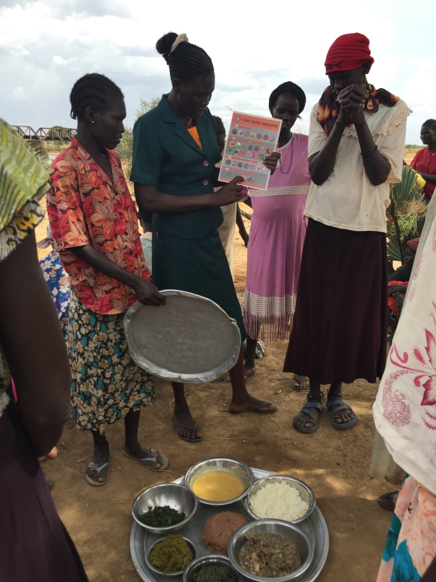
Last Quarter’s Achievements
Infant and Young Child Feeding (R3)
  1600 HHs have received training based on IYCF methodology:
    Session 1: What are good mothers and fathers doing for keeping their babies healthy? Why is nutrition important for you and your baby?
    Session 2: Healthy food for healthy mothers (mothers’ nutrition during pregnancy and lactation)
    Session 3: Optimum breastfeeding for girls and boys
    Session 4: Introducing complementary foods to your baby
    Session 5: Food hygiene
    Session 6: Cooking demonstration

Slide 14
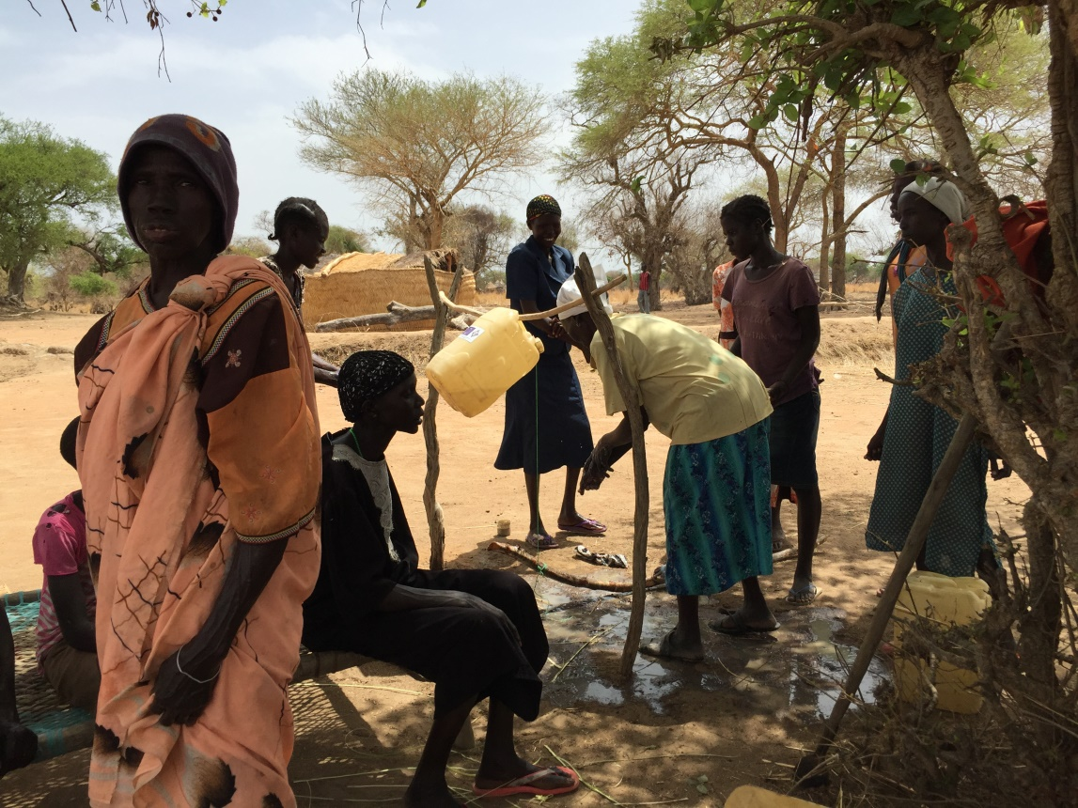
Last Quarter’s Achievements
Campaign on Safe Hygienic Practices (R3)
  Additional 600 HHs have received training in diarrhea treatment and prevention.
  The total number of HHs supported is now 1800.
Safe hygienic practices session in Cholchintok, Aweil West

Slide 15
Last Quarter’s Achievements
Cash for Assets (R4)
  Verified assets in 16 locations across Aweil West & Aweil North
  Received official authorizing letters from all payams
  All 500 beneficiary HHs verified (increase by 100 compared to 2015)
  Accompanying tools for all 500HHs procured and stored
  Works to start in May 2016

Slide 16
Work plan (remaining targets)
Market Support (R1.4)
  Identify interested CAHWs and EWs and link them with PIN-supported agro-/vet-dealers in order to foster a network of “sales agents”
Farmer Field Schools (R2.1)
  Wet-season cycle to be supported from June until October 2016
  Target: In 09/2016, all 25 FFS continue cultivating at least 2 promoted crops
Animal Traction (R2.2)
  Distribution of the remainder of ox-ploughs and monitoring of land opened
  Target: 200 HHs to receive ox-/donkey-ploughs by end of May 2016
Nutrition campaign (R3.1)
  Continue monitoring dietary diversity practices
  Target: By November 2016, at least 60% of caretakers follow 3 out of 5 key nutrition practices

Slide 17
Work plan (remaining targets)
Campaign on Safe Hygiene Practices (R3.2)
  Continue monitoring people’s use of tippy-taps and hand-washing behavior
  Target: By November 2016, appropriate hand-washing behavior will increase from 43.3% to 63.3%.
Cash for Assets (R4.1)
  Construction of 15 community assets, allowing 500 HHs to earn SSP 1200 over 30 days of work.
  Target: By July 2016, 90% of HHs will earn 70% or more of their income to buy food

Slide 18
Cooperation with other IPs
3-day Training on Infant and Young Child Feeding facilitated by Concern Worldwide nutrition staff
5-day Training on Village Saving and Loan Associations facilitated by CWW’s Agribusiness expert
Coordination and harmonization of Project Steering Committee meetings with CWW and WHH
Harmonization of market support approaches with CWW/WHH

Slide 19
Other IPs’ Projects & Challenges
Different perspectives on long-term development in NBeG across IPs in the area (esp. animal traction)
Lack of consultation when new projects are coming to a head
Some IPs coming to RAIN-supported villages with programs that undermine the strategies followed by RAIN (animal traction in AwN)

Slide 20
Thank you for your attention!
Contact us at: jakub.smutny@pinf.cz

