Slide 1

A Presentation to:
06th Quarterly Review Meeting
Aweil Grand Hotel, Aweil
26th – 28th April 2016

Slide 2


Food Security Thematic Programme (FSTP)

Slide 3


Project Fact Sheet:
Project Title: Improved food security, livelihoods and resilience for vulnerable target populations in Northern Bahr el Ghazal, South Sudan
Project Period: January 2015 – December 2016
Total Budget: €1,044,444
Implementing partners: Concern Worldwide (CWW); Langich United Youth Development Association (LUYDA);
Welthungerhilfe (WHH)
Coverage: Aweil Centre County: 4 Payams – 12 Bomas;
Aweil North County: 3 Payams – 09 Bomas; Aweil West County: 2 Payams – 06 Bomas;
A Presentation to 06th QRM – April 2016

Slide 4
Project Fact Sheet:
Goal: Empower returnees, IDPs and vulnerable populations to improve food security, enhance livelihoods and increase their resilience to disasters.
Specific objective: To improve the food, nutrition, and income security and reduce vulnerability to malnutrition, shocks and hazards of returnees, IDPs and vulnerable host populations in Aweil Centre, Aweil North and Aweil west, NBeG
Target: 1,550 households (HHs) - 10,850 individuals
A Presentation to 06th QRM – April 2016

Slide 5
Food security and livelihoods context:
Poorly supplied markets with essential commodities.
General economic crisis (inflation) restricting households demand.
Area prone to natural disasters
  Floods,
  Prolonged dry spells and
  Wild bush fires destroyed pastures mainly for livestock).
Low crop diversity coupled with poor yields, prevalence of subsistence agriculture, low technology adoption.
Low household incomes (lack of employment opportunities).
Low effectiveness of government extension services.
Inaccessibility of certain locations due to lack of roads.
A Presentation to 06th QRM – April 2016

Slide 6

Progress made last quarter:
Expected Results 1: Enhanced & diversified food production and utilisation among returnees, IDPs and vulnerable host populations through improvements in farming (and food-processing) techniques, access to agricultural and veterinary services and knowledge of nutrition
Achievements:
Average yields (sun dried) of Sorghum, Groundnuts, Sesame
Percentage of targeted Households with an agricultural surplus to trade.
2-1.5 meal frequency: % of targeted group consuming 2 or more meals a day.
A Presentation to 06th QRM – April 2016

Slide 7


Progress made last quarter:
Expected Result 2: Improved household income for returnees, IDPs & vulnerable host populations in Aweil West, Aweil North and Aweil Centre Counties of NBeG States through income generation and improved market access
Achievements:
Average yearly income of targeted households
60 percent of target households engaged in Income Generating Activities mainly dry season vegetable cultivation & VSLA.
11VSLA groups formed & each group made up of 25 members.
  04 groups received VSLA kits & started contribution in March and so far saved SSP. 625
A Presentation to 06th QRM – April 2016

Slide 8

Progress made last quarter:
  Expected Results 3: Reduced vulnerability of returnees, IDPs, poor households & their communities to shocks and hazards
  Achievements:
  50% of community disaster risk reduction plans fully implemented.
  40% of beneficiaries will be engaged on construction of community access feeder road.
  60% of HHs have chosen to work on floods protection dykes once the rain starts.
    Selection done by key stakeholders to identify the potential assets that will benefits the entire community through cash for work or vouchers for work.
  85% of beneficiary HHs used & benefited from the infrastructure constructed using CFW (e.g. dykes and access feeder road).
    Focus group discussions & community conversions meetings held in the 27 Bomas
A Presentation to 06th QRM – April 2016

Slide 9

Progress made last quarter:
1. Support for Infant & young child feeding (IYCF) programme
27 Lead mothers have been selected in all Boma locations
6 mother to mother support groups formed with 10 – 15 members each
Criteria for selection of Lead Mother
Is the mother in active reproductive age, has knowledge & skills in breastfeeding of infants,
Can take care of child from 6 to 24 months & able to seek antenatal advice at health facility.
Has distinguished characters to provide quality leadership in assisting mothers & guiding them in decision making for better health & nutrition;
Early adopter in behaviour change aspects & accepting new ideas & approaches from the trainers and free to share her knowledge accordingly;
A resident of that Boma location & able to speak local dialect of targeted beneficiaries.
Able to read & write to enable her understand modules of training &facilitate communication and conduct anthropometric measurement for under five years children in the community;
Should be healthy and able to convince the rest of lactating and pregnant mothers;
Willingness to move from house to house to disseminate hygiene & health messages;
A Presentation to 06th QRM – April 2016

Slide 10
Progress made last quarter:
Criteria for selection of Lead Mother continued…
Should be energetic young mother at age of 30-35 years old;
Should be hard working to ensure adoption & promotion of improve food & nutrition security messages;
Able to mobilise both men & women to attend training sessions on integrated food & nutrition security, hygiene and health education;
Should be able to form mother to mother support group for both lactating and pregnant women in the community;
Should be able to participate in vaccination & immunization campaigns for children, women and girls in the community;
Willing to implement all requires conditions of being a lead mother by constructing latrine, rubbish pit, cloth hanger, hand washing container and utensil tray.
Be able to establish back yard vegetable garden for demonstration to mother to mother support group members;
Should be knowledgeable in conducting cooking demonstration and food processing aspects;
A Presentation to 06th QRM – April 2016

Slide 11

Progress made last quarter:
Role and Responsibility of Lead Mother in the Community
She facilitates community mobilization & outreach for vaccination and immunization campaigns;
Lead Mother should attend all training sessions designs by Concern Worldwide;
To facilitate the formation & training of M to M support group in the community;
Conduct hygiene & health training sessions to M to M support group & entire community;
To carry out anthropometric measurement for under 05 years children & ensure referrals to health facility & identify children with other complications to seek clinical attention & treatment;
Able to set up home backyard vegetable garden to act as learning point for rest of group members;
Should conduct practical cooking demonstration for mother to mother support group;
Work in collaboration with County Health department and ICR team in close supervision of health facility;
Conduct her activity plan and follows the implementation schedules;
Able to provide written report to project staff on timely & regular basis.
A Presentation to 06th QRM – April 2016

Slide 12
Progress made last quarter:
A total of 7,521 children were screened in THREE months of Jan, Feb and March 2016
MUAC < 11.5 Male – 297; Female – 382;
MUAC < 12.5 Male – 1,292; Female – 2,918;
MUAC > 12.5 Male – 1,304; Female – 1,314;
Oedema: Male - 08; Female – 06;
A Presentation to 06th QRM – April 2016

Slide 13

Progress made last quarter:
Household Dietary Diversity Score is the tool used to locally identify available items to the food groups, seasonal foods and locally available fortified foods. HDDS composed of 12 food groups.
HDDS Category | Score | % change
0-4 food groups-poor | 13 | 17
5-8 food groups-moderate FS | 46 | 61
9-12 food groups-food secure | 17 | 22
A Presentation to 06th QRM – April 2016

Slide 14
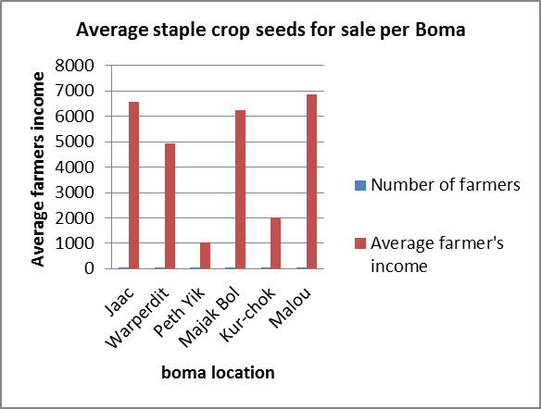
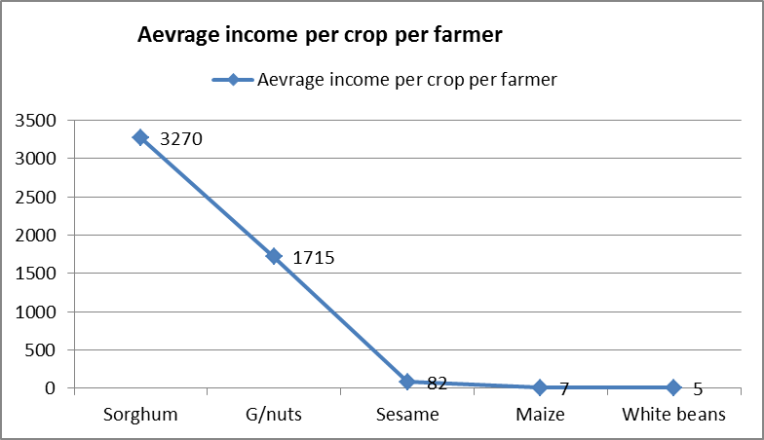

Progress made last quarter:
  Average staple crop seeds for sale per boma
Average income per crop per farmer
A Presentation to 06th QRM – April 2016

Slide 15
Synergies:
  At Programme implementation level
  Community based management of acute malnutrition (IYCF-CMAM) training conducted by CWW Health & Nutrition team to FSTP implementing partners’ staff (PIN, LUYDA & WHH);
    Will help in training of already identified lead mothers to facilitate transfer of knowledge & skills to M to M support groups and to do referrals for undernourished children in the community to health facility
    11 staffs of FSTP implementing partners trained on the VSLA methodology by SORUDEV technical team. VSLA methodology rolled out to help in formation of VSLA groups.
Promoting cooperation, coordination & collaboration
  Regular coordination meetings with LGA & stakeholders at State, County & Payam
  Participate in FSL cluster meeting with of the FSL partners.
  Work with line ministries during agriculture extension trainings & management of Nyamlell ADLC.
  Established MOUs with SMoAF & SMoARF to strengthen cooperation & coordination on Programme implementation.
  Joint monitoring & supervision of projects with line ministries technical teams
    Designed, training & monitoring of CFW/ VFW activities done by Engineer from SMoPI; handover of community asset created under CFW had been agreed by stakeholders & MoU developed to be signed by both parties. Community shall be responsible for repairs, maintenance &upgrade or more future extension.
A Presentation to 06th QRM – April 2016

Slide 16
Challenges and solutions:
Low household incomes
  lack of employment opportunities – Creation of employment opportunities
Prolonged dry season,
  Can be reduced by construction of water ponds for dry season irrigation, livestock drinking, etc.
Vegetable pest and disease infestation
  Use of bio-pesticide production from local herbs.
Promote both wet & dry season vegetable farming for returnees settled near to town centres;
  promote cash for activities or support with cash to initiate Income Generating Activities
High costs of inputs such as seeds & hand tools
  Support targeted beneficiaries crop farming due to super-inflation
A Presentation to 06th QRM – April 2016

Slide 17
Lessons learnt:
VSLAs – women do better in saving and loan repayment – Important to encourage more women to save & also those who are in groups to encourage the others not in VSLAs to form or join
Hygiene/ nutrition – involvement of husbands critical for positive campaign results
Dependency syndrome of key stakeholders do
Difficulty to transmit ownership of a project among beneficiaries
Low adoption of improved agronomic practices
A Presentation to 06th QRM – April 2016

Slide 18


Planned activities for next quarter:
Input trade fairs in May.
Look for ways of maintaining current activities and making them sustainable.
Invest in progressive farmers and support group farming - Demo plots.
Continue supporting linkages between nutrition and food security.
Promotes crop diversification and integrated food security and nutrition.
Promote synergies between partners active in the area.
Organise refresher training on improved agronomic and horticultural practices before starts of the rain for lead farmers.
Integrated CAHWs training with State department of Animal Resources & Fisheries to empower them before distribution of veterinary kits.
To continue support resilience activities of community access feeder road, floods protection dykes and water ponds construction.
A Presentation to 06th QRM – April 2016

Slide 19
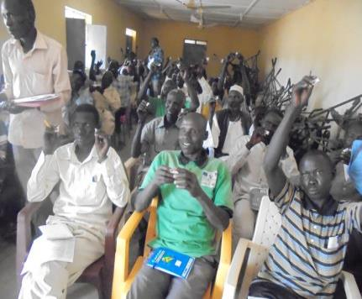
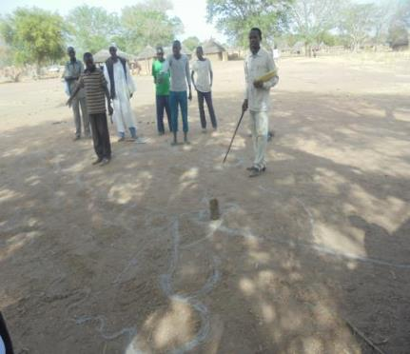


CM-DRR Plan during consultation-ACC

Slide 20
THANK YOU!
A Presentation to 06th QRM – April 2016

