Slide 1
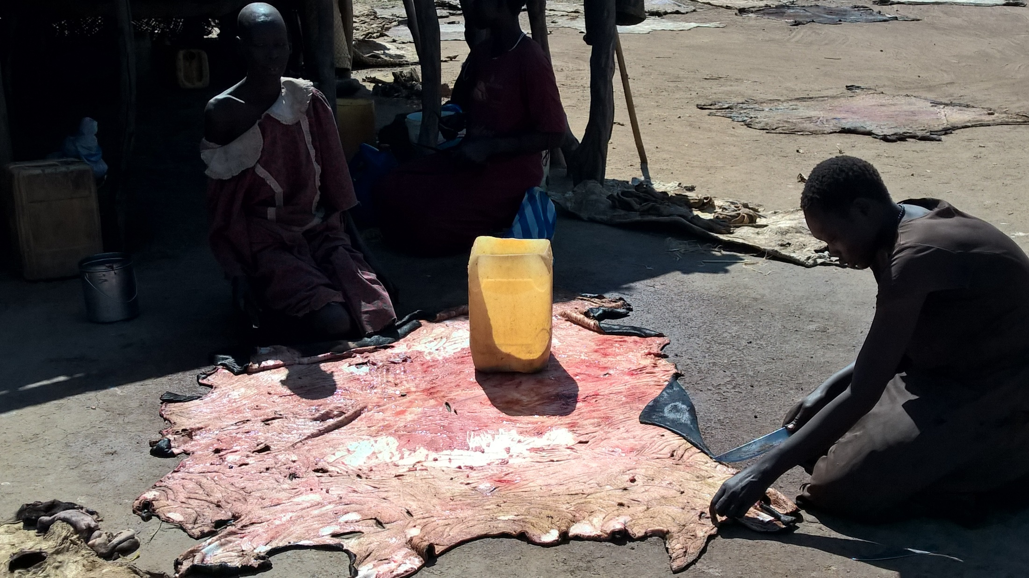


Microfinance
Relevance of Farmer Savings and Loan Association (FSLA)
In SORUDEV, FSTP and ZEAT-BEAD Programmes
By Tayo Alabi
At the 6th Quarterly Review Meeting
Aweil

Slide 2

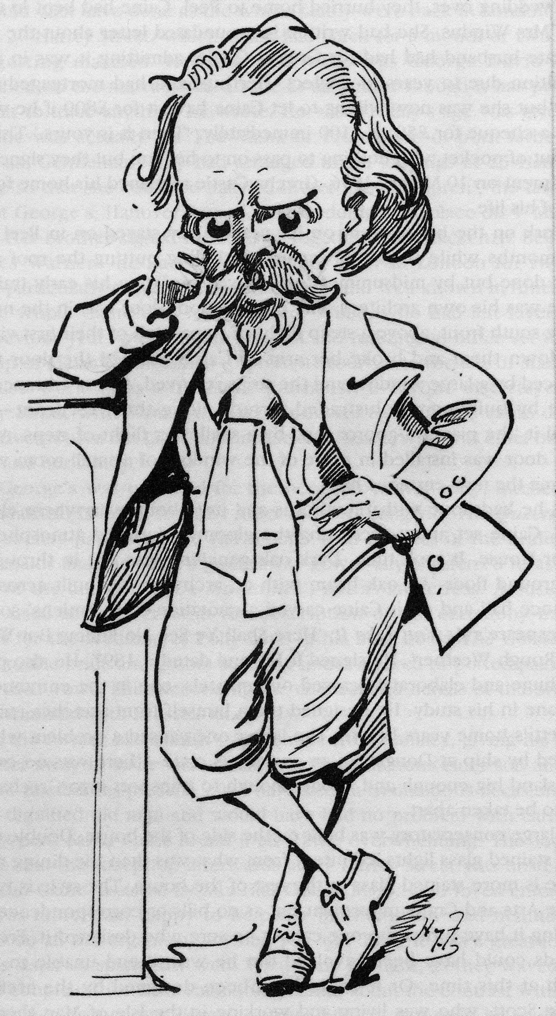

“Poor people are too poor to save”
“This is especially so for the people of South Sudan”

Slide 3

the reality in most cases is the opposite: poor people cannot afford NOT to save; they have to save to survive.
It is also a fact that poor people are much more vulnerable than wealthy people. In the event of major disasters and or major economic shocks poor people are less likely to quickly recover

Slide 4
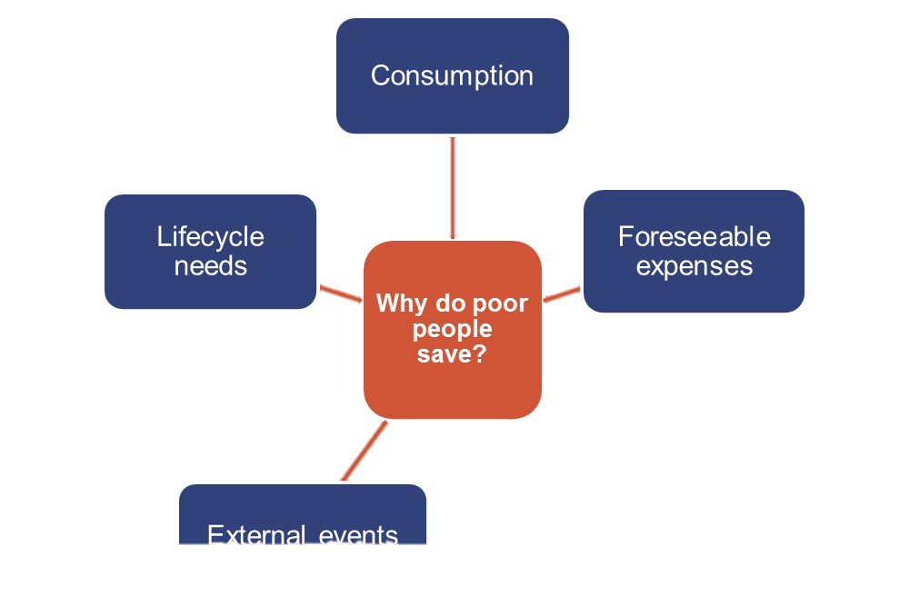
The reasons poor people save
to be prepared for any crisis, such as the sudden death of the main income earner in the family, theft, fire, accidents, and illness.
to prepare for unpredictable external events, for example price fluctuations or economic downturns;

Slide 5
Improving our performance
How can we can make our VSLA activities better?
Formal financial Institution
Cooperative financial Institutions
Traditional providers of micro finance
Community – based financial organizations
Traditional providers of micro finance services

Slide 6
for consumption smoothing, i.e. to prepare for lean periods during the year, especially in farming and in the informal sector where income streams are not steady;
for foreseeable expenses in the near future, for example farmers who need to buy fertilizer at the beginning of the cropping season;
for lifecycle needs, for example marriage, education, healthcare, homemaking, and old age;
to prepare for unpredictable external events, for example price fluctuations or economic downturns;
to be prepared for any crisis, such as the sudden death of the main income earner in the family, theft, fire, accidents, and illness. Hence, savings also plays the role of insurance for many poor.

Slide 7

Next Steps
Deployment of enumerators/ Questionnaire to collect VSLA data (Date: 16-20 May 2016 )
2nd training of staff to improve monitoring and impact (Date: 6-12 June 2016) ….funding and procedure
Design a unified monitoring tool and roll out (Date: after the training )
Introduction of Literacy and Numeracy into VSLA and farming group activities (Date: after the training)
Printing and launch of Extension Guide (June 20). Printing led by NRC.could be together with launch of NALEP, World Vision Symposium, launch of AFAAS-SS

Slide 8
The End
Thank you

