Slide 1

Improving Food and Nutrition Security for Vulnerable Groups in Warrap State.
World Vision South Sudan
FSTP Project Progress Updates
6th Quarterly Review Meeting
April 26 -28, 2016
Awiel
European Union

Slide 2
Project Overview
European Union
Project Name: Improving food and nutrition security for vulnerable groups in Warrap State
Project Duration: 36 Month,
Project Budget: 1,500,000.00 EUR
Operation Area : Operates in Warrap State,
            4 Counties , 8 Payams & 16 Boma
Project Target:- 7,000 HHs with 42,000 family members.
Implemented by : WVSS & THESO
Overall Objectives :- To Improve food security and nutrition for vulnerable groups in Warrap State, South Sudan
Result 1 : Strengthen community-level institutions ;
Result 2 : Increased Yield, Income & Reliability of Agri. Production
Result 3 : Improved utilisation of food

Slide 3
Business Development & Market Linkage
European Union
Business Development training conducted for 35 farmers group ( 175 HH attended ( 98 female)
40 VSLA Established and continued mobilizing their own saving.
VSLA kits support planned for all group.
As a pilot four Literacy Numeracy learning center established in close collaboration with county Education Department( One per County)
VSLA monitoring was done using tools shared from EU technical assistant. Found very helpful in identifying gaps and strengthen VSLA.
:

Slide 4
Group Extension
European Union
Year II - 20 FFS planned in four operational county. ( 5 per county)
Side By Side Demonstration in Tonj North County during Weeding
:
Farmer Field School
Farmer Demonstration ( Farmer to Farmer Demonstration)
Connecting one lead farmer with other follow farmers. 16 groups planned ( 4 per county)
FFS facilitator training conducted for 10 groups ( 50% progress)
Seed distribution started for the group through seed fair.( 75 % progress)
16 groups trained on FD ( 64 HHs ( 38 female)
Will do side by side comparisons with plot size of 10m by 10m

Slide 5
Vegetable Production
European Union
One of the project beneficiary managing Onion on seed bed
:
236 farmer group trained on Vegetable production ( 468 HHs( 257 female) + 16 Community Volunteers.
Eight type of vegetable seed already purchased and half will be distributed soon for rain season production.( Tomato, Onion, Okra, cabbage, kale, egg plant, carrot, & cow pea)
Wet Season: 1500 HHs
Dry season: 1500 HHs
The same training roll out to other group members by trained HHs & CVs.
Modality & Achievement

Slide 6
Other Training Conducted
European Union
Kitchen water Conservation Practice in GE County
:
20 farmer group trained ( 200 HHs( 113 female)
Climate Smart Agricultural Practice
Conservation Agriculture
25 farmer group trained ( 276 HHs( 169 female)
Kitchen Water Conservation
50 farmer group trained ( 50 HHs( 33 female)

Slide 7
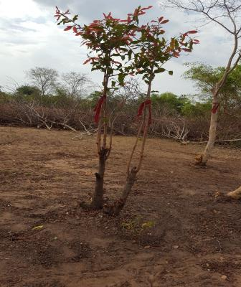
FMNR: Farmer Managed Natural Regeneration
European Union
:
Key learning:
18 FMNR Closed area /Community Learning centers/ rehabilitated or expanded
Retaining useful trees on farm land rather than clearing all.
Clearing bush and unwanted trees to speed up trees upward growth

Slide 8
Result 3: Improved Utilisation of Food
European Union
IYCF ToT in Kuajok
:
This Component implemented by THESO ( Nutrition Manager & Nutrition Trainer)
IYCF roll out training at Payam:
CNVs : 200
BHWs: 16
IYCF ToT in Kuajok : 37

Slide 9
Project Result Progress Tracking
European Union

Slide 10
Cooperation & Coordination
European Union
With other EU Implementing partner in Warrap
  Sharing experience and good lessons
    Seed fair experience of NRC
    Harmonization of seed fair approach with VSF-Germany.
  Conducting joint project steering committee meeting on quarterly base
    GE & TN : WV & VSF-Germany
    Twic , WV managed the quarterly meeting alone.
With Other WV projects;
  Good Integration with WFP Food for Asset program.
    WFP FFA: Support food for contribution of labour for land clearing, land preparation and weeding.
    EU FSTP : Support farmers with seed and also guided and supported to use improved farming practice. Jointly ==== Will increase yield

Slide 11
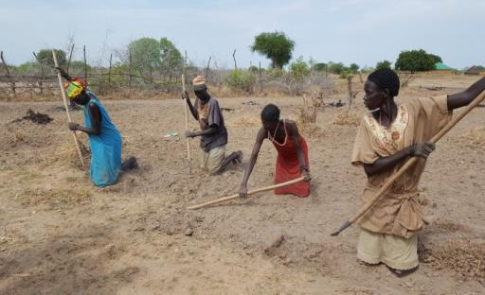
European Union
Thank You!

