Slide 1
European Union / South Sudan
Cooperation
Greater Bahr el Ghazal
RURAL DEVELOPMENT PROGRAMME
Steering Committee Meeting - ZEAT-BEAD
Quarterly Review - SORUDEV and FSTP
Funded by the European Union
Government of South Sudan

Slide 2


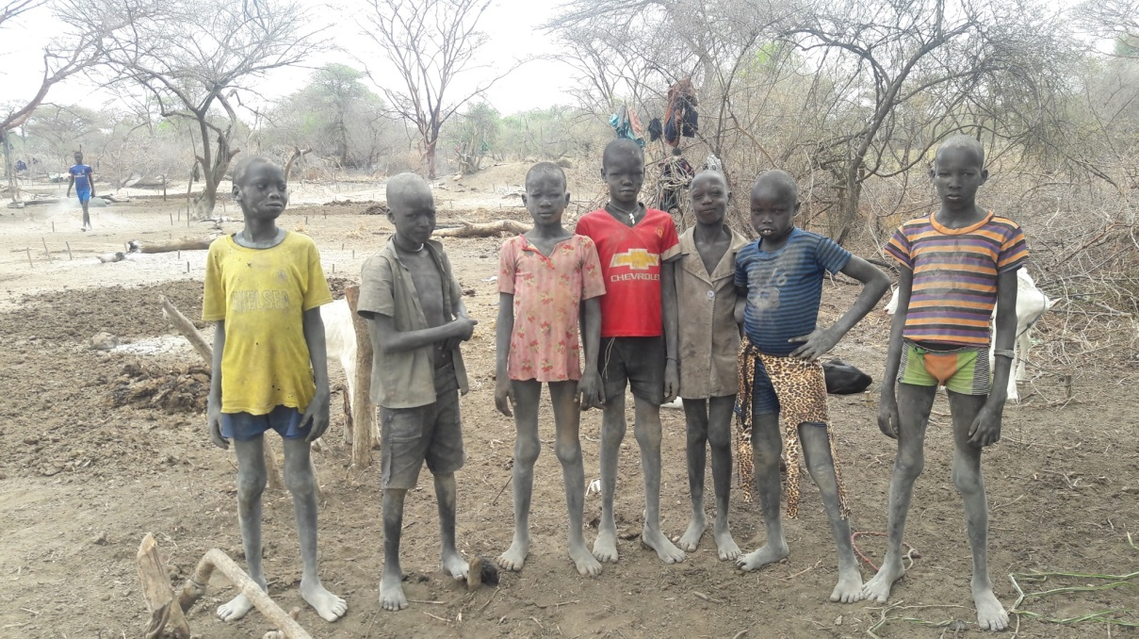
Enhanced Knowledge and Education for Resilience Pastoralist Livelihoods in South Sudan
Program Steering Committee Meeting
26-28 April 2016
Aweil

Slide 3

Project Background
Pastoralist communities in South Sudan receive limited services to improve their livelihoods.
To bring about attitudinal & behavioral change of pastoralists, there is need to extend livelihoods, literacy, numeracy life skills & basic skills training interventions.
Pastoral Field School (PFS) approach provides excellent entry point & platform to improve pastoralist knowledge & skills.
Pastoralist Livelihood and Education Field School (PLEFS) approach initiated that combine livelihood interventions with an education component
The pilot project integrates the PFS with pastoral education to enhance resilience of pastoralist communities livelihoods.
Notes:
Most social services are designed for sedentary lifestyle and pastoralist are transhumance that move seasonally between villages, grazing areas and different topographic zones.

Slide 4

Beneficiaries and Partners
Operation areas/ Counties :
  Yirol East, Yirol West, Awerial,
  Rumbek Center & Wulu
Target Beneficiaries
  Pastoralist in cattle camps: Young children ( 8-12ys); Youth ( 13+ years); Adults ( >18)
  Ministries staff and community facilitators/teachers
Project Partners
  National level: MAFCRD, MLFI, MoEST;
  State: SMAF, SMARF and SMoEST; NGO’s.

Slide 5
Impact
Resilient pastoral livelihoods
Outcome
Livelihood security & empowerment
Institutional capacity
Outputs
CBDRR
Livelihood Diversification
Skills transfer
PLEFS model Development
Coordination mechanisms
Activities
DRR mobilization
CBDRR action plans
Support action plans
Training members on IGA
Support IGA activities;
VICOBA
Train facilitator
PLEFS
Literacy, numeracy, ALP
Survey
Curriculum Devt
Regulatory framework
Master trainers
Visibility
Technical WG
Regional exposure
Pool of trainers

Slide 6

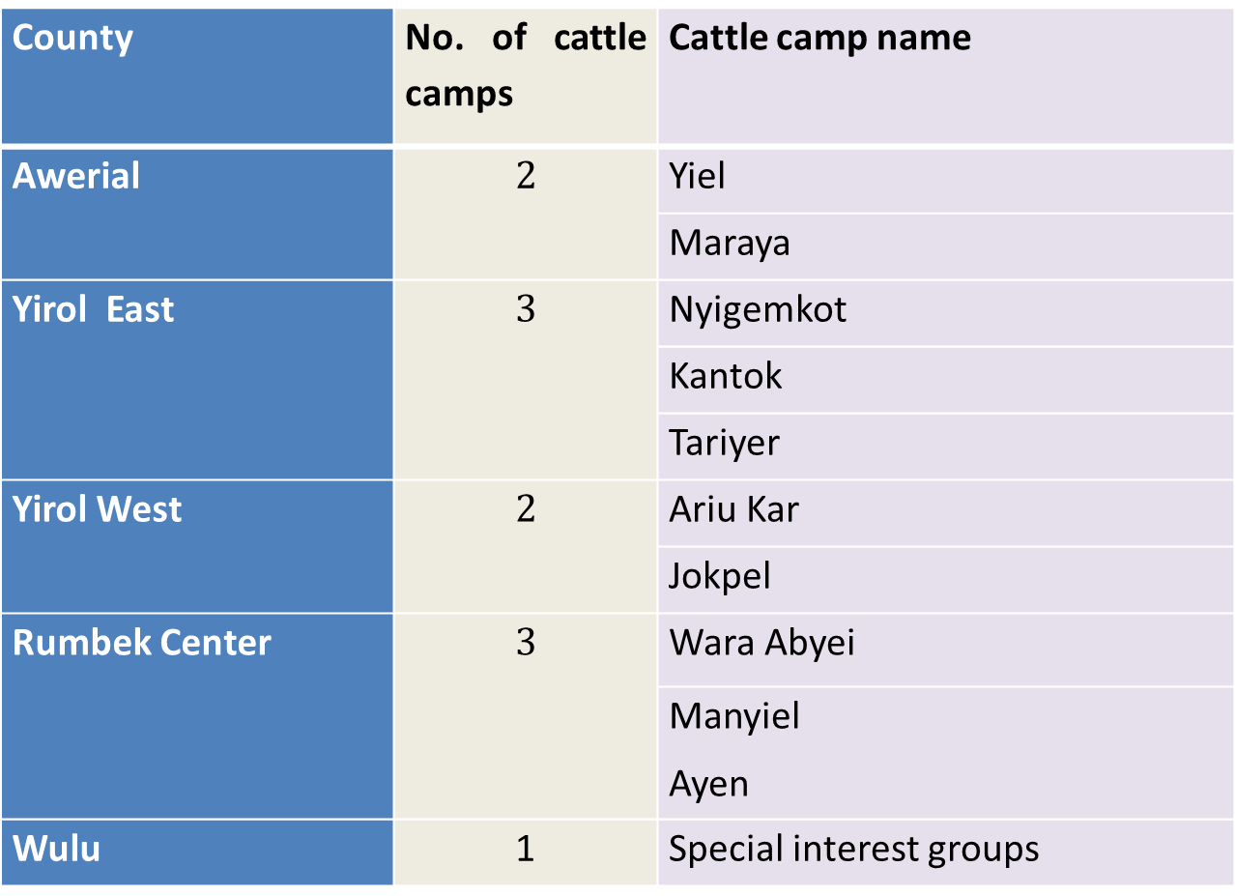
Table 1. Target Areas
County | No. of cattle camps | Cattle camp name
Awerial | $$2$$ | Yiel
 |  | Maraya
Yirol East | $$3$$ | Nyigemkot
 |  | Kantok
 |  | Tariyer
Yirol West | $$2$$ | Ariu Kar
 |  | Jokpel
Rumbek Center | $$3$$ | Wara Abyei
 |  | Manyiel Ayen
Wulu | 1 | Special interest groups

Slide 7
Key progress in 1st quarter 2016
Outcome 1. Pastoralist livelihood security & empowerment
Output 1. Community Disasters Risk Reduction & Planning capacity
Activity 1.1: PLEFs group formation/ learners registration
Formation of 21 groups in 7 cattle camps with total number of 1,079 members (Table 2)
        Table 2. Total No of PLEFS groups members by gender
PLEFS Group | Males | Females | Total
Children | 242 | 96 | 337
Youth | 211 | 172 | 383
Adult | 150 | 209 | 359
Total | 603 | 477 | 1,079
Notes:
awareness meetings with the state & counties stakeholders to introduce the project;

Slide 8
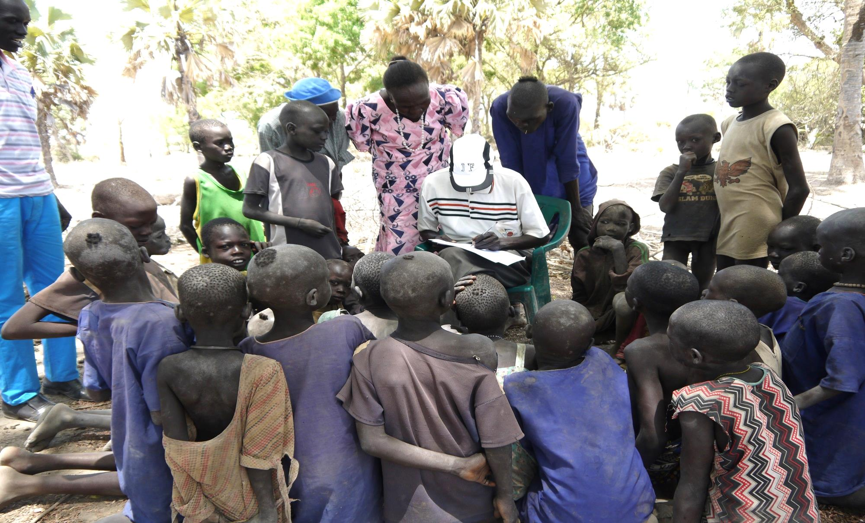
Key progress: Learners Registration
Notes:
awareness meetings with the state & counties stakeholders to introduce the project;

Slide 9
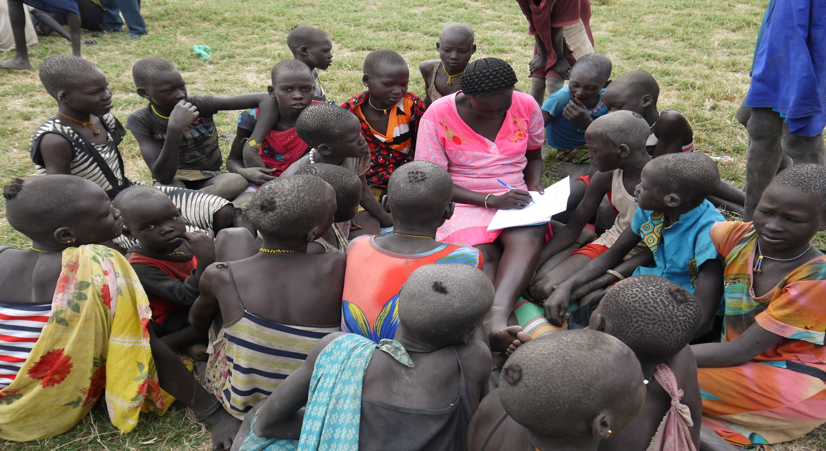

Key progress: Learners Registration

Slide 10

Key progress in 1st quarter 2016
Output 1. Community Disasters Risk Reduction & Planning capacity
Activity 1.2: Mobilize communities through a Community Managed Disaster Risk Reduction (CMDRR) approach
Community mobilization in 7 cattle camps were done in Awerial, Yirol East and Yirol West Counties.
260 community members (188 Males, 72 Females) attended the participatory CMDRR meetings in 6 cattle camps
Main disasters identified include:
- Conflict, -Human diseases
Livestock diseases,
Drought,
Crop pests and diseases.
Notes:
awareness meetings with the state & counties stakeholders to introduce the project;

Slide 11
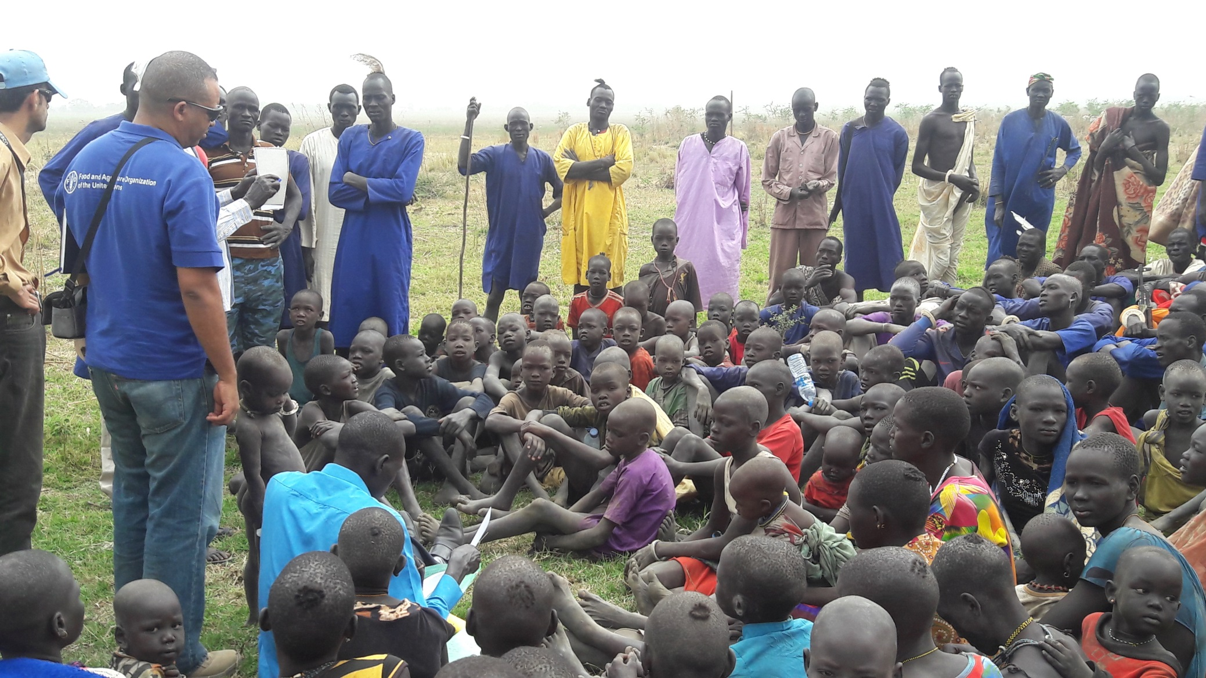
Key progress: Community Mobilization
Notes:
awareness meetings with the state & counties stakeholders to introduce the project;

Slide 12
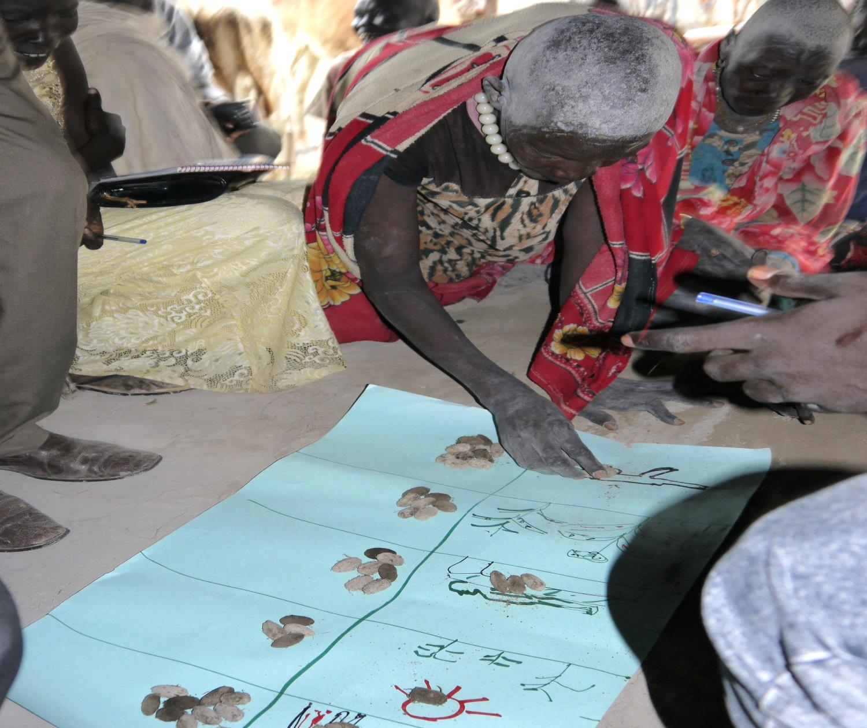
Key progress: Hazard ranking
Notes:
awareness meetings with the state & counties stakeholders to introduce the project;

Slide 13

Key progress in 1st quarter 2016
Output 1. Community Disasters Risk Reduction & Planning capacity
Activity 1.3: Develop CMDRR actions plans with the target communities
CMDRR action planed developed for 7 cattle camps
Notes:
awareness meetings with the state & counties stakeholders to introduce the project;

Slide 14
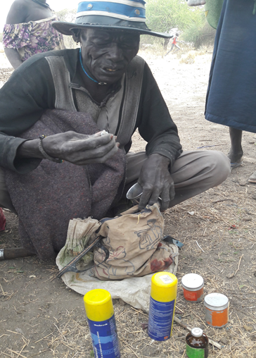
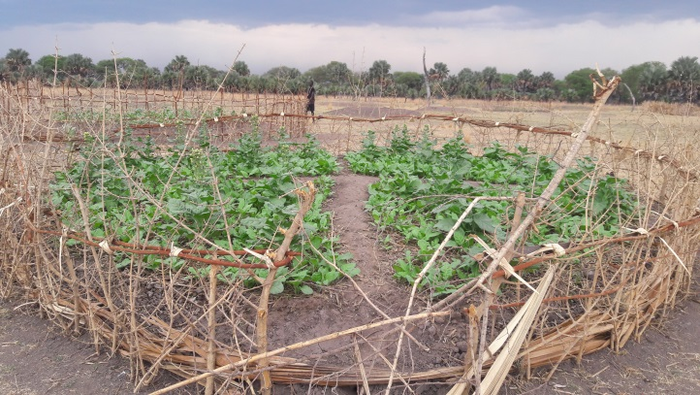
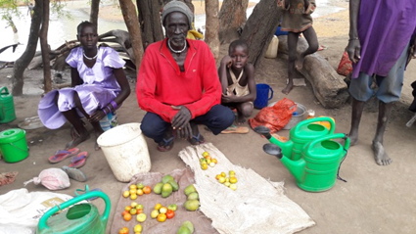
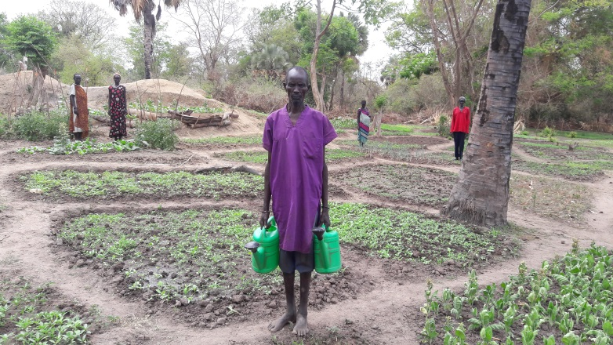
CMDRR plans

Slide 15
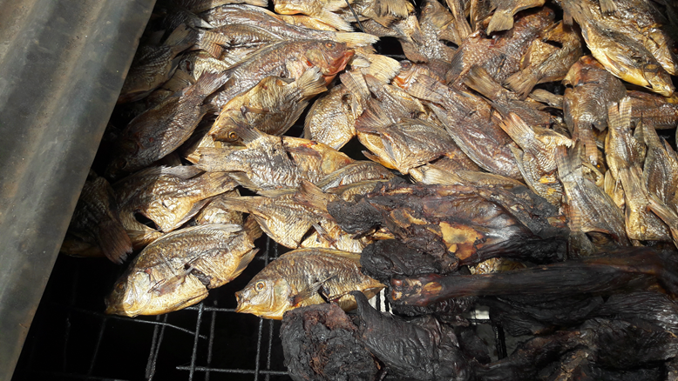
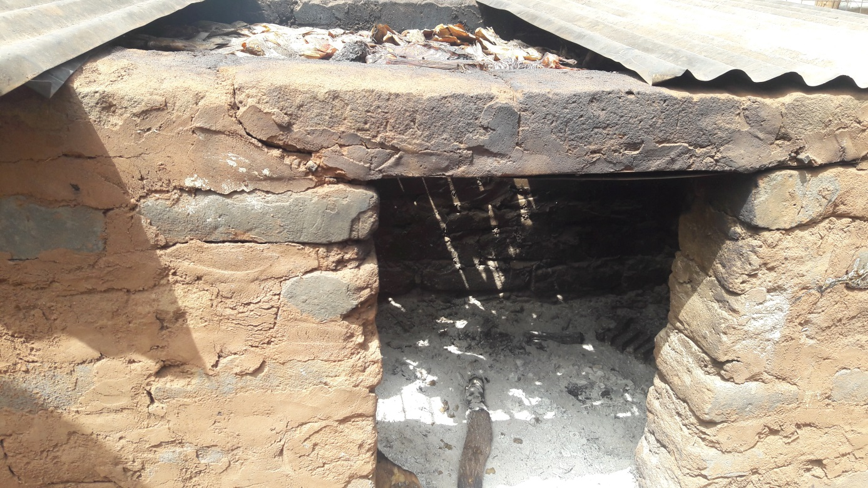
CMDRR plans

Slide 16

Key progress in 1st quarter 2016
Output 2: Livelihoods & income sources diversified & enhanced
Activity 2.1: Identification of Implementation partners
Preselected agencies: DRDA, IIRR, OXFAM, NPA, VSF-G, BRAC, PLAN.
Call for proposal launched.
Proposal evaluation is being carried out.

Slide 17

Key progress in 1st quarter 2016
Output 3: Skills, strategies and education essential for resilient pastoral livelihoods acquired by target communities
Notes:
awareness meetings with the state & counties stakeholders to introduce the project;

Slide 18
Key progress in 1st quarter 2016
Output 3: Skills, strategies and education essential for resilient pastoral livelihoods acquired by target communities
Activity: Develop learning curriculum, learning material and resources
PLEFS Curriculum adaptation & integration done
Adaptation scope:
- Children: P1- P4 (5 subjects)
- Youth: Level 1-4 (7 subjects)
- Adult : 1 Level with 3 modules.
Notes:
awareness meetings with the state & counties stakeholders to introduce the project;

Slide 19
Key progress in 1st quarter 2016
Output 3: Skills, strategies and education essential for resilient pastoral livelihoods acquired by target communities
Activity: Identification of community facilitators in each cattle camp
21 CF identified based on set criteria ( 4 women)
Notes:
awareness meetings with the state & counties stakeholders to introduce the project;

Slide 20
Key progress in 1st quarter 2016
Curriculum Adaptation Process:
1. Understanding the target beneficiaries, their livelihoods & the set up.
Getting and adapting concepts from existing curriculum materials.
Getting, rebuilding & contextualizing content from existing curriculum
(only changed content but adapted concepts).
Notes:
awareness meetings with the state & counties stakeholders to introduce the project;

Slide 21
Key progress in 1st quarter 2016
Curriculum Adaptation Process:
Cross cutting issues
Gender equity
Environmental care and conservation
Disaster Risk Reduction
Life skills
HIV and other common illnesses
Health and hygiene
Climate Change
Notes:
awareness meetings with the state & counties stakeholders to introduce the project;

Slide 22

Key progress in 1st quarter 2016
Curriculum Structure:
3 levels. (Adult, Youth & Children)
Package for the youth and children curriculum comprises of:
        A syllabus
        A teachers/facilitators’ guide
        Learners books
The Adult curriculum comprised of the facilitator’s manual and reference materials
Notes:
awareness meetings with the state & counties stakeholders to introduce the project;

Slide 23

Key progress in 1st quarter 2016
Curriculum Validation Workshop 6-7th April 2016:

Slide 24
Key progress in 1st quarter 2016
Outcome 2: Strengthened institutional capacity
Output 2. Ability of relevant institutions to effectively coordinate service delivery system is enhanced
Activity: Create opportunities for exposure visits
Exposure visit of national TWG members to Kenya
- Marsabit: IIRR Shepherd School & Adeso Mobile Non formal Education ( MNFE)
– Kajiado: FAO supported Pastoral Field schools
Two TWG meeting conducted at national level.

Slide 25
Key progress in 1st quarter 2016
Activity: Create opportunities for exposure visits – Areas of focus
Best practices of both PFS and PEPs programs
lessons learnt on increasing women & girls participation
Conflict mitigation mechanism
Sustainability strategies used in the programs
Curriculum content & development process
Role of community & stakeholders in the programs
Impact on livelihood of target communities by the programs
Cultural, behavioural & attitudinal changes of pastoralist due to the programs

Slide 26
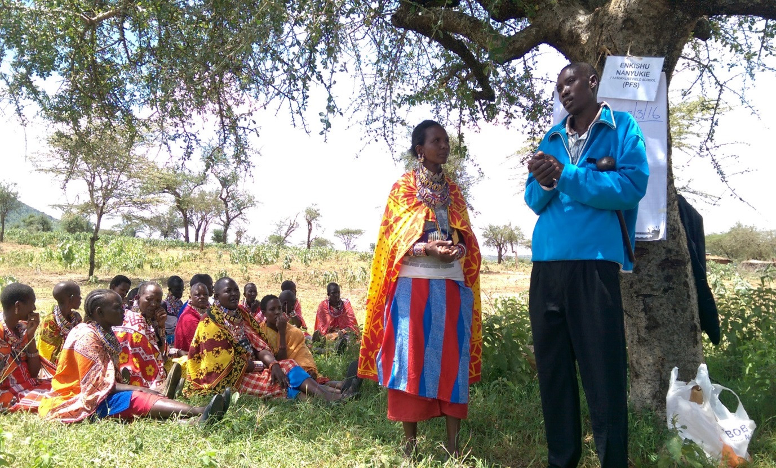
Key progress in 1st quarter 2016
Activity: Create opportunities for exposure visits

Slide 27
Key progress in 1st quarter 2016
Activity: Create opportunities for exposure visits
Lessons Learned:
A well structure community participation through similar committees such as CECs
A well structure community participation through similar committees such as CECs
A continues refresher training to upgrade teachers capability in teaching.
Shepherd and adult literacy were used to fight FGM & other negative cultural practices like bidding for young girl & early marriages

Slide 28
Key progress in 1st quarter 2016
Activity: Create opportunities for exposure visits
Lessons Learned Cont:
Flexibility of time such as evening class using solar lumps for those who are out all day with cattle
Change of attitude & behaviour towards pasture production & conservation through fencing & weeding
Government taking the lead in agriculture & livestock extension by providing platform for stakeholders

Slide 29
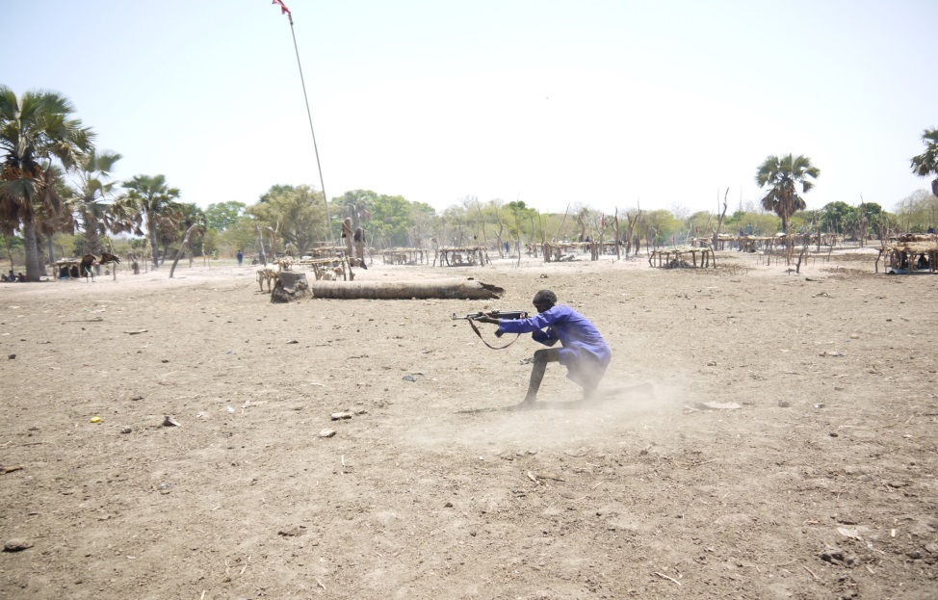
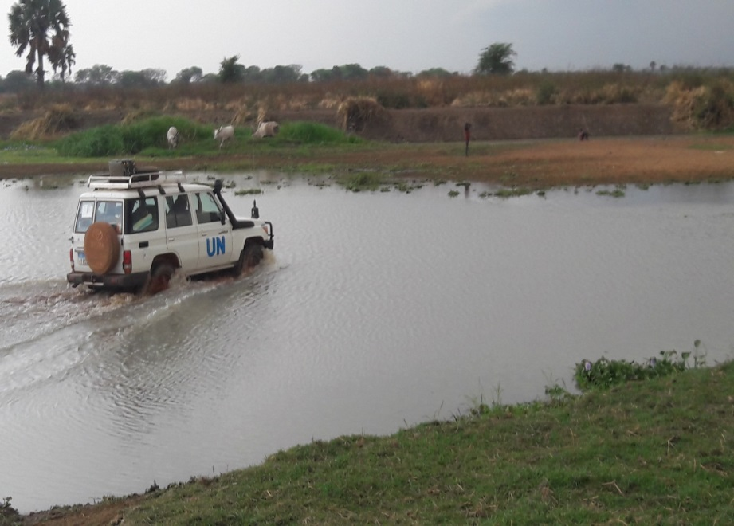
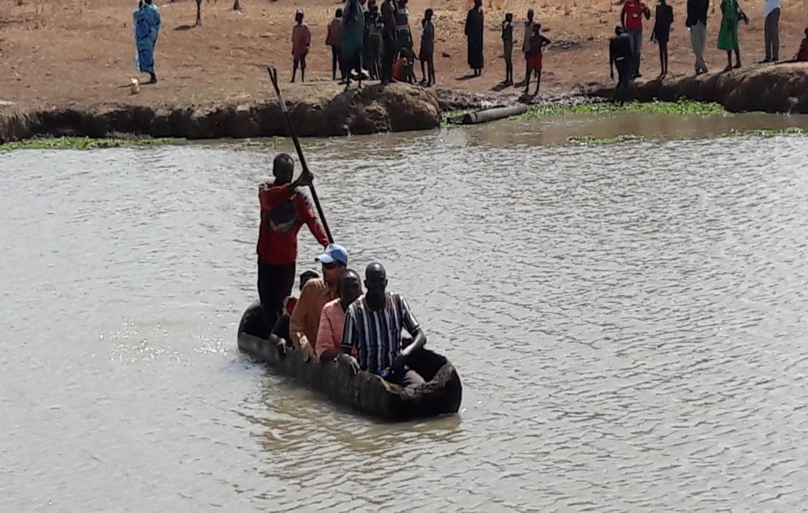

Main Challenges

Slide 30
2nd Quarter 2016 Plans
Complete identification of PLEFS community facilitators/teachers at cattle camp level
Finalising Implementing partner selection
Finalise PLEFS Group formation in five areas
Finalization and launch of the curriculum
5 weeks training of community facilitators and Teachers for the 10 cattle camps
Procure and distribute learning materials
Notes:
awareness meetings with the state & counties stakeholders to introduce the project;

Slide 31
2nd Quarter 2016 Plans
Initiate and implement new PLEFS groups with regular training sessions over an 18 month period
Carry out literacy, numeracy life skills and basic skills training classes disaggregated into three different age groups
TWG meetings at national and state level
Notes:
awareness meetings with the state & counties stakeholders to introduce the project;

Slide 32
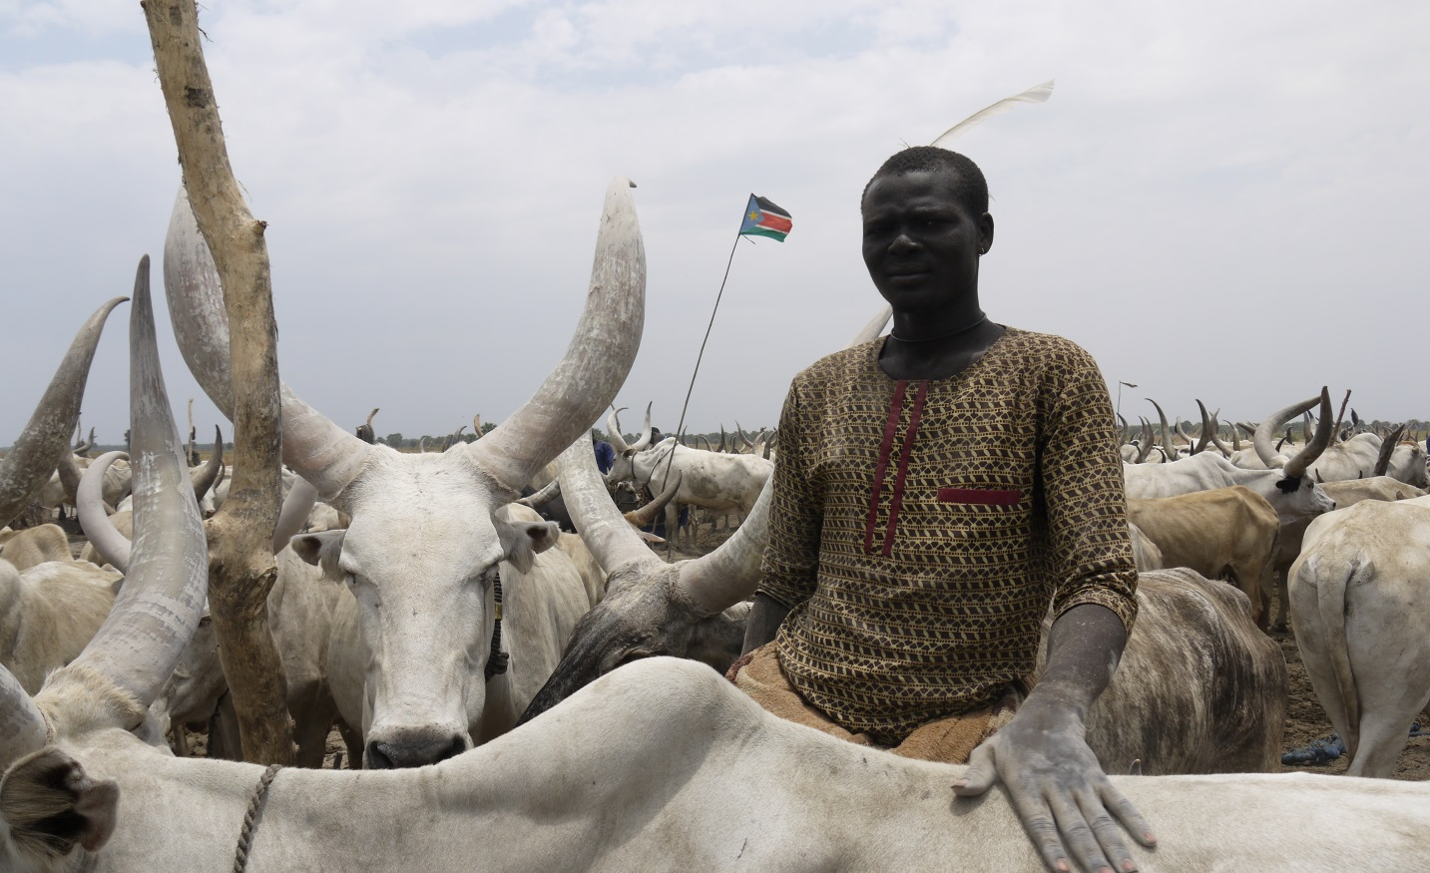
Pastoralist Livelihoods and Education Project
Funded by the European Union
Government of South Sudan
Thank you

