Slide 1


The European Union’s Food Security Thematic Programme for
South Sudan
Food security through enhancing sustainable agricultural production
(FESAP) Gogrial East and West Counties, Gogrial State – South Sudan
Implemented by VSF-Germany in partnership with SEDA and INFRAID
VSF-GERMANY FSTP PROGRESS UPDATE-Presentation
6TH QUARTERLY REVIEW MEETING

Slide 2
OVERALL OBJECTIVE
To contribute to increased food security, reduced vulnerability and enhanced livelihoods of rural communities by supporting household subsistence farmers in Warrap State of South Sudan
R1 : Increased agriculture production and productivity through strengthened extension services and innovative farming.
R2: Animal traction is adopted as a viable, cost-effective and sustainable technology and contributes to annual increase in cultivated farmed land, improved tillage and increased productivity per acreage.
R3: Increase in household income as a result of access to microfinance, local markets, and linkages to value chain actors.
R4: Increased resilience to shocks in climatic/ environmental changes and manmade disasters such as conflict.

Slide 3
QTR 1 2016 ACHIEVEMENTS
R1: Increased agriculture production and productivity through strengthened extension services and innovative farming.
Seed availability assessment and market survey for agricultural inputs carried out to evaluate currency devaluation impact on the market.
The 4FFS groups transitioned from rain-fed farming to commercial dry season vegetable production adopting improved agronomic practises
37% of targeted farmers were able to produce sufficient crops for their families in the previous growing season with some being able to produce surplus which they have in turn used to supply seed to the seed banks in the various project payams. Seed store reserves kept in GEC and GWC in a selected HH granary while awaiting construction of the seed banks with 76 farmers contributing 551 bags(50kg) of sorghum and groundnuts.
Youth innovative integrated symposium targeting 6 schools was held in GEC to enhance extension outreach to young farmers.

Slide 4
QTR 1 2016 ACHIEVEMENTS
R2 Animal traction is adopted as a viable, cost-effective and sustainable technology and contributes to annual increase in cultivated farmed land, improved tillage and increased productivity per acreage
The 30 community ox plough trainers (COTs) were refresher trained in Gogrial East and West Counties have supported 225 HH on ox-plough use, oxen handling and general plough maintenance.
The COT’s were contracted by other projects to provide animal traction training(21days) to 100HHs in GW.
Payam | HH whose Oxen were trained | Farmers trained | Total
Nyang | 36 | 31 | 67
Toch North | 29 | 30 | 59
Pathuon West | 15 | 9 | 24
Kuach North | 27 | 20 | 47
Kuach South | 13 | 15 | 28
Total | 120 | 105 | 225

Slide 5
QTR 1 2016 ACHIEVEMENTS
R2 cont’d…
300 farmers supported with 300 ox-ploughs at a cost-recovery basis in Gogrial East and Gogrial West with cumulative income being stored at community banks .
Income generated to be used in procurement of ox-plough spare parts ( based on ox-plough availability assessment findings)
Ox-plough oversight committees together with government representatives ensuring smooth management and adherence to agreed modalities as stipulated in signed MOUs.
County | Number of ox-ploughs distributed | Number of ox-ploughs sold | Cost per ox-plough(SSP) | Total(SSP)
Gogrial East | 150 | 150 | 600 | 90000
Gogrial West | 150 | 148 | 750 | 111000
Grand total | 300 | 298 |  | 201000

Slide 6
QTR1 -2016 ACHIEVEMENTS
R3: Increase in household income as a result of access to microfinance, local markets, and linkages to value chain actors
6 ASCA groups have been formed bringing the total ASCA groups to 20. Of these 15 are sustainably running with a cumulative savings total of 36,820SSP.
20 TOT’s further strengthened through refresher training on adult literacy and numeracy(curriculum development)
89% of targeted HHs have had an increase in household income through improved access to loans/credit via the ASCA groups.

Slide 7
R3: Increase in household income as a result of access to microfinance, local markets, and linkages to value chain actors
Crucial symbiotic linkages have been established between agrovet dealers, blacksmiths, co-operatives and community banks as was observed particularly during the sale of ox-ploughs in GEC and GWC.
Cooperatives
Agrovet dealers
Blacksmiths
Community banks

Slide 8
QTR1-2016 ACHIEVEMENTS
R4: Increased resilience to shocks in climatic/ environmental changes and manmade disasters such as conflict
Land under dry season vegetable farming increased from 0.75feddans in the previous farming season to 2Feddans due to increased interest after realizing lucrative earnings in the previous season.
Farmers were able to procure 50% of the seeds required for the dry season from ASCA savings and the project mitigated their efforts and supplied the variance. To date farmers are now able to procure more seeds through income from vegetable sales and seed harvesting.
Average dry season farming HH with 6plots measuring 12m² each is earning 900SSP/month particularly from the sale of traditional vegetables like rigla and kudra.
134 supported fish farmers had their capacities strengthened through fish farming and preservation training. To date an average fishing HH earns 35SSP/fish with a daily fish harvest of 5.

Slide 9
QTR1-2016 Challenges
Relocation of Nyang Payam to Amathenom closer to the Unity State border
High competition over water use between vegetable group members and the community members.
High rates of inflation are affecting income generating groups’ businesses in gaining good profits.
Mistrust of the community leaders to the local institution (Community Banks, Cooperatives) on capacity to play key roles on value addition chain. This was because the institutions were associated to given family and seen as a family entity hence mistrust.

Slide 10
Coordination and Synergies
Conduct joint county level steering committee meetings with LGA,WV and NRC on a quarterly basis
Harmonisation of implementing strategies such as the seed fair approach with WV.
Introduction of cost-recovery to other VSFG projects.

Slide 11
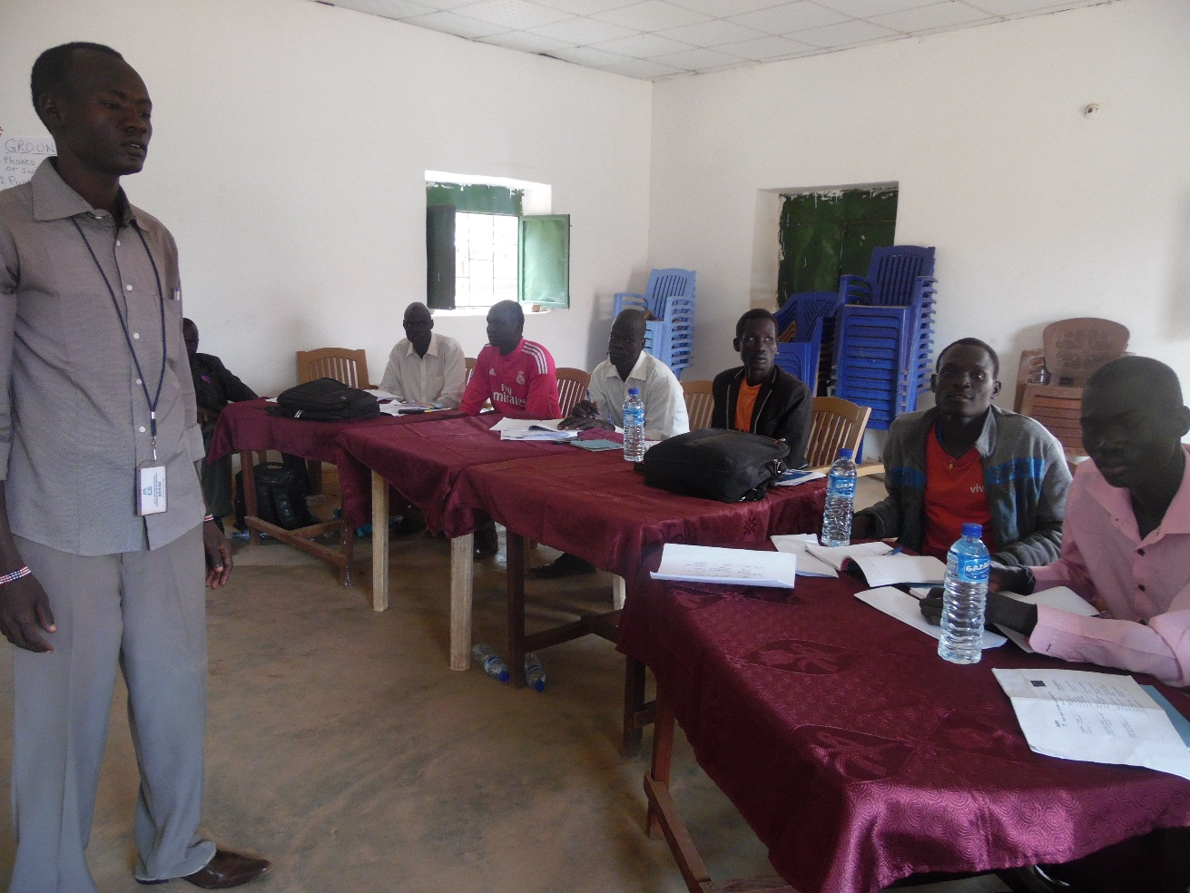
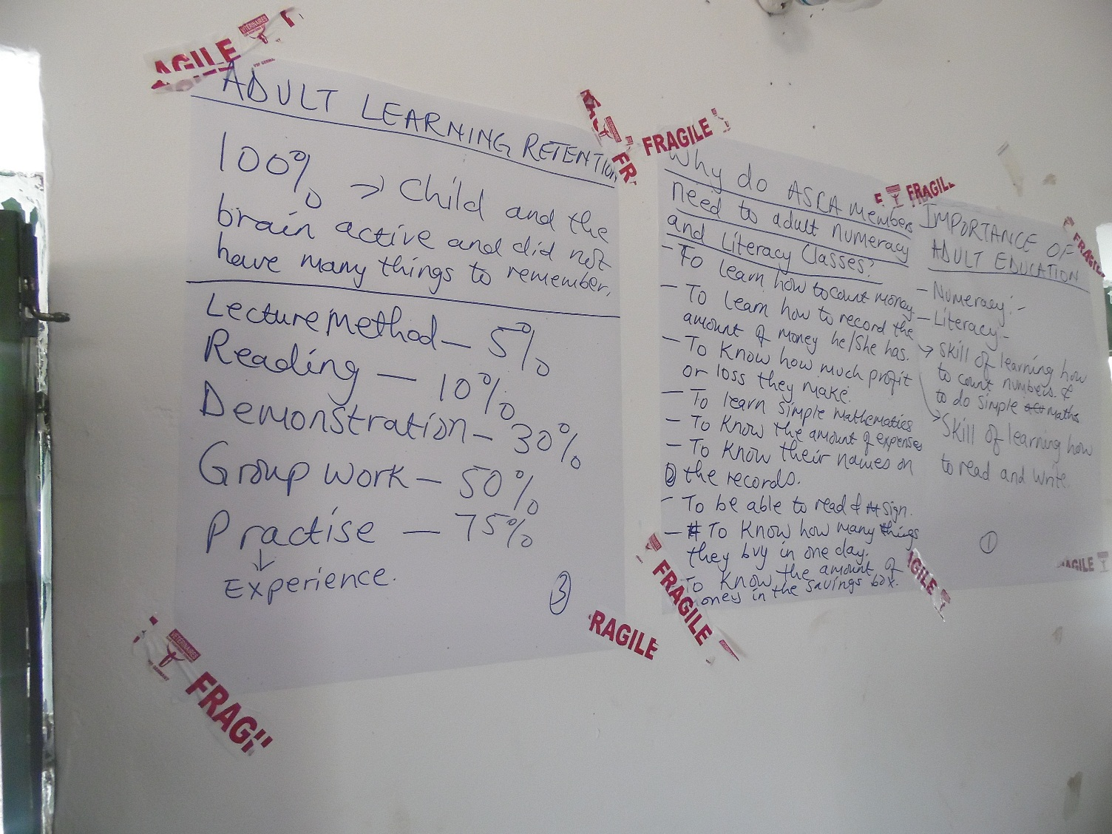
ASCA TOT TRAINING IN KUAJOK

Slide 12
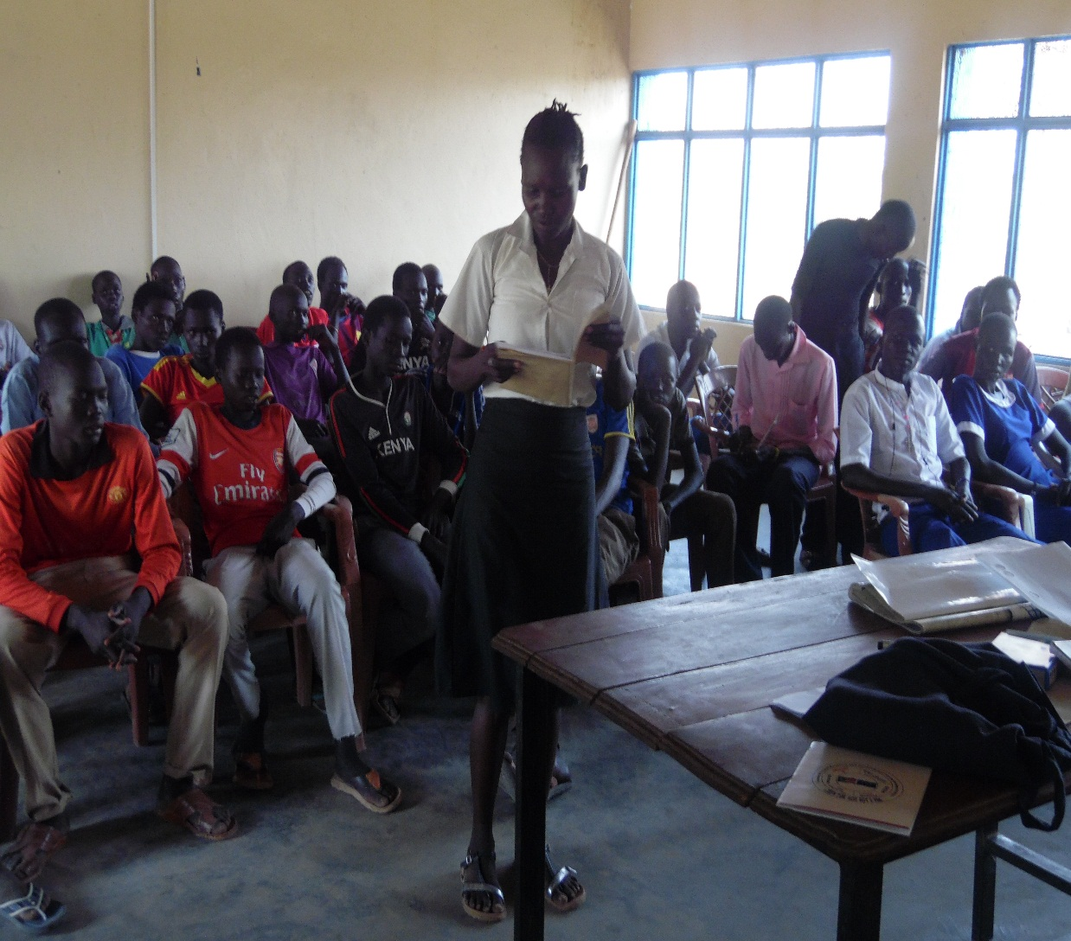
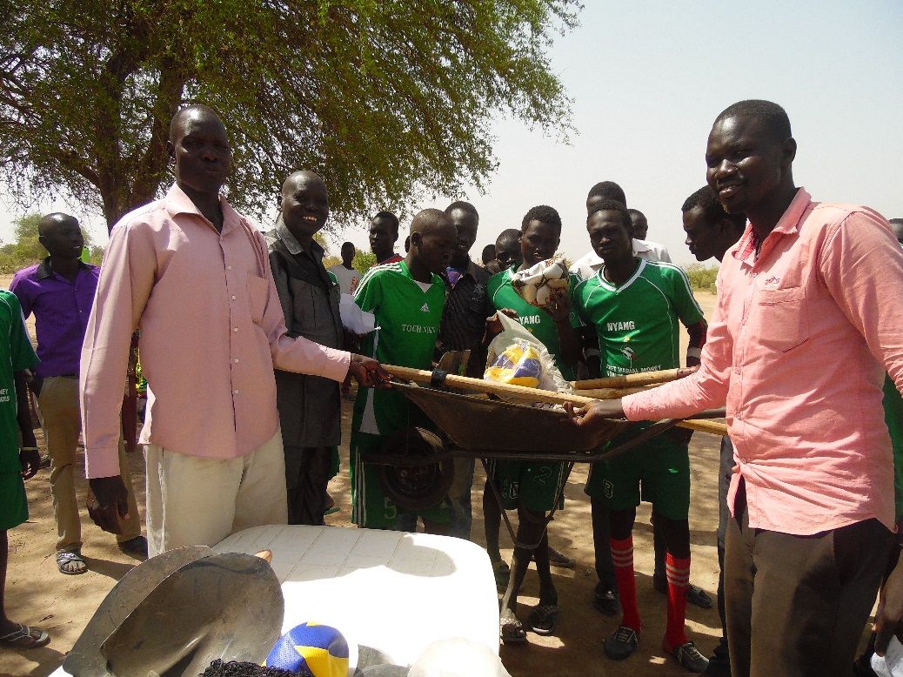
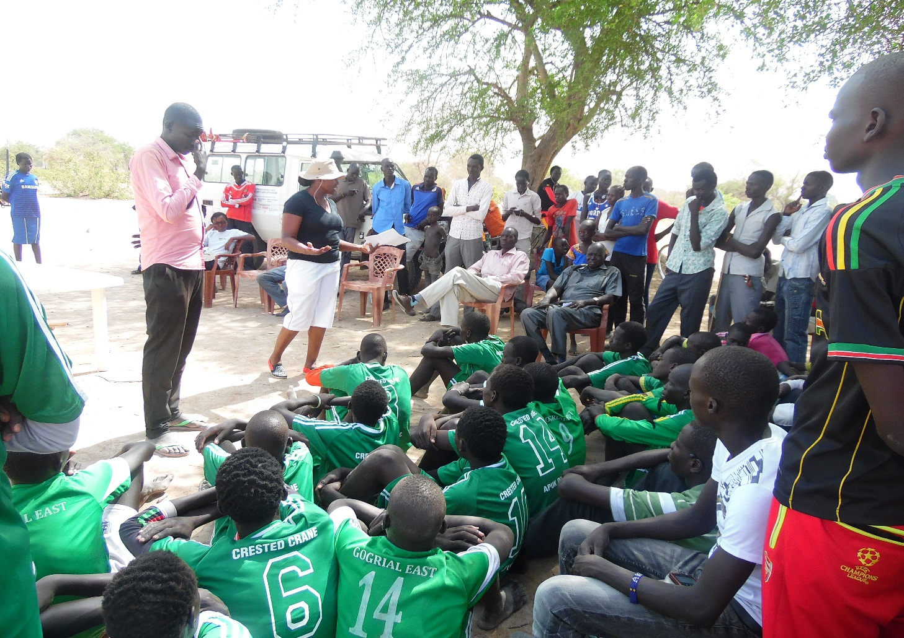
Youth Symposium in GEC-”catching them young”

Slide 13
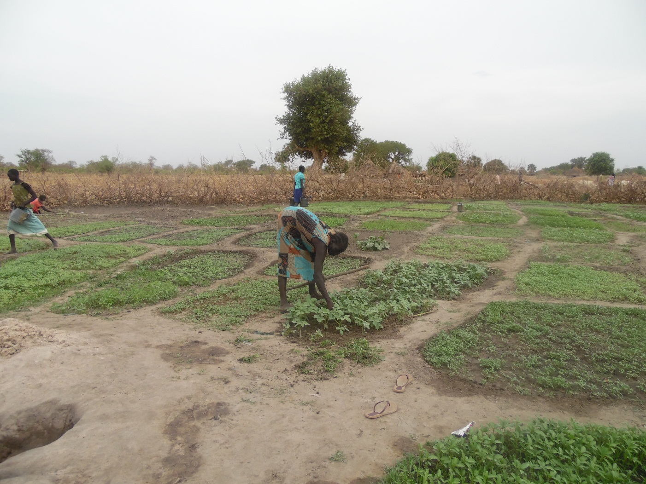
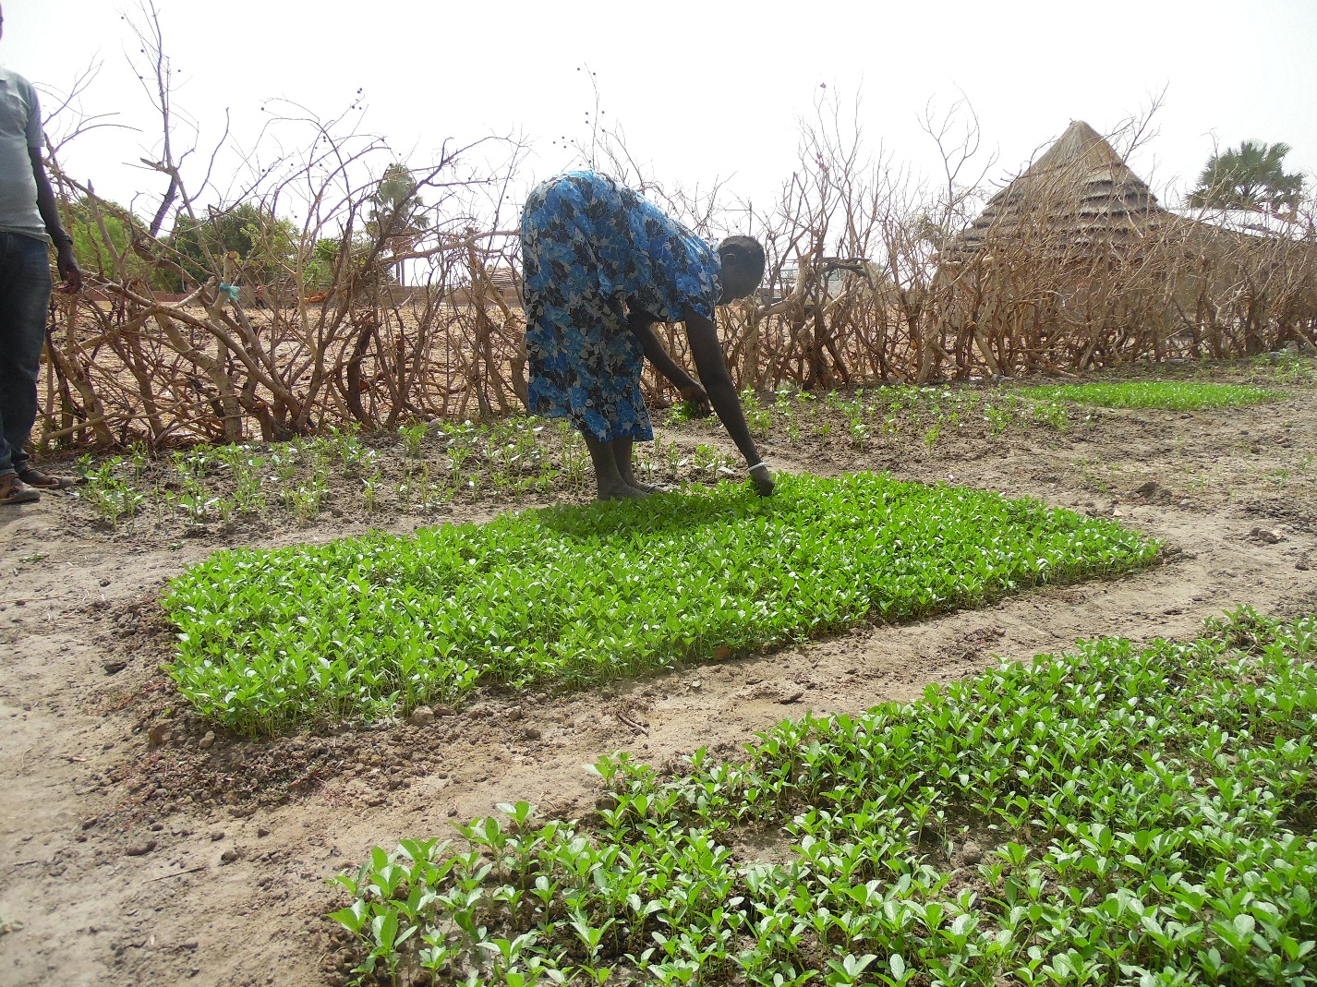
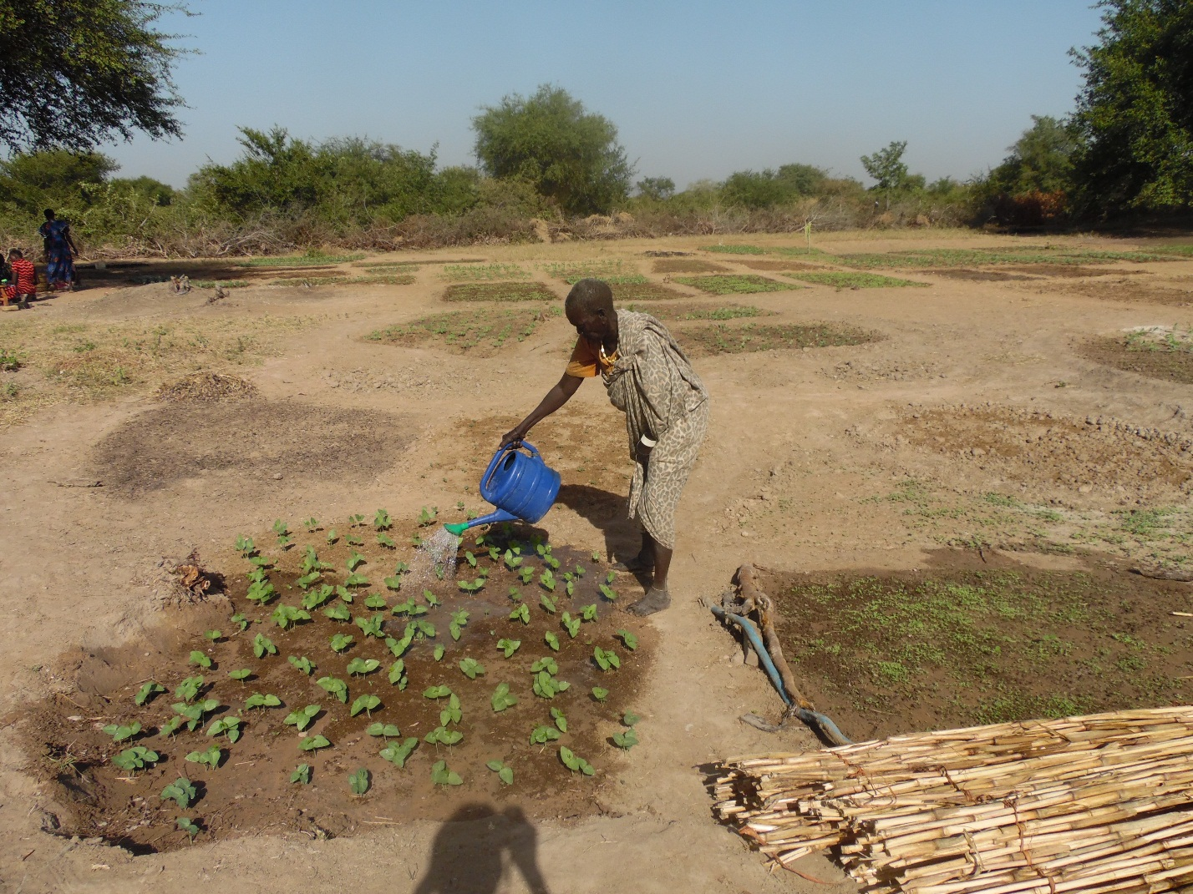
‘Women at work’- dry season vegetable farmers weeding and watering their crops

Slide 14
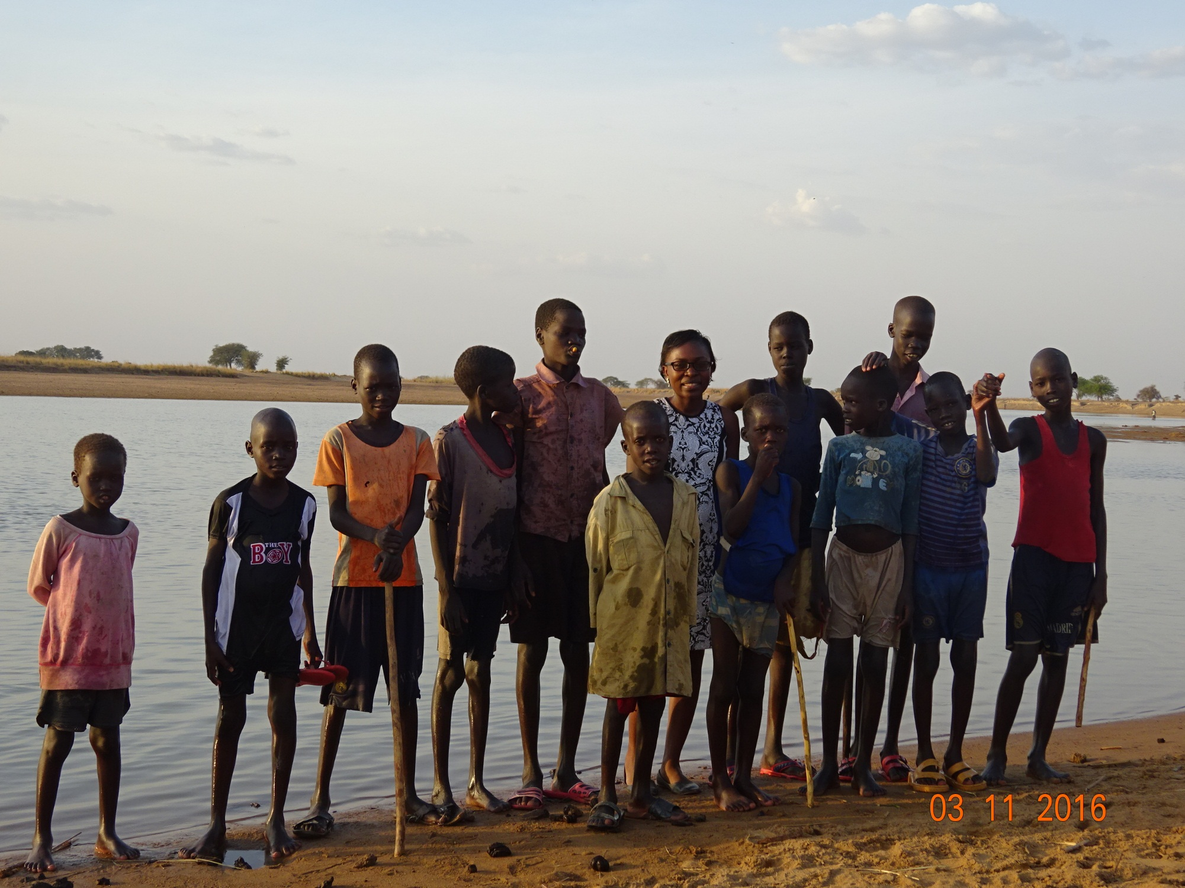
APOTHAPEH!

