Slide 1
SORUDEV
Strengthening Smallholder Animal Traction Capacity Extension Services
in Lakes State
28th April 2016
Aweil Grand Hotel
Presenter: Abraham Mading
Extension officer

Slide 2
Presentation outline
Background
Planned activities ,
Achievements
Challenges
Lessons learned
Next quarter planned

Slide 3
1. BACKGROUND
Overall objective: contribute to food security, reduce vulnerability and enhancing livelihood of rural households in 8 counties of lakes state,
Specific objectives: increased agricultural production & incomes of smallholder farmer in lakes through strengthening extension services that effectively reach smallholder farmers.
3 components:
1. Extension component- Increased adoption of good practices that increase production & reduce production losses through strengthening Extension services delivery system ,

Slide 4
Background cont....
2. Animal traction- Increased adoption of Animal traction among smallholders farmers,
3. Market & value chains- Improved market access & linkages among value chain actors & producer groups

Slide 5
2. Planned activities for 1st Qtr (Jan-April 2016)
To identify training needs of FGs(SORUDEV) growing vegetable in dry season,
To identify additional 960 farmers for 2016 support,
To train & re-train 4000 farmers for field crops,
To conduct project mid term evaluation,
To refresher/re-train extension counterpart,
To train 46 COTs ,
To distribute tools & working attires to community blacksmiths,
To establish trees nursery in 2 animal traction centres,
To facilitate mabui Centre to produce ploughs/parts and their marketing
To train and disburse loan to vet groups,
To form & train payam farmer associations,
To supervise VSLA activities,

Slide 6
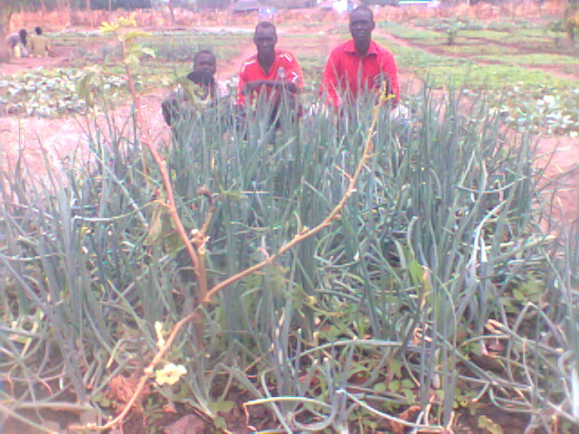
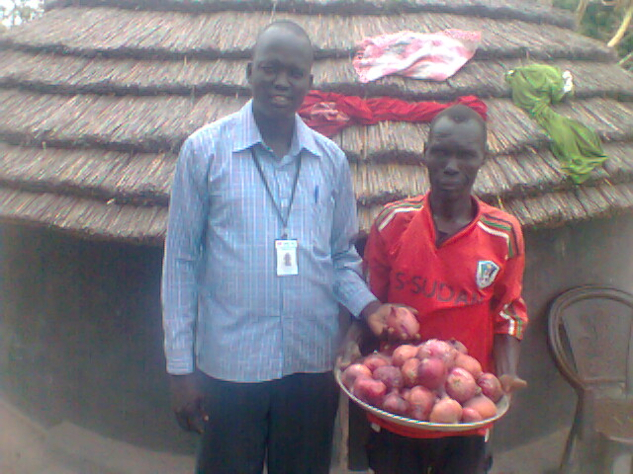
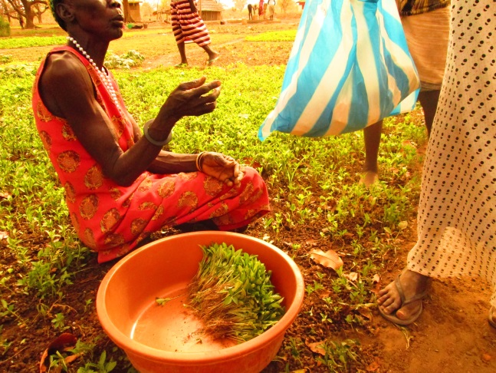
3. Achievement
816 individuals farmer dealing in dry season vegetable growing were identified,
Of the above identified , 709 (566 females &143males ) trained for 2-3 days based on their training needs for vegetable managements
Each farmers trained realizes benefit of 900 -1,100 SSP monthly through sale depending on plot side/number and types of vegetable grown,

Slide 7
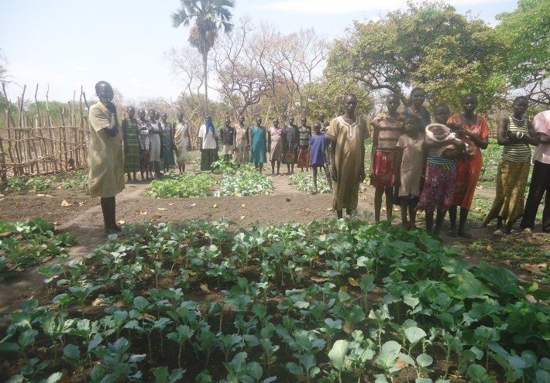
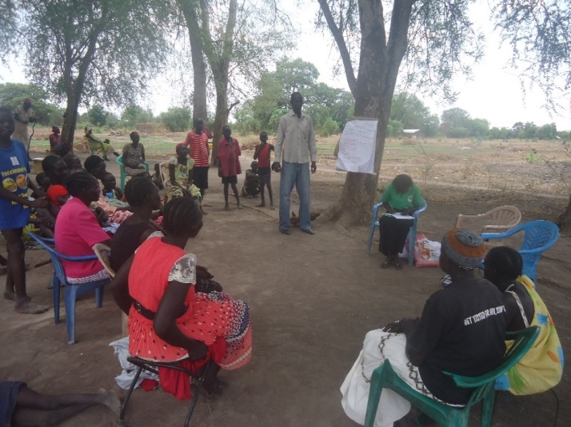
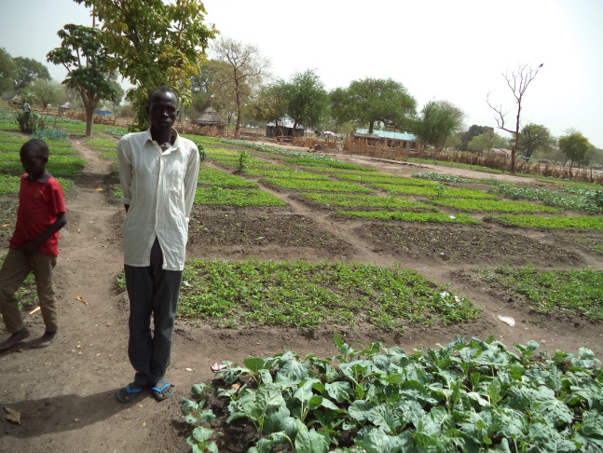
Achievement cont.....
Women‘s group during practical
892 (57.8% w & 42.2% m) new farmers identified in 7 counties,
2 days retaining of old farmers 3205(1823w/ 1582m) started and is currently going,
Mid term evaluation successfully conducted, but report not finalized

Slide 8
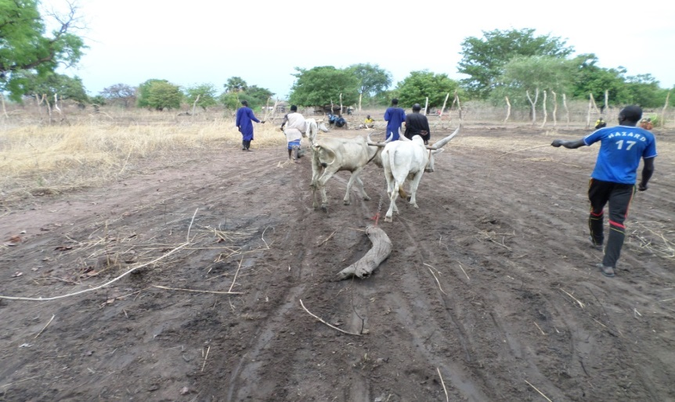
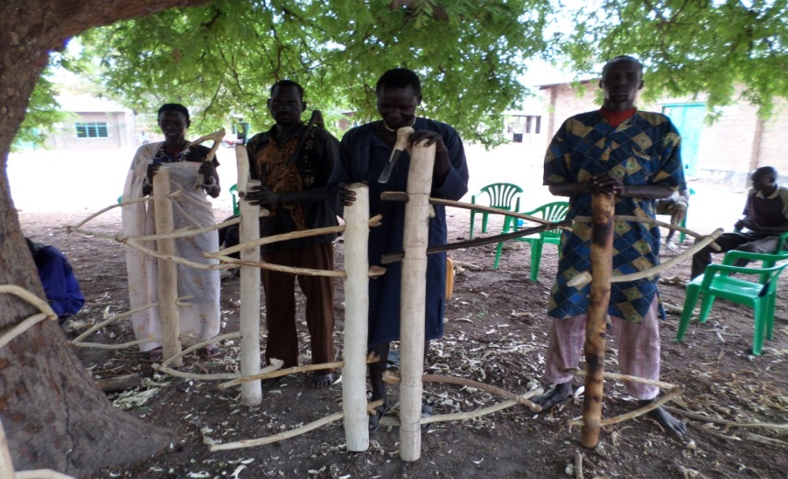
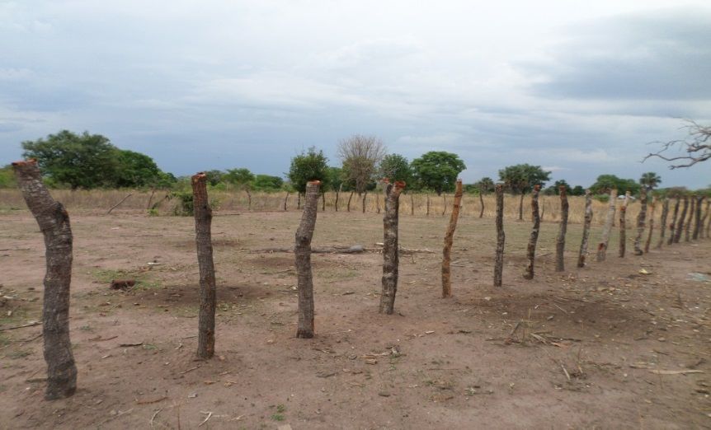
Achievements
4 pairs of oxen and 8 famers (1 women, 7 men) were trained on animal traction/ploughing,
46 COTs were given refresher trainings for one week (2ATCs),
138 chisels and 138 small axes were produced ( will be purchased by NPA) given to trained COTs,
Tree nursery establishment started in both Matangai and Mabui ATCs and in progress,

Slide 9
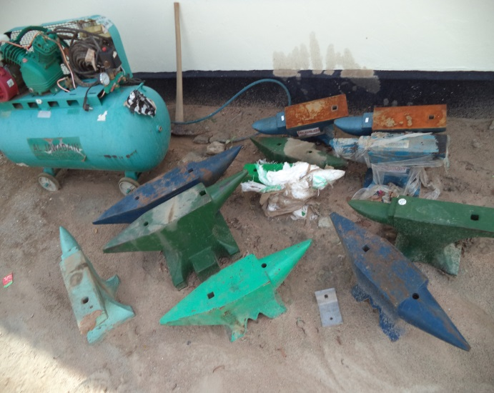
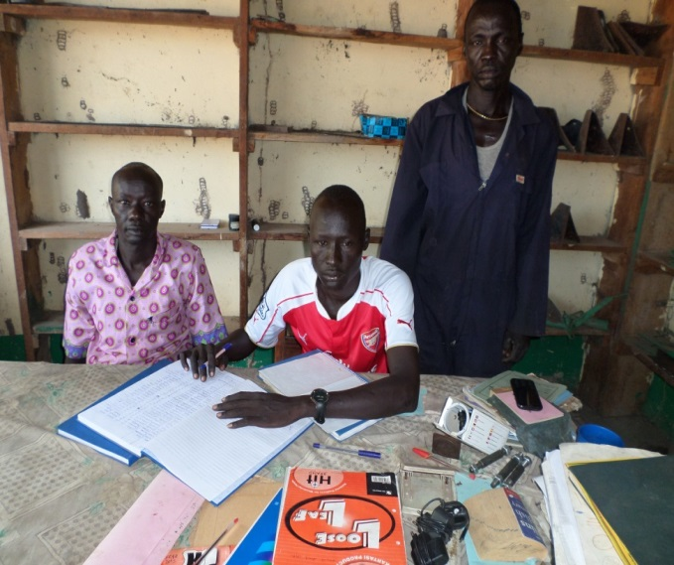
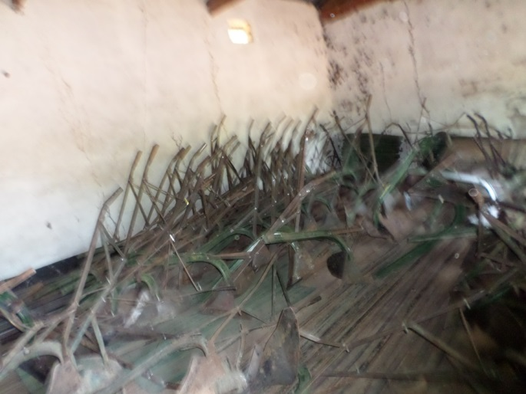
Achievements cont...
Gum boots, overalls, Anvil, hammers, file box, vice, plier, hacksaw and blades were distributed to 38 trained local blacksmiths,
Assorted parts of plough produced( this include: wheels 32, handle grips 96, wheel arms 56, landslides 22, shares 46 and frogs 05),
Sales of ploughs (29 x 2413.8 = SSP 70,000), parts and repairs of ploughs (SSP 9,100) generated 79,100 SSP.
22 ploughs were assembled this quarter,
The current assembled ploughs available = 138 pcs for COTs (NPA to buy)

Slide 10
Achievement cont....
Income generated
a) Cash in hand (19,000+25,200+79,100)= SSP 123,300
b) Inventory worthy = 340,000 SSP
138 ploughs valued at market price = SSP 333,104
138 chisels valued at market price = SSP 2,760
138 axes valued at market price = SSP 4,140
Land certificate was issued to Nhompath Blacksmith Rumbek

Slide 11
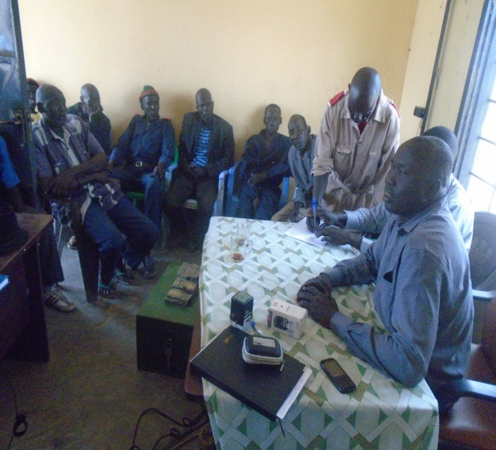
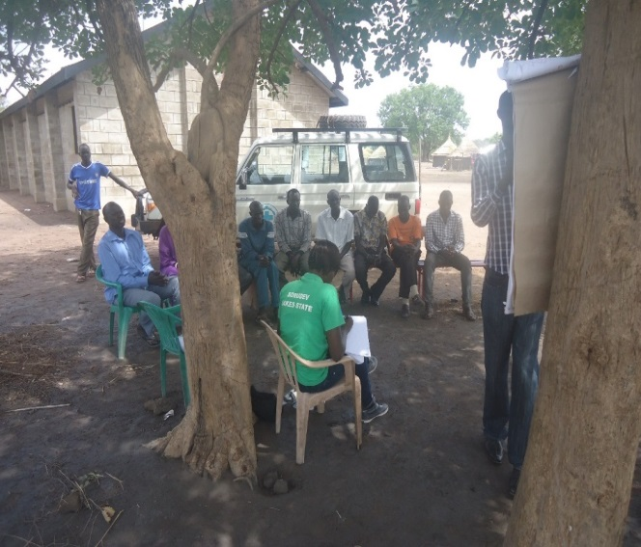
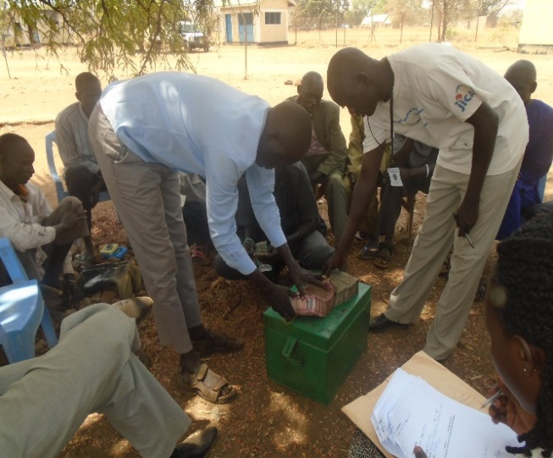
Achievements
5 days training given to 7 vet pharmacies on development of business & management , record keeping,
A loan 105,000 SSP disbursed to 7 vet pharmacies to help them purchasing drugs
23 farmer associations organized in payam levels-with memberships of 207(128 men/79 women),
25 FGs ( 508 individuals) have registered their willingness to be supported in VSLA as they had heard benefits from their village mates,

Slide 12
Summary of VSLA ledger book
Total number of farmers currently participating in VSLA is 1,931( 722 men/1,209 women),
Accumulative saving is 658,677 SSP while saving this quarter is 181,315 SSP,
Accumulative loan given out is 411,645 ssp, while the loan given out this quarter is 190,085 ssp,
Accumulative interest obtained from loan 12, 0368 ssp while loan paid back in this quarter 161,595 SSP with interest of 33,242 SSP,
Accumulative social and emergences fund 26,060 while social & emergency fund this quarter 8,530 cash.

Slide 13
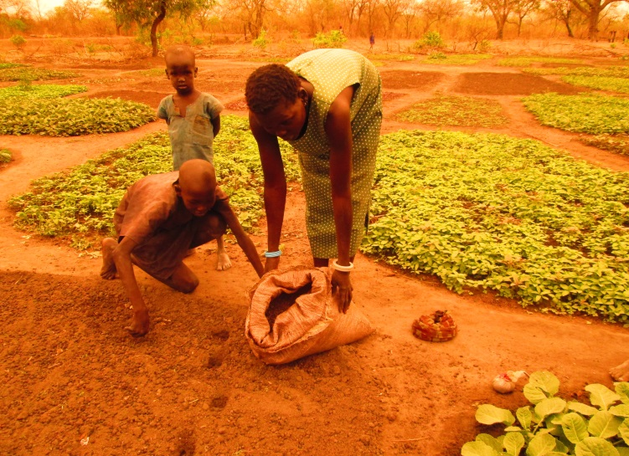
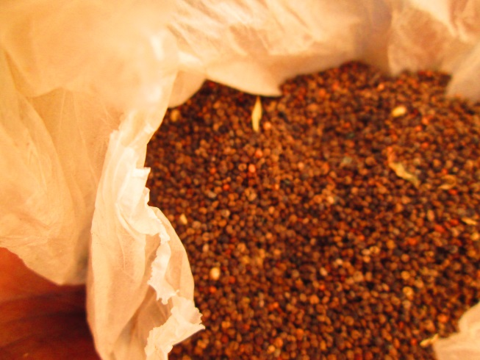
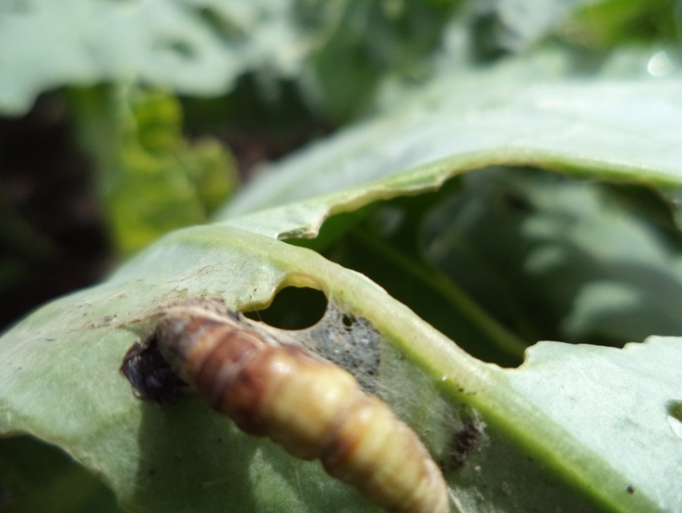
4. Challenges
Inadequate knowledge & skills in vegetable growing,
Lack of enough water for irrigation causes into serious competition among users,
Absence of highly valued vegetable seeds in local markets,
Lack of basic farm tools & equipment in the market,
Pests and diseases vegetable

Slide 14
Challenges cont....
Insecurity: constraint farmers to attend saving meeting regularly and fear of safety of the money.
Lack of raw materials: delays fabrication of saving boxes, ploughs and plough parts.
High rate of illiteracy: almost 95% of people participating in VSLA don't read & write – this increase work load for extension agents attending meeting/saving,
Inadequate loan: the loan given to the vet groups was enough following inflation of the country,
dollars rate: this is affecting the sources the raw materials mean for ploughs.

Slide 15
Key lessons learned.
Production of vegetable was not a focus of SORUDEV, but this activities considered important by women and schools children as it is source of diet and income generation during dry season,
VSLA is vigorously expanding and more spontaneously formed farmer group need support in term of training and provision of saving boxes.

Slide 16
4. Next quarter planned 2nd quarter 2016
Continue with the training of farmer and advisory services,
Training of the 4-5 government extension agents for 3 months basic agriculture in Yei,
Capacity development of government counterparts in report writing and M&E,
Formation & training of farmer associations ( counties level) and farmer union(state level),
Training and development of business plan for Matangai and Mabui centre.
disbursement of to Rumbek North vet group.
Continue formation and integrations of VSLA in farming activities.

Slide 17
Next quarter cont...
Trainings of:10 local blacksmiths,45 COTs, Farmers and their oxen on ox plough technology ,
Demonstration of ox drawn implements in the ATCs
Establishment of tree nursery, distribution and transplanting of seedlings
Production of parts, assembling of ploughs, sales of ploughs and parts
Construction structures in ATCs

Slide 18
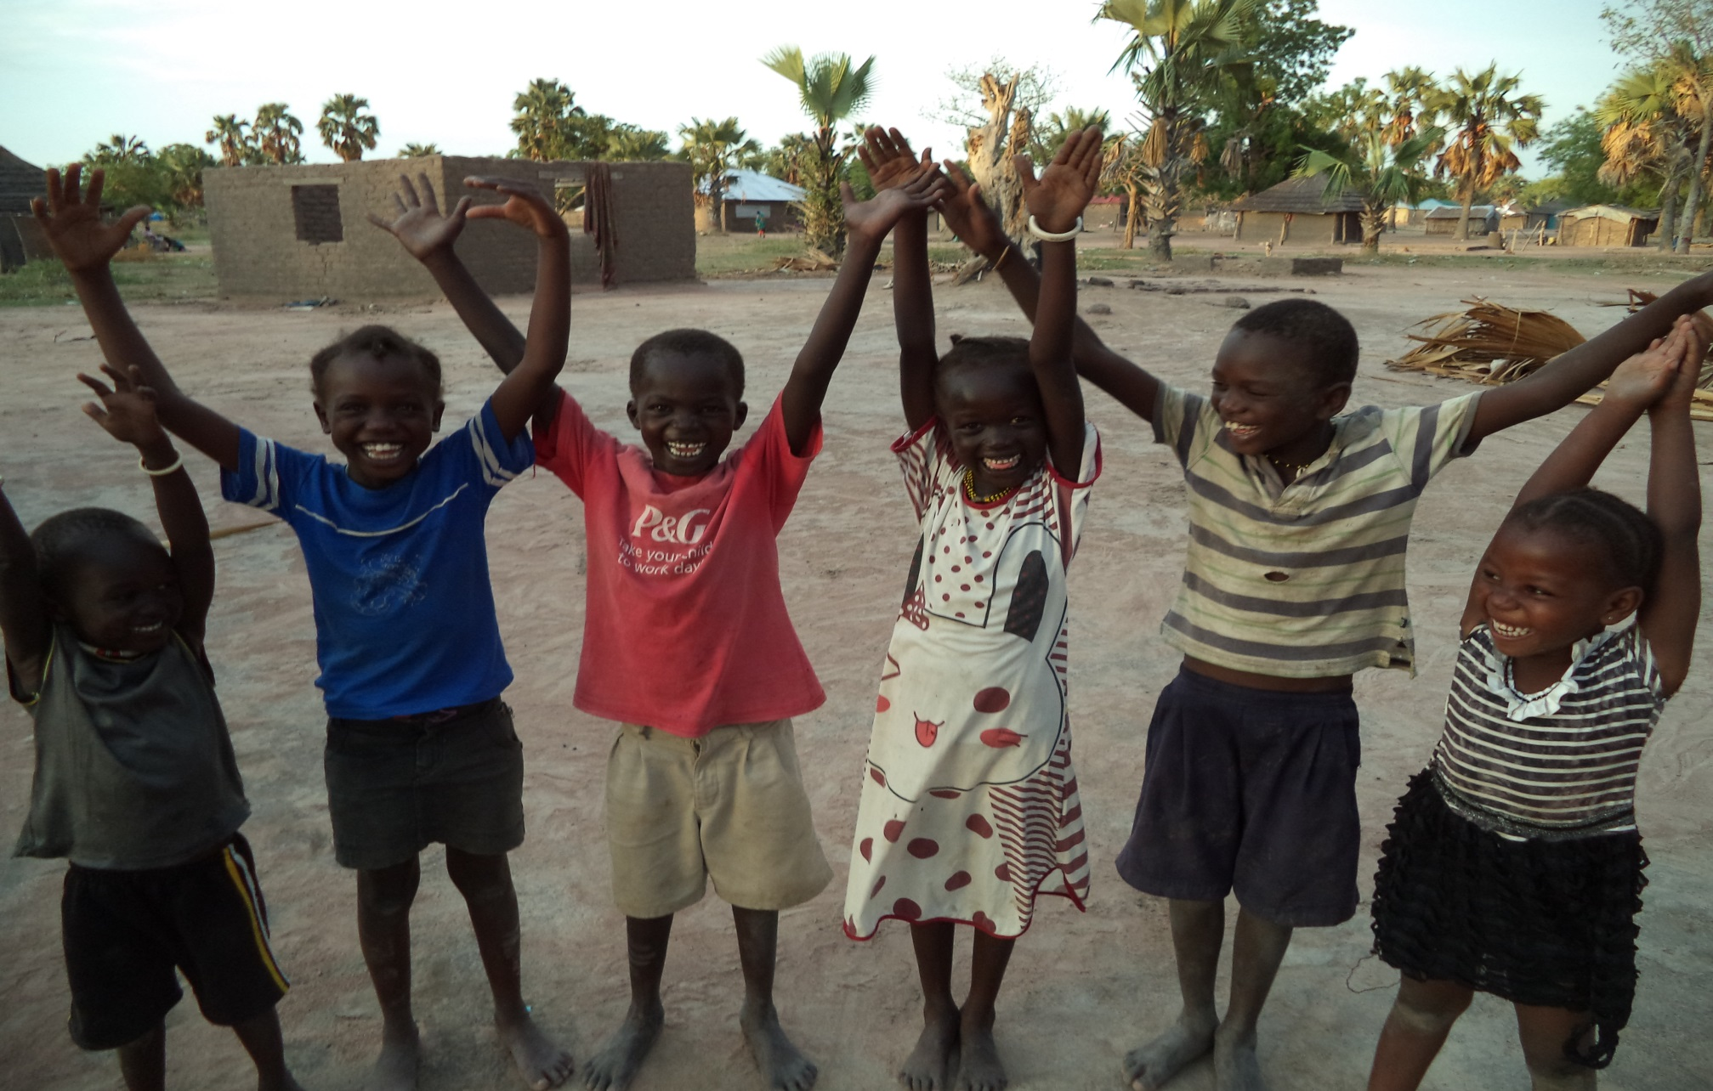
THANK YOU

