Slide 1
European Union / South Sudan
Cooperation
Greater Bahr el Ghazal
RURAL DEVELOPMENT PROGRAMME
Steering Committee Meeting - ZEAT-BEAD
Quarterly Review - SORUDEV and FSTP
Funded by the European Union
Government of South Sudan

Slide 2


PRESENTATION
Taban Kaps Robert- NRC Project Coordinator
Eddington Chinyoka–NRC Program Manager
Peter Madut Amet- SORUDEV Focal point SMAF
Achuil Kuoch Achuil- Reprenting the DG SMAF

Slide 3
Layout of presentation
Project Objectives
Achievements
Activities planned for the next quarter
Challenges, and
Lessons learnt

Slide 4
Project Objectives
Overall objective
To contribute to increased food security, reduced vulnerability and enhanced livelihoods of rural households in Warrap State
Specific objective
Smallholder farmers in Warrap State have increased sustainable and diversified agricultural production and income.

Slide 5
ACHIEVEMENTS BY RESULT
Result 1: "County and Payam level agricultural extension systems strengthened and providing support to small holder farmers throughout the farming season”
Key activities have been achieved
provision of motorbikes, bikes, bicycles, computers and office equipment.
4 Government extension workers trained in Yei
Pending activities under this result area
Installation of solar system for County offices
4 additional motorcycles procured but still in Juba.
Impact of the activities conducted;
Due to motorcycle and bicycle support, Government extension workers have been able to deliver extension services to farmers at the County and Payam level.
Yei-trained government extension workers are conducting training for farmer groups.
Confidence of the extension workers and farmers has improved drastically.

Slide 6
Result 2: “ Targeted HH have improved access to inputs, knowledge and skills in diversified crop production, post-harvest management and environmental protection”
Key activities have been achieved eg
Monitoring of VSLA groups was done in the last quarter NRC witnessed some group sharing their money
Extension service offered through SMAF and NRC
Pre-testing of the VSLA monitoring tool shared by the TA
Impact of the activities conducted;
Households managed to address immediate food need from saving generated through VSLA
Most families failed to procure agricultural inputs since the saving were eroded by inflation and also high price of food

Slide 7


Result 3: “Smallholder farmers have access to and adopt animal traction technology and other improved farming implements”
Key activities have been achieved
Training of 200 farmers on animal traction and the training is ongoing
Extension service offered through SMAF and NRC
Impact of the activities conducted;
Farmers are taking advantage of the current onset of rains to prepare their gardens through the use of ox-ploughs.
Farmers do appreciate the need to transition from the use of malodas to the use of ploughs.

Slide 8
Result 4: “Smallholder farmers have increased access to markets and other value chain actors”
From the onset of the implementation of the project, the idea of establishing of agro-dealers has been a daunting task.
NRC in collaboration with SMAF has been able to support the formation and registration of a company RAISE (Rhino Agro-inputs and Services). The company was formed with the objective of delivering agricultural inputs and services to farmers.
Next steps;
NRC will hire a consultant to provide training on business management, seed production and management and on how to provide agriculture advisory services to the farmers.
Nurture the company through coaching using the GROW-ME coaching module.

Slide 9
Activities planned for the next quarter
Training of value chain actors and farmers on small scale business management, seed production and management, seed science and multiplication.
Conduct the VSLA monitoring
Continue providing the VSLA groups extension support.
Distribution of the 4 motorcycles to Government
Conduct crop assessments in liaison with partners.

Slide 10
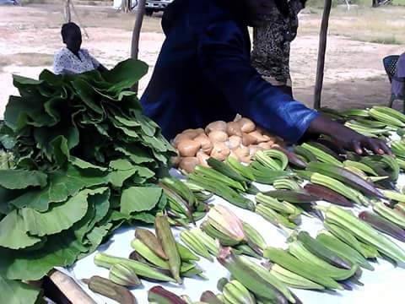
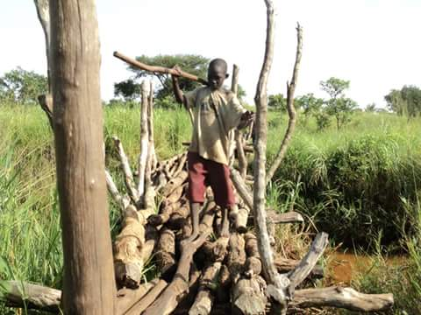
SUPPORTING FARMERS CROSS THE BRIDGE OF POVERTY
END

