Slide 1

European Union / South Sudan
Cooperation
Project: SORUDEV Food Security and Livelihoods Project, 2014 -2017
Wau and Lol States.
Implementing agency: Hope Agency for Relief and Development (HARD).
Implementation progress report presented at SORUDEV partners’ 6th quarterly review meeting at Aweil Grand Hotel, Aweil on 26-28 April 2016.
By
Dominic Albino - M&E Officer.

Slide 2
Expected results
Specific Objective: Increased agricultural production and income of smallholder farmers in Western Bahr el Ghazal state
Results.
R1 - Increased area of land cultivated using animal traction without corresponding decrease in crop yields.
R2 - Increased promotion and adoption of appropriate agricultural practices for 1500 smallholder farmers.
R3 - Increased diversification of crops grown through integrated fruit trees, vegetables and cassava farming.
R4 - Improved post harvest handling and management & increased adoption of post harvest storage facilities and marketing of surplus farm produce.

Slide 3
Implementation of the
Jan– March 2015
work plan.

Slide 4
Work plan Jan– March2015
Midterm evaluation of the project.
Complete yield data collection, analysis and disseminate results.
Training 360 farmers in post-harvest management and handling.
Training of 5 marketing groups.
Training of farmers in 5 vegetable growing groups.
Training 5 project staff and 6 CAD officials for 1 month at CTC Yei.
Support 60 farmers to construct improved granaries.
Carry out publicity activities on availability animal traction equipment.
Training of VSLAs – new groups in VSLA process and old groups on income diversification.
Refresher training of 26 CORPs.
Convene project steering committee meeting.
Quarterly planning meeting

Slide 5
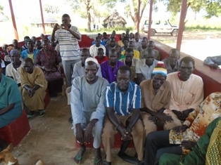
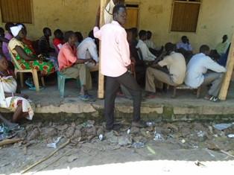
1. Mid term evaluation (MTE).
Midterm evaluation was conducted in February and March and the findings are summarised in the next two slides below:
Community meeting during MTE in Marial Bai
MTE FGD in Kayango boma

Slide 6
Key findings of MTE
Increased agricultural production e.g. both gross yields and productivities for sorghum and groundnuts by 32% and 50% and by 2% and 150% respectively;
Land cultivated using animal traction rose by 55% while food stock months rose by 9% in the last 18 months,
2% rise in own harvest food sourcing,
54% drop in food expenses and marginal distress related disposals of livestock.
Impacts on incomes include, for instance, both gross monthly and sale of surplus farm produce derive incomes rising by 35% each.
20% and 6% rise in health and education expenses respectively and 35% rise in food purchasing.
26% increase in farm produce marketing;
32 CORPS Jur river and Raja County were given a refresher training on how to offer better extension service to the farmers, out of the 32 were 3 female CORP and 30 male

Slide 7
Key findings of MTE cont’d
9. 71% and 22% rise in adoption of animal traction ploughing and agro forestry respectively.
10. diversified cropping and effective post harvest practices rose by 23% and 110% respectively,
11. Post harvest losses dropped by 15%.
Conclusion: Overall, the project is on track to improving food security and livelihoods of beneficiaries. However, exogenous factors like insecurity and economic meltdown dilute gains made and limit realization of more benefits. The timeframe is also insufficient to do more than contribute to alleviating short term livelihood needs. Intensification of successes should be able to consolidate the gains for long term impacts.
Final report has been produced and shared with EUD

Slide 8
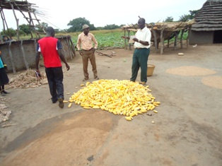
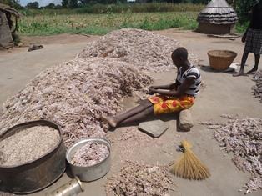
2. Yield assessments
This has been completed in most bomas and the results are discussed under results section below:
Yields assessments taking place in different bomas

Slide 9
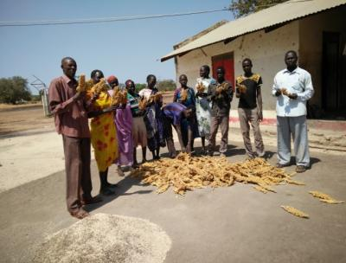
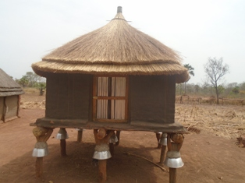
3. Improved household level granaries
So far 620 (M=315; F= 285) farmers have been trained in improved post-harvest management and handling practices.
202 hh (M= 123; F= 79) have constructed improved granaries.
Farmers training in Udici boma
Completed improved granary.

Slide 10
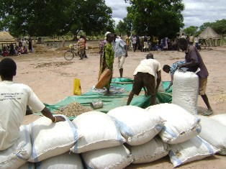
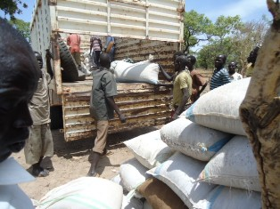
4. Marketing of agricultural produce
Five cooperative societies supporting about 370 (M=211; F= 159) farmers were trained in management and marketing
Sale of produce in local markets
Loading produce on a truck for onward transport to Wau

Slide 11
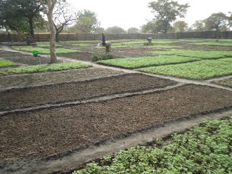
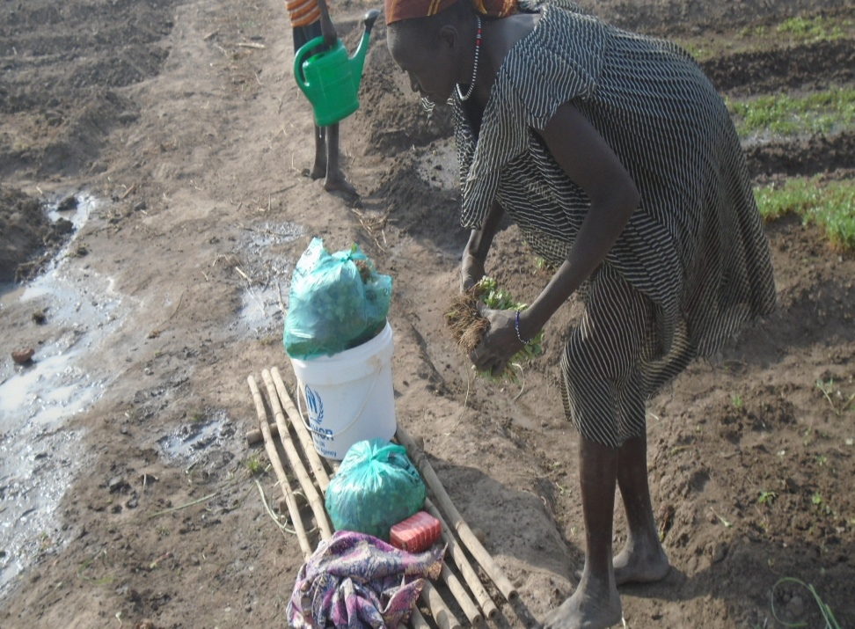
5. Dry season vegetable production
4 vegetable groups are in operation supporting 114 hh (M=34; F=80).
Plots prepared for replanting of rigila (purslane) in Uyu-juku
A farmer harvesting purslane for the market in Kuanya vegetable garden

Slide 12
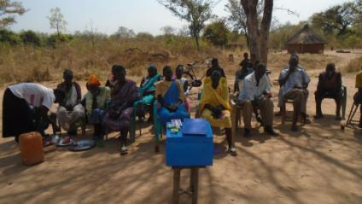
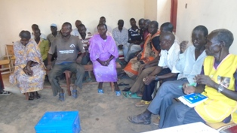
6. Voluntary Savings and Loans Associations (VSLAs)
32 VSLAs are in operation with accumulated savings of 134,273 SSP and 32,300 SSP lent out to members. Training and sensitisation is currently on-going on income diversification and investments to hedge against inflation.
VSLA meeting in Abushaka Boma
VSLA meeting in Gumaba Boma
Inflation is fast eroding the value of money and there is need to buy assets and engage in other streams of income generation.

Slide 13
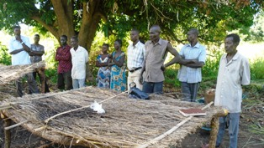
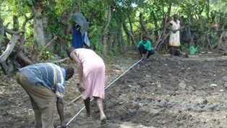
7. Tree nurseries.
1 tree nurseries have been established with 1,200 fruit tree seedlings. The seedlings will be mature for transplanting as from July 2016
Training of farmers in nursery establishment and management

Slide 14
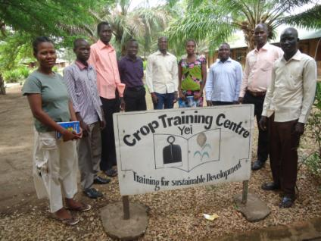
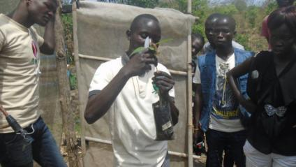
8.Training of project and CAD staff in Yei
5 project staff and 6 CAD officials received 1 month training in Yei.
HARD staff and CAD officials at Yei CTC
Practical demonstration during the training

Slide 15
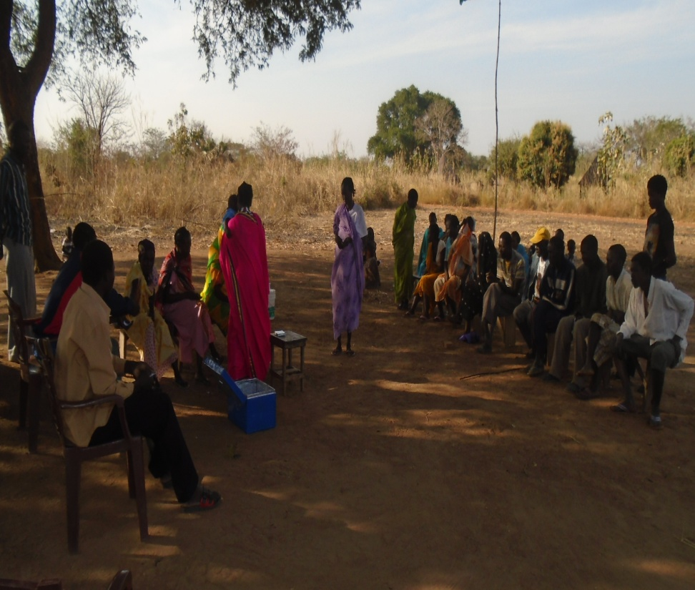
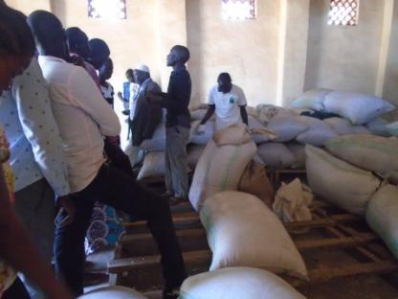
9. Agricultural loan programme
25 farmers groups/cooperatives were given loans totaling 255, 275 SSP at an interest of 15%. 11 groups/cooperatives have repaid a total of 95,625 SSP giving a repayment rate of 32%.
Main challenges are: insecurity in Wau County and low harvests .
Warehousing produce in Raja County
Deim Zubeir VSLA members

Slide 16
8. Field day and launch of 2016 agricultural season
Organised by State Ministry of Agriculture in partnership with HARD. A total of 87 (M=; 57 F= 30) farmers participated a one-day field day and launch of 2016 agricultural season. State Ministry of Agriculture, CAD officials, farmers representatives and 8 other partners working in food security took part in the function.
Objectives of the fair were as follows:
To provide relevant information required to improve their agricultural practices
To promote use of short term varieties (diseases resistant and drought resistant) and their advantages.
To encourage farmers cultivate much staple food and sorghum, cassava, groundnut, millet, sweet potatoes and other vegetable.
To create market- oriented farming activities.

Slide 17
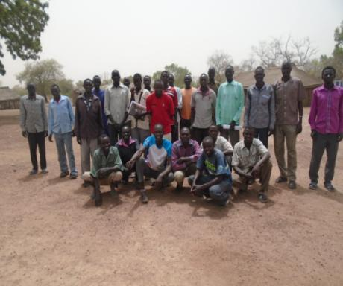
10. Training of CORPs/CBLEWs
32 (M=28;F=3) CORPs from Jur River and Raja Counties were given a five-day refresher training in extension methods.

Slide 18
Challenges ,solutions and lessons learned.
Insecurity: Wau County has been affected by insecurity and most people have been displaced. Activities are being relocated to Jur River County.
Continued deterioration of economic situation of households: evidenced by rapid sale of produce, cutting down of trees and migration to towns. In addition, it impacts on the capacity of farmers to afford the inputs at market prices; pool resources in VSLAs & agricultural loans.
Fuel: Intermittent fuel supply in the market affecting field operations; stocking & bulk buying but suppliers are not willing to store fuel for long.
Low buy-in of technologies due to (illiteracy, lack of capital and inadequate labour): Practical learning - Demo farms and FFS Flexible learning times.

Slide 19
D. State Government nominated focal points and call tree to all administrative levels.
Mr. Martin Damazo has been nominated for SORUDEV project at SMoAAR.
The focal person at the County levels are CADs. Payam offices are not operational.
Partnership with UNOPS on community mobilisation and sensitisation along the proposed feeder road ,community sensitisation done and building community structures is taking place.
There has been sharing of information with other ZEAT-BEAD partners.
Two coordination meetings with ZEAT-BEAD partners held in October and November, focusing mainly on strategizing and info sharing.
Collaboration has started with UNIDO in training of store/granary technicians and GIZ on linking our farmers to the warehouse in Kangi.
Training of staff at CTC Yei on staff training in February and March 2016.

Slide 20
Work Plan and measures (quarterly targets) for the forthcoming 9 month period

Slide 21
Work plan and targets for the next 9 months.
Quarter 2: April – June 2016.
Recruit , train and distribute seeds 180 seed producers.
Train at least 300 farmers in animal traction.
Work with agro-dealer and avail over 300 ploughs to farmers
Establishment of 20 FFS.
Establish of additional 5 cassava bulking farms
Data collection: household food security assessments.
Hold at least 7 Payam based field days
Quarterly planning meeting.

Slide 22
Work plan and targets for the next 9 months.
Quarter 3: July – Sept 2016
Provide extension support to at least 1,500 farmers in improved agronomic practices; group training, FFS and household-level visits.
Data collection: land area cultivated and crop assessments.
Training in 120 farmers in agro-forestry.
Agro-forestry training and transplanting of seedlings.
Initiate vegetable production.

Slide 23
Work plan and targets for the next 9 months.
Quarter 4: Oct – Dec 2016.
Training 5 project staff and 6 CAD officials for 1 month at CTC Yei.
Convene project steering committee meeting.
Provide extension support to at least 1,500 farmers in improved agronomic practices; group training, FFS and household-level visits.
Training 360 farmers in post-harvest management and handling.
Support construction of at least 60 improved granaries.
Provide training to more marketing groups.
Data collection: yields and crop performance assessments.

Slide 24
A. Key achievements – performance and result indicators.

Slide 25
SO - Increased agricultural production and income of smallholder farmers in Western Bahr el Ghazal state
SO Indicator 1: Yields for the three main crops(sorghum, groundnuts and maize) per feddan increased by 50% in at least 3000 supported households by 2017
 | Year 1 (2015) in 900 households.
 | Sorghum | Groundnuts | Maize
Baseline values | 164 Kg | 302 Kg | 169 Kg
Target average yields per feddan per HH | 264 Kg | 413 Kg | 254 Kg
Actual average yields per feddan per HH | 278 Kg | 590 Kg | 315 Kg
% increase in yields | 23.26% | 41.16% | 19.77%
Yield of maize which is usually a short term crop was affected by erratic rains early in the season.

Slide 26
SO - Increased agricultural production and income of smallholder farmers in Western Bahr el Ghazal state
SO Indicator 2: Monthly household incomes increased from 571 SSP to 800 SSP in at least 900 supported households by 2017(Targets: Y1:629 SSP in 100 HHs; Y2:714 SSP in 400 HHs, Y3:800 SSP in 900 HHs).
 | 2014/2015 | 2015/2016
Baseline income value | 571 SSP | 571 SSP
Target average income per hh per month | 629 SSP | 714 SSP
Actual income per hh | 680 SSP | 1180 SSP
% increase in incomes compared to baseline income value | 11.86% | 106.65%
Target number of farmers | 100 | 400
Actual number of farmers | 143 | 367 (M=192; F=175)
Data was collected from farmers 367 (M=192; F=175) Most of the households earned incomes from sale of agricultural production and sale of grass, firewood and charcoal.

Slide 27
SO - Increased agricultural production and income of smallholder farmers in Western Bahr el Ghazal state
SO Indicator 3: Proportion of food consumed derived from own production increased from 40 -90% in at least 3000 households by 2017 (Targets: Y1: 10% in 900 HHs; Y2: 25% in 2200 HHs; Y3: 40% in 3000 HHs)
 | 2015 | 2016
Baseline percentage of own production consumed at the household level (August 2014) | 64% | 64%
Target percentage of own production consumed at the household level | 70% | 80%
Actual percentage of own production consumed at the household level (Jan/Feb 2016) | Data not collected. | 82%
Target number of farmers | 900 | 1300
Actual number of farmers | 1043 | 870
To assess the proportion of food consumed at household level, data was collected from 1,645 (M= 913; F=623). focus group discussions (FGDs) were also held in 4 bomas.

Slide 28
R.1 Increasing production and productivity: animal traction
Indicator 1.1: 3,000 farmers have increased their knowledge and skills in use of draught animal power for cultivation by 2017
 | Y1(2015) | Y2(2016) | Y3(2017) | Total
Baseline number of farmers (August 2014) | 0 | 0 | 0 | 0
Target number of farmers | 900 | 1300 | 800 | 3000
Actual number of farmers (August 2015) | 415 (M=354; F=61) | N/A | N/A | 415 (M=354; F=61)
A total of 415 (M=354; F=61) farmers increased their knowledge in animal traction out of whom, 90 (M=75; F=15) were Animal Traction Trainers (TOTs).

Slide 29
R.1 Increasing production and productivity: animal traction
Indicator 1.2 : Average land area cultivated per household increased by 50%, (from 2 feddans to 3.5 feddans in at least 2,720 households using animal traction in cultivation by 2017
 | Y1 (2015)
Baseline land area cultivated per households (August 2014) | 3.2 feddans
Target land area cultivated per household. | 3.52 feddans
Actual average land area cultivated per household (August 2015) | 4.9 feddans.
% increase in land area cultivated (actual vs. baseline) | 40%
Target number of farmers | 800
387 (M= 341; F=46) farmers cultivated an average of 4.9 feddans each in the 2015 agricultural season. One ox-plough cultivated for an average of 5 households in one season with an about 21 feddans per ox-plough

Slide 30
R2 - Increased promotion and adoption of appropriate agricultural practices for 1500 smallholder farmers.
Indicator 2.1: County-based extension delivery system established & functional to support at least 3000 farmers by 2017. (Targets: Y1:10% in 900 HHs; Y2:30% in 2200 HHs, Y3:50% in 3000 HHs) (R2)
 | Y1 (2015) | Y2 (2016)
Target number of households reached | 900 | 1300
Actual number of farmers | 2,442 (M=1,338; F=1,104)
The county based extension system is composed of; 11 project staff, 10 County Agriculture Department (CAD) extension officials and 48 Community Own Resource Persons (CORPs).

Slide 31
R2 - Increased promotion and adoption of appropriate agricultural practices for 1500 smallholder farmers.
Indicator 2.2: Adoption of farm fertility improvement measures increased by 50% in at least 3000 farmers by 2017. (Targets: Y1:10% in 900 HHs; Y2:30% in 2200 HHs, Y3:50% in 3000 HHs) (R2)
 | Y1 (2015) | Y2 (2016) | Y3 (2017)
Baseline percentage number of farmers (August 2014) | 216 farmers (27%)
Target number of farmers | 900 | 2200 | 3000
Actual number of farmers | 920 (M= 507; F=393)
The most common practices adopted were; 1) legume cropping; 2) correct mixed cropping and; 3) better decomposition of farm yard manure and 4) line planting of groundnuts.

Slide 32
R2 - Increased promotion and adoption of appropriate agricultural practices for 1500 smallholder farmers.
Indicator 2.3: Adoption of agro-forestry practices such as tree planting increased by 50% in at least 800 supported households by 2017 (Targets: Y1:10% in 150 HHs; Y2:30% in 450 HHs, Y3:50% in 800 HHs) (R2)
 | Y1 (2015) | Y2 (2016) | Y3 (2017)
Baseline percentage number of farmers | 41 farmers (27%)
Target number of farmers | 150 | 300 | 350
The farmers acquired knowledge and skills in different aspects of tree nursery establishment and management

Slide 33
R2 - Increased promotion and adoption of appropriate agricultural practices for 1500 smallholder farmers.
Indicator 2.3 Access to extension services increased by 30% for at least 3,000 supported households by 2017. (Targets: Y1: 5% in 900 HHs; Y2:17.5% in 2200 HHs, Y3: 30% in 3000 HHs) (R2)
 | Y1 (2015)
Baseline percentage number of farmers targeted in year 1 | 306 farmers | Baseline percentage number of farmers targeted in year 1
Target number of farmers | 900 | Target number of farmers
Actual number of farmers | 2,442 (M=1,338; F=1,104) | Actual number of farmers
2,442 (M=1,338; F=1,104) farmers were reached with extension services through different extension methods such as; FFS, demonstration farms, field days, individual farm visits, vegetable production, tree nursery management, improved post harvest management and VSLAs

Slide 34
R3 - Increased diversification of crops grown through integrated fruit trees, vegetables and cassava farming.
Indicator 3.1: Adoption of diversified crop types (fruit trees, vegetables & cassava) increased by 50% in at least 1000 households by 2017 (Targets: Y1:10% in 200 HHs; Y2: 30% in 600 HHs, Y3: 50% in 1000 HHs) (R3).
 | Y1 (2015) | Y2 (2016) | Y3 (2017)
Target number of farmers | 200 hh (10%) | 600 hh (30%) | 800 hh (50%)
Actual number of farmers | 246 hh (m=139; F=150)
289 (M=139; F=150) farmers were engaged in the production of these crops in the period under review as follows; cassava production 86 (M=67; F= 19) farmers, tree nursery 28 (M=19; F= 9) farmers and vegetable production 132 (M=60; F=72) farmers.

Slide 35
R3 - Increased diversification of crops grown through integrated fruit trees, vegetables and cassava farming.
Indicator 3.2: Income per household from sale of vegetables increased by 50% (from 77 SSP to 138 SSP) in at least 120 supported households by 2017 (Y1: 10% (100 SSP) in 30HHs; Y2: 30% (115 SSP) in 40HHs, Y3: 50% (138 SSP) in 120HHs) (R3).
 | Y1 (2014/15) | Y2 (2015/16) | Y3 (2017)
Target income per household (August 2014) | 100 SSP (10%) | 115 SSP (30%) | 138 SSP (50%)
Actual average income per household from sale of vegetable | 680 SSP | 1,390 SSP
Actual number of farmers who cultivated vegetables (January/February 2016) | 143 | 132 (M=60;F=72)
132 farmers (M=60; F=72) earned an average of 1,390 SSP since the beginning of cultivation season in December 2016. Vegetable production is still on-going till the onset of rains in late April and it is expected that the incomes earned by farmers will be higher.

Slide 36
R4 - Improved post harvest handling and management & increased adoption of post harvest storage facilities and marketing of surplus farm produce
Indicator 4.1: Adoption of effective post harvest practices increased by 80% in at least 2,100 farmers by 2017.
 | Year 1 (2015/16) | Year 2 (2016/17)
Target number of households adopting post harvest management practices. | 700 | 700
Actual number of households. | 522 (M=333; F189) | N/A
Target number of granaries | 100 | N/A
Actual number of improved granaries constructed. | 202 | N/A
522 (M=333; F189) farmers were trained compared to the target of 700 households. 202 household level granaries have been contracted while the target was 100 granaries.

Slide 37
R4 - Improved post harvest handling and management & increased adoption of post harvest storage facilities and marketing of surplus farm produce
Indicator 4.3: Indicator 4.3: Incomes from sale of surplus farm produce increased by 50% (from 479 SSP to 718 SSP) in at least 2500 supported households by 2017.
 | Year 1 (2015/16) | Year 2 (2016/17)
Baseline income levels | 479 SSP | N/A
Average actual income earned per household. | 1825 SSP | N/A
Target number of households selling surplus produce. | 800 | 1,000
Actual number of households. | 125 (M= 87; F=38) | N/A
Only 125 (M= 87; F=38) out of the targeted 800 farmers reported to have sold surplus produce in the interim period. The produce which was most sold was groundnuts. The low number of farmers selling the produce is attributed to low yields of crops in 2015 agricultural season.

Slide 38
D. State Government nominated focal points and call tree to all administrative levels.
Mr. Martin Damazo has been nominated for SORUDEV project at SMoAAR.
The focal person at the County levels are CAD. Payam offices are not operational.
Partnership with UNOPS on community mobilisation and sensitisation along the proposed feeder road- baseline survey done, community sensitisation done and building community structures is taking place.
There has been sharing of information with other ZEAT-BEAD partners.
Two coordination meetings with ZEAT-BEAD partners held in October and November .
There will be collaboration with UNIDO in training of store/granary technicians and GIZ on linking our farmers to the warehouse in Kangi.
Discussions with CTC Yei on staff training to be held in Feb/March 2016.

Slide 39
B. Procurement plan.
Total grant budget: €2,222,222
Total amount disbursed to date: €1,527,689
Funds spent to date: €1,242,340
Quarterly forecast:
April – June: €250,000
July – Sept: €200,000
Oct – Dec: €150,000

Slide 40
The end.
Thank all you for your attention.

