Slide 1
OpSys project 1
First Domain User Group meeting
22 April 2016
1

Slide 2
Agenda
Introduction on OpSys programme
DUG objective
Project 1 presentation
OpSys project 1 Scope
OpSys project 1 Main actors
OpSys project 1 roadmap
Agile method
Focus on business needs: discussion and priorities
Wrap-up and next steps

Slide 3
1. Introduction
What do you need to know about OpSys programme?
OpSys vision
OpSys scope
3

Slide 4
OPSYS VISION
Opsys programme will gradually offer improved OPERATIONAL PROCESSES AND TOOLS to DEVCO/NEAR/FPI staff from end users to top managers in order to manage efficiently their portfolio of projects/programmes throughout the cycle of operations.
Through a FLEXIBLE AND AUTOMATED SYSTEM, our staff will be able to easily access information on projects/programmes, prepare, validate and monitor them as well as manage results with ‘no re-encoding’ principle.
Our staff will be able to do COLLABORATIVE WORK, get input from EXTERNAL PARTNERS and to feed reporting and communication tools for a greater transparency.

Slide 5
OPSYS SCOPE
Result management and operational entities
1
Dependencies
Action management and
level 1 commitment
2A
ABAC
CRIS invoicing
Contract management and level 2 commitment
2B
Hermes, Decide, SEDIA
Implementation & Evaluation
(complementary to 1)
MIS
3
Eval Rom
Prospect
GIS
Programming process and preparation of actions (complementary to 2A)
4
Tendering (complementary to 2B)
Governance revision
5
TRANSVERSAL PROJECTS
Architecture (Enterprise & IT)
Re-use and integration
Data model & Taxonomy
Data migration
Change management

Slide 6

2. DUG objective
Collaborating work as a team
Composition: DEVCO 06, 05, R1, R6, relevant NEAR representatives, FPI 01, thematic and geographic operational units and pilots EUDs and HQ Units
Understanding about what is expected from you
Main responsibilities:
Contribute to specific business needs
Explore harmonisation and simplification opportunities
Provide continuous feedback on developments
Participate to specific user acceptance testing
6

Slide 7
EU Delegations
Working with EU delegations in OpSys project 1:
Why?: most of users, specific needs, Pilot phase in 2017
Who? Diversified profiles;
DEVCO: Brazil, Ethiopia, Pakistan,
NEAR: Ukraine, Morocco, Bosnia
How? Kept informed, Video conference, testing, annual workshop
7

Slide 8
3. Project 1 presentation
Scope
Actors
Miletones
8

Slide 9
OpSyS Project 1 - Scope
Strategic Objectives
Increasing productivity (efficiency, processes)
Improving quality (data/operations)
Shifting to a result orientation mind-set
Transparency/ Connecting to external partners
Vision: Users will shape their operational portfolio and manage automated results
1- Operational entities (prerequisite)
Programming – access data
Action, Contract – access data
Projects/programmes – create and manage
6- External access (first phase)
Implementing partners will be able to provide direct inputs on results
2- Results
Logframes; EU indicators
Baseline and target
Achieved results
5- User experience
Internal portal for a single access to operational systems
Harmonised and intuitive user interface
USER
4- Integration & interoperability
Data legacy
Progressive integration with EU websites,
EAMR, GIS, ROM, EVAL, etc.
3- Monitoring (first phase)
Monitoring outputs and activities from the implementing partner
Plan and monitor key events and activities from the EC Operational manager
9

Slide 10
OpSyS Project 1 - Actors
OpSyS Programme
OpSyS Project 1
DEVCO IT SC
Incl. NEAR and FPI rep.
informs
NEAR IT SC
Business Manager (BM)
DEVCO 05 - Lucile PETITPIERRE
IT project manager (ITPM)
DEVCO R6 – Eric PASTELEUR
endorses
OpSys Programme Steering Committee (PSC)
DEVCO & NEAR dir. + FPI + DIGIT + ad hoc DGs
Domain User Group 1 (D-UG 1)
Agile project team 1 (APT 1)
Process owners
DEVCO 06, NEAR A4-A3, FPI 01
Product owner
DEVCO R6 – Giuliano ROSCIGLIONE
OpSys Programme User Committee (PUC)
HQ & EUD rep. from DEVCO/NEAR/FPI/ECHO/EEAS dir.
Geographic & thematic units
Operational units Representatives from DEVCO, NEAR, FPI
Scrum master
DEVCO R6 – to be defined
System Owner (SO)
DEVCO 05 – Thierry MATHISSE
System supplier (SS)
DEVCO R6 – Fernando CENTURIONE
Pilot EUDs
Brazil, Ukraine, Ethiopia, Pakistan + IPA, ENI South, sub-Saharan francophone Africa
Architecture Owner
DEVCO R6 – Johan GAUDIN
Programme manager
DEVCO 05 – Denis THIEULIN
Programme manager
DEVCO R6 – Fabrice VAN OOST
Dev team
DEVCO R6 - developers
Pool of experts
Experts on specific topics
Coordinator BMs
DEVCO 05 – Paul RIEMBAULT
Coordinator ITPMs
DEVCO R6 – Dris RACHIK
10

Slide 11
OpSys project 1 - High level roadmap
2016
2017
Feb
Mar
Apr
May
Jun
Jul
Aug
Sep
Oct
Nov
Dec
Jan
Feb
Mar
Apr
May
Jun
Jul
Aug
Sep
Oct
Nov
Dec
22/04 DUG
13/05 –PC approval (ITSC)
BC approval (ITSC written)
30/03
20/04 PUC
Deliverables
Project Charter
Starting intermediary user tests
Deploy in pilot EUDs (exact date tbc with EUDs)
Roll out in HQ and all EUDS
(exact date tbc with EUDs)
End of roll out
End of project result reporting 2016-2017 done in OpSys
Architecture overview
Change management strategy
Coordinate
(Process owners 2 meetings/week) (DUG: 1/month)
Coordinate
Backlog management
& maintenance
Sprint 0
Implement
(2 sprints /month)
Roll-out
Iteration cycle
Agile team constitution (start sprint 1)
Implement corrective actions
Review
(DUG: 1 meeting/month)
Test & monitor
(pilot EUDs)
Review
DUG constitution
Training
Draft training
packages for
Roll-out
Monitoring missions in 2018 in selected EUDS
Prepare induction package (training and com) for Pilot EUDs
Missions
in
Pilot EUDs
Change management activities
(train EUDs and HQ)
Change management
Communication
Workshop pilot EUDs
Workshop pilot EUDs
Support
Portfolio analysis of
Pilot EUDs
Support & monitoring
Full support
team
11

Slide 12
4. Agile
Agile is an approach for managing projects, which promote adaptive planning, evolutionary development, early delivery, continuous improvement and encourages rapid and flexible response to change
Agile adopts short feedback loops to quickly respond to changes of product requirements and constantly improve all its processes
12

Slide 13
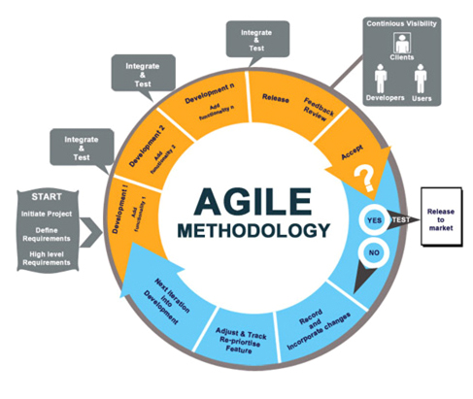
Some Agile Key Characteristics
Feedback from users
Focus on delivering value early and frequently
Continuous stakeholder involvement at all levels
Incremental development with short cycles
Scope management by continuous (re)prioritisation of the work items
3 weeks iterations

Slide 14
OpSys project 1 - Agile iterations & milestones
May
June
July
August
September
October
November
December
02
09
16
23
30
06
13
20
27
04
11
18
25
01
08
15
22
29
05
12
19
26
03
10
17
24
31
07
14
21
28
05
12
19
26
80%
Operational entities
40%
80%
Results management
Milestones
20%
Monitoring
Interoperability
20%
User experience (UX)
80%
External access
COORDINATE (3 weeks)
IMPLEMENT (8 w/days)
Iteration cycle
Sprint 11
Sprint 13
Sprint 15
Sprint 16
Sprint 17
Sprint 1
Sprint 2
Sprint 3
Sprint 4
Sprint 5
Sprint 6
Sprint 7
Sprint 8
Sprint 9
Sprint 10
Sprint 12
Sprint 14
REVIEW (2w/days)
OE
OE
OE
OE
OE
OE
Results
Results
Results
Results
Results
Results
Results
Interoperability
Interoperability
Operational entities
Operational entities (OE)
Results
Results
Monitoring
Outputs
Results
Results
External access
Results
Monitoring
UX
UX
UX
UX
UX
UX
UX
UX
UX
UX
UX
UX
UX
UX
UX
14

Slide 15
4. Business needs
Operational entities
Results
User experience
External access
Monitoring
Interoperability
15

Slide 16
Issues and Requirements
1. Operational entities
"AS IS" Situation:
CRIS is based on financial and legal entities (CRIS decisions and contracts) → Extremely difficult to follow operational entities
"TO BE" Situation:
OPSYS will allow users to shape and manage in real time their operational portfolio based on operational concepts (projects, programmes, results, activities)while ensuring financial entities management
Operational entities must be:
Linked – temporarily – to CRIS decisions and contracts;
After CRIS is phased out: Linked to global and individual commitments in ABAC
16

Slide 17
Operational entities - business needs
Create/retrieve operational entities
1
MIP
Action
Programmes
Projects
Link Operational entities with CRIS data (user-friendly access)
2
CRIS decisions
CRIS contracts
Related commitments
Link Operational entities across operation cycle
3
Instrument, Domain, MIP, Action, Commission Financing Decision, Projects, Programmes, Contract
Harmonised methodology
4
DEVCO
NEAR
FPI
17

Slide 18
Issues and Requirements
2. Results management
"AS IS" Situation:
Political commitments taken by the EC to improve its reporting on results. EU Results Framework launched in DEVCO and in drafting at NEAR and FPI.
No existing Commission corporate tool to capture and aggregate results → Results information scattered across not consistently stored documents/tools with the exception of IPA (MIS).
Reporting is only on projects and programmes that have ended.
"TO BE" Situation:
OPSYS will facilitate encoding, storage and consolidation of results and related monitoring through an integrated approach
OpSys will allow to follow results an ongoing basis.
OPSYS will allow external users to encode key information directly into the system
18

Slide 19
Results management - business needs
Manage structured results across the cycle of operation in a seamless way
1
Sector intervention framework
Logframe
indicative list of results indicators
Encode, update, retrieve and follow results information
2
Indicators
Baseline
Target
Milestones
Match indicators with corporate indicators or Other Matching Indicators (OMI)
3
EURF indicators
(DEVCO)
NEAR corporate indicators
FPI corporate indicators
Country, thematic
indicators
Quality control encoded results across cycle of operation
4
QC of data encoded by Implementing Partners
HQ result coordinators (DEVCO, NEAR, FPI)
Display aggregated/combined results information
5
by corporate indicators, project/programme, EUDs/HQ units, Sector, country, region, year, financing instrument
19

Slide 20
Issues and Requirements
3. Monitoring
"AS IS" Situation:
Reporting on outputs and related activities by implementing partners in progress reports (no standardized, not accessible online)
Excel-based Monitoring and evaluation plan as part of the EAMR exercise
"TO BE" Situation:
OpSys will allow Implementing partners to report/comment on activities related to individual outputs as well as on overall project and programme progress.
OpSys will allow OMs to build their own monitoring plan by accessing a calendar to schedule key events and milestones of their Project or Programme and according to its specific needs.
20

Slide 21
Monitoring - business needs
Monitoring outputs and activities from the implementing partner (including milestones)
1
Report on activities
Report on overall progress
Plan and monitor key events and activities from the EC Operational manager
2
Schedule key events and milestones
Tailored made M&E plan
21

Slide 22
Issues and Requirements
4. Interoperability
"AS IS" Situation:
EC Information and communication systems (incl EC websites), reporting, ROM, Evaluations, GIS based on CRIS decisions and/or contracts
"TO BE" Situation:
OpSys will allow the use of projects and programmes for:
Reporting (Result reporting, EAMR);
Evaluation (Project/programmes or strategic evaluation);
Communication and knowledge management (EC websites);
Geographical Information System (GIS) – based maps;
Transparency and accountability (IATI)
Operational portfolio management
22

Slide 23
Interoperability - business needs
1
Interoperability with documents storage systems
CRIS
ARES
Migration of Results information from other systems/local tools
2
Online systems (MIS)
Offline tools (excels)
Documents (Actions)
3
Interoperability for reporting (EAMR)
KPI 5 (implementation progress), KPI 6 (achieving results), KPI 18 (projects visited), KPI 19 (evaluation), Rr (ROM request) and I-4 (Project communication plan)
4
Interoperability for ROM and Evaluation
ROM module
Evaluation module
Interoperability for transparency, communication and knowledge sharing purpose
5
GIS
IATI
EC websites
C4dev
23

Slide 24
Issues and Requirements
5. User experience
"AS IS" Situation:
CRIS old interface, connectivity issues in EUDs
Daily workflow of OM in several different IT tools and interfaces
"TO BE" Situation:
First step for innovative user-friendly interface coherent all over the workflow
Intuitive “look and feel” and navigation system
24

Slide 25
IT features - business needs
1
Security (interface comply with protection rules)
ECAS authentication
Corporate data protection rules
2
Information (interface has correct, readable and up-to-date content)
Multi-language
Real-time information
Functionality (Interface works and don't break)
decent response times
available 24 hours a day, 7 days a week
3
work offline
Versioning
4
Usability (Interface allows users to complete tasks quickly and accurately)
Usable on all web-browsers
Key features
Mobile friendly
Multimedia
5
Aesthetic (Interface looks unique, friendly and professional)
standardized look-and-feel
Intuitive pages
User-friendly
6
Customization
Personalized dashboard
notifications
Geo-localisation
25

Slide 26
Issues and Requirements
6. External access
"AS IS" Situation:
Lot of double encoding by the OM
Reporting by the implementing partner in progress reports (offline)
"TO BE" Situation:
OpSyS will allow implementing partners to provide inputs directly in the system
26

Slide 27
External access - business needs
1
Provide permission to external user to provide inputs
Direct encoding by IP
Internal DEVCO/NEAR/FPI validation
2
Provide permission to external user to visualize information
External user access to visualize information (upon approval)
27

Slide 28
Some screens
Design to be finalised
Data and info coming from CRIS
28

Slide 29
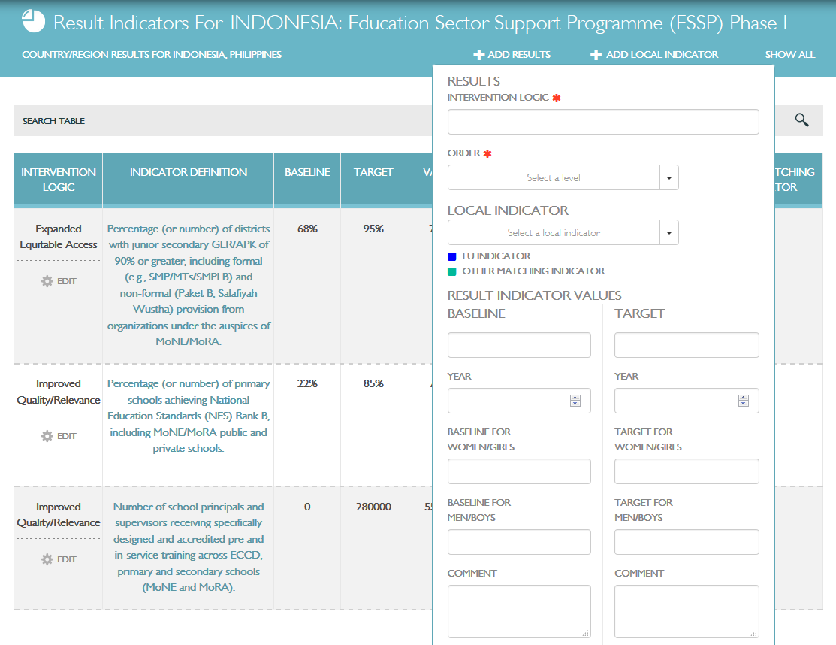
Prototype – possibility to add logframes, indicators, results and consolidate them
29

Slide 30
Next steps
MAY 2016
Individual meetings with DEVCO-NEAR-FPI experts working on result methodology
Individual meetings with experts on specific area (BS, Blending, trust fund, FPI, IPA, CBC programmes, twinning) to discuss the scope of operational entities (to be continued in June incl. Results management)
1 DUG working session to discuss the scope of operational entities + User experience (tbc)
1 meeting with pool of experts focusing on integration/interoperability
Video Conferences with pilot EUDs (to be continued in June)
JUNE 2016
1 DUG working session to discuss the scope of Results management and first screens
30

