Slide 1



Slide 2



Organization of Agro & Vet Dealers in NBeG
EU Thematic Workshop
By James Mathiang, People in Need
Juba, May 24-25, 2016

Slide 3
Situation of Agro & Vet-dealers in NBeG before PIN Intervention
Several sellers offering a basic range of agro/vet inputs
Steady influx of free inputs by UN & INGOs (market distortion)
Low Purchasing Power of local population
Low diversity of inputs due to limited number of local wholesalers
Limited willingness of local population to invest resources into agri/vet inputs

Slide 4
PIN’s Intervention Logic
DESIRED IMPACT
More shops sell a greater variety and quality of essential agricultural (incl. veterinary) inputs to a larger number of local farmers and pastoralists.
CORE ACTIVITIES
Rapid Market Assessment to identify potential participating shops
Voucher Campaign for 1,000 agro-pastoralist HHs
Training in Improved Selling & Marketing Skills for participating shops
Village Promotion Campaign in 160 communities

Slide 5
Step 1: Rapid Market Assessment – Objectives
Determine capacities of existing and potential sellers of agricultural (incl. veterinary) inputs (variety and volume of products offered; knowledge on their correct selection and use; ability to store the inputs in a safe way)
Identify most resilient and feasible supply chains (identification of which supply routes are most reliable and least vulnerable to increased insecurity incl. to what extent they are currently used)
Lay out specific possibilities for increasing the quality and accessibility of sellers’ inputs

Slide 6
Step 1: Rapid Market Assessment – Outcomes
FOCUS GROUPS – PARTICIPANTS’ FEEDBACK AND EXPECTATIONS
Only 10 out of 32 participants interested in the program after being informed that PIN would not provide the requested initial capital
Sustainability concerns - most proposed items often distributed free of charge by NGOs and UN
High exchange rate for USD impacting cost of imported items
Participants: average monthly turnover should be between 10 000 and 20 000 SSP by the program’ end
Participants: on average, 10% profit margin considered as sufficient
Participants: total annual profit should be at least 10 000.
Traders reluctant to spend time in prospected trainings due to time and management constraints
Traders would most appreciate if PIN could link them to various suppliers of agri inputs and improve shops´ visibility by promoting them in the communities

Slide 7
Step 2: Business Plan & Selection of Traders
BUSINESS PLAN
10 Business Plans received
Plan contents: motivation, business knowledge, operational capacity, economic plan for the next 3 years, visibility strategy
Outcome: 8 traders selected
Challenges: Poor quality of proposals – no prior experience with business planning
INCREASING LINKS WITH NATIONAL SUPPLIERS
Contacts for more than 30 agro-vet suppliers’, including quotes, terms & conditions, were shared with the shop traders.
Success: increased diversification of supply chain
Challenges: Insecurity of supply route, costly transportation, buying inputs in USD too expensive – better deals with traders from Khartoum

Slide 8
Step 3: Activities – Voucher Campaign
1000HHs participating
100 SSP vouchers used toward purchasing pre-selected agro/vet items
SUCCESSES
Strengthened awareness of the shops’ products among the farmers/pastoralists (monitoring: knowledge of local suppliers'’ location grew from 2.2% to 99%)
Important revenues for the shops + widening of client base
Focus on a limited number of items necessary for efficient planning of supply chain (advantage or disadvantage?)
CHALLENGES
Pre-stocking – delayed deliveries, vendors’ impatience to store items for a longer period of time
SSP depreciation – people could buy way fewer items than originally planned
Dependency – profits gained from the voucher campaign not used for re-stocking due to low demand. Transition from vouchers to regular market behaviour difficult

Slide 9
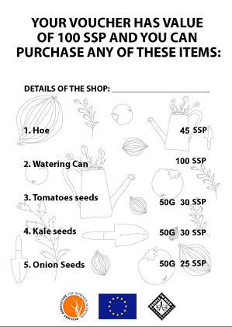
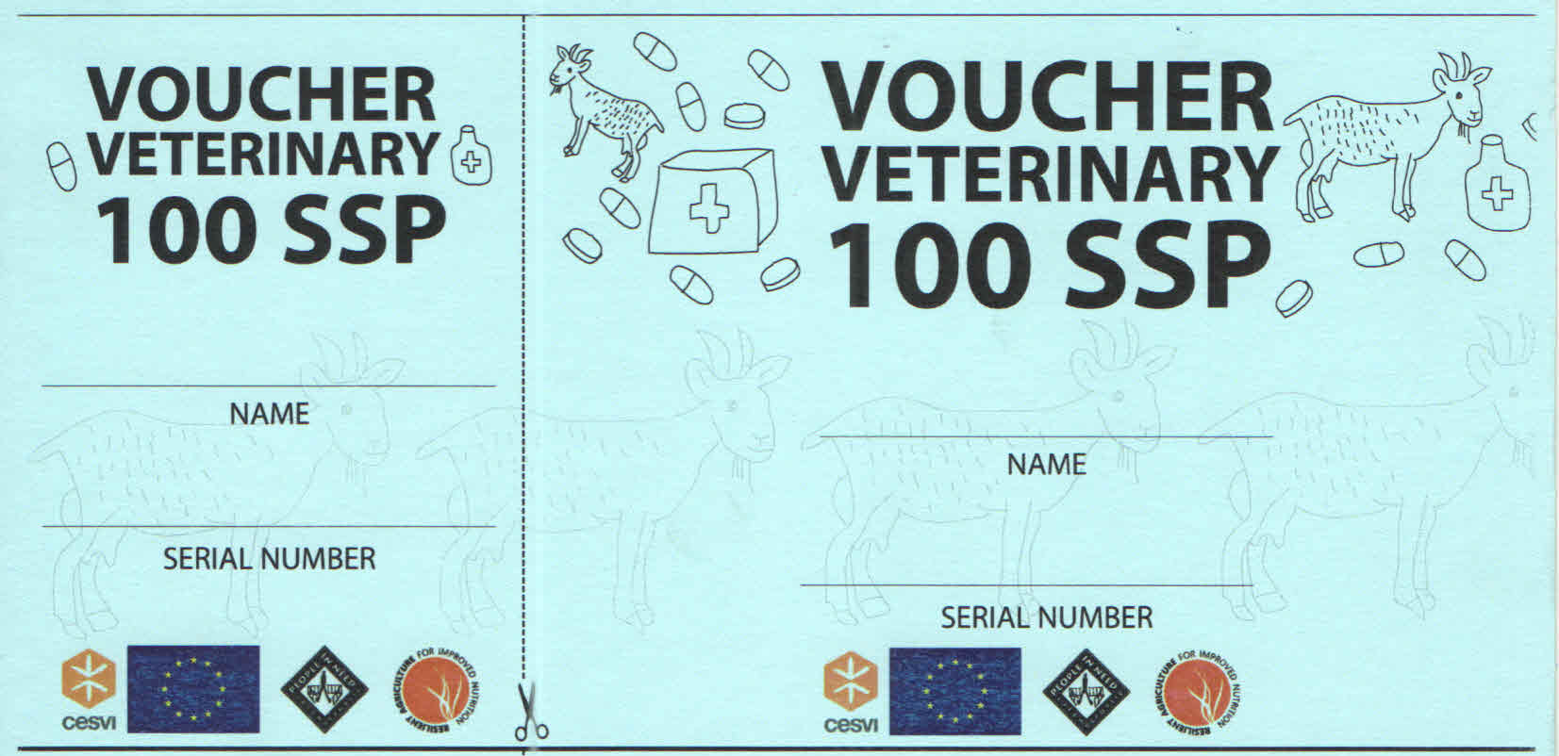
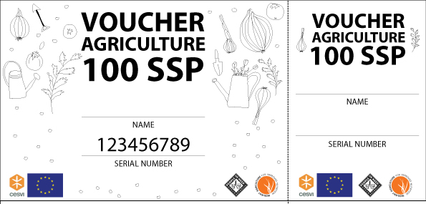
Campaign - Voucher Design

Slide 10
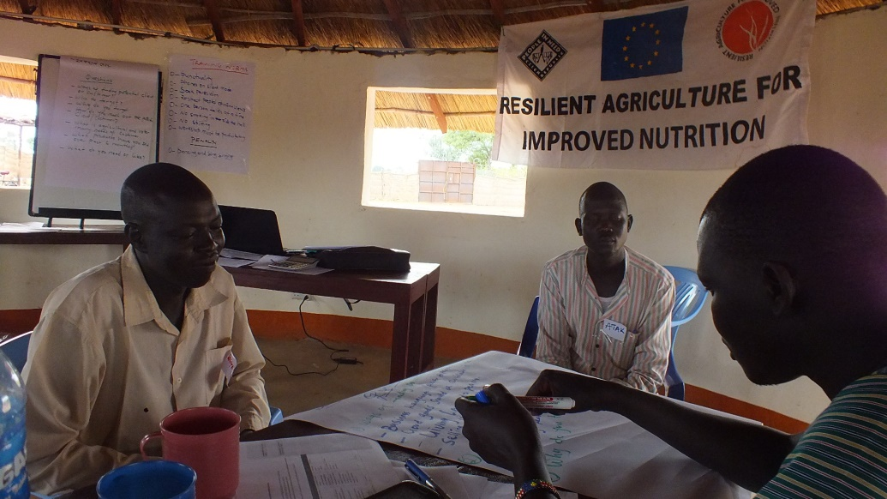

Step 3: Activities – Training on Selling & Marketing Skills
Two-day training for the participating shops conducted by local consultant
Themes: Sales Process, How to reach out to a potential client, Understanding clients’ needs, Understanding your product, Presentation skills, Overcoming objections from client
SUCCESSES
All 8 traders took part despite having to close their shops for two days
Capacity building tailored and delivered by a local agri-business trainer
CHALLENGES
Vendors’ mindset set on immediate financial benefits rather than long-term planning

Slide 11
Step 3: Activities – Village Promotion Campaign
Each trader selected 20 villages located in close proximity to his shop. 160 villages covered.
Community meetings designed to introduce people to the shop and its products
PIN provided promotional banners and leaflets, cost of samples and transportation
SUCCESSES
Direct application of skills acquired through the preceding training
At least 3,200 people learned about the shops from the owners themselves
At least 20% of leaflets brought back to the shop and used toward discounts
Significant widening of the pool of potential clients
CHALLENGES
Despite clear benefits, shops remain reluctant to conduct similar campaigns on their own (organization, fuel cost, low profit margins to cover the costs)

Slide 12
Sustainability – Vital Preconditions
PROJECT-SPECIFIC
RAIN project beneficiaries continue growing vegetables and invest earned income into acquiring seeds, tools or veterinary products
Shops continue to actively promote their business without complete reliance on NGO assistance
Shops use the skills gained through the Improved Selling & Marketing Skills to improve different aspects of their business (structure, pricing, contact with client, etc.)
GENERAL
Economic situation across NBeG does not force shops to reduce their product offering
High import prices do not further weaken demand
Relief & Emergency interventions do not further increase aid dependency
Supply routes remain accessible and stable

Slide 13
Conclusion – PIN’s Further Efforts
IMPROVE LINKS BETWEEN SHOPS & TARGET COMMUNITIES
Plans to negotiate cooperation between the shops and PIN-trained CAHWs/EWs (Midterm Review recommendation)
CAHWs/EWs as potential “sales agents” selling shops’ products and offering them in their local communities for a set commission
Plan fully supported by local authorities
CAHWs/EWs already equipped with bicycles to help them better serve their communities
One of PIN-supported shops already applying similar scheme with success
CHALLENGES
Varying and changing degree of commitment on the side of Ews/CAHWs
Difficult to promote an idea where no clear benefit from PIN can be seen

Slide 14
Thank you for your attention!
Contact us at: jakub.smutny@pinf.cz

