Slide 1





European Union / South Sudan
Cooperation
EU Pro-Resilience Action (PRO-ACT)
Food Security Thematic Programme Crisis Prevention and Post-Crisis Response Strategy Projects
Greater Upper Nile (GUN) and Greater Bahr el Ghazal (GBEG)
INTER-REGIONAL THEMATIC WORKSHOP
Funded by the European Union
Government of South Sudan

Slide 2


Name of Presenter: Lewis Karienyeh
Agency: Concern Worldwide
Contract Reference:
Project: Implementation of SORUDEV Smallholders' Component in Northern Bahr el Ghazal State
Juba, 24 - 25 May 2016
Greater Upper Nile (GUN) and Greater Bahr el Ghazal (GBEG)
Inter-regional Thematic Workshop
EU Pro-Resilience Action (PRO-ACT)
Outline
Purpose of workshop
Presentations
Background of SORUDEV
Goals & objectives
VSLAs
Approach
Progress
Lessons Learnt
Challenges
Workshop theme
WORKSHOP THEME
Transitioning from emergency response to resilience building: is it working ?
Two-day information sharing and learning and coordination workshop to Reflect on the strategies and progress of EU funded projects.

Slide 3


Purpose of the workshop
  Aim:
  Inform GBEG region project managers on emerging innovative programmatic trends in the GUN region,
  Sensitize PRO-ACT projects in the GUN region on resilience measures underway with EU funded projects in the GBEG region.
  Theme:
  Transitioning from emergency response to resilience building: is it working?
  Frame:
  Highlight successful innovations and challenges to the realization of the EU funded projects and regional programme short to medium term results.

Slide 4


Presentations
  Day 1:
  NRC (Institutional & CBO Support),
  NPA (Blacksmiths & Implements),
  Concern (Savings & Loans Associations),
  HARD (Extension Skills & Group Loans),
  PIN (Organisation of Agro-dealers),
  World Vision (Seed-multiplication & Storage),
  VSF-G (Poultry & Youth Groups),
  FAO (Vocational Training & Extension).
  Day 2:
  IRC (Multi-sector Collaboration),
  Cordaid (Community Planning and Monitoring),
  ZOA (Nutrition Education and Promotion),
  Oxfam (Vouchers and Market Development).

Slide 5


1. Background
Project Period: 15th Feb. 2014 – 14th Feb. 2017
Total budget: € 2,222,222
Implementing partners: Concern Worldwide (CWW); Langich United Youth Development Association (LUYDA)
Aweil Project for Agriculture Development (APAD)
Coverage: Aweil Centre County: 3 Payams – 18 Bomas Aweil North County: 4 Payams – 24 Bomas; Aweil West County: 7 Payams – 39 Bomas;
SORUDEV

Slide 6


Goal & Objectives
Goal: To contribute to increased food security, reduced vulnerability and enhanced livelihoods of rural households in NBeG, SSD
Specific Objective: To increase agricultural production & income of smallholder farmers in NBeG.
The specific objective will be achieved by:
Strengthening extension services, use of good practices & reduced losses
Facilitating the adoption of animal draught cultivation throughout the State
Increasing market access & linkages between value chain actors
Target: 4,500 active smallholder (SH) farmer households (HHs)

Slide 7


2.
A self-selected group of people who pool their money into a fund from which members can borrow.
Groups governed by set of rules developed by members
Members decide on how much to save , when & where to meet, elect officials, interest rates for loans, etc.
Any money borrowed is paid back with interest, making the fund to grow
After a cycle of 12 months, the members can share all or part of the money saved
Village Savings & Loans Associations (VSLAs)

Slide 8
Why VSLAs?
Financial services providers (i.e. banks, Cooperatives, Unions, SACCO, etc. ) missing in the communities
  Create financial services in the communities where the project was being implemented
Beneficiaries to pool their resources together
  Be able to borrow to buy agricultural input & treat their animals
  Fund to borrow for repair or replacement of worn out or missing parts, etc.
Provide social safety net
  Social fund – death, sickness, loss of property, etc.
Guaranteed returns
  Money earns interest as it is rent to members (& non-members) at an interest rate
Provides short-term financial needs for income generating activities (IGAs), social obligations and emergencies
  Not at the mercy of shylocks (money lenders)

Slide 9
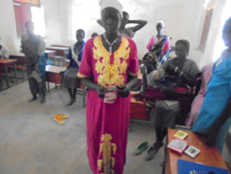
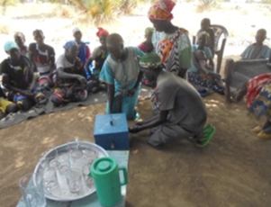
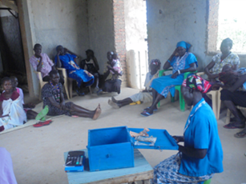
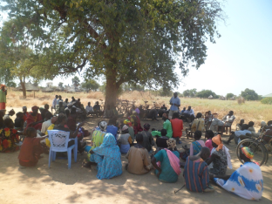
Photos
Money counter confirming money received
Key holders opening the VSLA box
Money counter confirming the cash in Malual West
Community meeting in Lanager boma, Ariath Payam to discuss about VSLA

Slide 10


3.
Community sensitization & mobilization conducted in all the project locations
Groups formed & operational –
  108 groups
  Over SSP. 197,000 in savings
  Over SSP. 115,000 loaned to members
Some groups have shared out the money after finishing one cycle
  Some groups have started another cycle
  Other groups
In some locations, farmers did not form VSLA groups possibly because they were not aware
Progress

Slide 11


VSLA progress by end of year 2
 | Year 1 |  |  |  |  | Year 2
County | # of VSLA groups | Membership |  |  | Savings (SSP.) | # of VSLA groups | Membership |  |  | Savings (SSP.) | Loans (SSP.)
 |  |  |  |  |  |  | M | F | Total
 |  | M | F | Total
Aweil Centre | 00 | 00 | 00 | 00 | 00 | 20 | 283 | 189 | 472 | 27,502 | 23,519
Aweil North | 04 | 67 | 15 | 82 | 2,930 | 30 | 399 | 337 | 736 | 74,329 | 59,079
Aweil West | 03 | 26 | 53 | 79 | 5,850 | 58 | 478 | 787 | 1,265 | 95,544 | 32,502
Total | 07 | 93 | 68 | 161 | 8,780 | 108 | 1,160 | 1,313 | 2,473 | 197,375 | 115,100

Slide 12
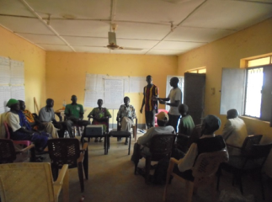
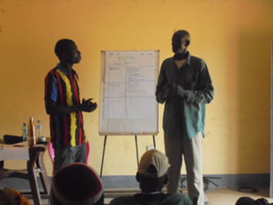
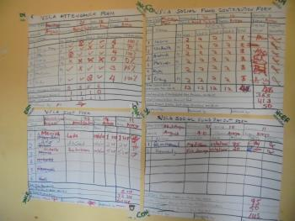
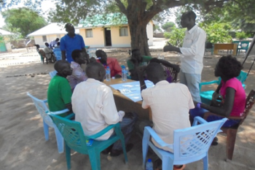


Photos
Concern staff training the farmers
Lead farmer makes a presentation during training
Lead farmers training on VSLA
Training on record keeping for lead farmers
Group discussion during the training

Slide 13

4.
VSLA discussed during inception meetings at all level
  State, County, Payam, Boma
Staff trained as ToTs - to train VSLA members in turn
Selected group officials trained on VSLA
  to be ambassadors of this new concept in the community
  pass the message about the training to beneficiaries
Lead farmers trained as field agents to support groups
Groups formed & trained by Project staff
  Regular monitoring visits conducted
Groups provided with starter kits
No cash grants given to the groups – all is own savings
Approach

Slide 14

What changes has VSLAs made?
Success stories about how VSLA has changed the members lives:
Marial Bai (Ayat East Payam – Aweil West County)
  One member of the Kongdai group commented that the VSLA has helped her a great deal. Before she joined the group, she used to brew alcohol and sell to the soldiers in the barracks nearby. To do this, she had to walk for long distances making her home very late. This used to cause problems with her husbands and there were fights all the time. However since joining the group, she has stopped brewing alcohol and now sells tea and groundnuts in the Marial Bai and this has helped bring harmony at home. There are no more fights and she is able to provide for her family.
Lion group (Lulic Boma, Ayat East Payam – Aweil West County) .
  Abuk Mayom volunteers “For the first time in my 45 years of life I had SSP. 1,200 to my own” she states with excitement and joy visible all over her face.
  The total transactions of the group for 2015 stands at SSP. 54,000.
  Excitedly, these women feel that if they maintain the momentum, they should be able to fund CWW in the next 5 years!!
  Join hands group (Aguat Boma, Gumjuer East Payam
  Had saved over SSP. 20,000
  Produced groundnuts that they have sold for over SSP. 93,000 (50 bags)

Slide 15


5.
VSLA was a new idea that was not known in the area but which has brought a lot of change in many HHs
A lot still needs to be done to sensitize community about the benefits of VSLAs
New groups have emerged on seeing the benefits that VSLAs are bringing to the members’ HHs
VSLAs near market places doing better than those far
  Possibly due to availability of market opportunities
-
Lessons Learnt

Slide 16
Lessons Learnt Cont’d…
Income generating activities (IGAs) – income during difficult economic times
Literacy training for the members important – women groups have 01 or 02 male members as secretaries
Communities not too poor to save – have resources & are resourceful
More sensitization needs to be done on why the group members should borrow
  Loan fund does not grow

Slide 17
Economic downturn
  Affecting savings in many groups – priority changes to consumption than feeding
  May be important to support some IGAs for the groups
  Important to train members in business skills
Low literacy levels –
  Need to train the members on simple numeracy & literacy skills
  Affecting record keeping
6.
Challenges

Slide 18
Challenges Cont’d…
Poor crop yields experienced in 2015
  Farmers left with very little or no surpluses to sell to earn an income
Need to borrow
  Some group members not willing to borrow money from the groups – fund not growing
  Understanding the need to meet more frequently – monthly meetings or bi-weekly meetings
  Lack of understanding on how the VSLA works
    Some members do not want to borrow the cash – not because they do not have business ideas but because they want the money to remain in the box for fear of losing the money

Slide 19

7.
Evidence from the VSLAs shows that the transitioning is happening
  Finished a cycle & started a new one
  Savings from members only – no cash injection from CWW
  Amounts saved & loaned out
  New groups being formed – benefits accruing to members
  But more still needs to be done:
    Sensitising the community on VSLA & its benefits
    Change of mind set on handouts – Need to believe in themselves
    Need to understand why the need to borrow
    To grow the VSLA groups to stronger financial services provider
Transitioning from emergency response to resilience building: is it working ?

Slide 20

Thank you and God bless you!

Slide 21


-
?
Questions

