Slide 1

European Union / South Sudan
Cooperation
EU Pro-Resilience Action (PRO-ACT)
FOOD SECURITY THEMATIC PROGRAMME CRISIS PREVENTION AND POST-CRISIS RESPONSE STRATEGY PROJECTS
FOOD SEURITY & LIVELIHOOD COORDINATOR
CLAYTON MASHAPA – OXFAM SOUTH SUDAN PROGRAMME
Funded by the European Union
Government of South Sudan

Slide 2

Purpose of the presentation
For participants:
Better understanding of Food security and livelihood programming in Oxfam with specifics on protracted crisis/conflict context in relation to Pro-resilience interventions
Demonstrate the needs for strong programme integrations (Vouchers and Market Programming) for positive outcome in FSL programming.
Discussion on trends that will continue affecting FSL programming in South Sudan, (in addition to drivers and barriers already identified) and appropriate local and innovative solutions to the problem

Slide 3
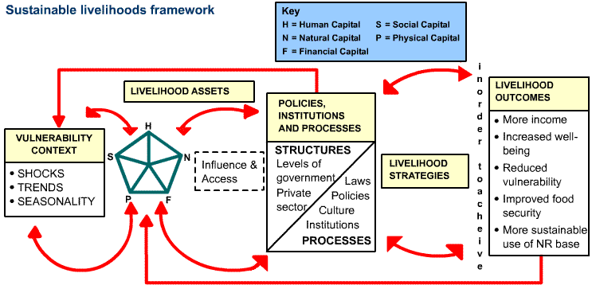
Sustainable livelihoods framework

Slide 4
Thematic areas of Oxfam FSL
Oxfam uses a livelihoods approach that focus not only on meeting immediate needs (Livelihood provision) but on ensuring we are protecting livelihoods, supporting livelihoods recovery, and working with vulnerable people and Oxfam’s longer-term livelihoods programs to identify ways to build resilience and pathways to viable livelihoods (Livelihood promotion).
2. We invest in social protection/safety nets mechanisms that enable vulnerable people to meet their basic needs and to better manage the impact of shocks (eg: predictable/seasonal cash transfer, flood events, droughts etc.. )

Slide 5
Thematic areas of Oxfam FSL…cont.
3. Markets are essential for accessing food, livelihoods inputs, and income before, during, and after a shock. We have a reputation as a leading voice in work on markets and to push the boundaries of market-based interventions (Livelihood protection)
4. Cash programming to support food security and livelihoods in crisis context. Oxfam promotes a “cash first” approach, so long as it is backed up by sufficient analysis of the market, wider context, and where it is not appropriate, we will utilize other modalities including in-kind support.

Slide 6
Vouchers in Programming
Voucher programming refers to projects in which beneficiaries are paid in vouchers
e.g (printed cards/paper vouchers designated as having monetary value in exchange for beneficiary entitlements
Vouchers can be conditional or unconditional
The vouchers can then be exchanged for specific items – beneficiary entitlements e.g
( agricultural inputs such as seeds, goats, tools, or food, cash etc ).

Slide 7
Why use Vouchers?
Compared to construction projects in which agencies contract the work to external companies or procure goods and services to external entities, Vouchers in projects doubly benefit community members
The voucher value earned through voucher payments benefit individuals participating in the project, while the local business community re-deemimg vouchers benefit the community as a whole.
Voucher Programming can strengthen the local market and promote local traders

Slide 8
Why use Vouchers …..continued
Vouchers in projects empower beneficiaries to choose the items they will be able to access
This freedom of choice is a powerful way to mark the transition from relief settings and to reinstate a sense of normalcy and recovery among beneficiary communities.
It can also bring about a sense of dignity and self-respect as beneficiaries are able to choose products of their choice.

Slide 9
Market related factors affecting food security in South Sudan
local currency depreciation, Staple food prices have increased, below-average 2015 production, fuel shortages that have increased transportation costs,
continued conflict that has reduced market functioning.
High prices continue to limit household food access, especially among market-dependent poor households in urban areas.
In Juba, the price of sorghum in March 2016 was 400 percent above the five-year average.
In both Greater Bahr el Ghazal and Greater Upper Nile, given the high cost of importing, a relatively low level of commercial stocks were prepositioned in markets in preparation for the rainy season, when road access will limit trade.

Slide 10
Market Analysis: Why?
Do No Harm
Design responses (cash, in-kind, vouchers)
Ensure no disincentive effects on supply
Increase efficiency and effectiveness
Ensuring minimisation of costs in delivery (cost efficiency)
Strengthen interventions
Program alternative, more creative responses designed to strengthen capacities of individuals, communities and institutions.
For example, ensure no significant long term inflation as a result of intervention (
Ensuring objectives are met in a cost-effective manner (e.g. delivering nutrition cost-effectively)

Slide 11
Market Assessments
Multi-stakeholder vulnerability and risk analysis, including market analysis will enhance HEA baselines. This will enable stakeholders to identify the structural causes of risk and vulnerability including barriers that restrict economic opportunities.
facilitating connection and links between other actors. Oxfam will focus on the incentive structures within the market and influencing actors without taking over the roles of market actors.
Support market actors: assisting traders to restock depending on need either by supporting transportation, provision of market storage facilities to enable goods to be available in markets.

Slide 12
Examples of successful programming
Cash for work programming to rehabilitate community infrastructures – secondary dykes, feeder roads, community irrigation schemes, school fencing, school rehabilitation
Support to local seed multiplication programme (seed banks, cassava cuttings and groundnut)
Value chain development. Promoting cooperative farming, fishing, Vocational training on livelihood skills – linking famers to markets.
Livestock restocking – goat distributions, poultry distributions
Goats restocking / cross breeds with boar goats to improve quality
- Support for traders to pre-position food stock during the dry season
Notes:
Along thematic areas (Justin and Alex)

Slide 13
Market Map e.g Akobo Market system
Akobo Market-system Map Template – Red sorghum Pre-Crisis
TRADE UNIONS
/COOPERATIVES
Symbol Key
Critical issue
Major disruption
Partial disruption
IMPORT LICENCES
!
The market environment:
institutions, rules,
norms & trends
IMPORT TAXATION
INTERNATIONAL BORDERS
OPEN /CLOSED
CLEARING AGENTS/CUSTOMS
TRADE LICENCES
POLICING/
SECURITY AT NIGHT
The market chain:
market actors & their linkages
Within South Sudan
Retailer (WAAT/Lankien
Target Group (vulnerable Households=FFW, FA)
WFP
Smaller Retailer (Nyandit, Dengjok)
International Market –Sudan
Wholesaler (transit Malakal- Bor)
Target group consumer
International
Wholesaler
(Akobo)
Big Retailer (Akobo)
International Market - Ethiopia
Local area
Wholesaler (Transit Juba-Bor)
International Market - Uganda
Local producer
Roads
Transport - truck
Warehouse
Transport – donkey/human
Waterways
Transport - boat
Notes:
Along thematic areas (Justin and Alex)

Slide 14
The END
YES TOGETHER WE CAN
MARKETS CAN WORK FOR THE POOR

