Slide 1





European Union / South Sudan
Cooperation
EU Pro-Resilience Action (PRO-ACT)
Food Security Thematic Programme Crisis Prevention and Post-Crisis Response Strategy Projects
Greater Upper Nile (GUN) and Greater Bahr el Ghazal (GBEG)
INTER-REGIONAL THEMATIC WORKSHOP
Funded by the European Union
Government of South Sudan

Slide 2

Samuel Deng, Norwegian People’s Aid (NPA)
Contract Reference: Sdeng@npaid.org
0955571483
Project: SORUDEV, Lakes States
Juba, 24 - 25 May 2016
Greater Upper Nile (GUN) and Greater Bahr el Ghazal (GBEG)
Inter-regional Thematic Workshop
EU Pro-Resilience Action (PRO-ACT)
Outline
Project duration
Total budget
Components
Two workshops & equipment
Challenges
Lessons learned
Recommendations
WORKSHOP THEME
Transitioning from emergency response to resilience building: is it working ?
Two-day information sharing and learning and coordination workshop to Reflect on the strategies and progress of EU funded projects.

Slide 3
Purpose
  • Aim:
  Inform GBEG region project managers on emerging innovative programmatic trends in the GUN region.
  Sensitize PRO-ACT projects in the GUN region on resilience measures underway with EU funded projects in the GBEG region.
  • Theme:
  Transitioning from emergency response to resilience building: is it working?
  • Frame:
  Highlight successful innovations and challenges to the realization of the EU funded projects and regional programme short to medium term results.

Slide 4
Project Duration
Total budget
This is a 36 months project running from 15 Feb 2014 -15 Feb 2017
2,222,222 million Euros

Slide 5
Components
The project has three components:
Extension component
Animal Traction component
Marketing and value chain

Slide 6
The two workshops & equipment
Mabui ox plough production unit
Malith blacksmith workshop
Mabui is an old set up dated back to 2002. With a long history of support from NPA. Currently the centre is fully privatized, but still under technical support from NPA.
Malith blacksmith workshop is a private set currently under technical support from the organization.
Both workshops fabricate moldboard parts, spare parts, and ox plough implements.

Slide 7
Sample of implements produced by the workshops
Weeder
Riper planter & seed disks
landslide
Ground nut lifter (harvester)
Ground nut stripper

Slide 8
Blacksmith training at Mabui OPU
Handle
Frogs
Frogs production
Moldboard parts
share
Land slide
Some of the smallholders farmers trained
Blacksmith displaying moldboards after training

Slide 9
Lessons learned
Relief oriented mindset (syndrome) is one of the factors that do not allow inclusive private sector support by some government institutions. despite this fact, both local blacksmith and workers at the workshops underscore importance of working it our themselves.
Lack of managerial and financial skills is one area that need a serious investment. SORUDEV might not achieve this with the remaining period of time.
Market demand for spare parts e.g. frogs, landslide, shares is actually on rise. Demand for moldboard plough is a factor in absence of spare parts.

Slide 10
Challenges
Current economic crises in the Country may be a disincentive to production! high cost of raw materials which are basically sourced from Uganda. High transport cost coupled with unfavourable taxes. Virtually there is no economic incentive that encourages production and growth!
Poor road infrastructure, not only during the wet season, but during dry seasons is a clear indication of a paralysed market system.
Free input distribution (e.g. ploughs) by other INGOs /Agencies is a disincentive to development efforts.

Slide 11
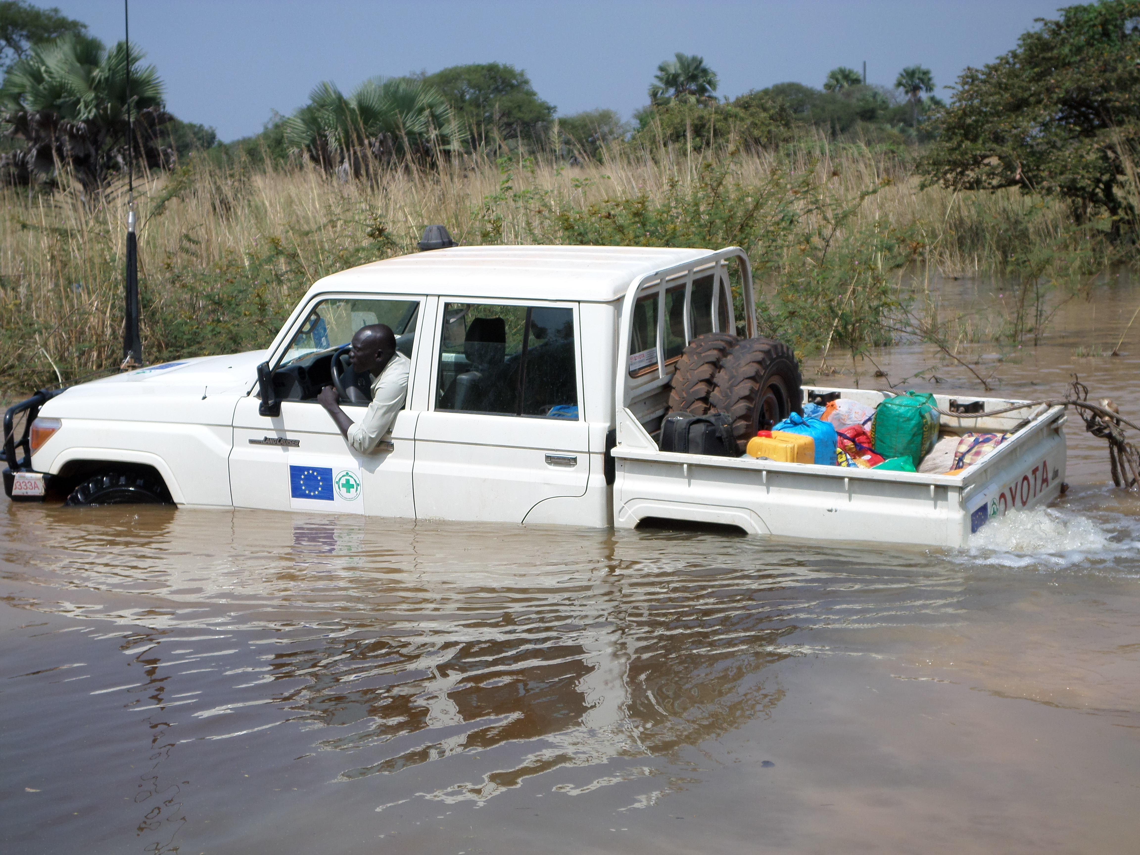
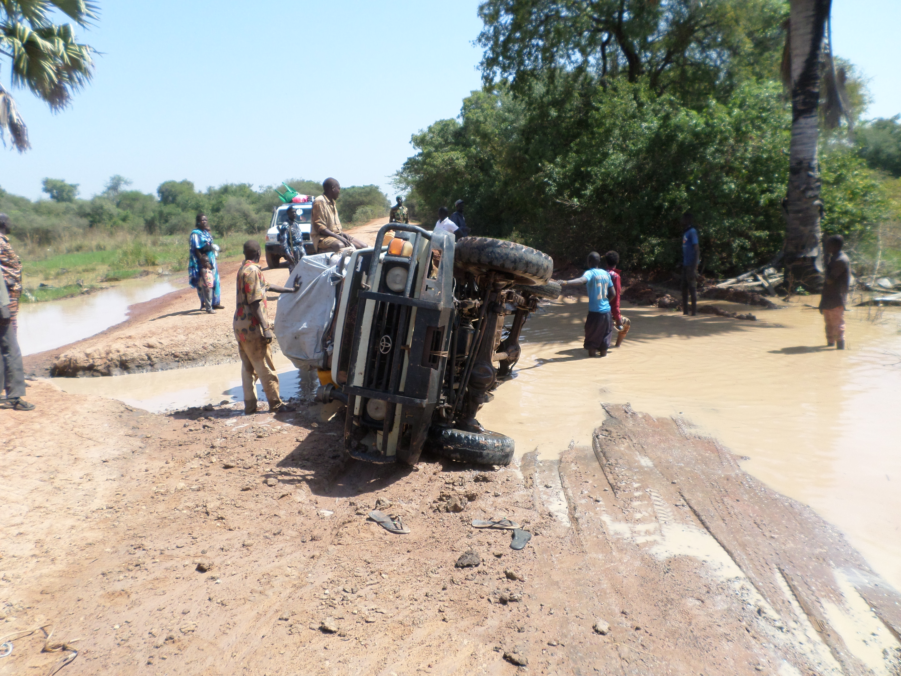
Practical challenges
NPA car taking staff to Mabui for training
A business car slipped off and fell

Slide 12
Recommendations
Blacksmith sector is a vibrant sector that needs to be supported; i) technical backstopping, ii) buying spare parts and iii) sending in trainees for training.
Mabui and Malith workshops need support from a local private company that shall continue building capacity of workforce and general administration of the two workshops. One of the lessons learned, is the duration of SORUDEV is too short to ensure an independently working workshops thus, it is imperative that the current support is extended for another 1 ½ years.
Smallholder farmers and ox plough users provide ready market for spare parts and other tools. Thus there is need to encourage local production. it is working!

Slide 13
End of Presentation
Thanks for listening

