Slide 1

World Vision South Sudan
Farmer Seed Multiplication, Improved Granary & FMNR
‘’Transitioning from emergency response to resilience building: is it working "?
May 24 -25, 2016 , Juba
European Union

Slide 2
Project Overview
European Union
Improving food and nutrition security for vulnerable groups in Warrap State
November 1, 2014 until October 31, 2017 (36 months)
1,500,000.00 EUR
Warrap State: Twic, Gogrial East, Gogrial West, Tonj North counties (2 Payams per county and 2 bomas per payam)
7,000 farmer HHs with 42,000 family members.
Overall Objectives : To Improve food security and nutrition for vulnerable groups in Warrap State, South Sudan
Result 1 : Strengthen community-level institutions ;
Result 2 : Increased Yield, Income & Reliability of Agri. Production
Result 3 : Improved utilisation of food

Slide 3
Seed Multiplication
European Union
Seed Multiplication in Gogrial West County, Akon South
:
Rationale;
Encourage farmer participation on seed multiplication & ownership.
Modality;
Group approach: reach larger farmer
Provide 2 bag unshelled G.Nuts, 8 kgs sorghum, and 3kg sesame seeds
Seeds returned to other farmer groups after harvest
Use local seeds, supported by local extension agents & use improved farming practice
Combine individual and group learning
Reduce high cost for purchase, transport & distribution to individuals.

Slide 4
Seed Multiplication
European Union
Seed Multiplication Site in GW County
Learning;
Procurement of seeds from Equatorias takes time, therefore local purchase is recommended.
First Year Experience;
Procured recommended seeds from Juba and Equatorias.
Provided 2 bag unshelled G.Nuts, 8 kgs sorghum & 3kg sesame
Local purchase is cheaper (avoid expensive transport)
The majority of seeds distributed did well especially the ground nut Red Beauty variety and sorghum Gedm- mam variety.
The sorghum variety called recession did not do well.
:

Slide 5
Seed Multiplication
European Union
:
Second Year Experience;
Based on first year joint review agreed with CAD to buy seed locally through seed fairs
Purchase and distribution of seeds completed for 175 farmer groups through seed fairs
Learning;
Local purchases encourages local seed producers to supply to markets
Local purchase of seeds resulted in timely distribution of seeds to farmers ahead of planting season
Cost effective

Slide 6
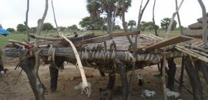
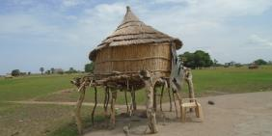
Construction Of Improved Granary
European Union
Rational;
:
Asses the existing granary structure
Address weevils infestation, damage due to rain, excess moisture, birds, rodents, termite, and ants
Modality;
To reduce the post harvest crop loss by 20 -30%
Improved design developed and shared with farmers for their inputs
Construction with full household participation using a cost-sharing approach

Slide 7
Construction of Improved Granary
European Union
Added value
:
Rat barrier installed at height of 70 cm
Constructed with affordable cost.
The roof and side expected to be cover with grass/poles to avoid exposure to rain
Two windows on opposite direction for ventilation
One door for periodic insect, pest & disease inspection
Improved Granary in Gogerial East County

Slide 8
FMNR: Concept
European Union
:
Natural Regeneration; Is the growing of trees from living tree stumps, tree roots and seeds in the fields, grazing lands and degraded forests to be re-vegetated. The emphasis is on natural regeneration rather than on tree planting with the use of tree seedlings raised in tree nurseries. .
Farmer Managed: The emphasis is on farmers or communities managing the regeneration rather than expert directed regeneration. It is the farmers who decide what species to protect, when and how to prune, etc & define the future use of the land considering their own need & interest.

Slide 9
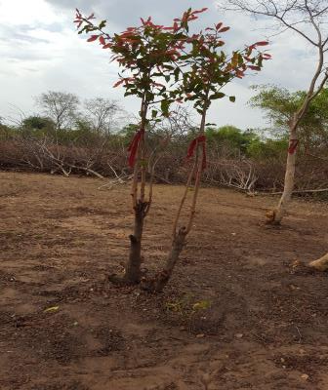
FMNR: Rational
European Union
:
The cost of growing tree seedlings for conventional tree planting is high and cumbersome
Limited survival of seedlings due to drought, bush fires, termites, livestock browsing
Locally regenerated trees are better adapted to local conditions than introduced species

Slide 10
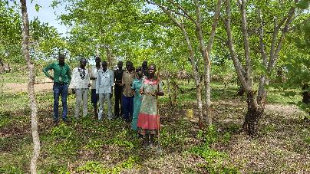
FMNR: Farmer Managed Natural Regeneration
European Union
:
Key learning:
Clearing bush and unwanted trees to speed up trees upward growth
Project achievement;
Retaining useful trees on farm land rather than clearing all.
Farmers group training
ToT conducted on FMNR
Establishing 18 FMNR Closed area /Community Learning centers.

Slide 11
‘’Transitioning from emergency response to resilience building: is it working "?
Yes it is Working
Because there are different project efforts & tangible achievements for smooth transition & also observing farmer participation to transit.
However; still there are challenges that need to be considered & addressed for effective resilience building!
European Union

Slide 12
Resilience: The ability of an individual, a household, a community, a country or a region to withstand, adapt, and quickly recover from stresses and shocks such as drought, violence, conflict or natural disaster. ECHO/Europe Aid Factsheet Resilience –October ,2012
European Union
s/no | Elements of Resilience | Project Activities Contributing for Resilience Building
1. | Withstand | Creation of livelihood asset and asset protection through cash for work or food for work, Disaster committee & preparedness plan, formation of community committee
2. | Adapt | Aware the community the climate change and adjust the way of doing farming like Introduction of early maturing seeds, Prompting Climate Smart Agri,
3. | Quick Recovery | Providing immediate support in terms of food, cash or in kind. preparation of county preparedness plan, Formation and strengthen of farmers group, Mobilizing saving through VSLA, peace building and reconciliation

Slide 13
Challenge On Transition To Resilience Building
Challenge:
Frequent occurrence of disaster hamper development gains.
Recommendations:
1. A strategy to include all segments of the community (vulnerable-, small holder-, progressive farmers) is required for resilience building
2. A harmonized approach to input provision should be applied by all donors.
3. Projects with a shorter duration than < 1 year cannot ensure smooth transition to resilience building
European Union
Emergency
Recovery
Development

Slide 14
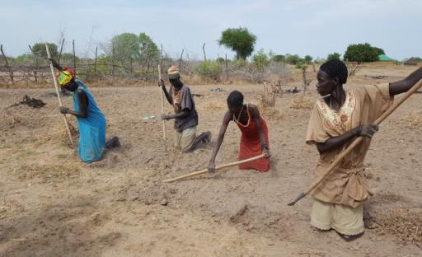
European Union
Thank You!

