Slide 1





European Union / South Sudan
Cooperation
EU Pro-Resilience Action (PRO-ACT)
Food Security Thematic Programme Crisis Prevention and Post-Crisis Response Strategy Projects
Greater Upper Nile (GUN) and Greater Bahr el Ghazal (GBEG)
INTER-REGIONAL THEMATIC WORKSHOP
Funded by the European Union
Government of South Sudan

Slide 2

Name of Presenter,: Ezana G. Kassa
Agency: FAO
Project: Resilience Pastoralist Livelihood & Education
Juba, 24 - 25 May 2016
Greater Upper Nile (GUN) and Greater Bahr el Ghazal (GBEG)
Inter-regional Thematic Workshop
EU Pro-Resilience Action (PRO-ACT)
Outline
- NALEP
- PLEP Description
- PLEP Update
- Resilience
- Risk Management
WORKSHOP THEME
Transitioning from emergency response to resilience building: is it working ?
Two-day information sharing and learning and coordination workshop to Reflect on the strategies and progress of EU funded projects.

Slide 3
NALE
NALEP
Pluralistic Extension System
Ext Provision & organization
Privatisation & Commercialis.
Ext Approaches & Methods
Content / choice of Msgs
Cliental empowerment
Roles of Stakeholders
Mandate of ministries
Coordination Ext
Formalizing collaboration
Standard & Licensing of ESP
Bottom up planning
M & E
Identify subsectors
Models for privatization
Incentive to attract private ESP
Current approaches
Library of approaches
Selection criteria for approaches
ICT for Ext delivery & market information
Mechanisms to estimate farmers needs
Working groups to develop message
ESP roles in Famers institutions
Increase women extension agents
Payam Agric & livestock info centers

Slide 4
NALEP
Pluralistic Extension System
Stakeholder coordination
HR development
Technology Development
Facilitating factors
Financing Ext service
Mainstream cross cutting
Stakeholder fora
Responsibility of For a
Steps to establish fora
Fora activities
Sustaining fora
Staffing and recruitment
Capacity develop’t / Training
Training centers/ institutions
Role of partners support to institutions
Seconding staff to partners
Farmer agenda in research
Communication between farmer, research & extension
Research finding available to s/holders
Access to grants/credit
Road access to markets
Market facilities & transport
Market information system
Irrigation infrastructure
Quality inputs & equipment
Policies
ICT
Cold chain & animal clinics
Security
Funding ext mechanism
Contracting ext services
Principles in financing ( accountability to clients)
Organization for financial participation
Examples:
Conflict
Child rights
Climate change
Cultural values
Disease
Gender
Nutrition
Literacy etc
How to mainstream specific issues

Slide 5
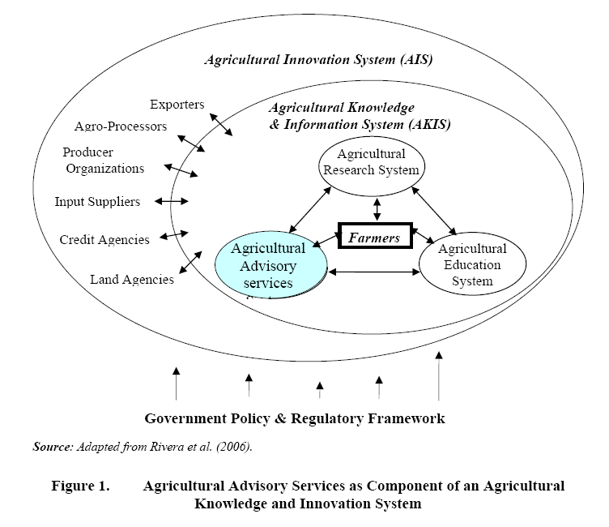

Slide 6


PLEP Background
Pastoralist communities in South Sudan receive limited services to improve their livelihoods.
Greater Lakes State has experienced an intensification of the drivers of conflict, within the state itself and among the states of the triangle.
Food insecurity, youth unemployment and cattle raiding remain the top security concerns in the different counties of the state
Pastoralists in Lakes also face major barriers in terms of access to educational opportunities provided either through the formal system or the Alternative Education System (AES)
Static schools established through the formal school system are not compatible with pastoral mobility
Notes:
Most social services are designed for sedentary lifestyle and pastoralist are transhumance that move seasonally between villages, grazing areas and different topographic zones.

Slide 7
Project Intervention
To bring about attitudinal & behavioral change of pastoralists, there is need to extend livelihoods, literacy, numeracy life skills & basic skills training interventions.
Pastoral Field School (PFS) approach provides excellent entry point & platform to improve pastoralist knowledge & skills.
Pastoralist Livelihood and Education Field School (PLEFS) approach initiated that combine livelihood interventions with an education component
The pilot project integrates the PFS with pastoral education to enhance resilience of pastoralist communities livelihoods.
Notes:
Most social services are designed for sedentary lifestyle and pastoralist are transhumance that move seasonally between villages, grazing areas and different topographic zones.

Slide 8

Beneficiaries and Partners
Yirol East, Yirol West, Awerial,
Rumbek Center & Wulu
.
Operation areas/ Counties
Target Beneficiaries
Pastoralist in 10 cattle camps:
Young children ( 8-12ys) ;
Youth ( 13+ years) and
Adults ( >18)
National level: MAFCRD, MLFI, MoEST;
State: SMAF, SMARF and SMoEST; NGO’s
Project Partners

Slide 9
Impact
Resilient pastoral livelihoods
Outcome
Livelihood security & empowerment
Institutional capacity
Outputs
CMDRR
Livelihood Diversification
Skills transfer
PLEFS model Development
Coordination mechanisms
Activities
DRR mobilization
CMDRR action plans
Support action plans
Training members on IGA
Support IGA activities;
VICOBA
Train facilitator
PLEFS
Literacy, numeracy, ALP
Survey
Curriculum Devt
Regulatory framework
Master trainers
Visibility
Technical WG
Regional exposure
Pool of trainers

Slide 10
Key progress made so far
County level induction workshops done
DRR mobilization in 10 cattle camps
CMDRR action plans in 10 cattle camps
Formed 32 PLEFS groups with 1,618 members (730F)
Demographic Survey
15 County Facilitators identified trained
Identified 21 Community facilitators
Registered learners
TWG formed at National and State level
Integrated PLEFS curriculum
Exposure visit to Kenya
3 TWG Meetings
CBDRR
Livelihood Diversification
Skills transfer
PLEPS Model & Coordination

Slide 11
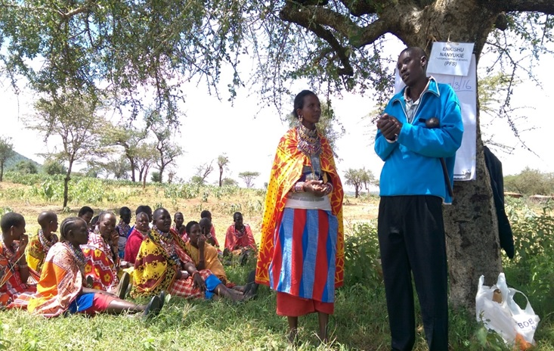
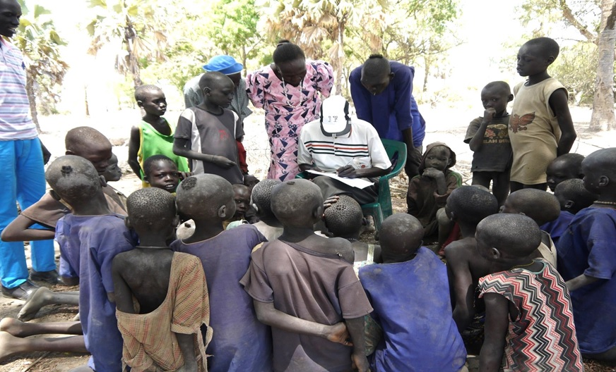
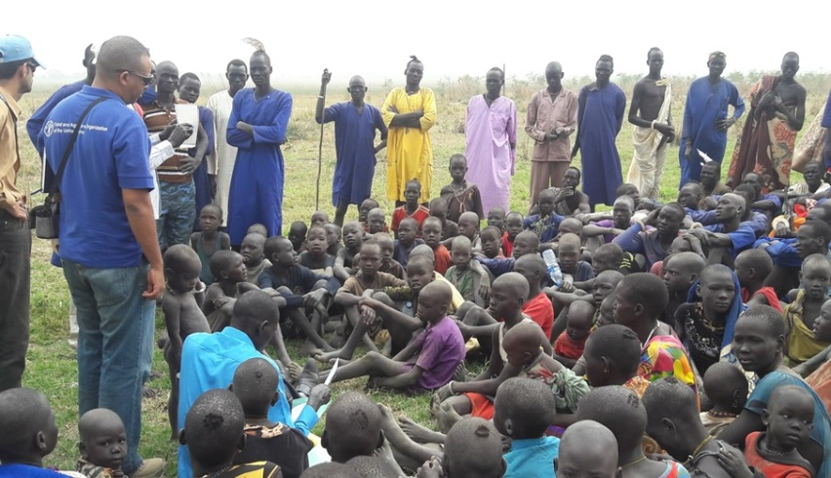
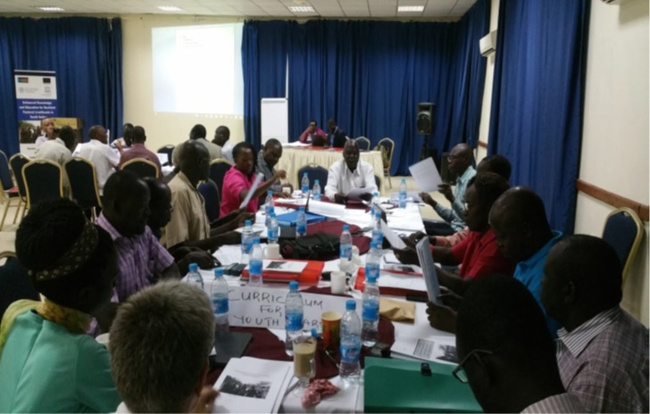

Key progress Cont..
Exposure visit Learner Registration
Community Mobilization Curriculum Validation Workshop
c

Slide 12
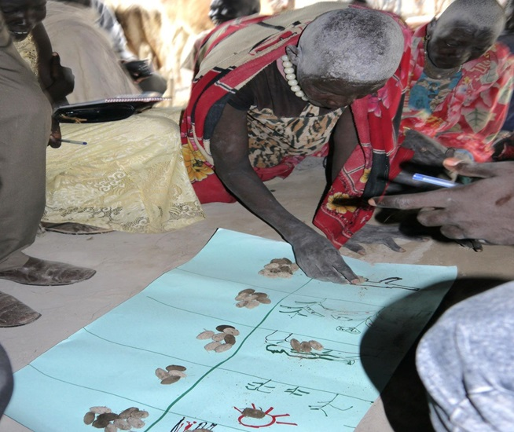

Key progress: Hazard ranking
Main disasters identified include:
- Conflict - Human diseases - Drought,
Livestock diseases, - Crop pests & diseases
Notes:
awareness meetings with the state & counties stakeholders to introduce the project;

Slide 13

PLEFS Curriculum adaptation & integration
Curriculum for Youth
(Level 1- 4,
6 subjects)
Curriculum for Children
(P1- P4
5 subjects)
Cross-Cutting Issues
(DRR, PB, Gender, Life skills, Climate Change Entrepreneurship, HIV, Health & Hygiene)
Adult Learners
(Facilitator’s manual,
Reference materials)
Syllabus
Learners books
Teachers/Facilitators Guide

Slide 14
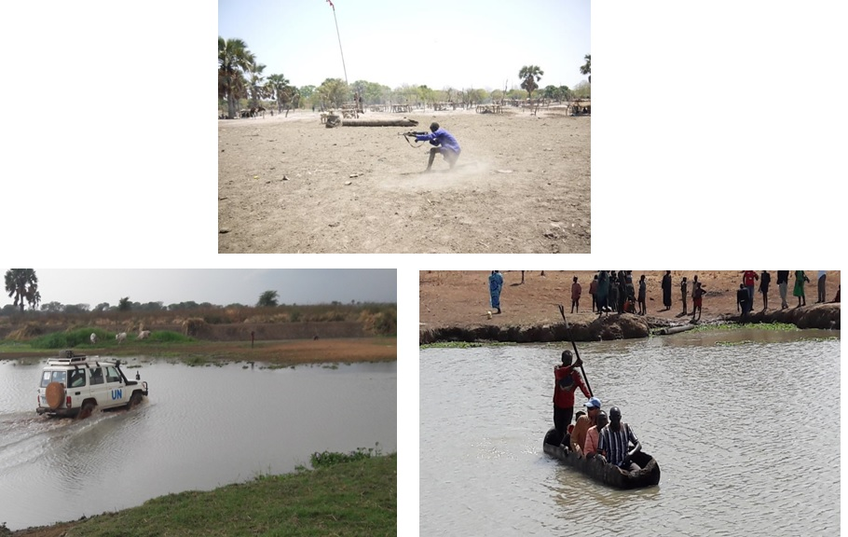

Main Challenges

Slide 15

Next Steps
5 weeks training of 30 community facilitators/teachers of 10 cattle camps
Finalising Implementing partner selection
Finalization and launch of PLEFS curriculum
Procure and distribute learning materials
Initiate and implement new PLEFS groups with regular training sessions over an 18 month period
Carry out literacy, numeracy life skills and basic skills training classes disaggregated into three different age groups
TWG meetings at national and state level
Notes:
awareness meetings with the state & counties stakeholders to introduce the project;

Slide 16
Project contribution to Resilience
Resilience Livelihoods
LIVELIHOODS
Livelihoods diversification
Increased income
Social interaction & capital
Improved health, nutrition and hygiene
EDUCATION
Social Cohesion
Equity in service provision
Appropriate Knowledge, skills & behaviour change
Notes:
awareness meetings with the state & counties stakeholders to introduce the project;

Slide 17
Risk Management
Mode
Emergency
Outcome
Livelihoods of vulnerable protected in crisis
Disaster Risk Reduced
Food & Nutrition Security
Income & Livelihood diversification
Interventions
Provision
Protection
Recovery
Promotion
Role of Extension
- Data collection - Disaster risk mapping - Experimentation - Agro dealers - Rural finance
- Beneficiary identification - CAP development - Farmers organization - Market actors - Support local institution - Seed system - New technology - Post harvest/ processing
Role of Vocational Training
romotion
- Tools production - Skills training - Value chain
- Appropriate technology - Non farm Livelihood options
- Income Generating Activities

Slide 18
Gaps in the link
Methodologies
Access, Availability issues
Target group identification criteria
Overlapping
Protracted relief & provision
Needs identification
Targeting
Interventions
Filling the Gap
SSSA - Layering of taget groups - Market bases appr.
- Geogrpahic: Gap vs Resilience areas - Cash transfers, ITFS
- Private Sector Support /involvement - Value chain
- Linking gap with surplus areas - Graduating beneficiaries - CMDRR
- long term perspective - Addressing risk drivers -evolving approach

Slide 19
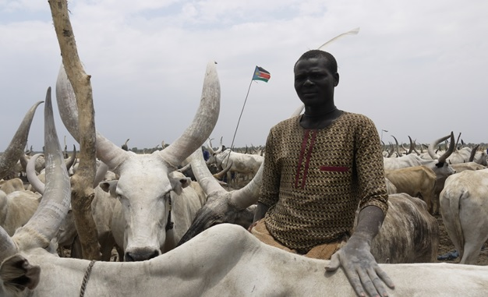
Cattle camps as a learning space
Funded by the European Union
Government of South Sudan
Thank you

