Slide 1
Youth Groups and Farms
Background
Youth in this context are boy and girl between 15 to 30 age bracket
Most them are involve in taking care of their HH livestock and other domestic chores
This is also the school attending bracket of which up to 65 % are school going at different levels (primary, secondary and tertiary)
They are robust of physical energy if wrongly tapped can be very detrimental to the community.
For the last 5 years, VSF Germany has successful harnessed this energy resourcefully and utilized it productively in contributing to many community’s food security baskets.
The groups have enormously contributed to boosting labor force as one of the key factors of production that in many cases has been a challenge in this areas.

Slide 2
Youth Groups and Food
Types
The youth have been organized in two may avenues: Formal and Informal avenues
Formal Avenues: youths supported to organize themselves in to working groups with set structures and objectives. This is initiated through the Local Authorities or through the exiting local institutions like schools or churches.
I. Young Farmers/Vets clubs: Through schools, students and pupils are encourage to form farmers clubs that experimentally farm to learn new ideas which in turn they practice at home.
The project through their agric teachers support the students with tools and seeds of their choices and train them on how to farm innovatively.
Learning inter school challenges are organized through symposium and debates where winning group is rewarded.

Slide 3
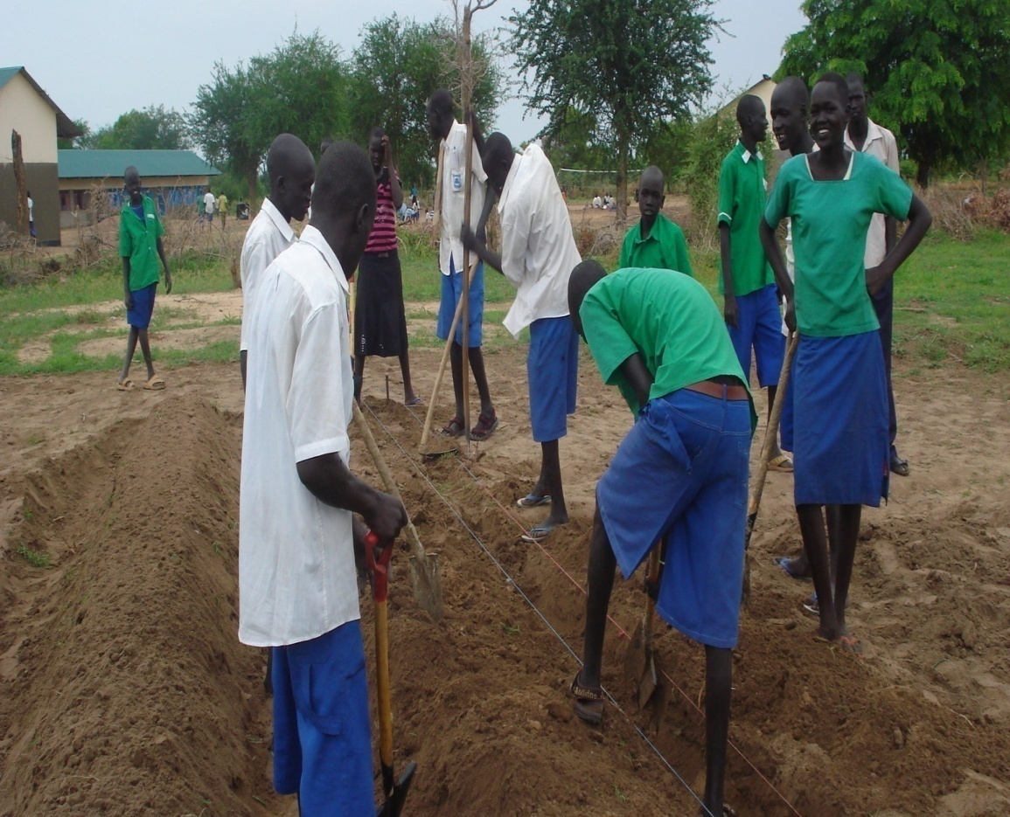
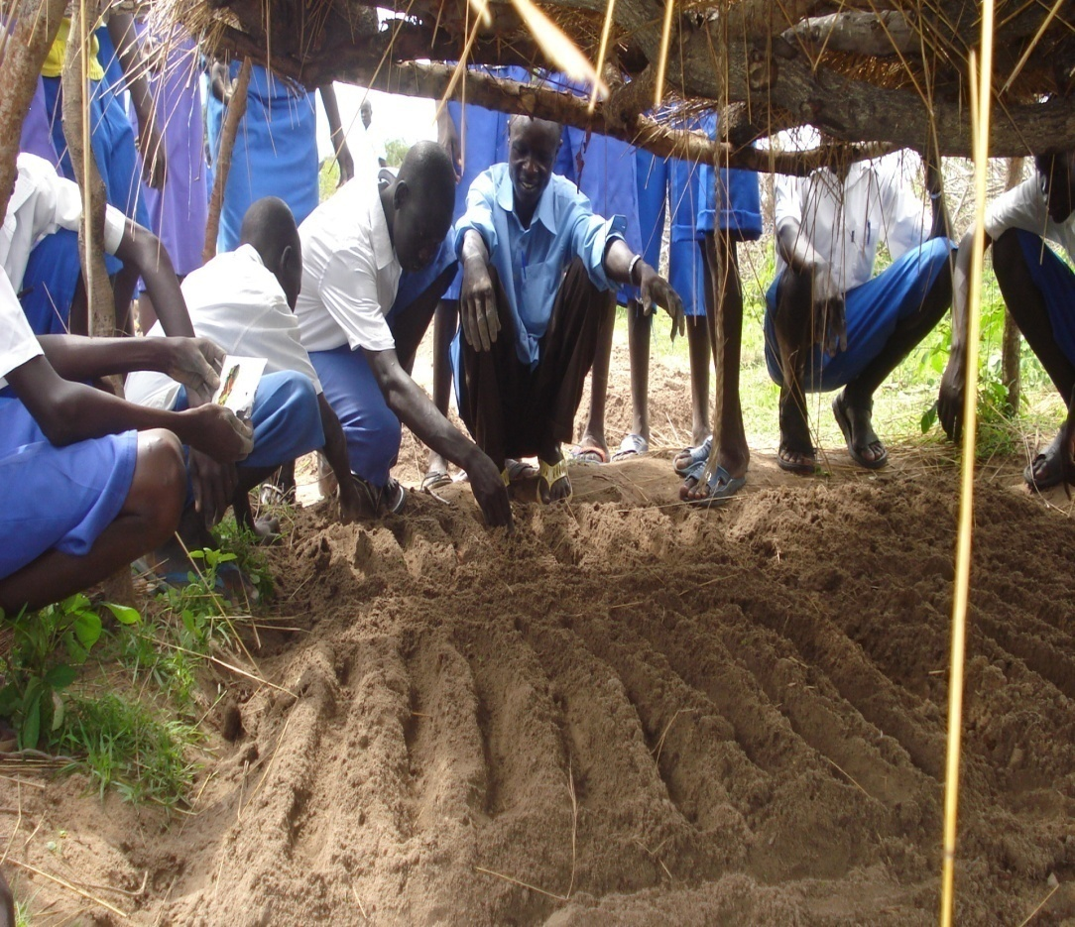
Youth Groups and Food
Young Farmers club members from Ajogo Primary school on improved land preparation methods.
Young farmers club members from Warabei primary school practically taken through nursery preparation steps

Slide 4
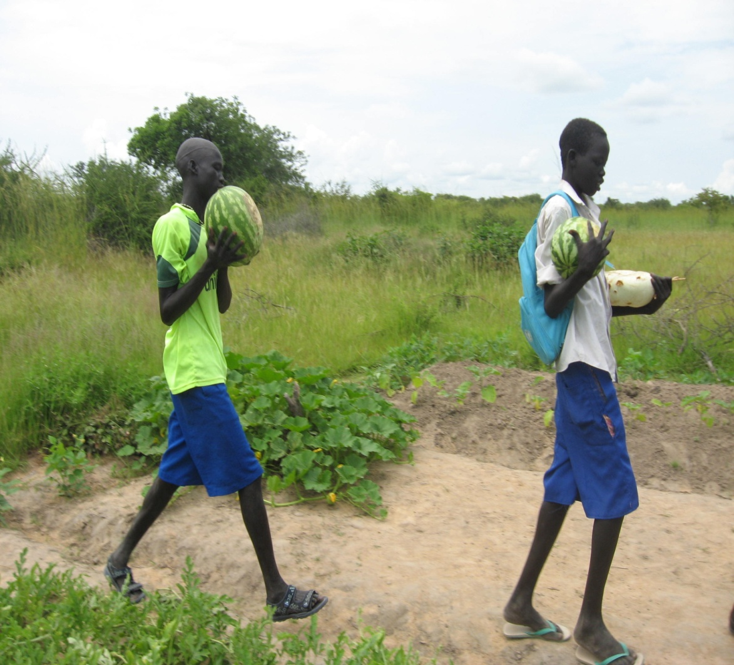
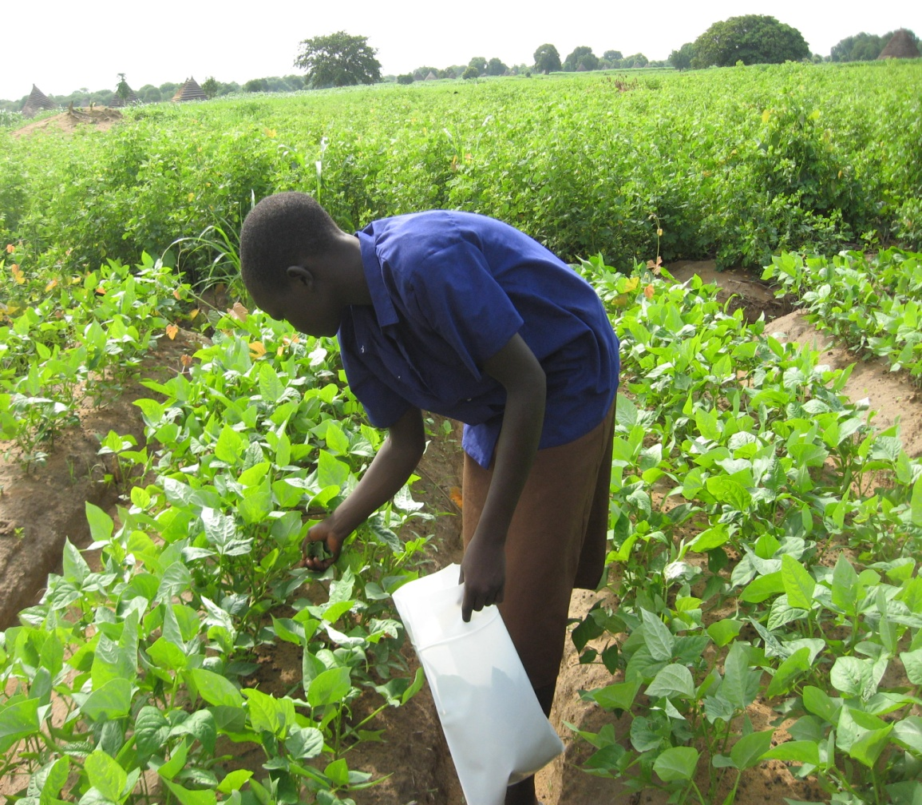
Youth Groups and Food
Nyadeng a member of the Warabei primary school Young Farmers club harvesting some vegetable to take home for the family to cook
Some Young farmers club members from Marol primary school carry home water melons from their school farm

Slide 5
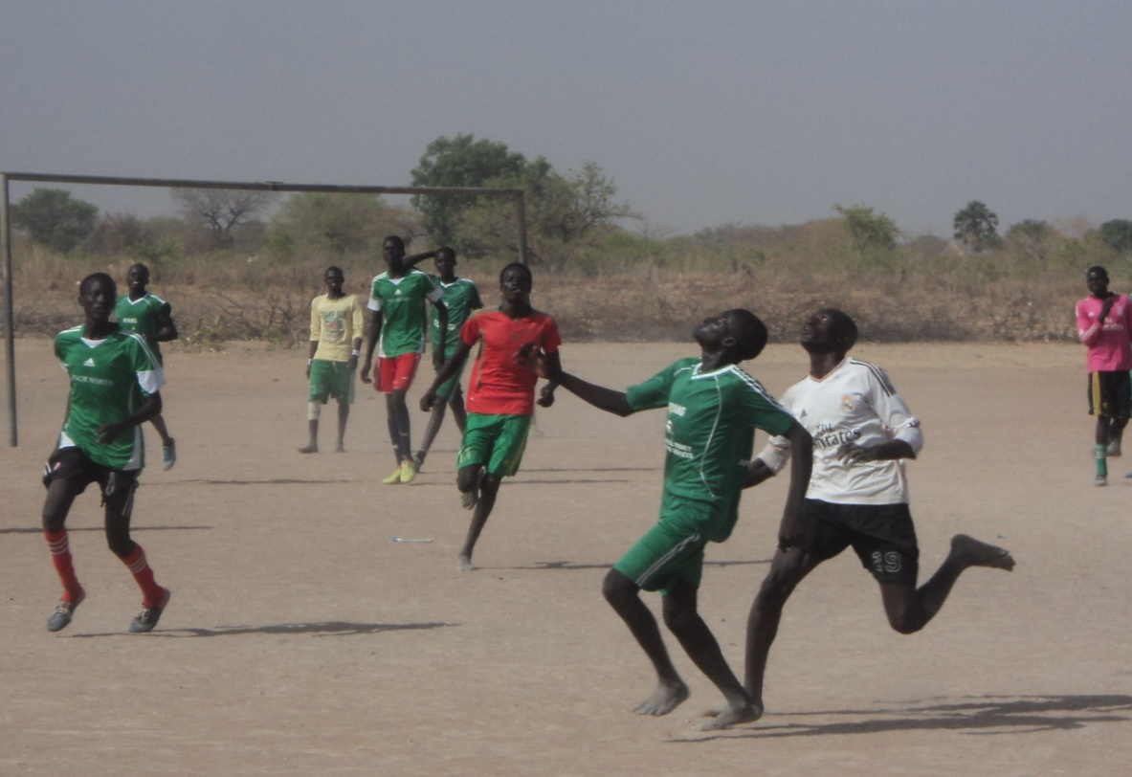
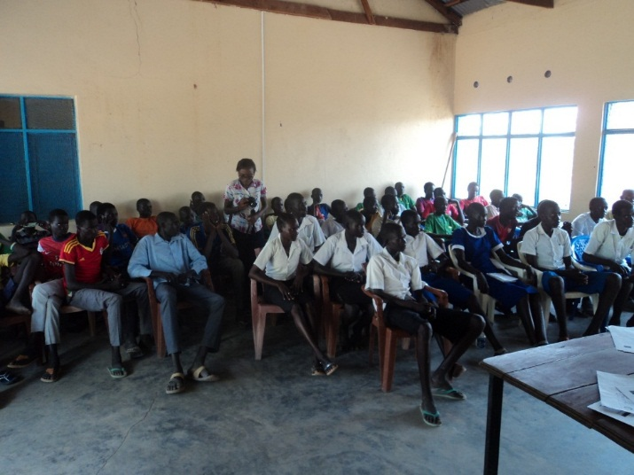
Youth Groups and Food
Interschool's food ball matches with Food security as the main Theme
Interschool's symposiums discussing agricultural issues

Slide 6
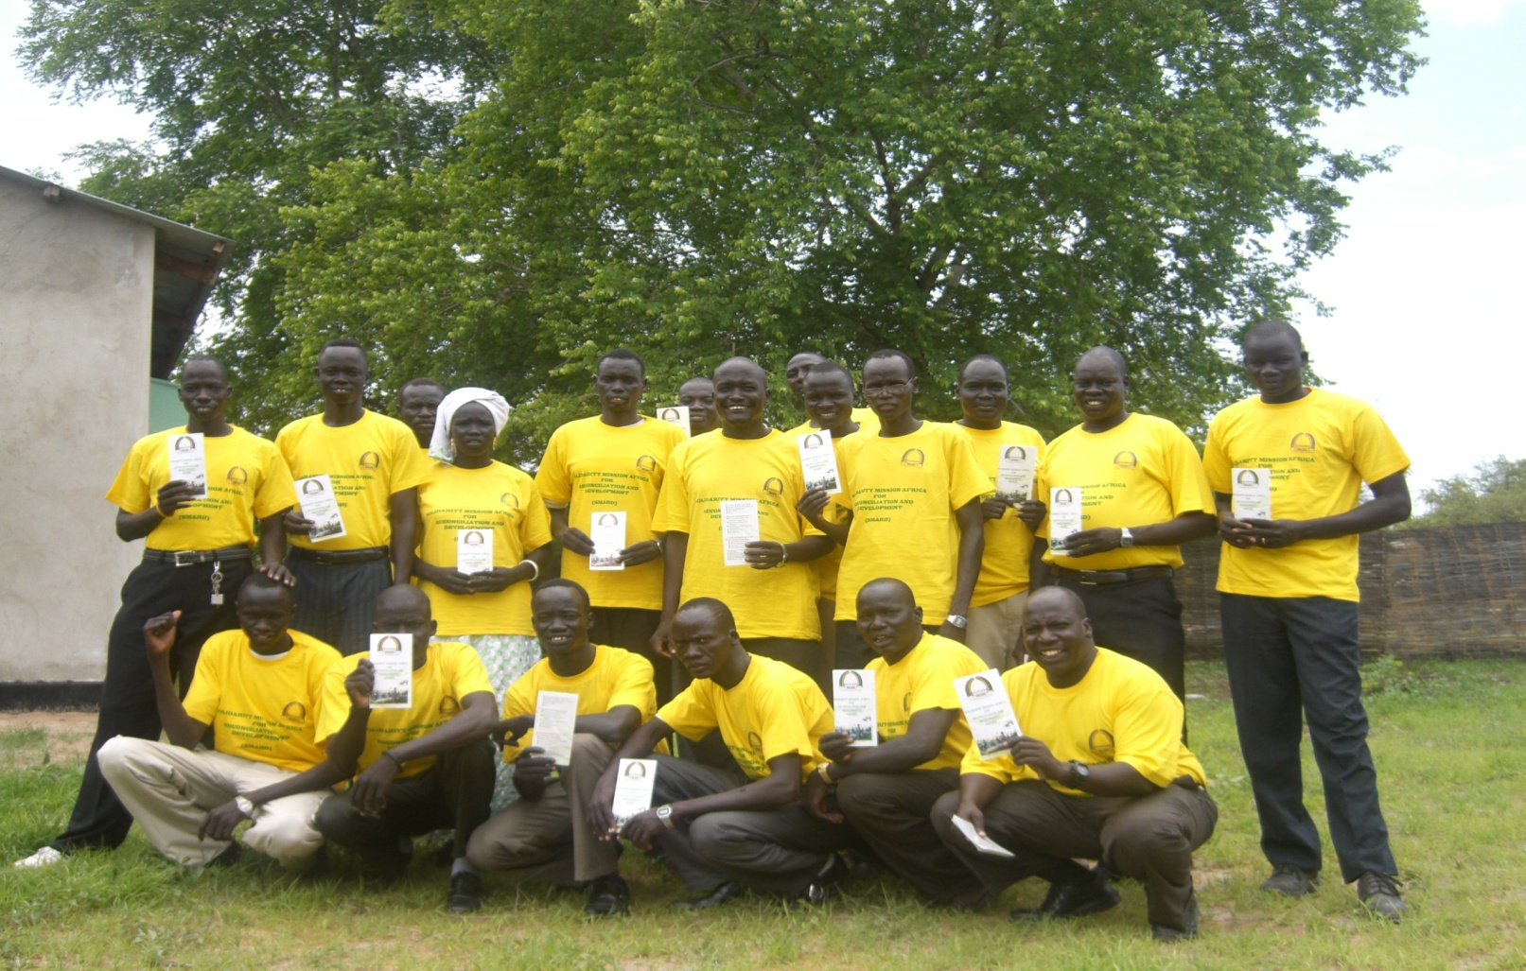
Youth Groups and Food
Types
II. Youth Associations- formed and registered at County or State level to voice youths agendas like Gogrial East Youth Association.
Some times support to start business or income generating activities

Slide 7
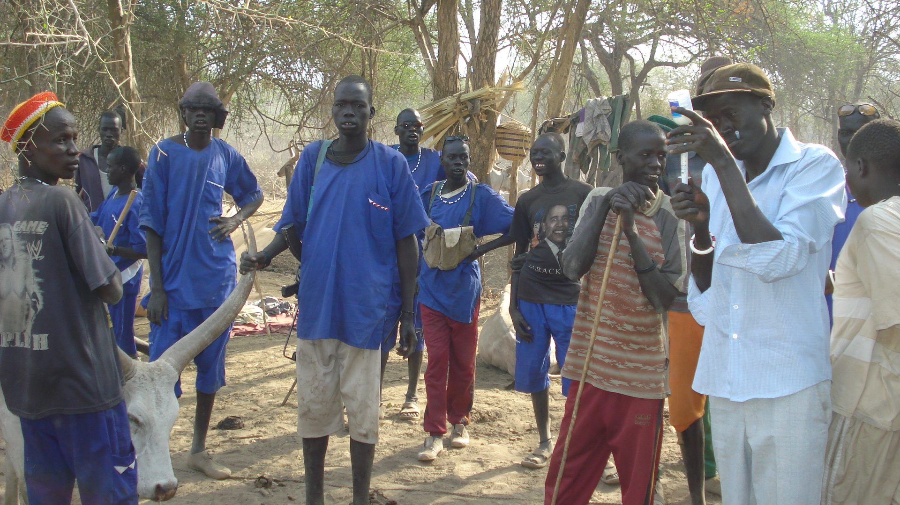
Youth Groups and Food
The informal self organized groups like cattle camp boys also are trained on basic income generation like animal treatment:

