Slide 1
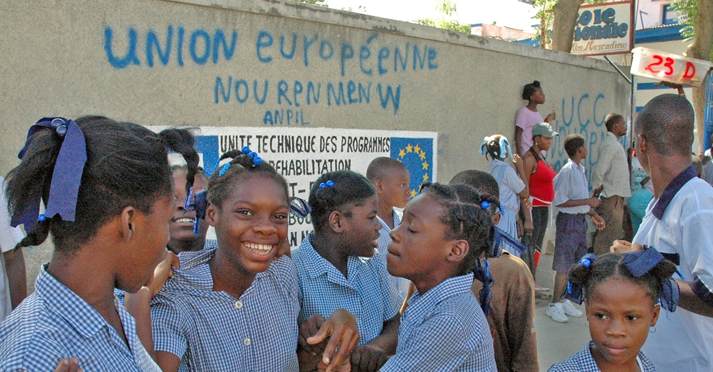
Introduction: why a workshop on He?
Mr luc de schepper

Slide 2
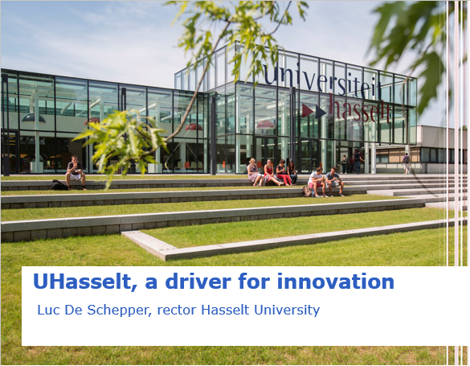

Slide 3




Hasselt University, knowledge in action

Slide 4
Hasselt University as a driver for innovation
Innovation strategy for Limburg (SALK)
Full Regional Innovation System (FRIS)
Making full use of the proximity of
knowledge, talent, ideas and infrastructure
7 ‘cornerstones’
Universities and university colleges
as one of the engines of innovation

Slide 5
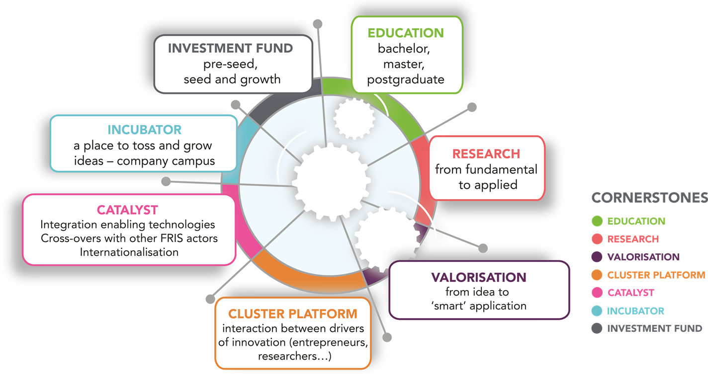
Cornerstones of the Full Regional Innovation System
FRIS in the Limburg Region

Slide 6
FRIS in the Limburg Region
Regional FRIS clusters
Life Sciences and Health Care
Logistics, Transport and Mobility
Construction
Cleantech and Sustainable Energy
Recreation Economy
Manufacturing
Agriculture and Fruit Cultivation
Creative Economy

Slide 7

Future goal
To make Limburg a strong innovation hub with all FRIS clusters on full speed to obtain a sustainable economy.

Slide 8
Routed in the region

Slide 9
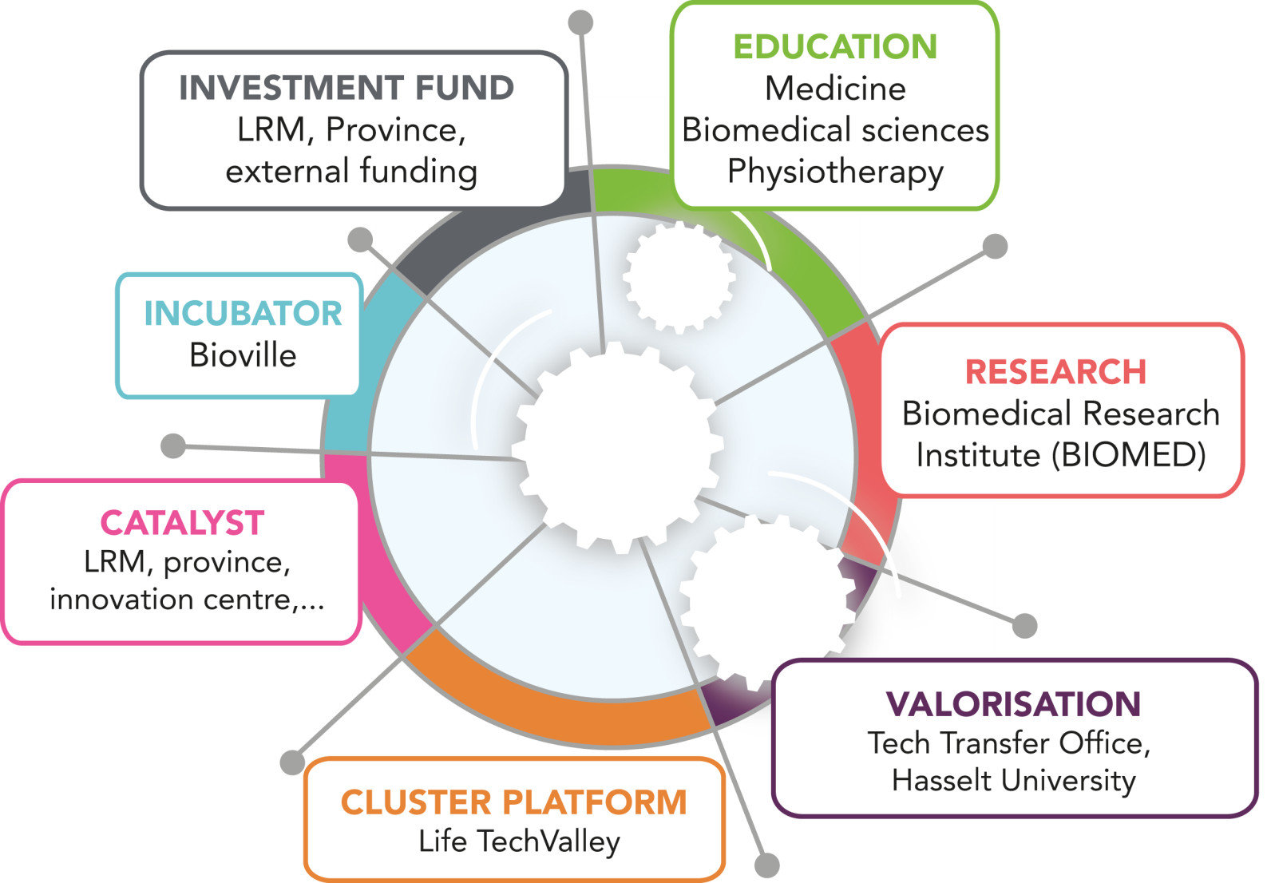
Life sciences: Industry of the future
A success story of the FRIS approach

Slide 10
Life sciences cluster
Success story – action plan 2007
2007: Hasselt university implements a FRIS based Life Sciences Action plan
Stimulation of cooperation and innovation between companies, knowledge institutions and hospitals in the region by creating a knowledge cluster;
Creation of a regional funding system with risk capital for the development of new and to strengthen the existing life science companies;
Creation of infrastructure by building a life sciences incubator (Bioville) and developing a life sciences campus;
Creation of a network platform LifeTechLimburg as a driver for the development of the action plan.

Slide 11

Life sciences cluster
Success story: LifeTechValley
2015: Creation of a new healthy aging platform LifeTechValley
“We want Limburg to grow into an international topregion where innovations in ‘healthy aging’ are developed, applied and commercialized. This clear focus should lead to more economic activities and qualitative care”

Slide 12
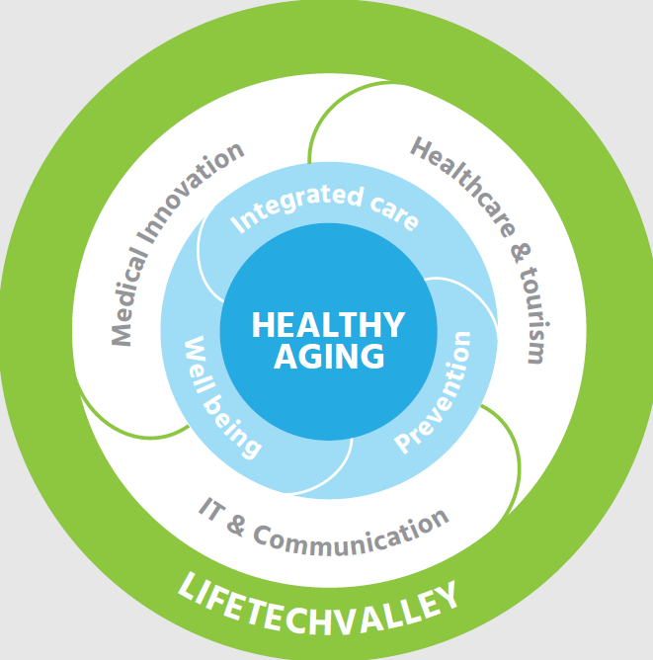

“innovative medical devices, rehabilitation”
“food, medicines, therapy adherence”
“care vacations, mobility”
“cycle network”
“health apps, telemonitoring, communication…”

Slide 13







































Life sciences cluster: partners

Slide 14

the Belgian
university cooperation
for development
Luc De Schepper
Rector Hasselt University and VLIR Chairman

Slide 15

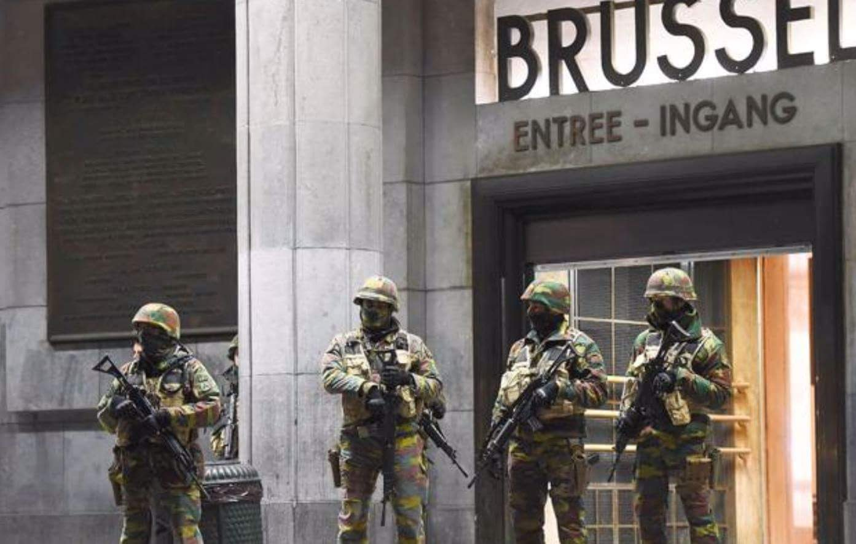
BELGIUM
Notes:
Belgium in the news: not very positive

Slide 16
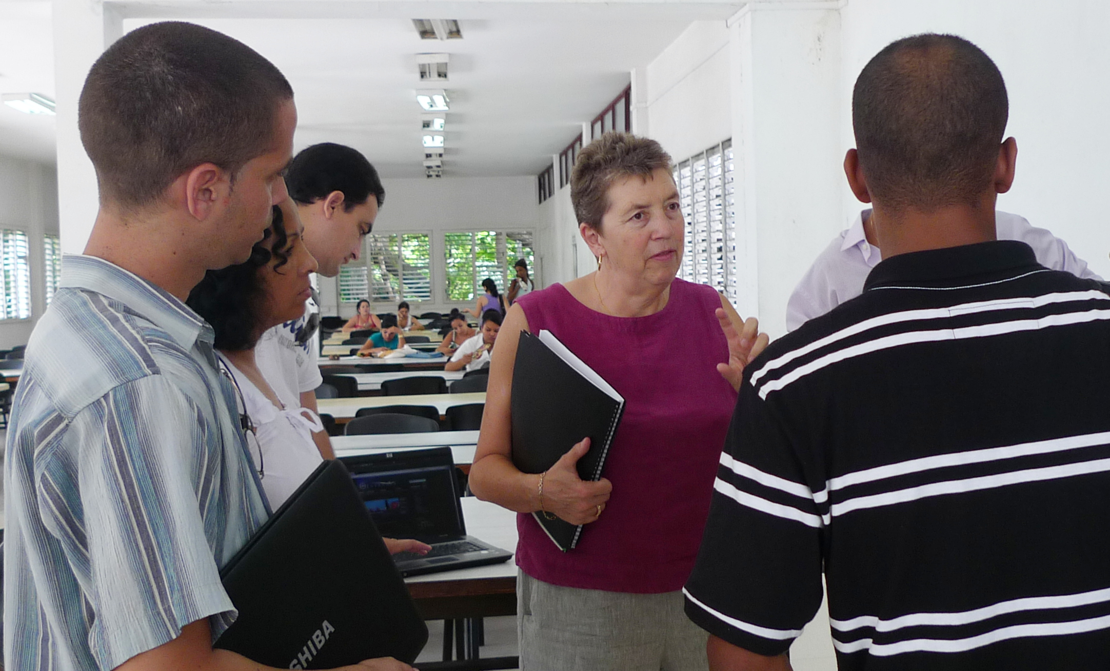
“Investing in university cooperation
is something
THE BELGIANS DO UNIQUELY WELL ”
THE BELGIANS DO UNIQUELY WELL
Julie Carpenter, director of Education for Change
Notes:
But one thing we can be proud of, according to foreign experts, is the Belgian university cooperation for development model

Slide 17

Notes:
We are facing huge global and local challenges, cfr Sustainable Development Goals

Slide 18


PROBLEM
SOLUTION
Notes:
There are lots of problems we need to solve, related to health, food insecurity, climate change, human rights …

Slide 19
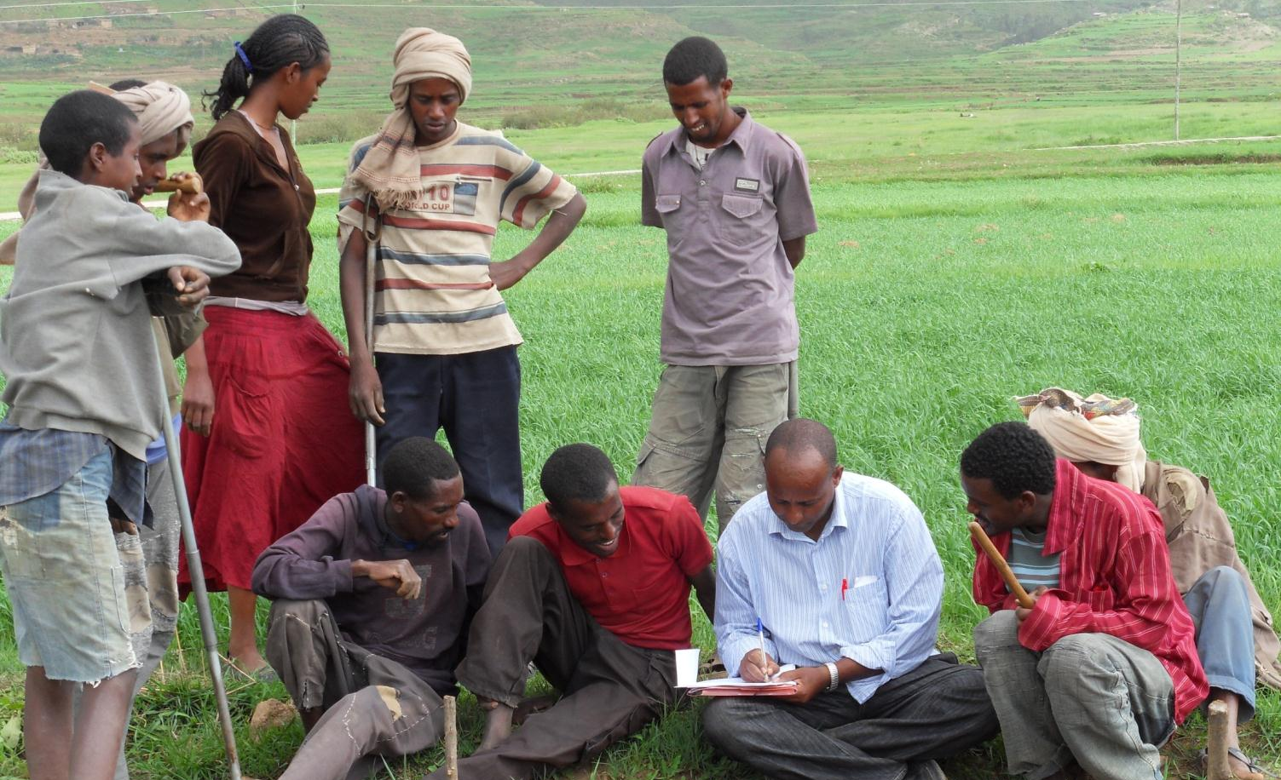


KNOWLEDGE
APPLICATION
Notes:
To find the right solutions we need knowledge and put that knowledge into practice

Slide 20
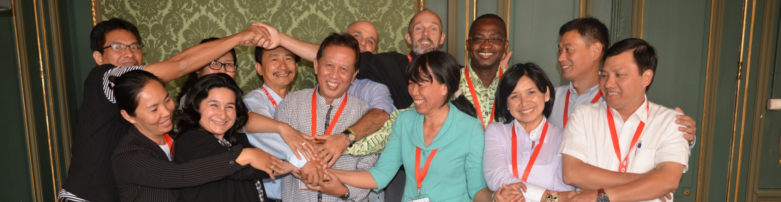

Notes:
Universities and colleges worldwide are best placed to create knowledge and share it. We believe that by joining forces and creating partnerships between universities, in Belgium and in the Global South, we can find better solutions.

Slide 21

non governmental cooperation (20%)
university
cooperation
(5%)
2014: € 61 million
25%
Notes:
The Belgian development cooperation dedicates 5% of its funds to university cooperation for development, for partnerships and exchange between Belgian universities or university colleges and universities in a limited number of developing countries in Africa, Asia and Latin America. It is a rather big amount of money, as it represents one quarter of the Belgian development cooperation funds for non governmental cooperation.

Slide 22
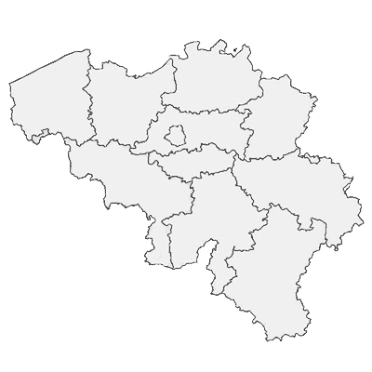

Notes:
2 agencies facilitate and organize the Belgian university cooperation for development: VLIR-UOS for the Dutch speaking Flemish universities and university colleges and ARES for the French speaking part. The boards of both agencies consist of representatives of the universities and university colleges.

Slide 23
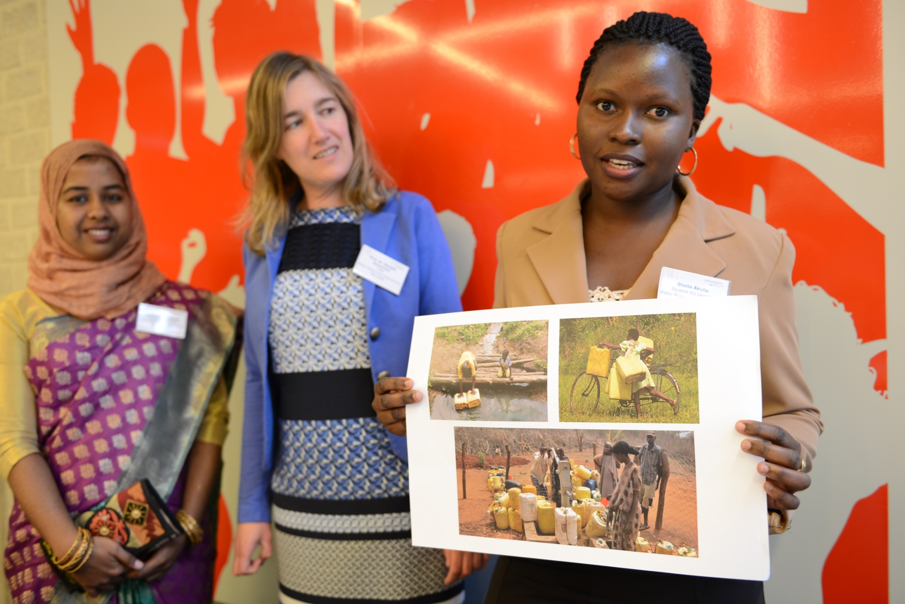




=>
research
projects
scholar-ships
institutional strengthening
social impact
Notes:
What do they do?
They manage the funds for research and education projects, scholarships and institutional strengthening of partner universities in developing countries. The universities and university colleges involved execute the projects.
The final goal is to achieve social impact and to find solutions to global challenges.

Slide 24
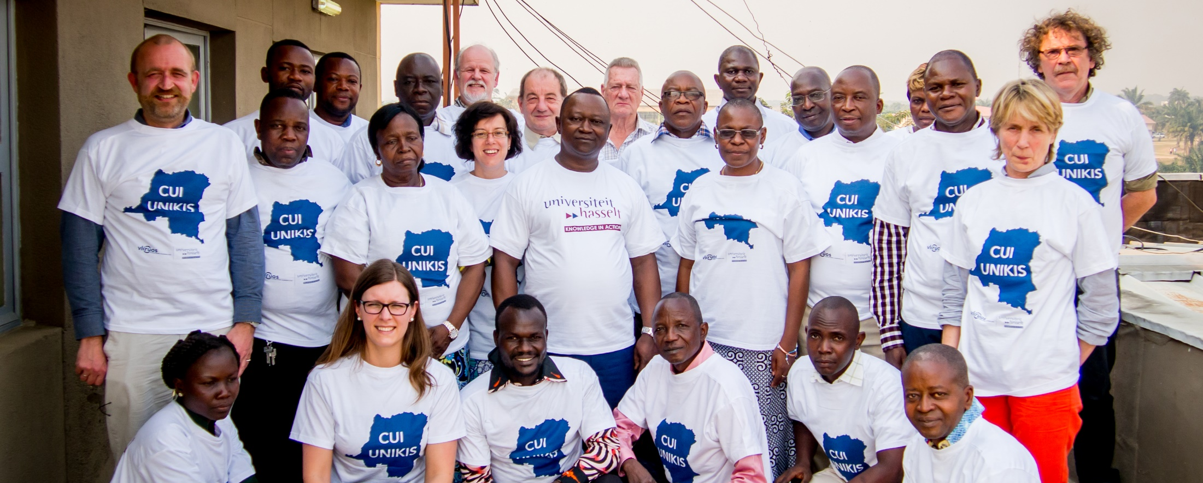

UNIVERSITÉ DE KISANGANI
biodiversity
sustainable agriculture
institutional strengthening

Slide 25
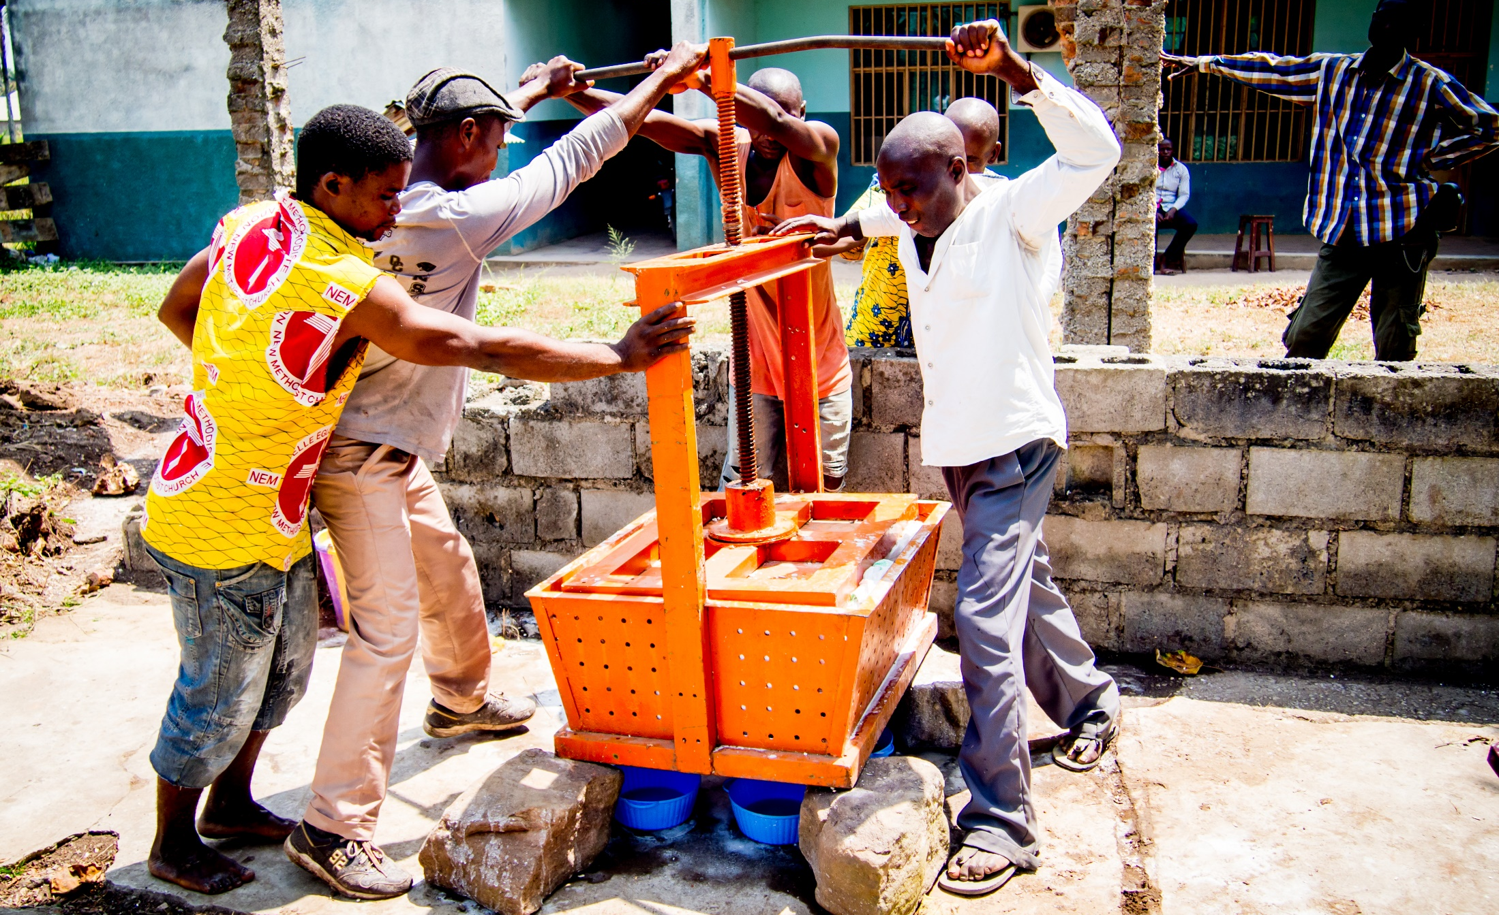
Notes:
It’s not easy to work in Kisangani, being the center of violent wars in the past decades. There are so many challenges in the region, but we cannot change everything, so we needed to focus and make choices, together with all the parties involved. At the end the Congolese partners take the decisions, and we are the advisor.
Trust is an important element. You have to believe in each other and in the possibility to level up the university and the society. But it's a mutual trust, their faith in us is also crucial, otherwise you cannot start. As the rector of UNIKIS once said, "We trust you, Belgians, because we get other fundings, but when the war ravaged everything here, you were the only ones who kept coming".

Slide 26


Complementary cooperation levels
international
country
university
department
individual
Notes:
The first element are the complementary cooperation levels.
There is a wide variety of intervention types, from individual support to researchers, offering scholarships; 4-year joint research projects at departmental level and institutional support programmes lasting more than 10 years, involving the whole university.
At country level we create programmes where different universities can build upon earlier experiences in university networks.
And we also have international South South cooperation, involving universities from different countries in the Global South.
All the projects fit into a country strategy and programme, with jointly defined intervention priorities.

Slide 27
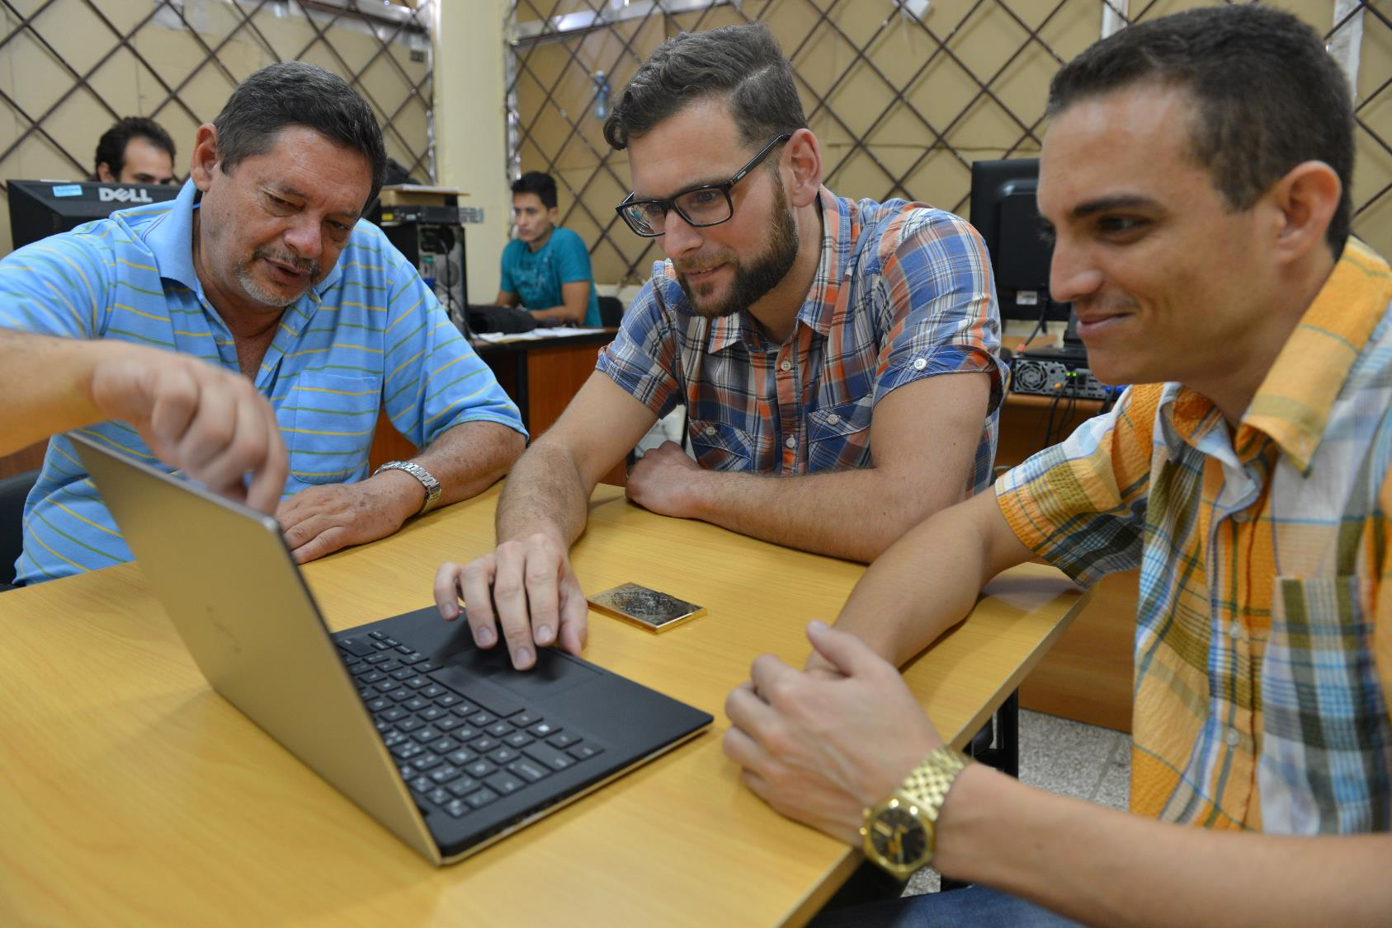
Long-term investments
Notes:
We believe real change takes time. That’s why we invest in long-term partnerships of ten years and even longer. That long-term investment is important to create sustainable education and research infrastructure, to “grow” PhDs and train people, have an effect on the research culture of a university and achieve impact in the broader society.
Our goal is to transform individual scholars into change agents, and universities in social change makers.
Those 10-year university cooperation programmes are quite unique in the world.

Slide 28
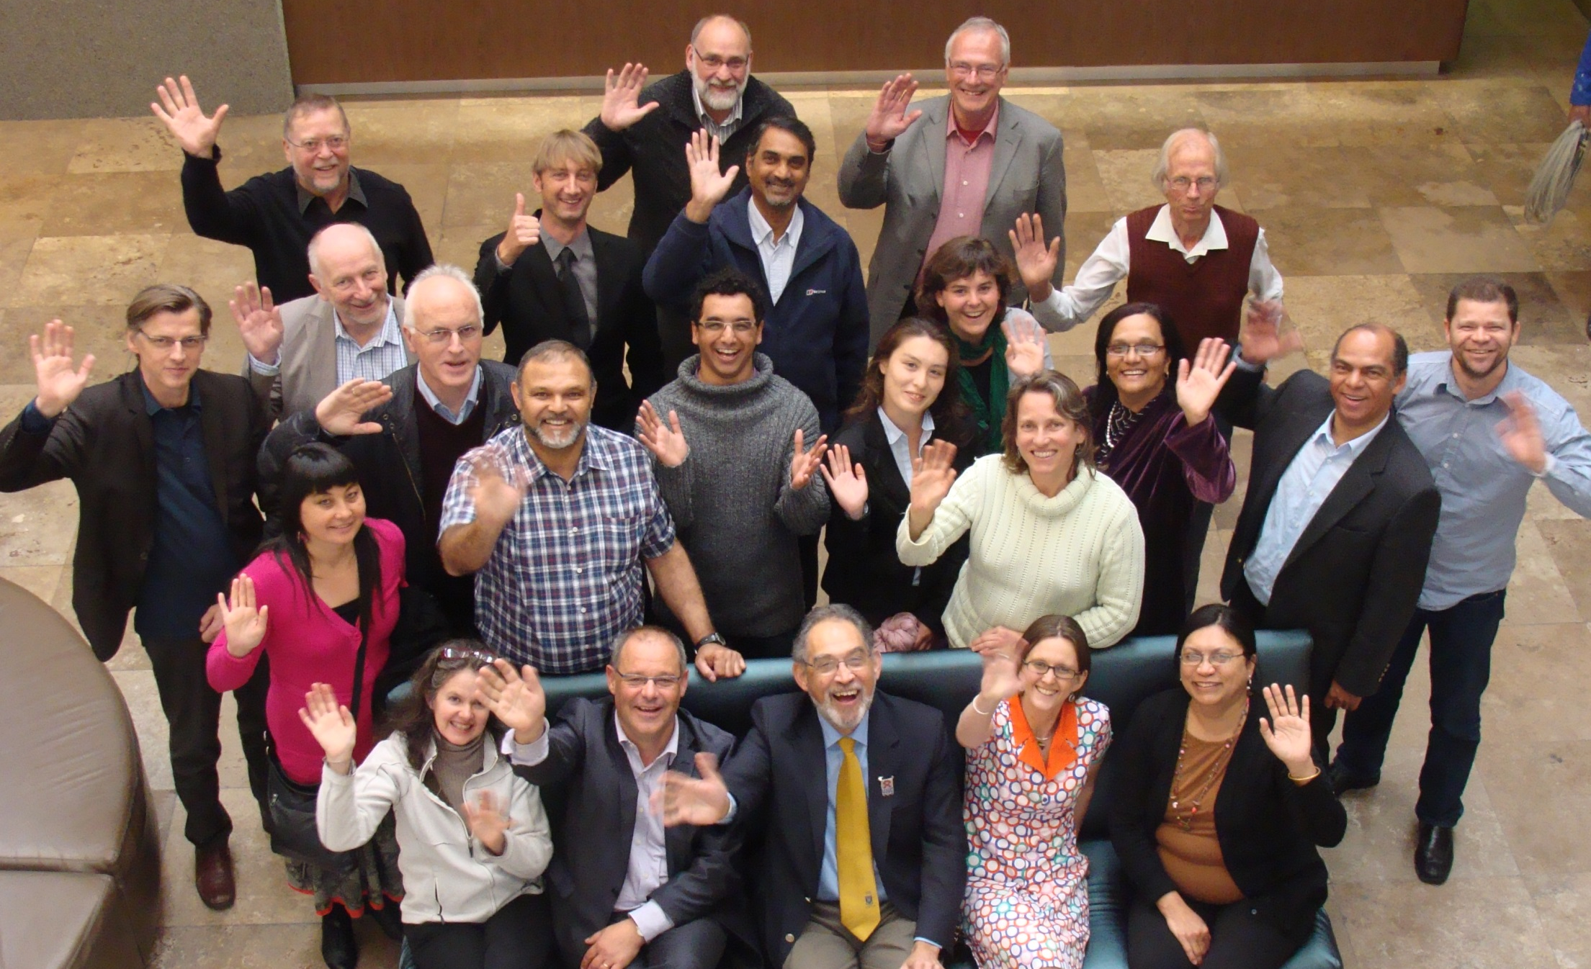
Interdisciplinary and interinstitutional
partnerships
Notes:
Social challenges are complex. To find better solutions we bring together experts from different disciplines and institutions. We not only involve universities and university colleges, but also governments, civil society organisations and companies.
Something interesting to notice is, that in several cooperation projects, all the Flemish universities are involved. So, instead of being competitors, they join forces to extend the scientific quality and scope of their actions.

Slide 29
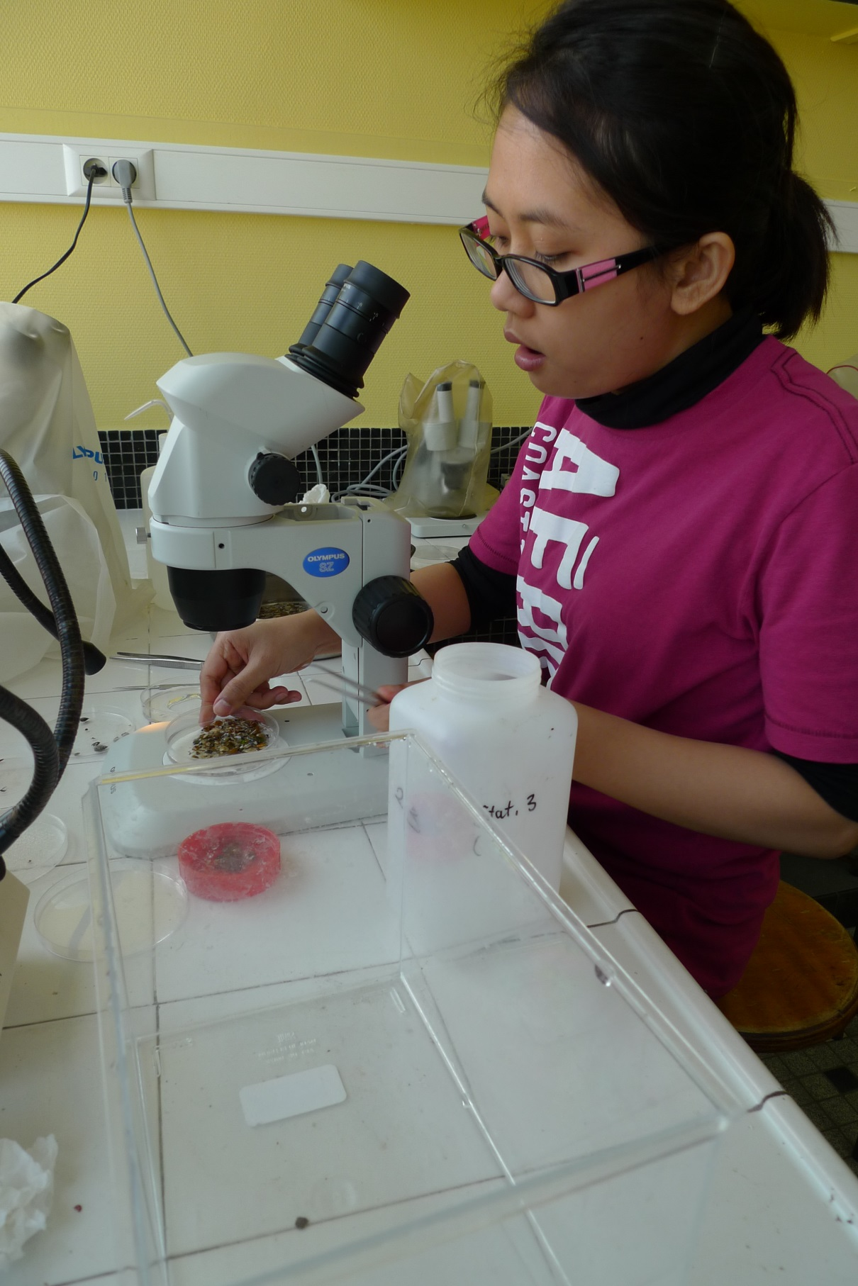
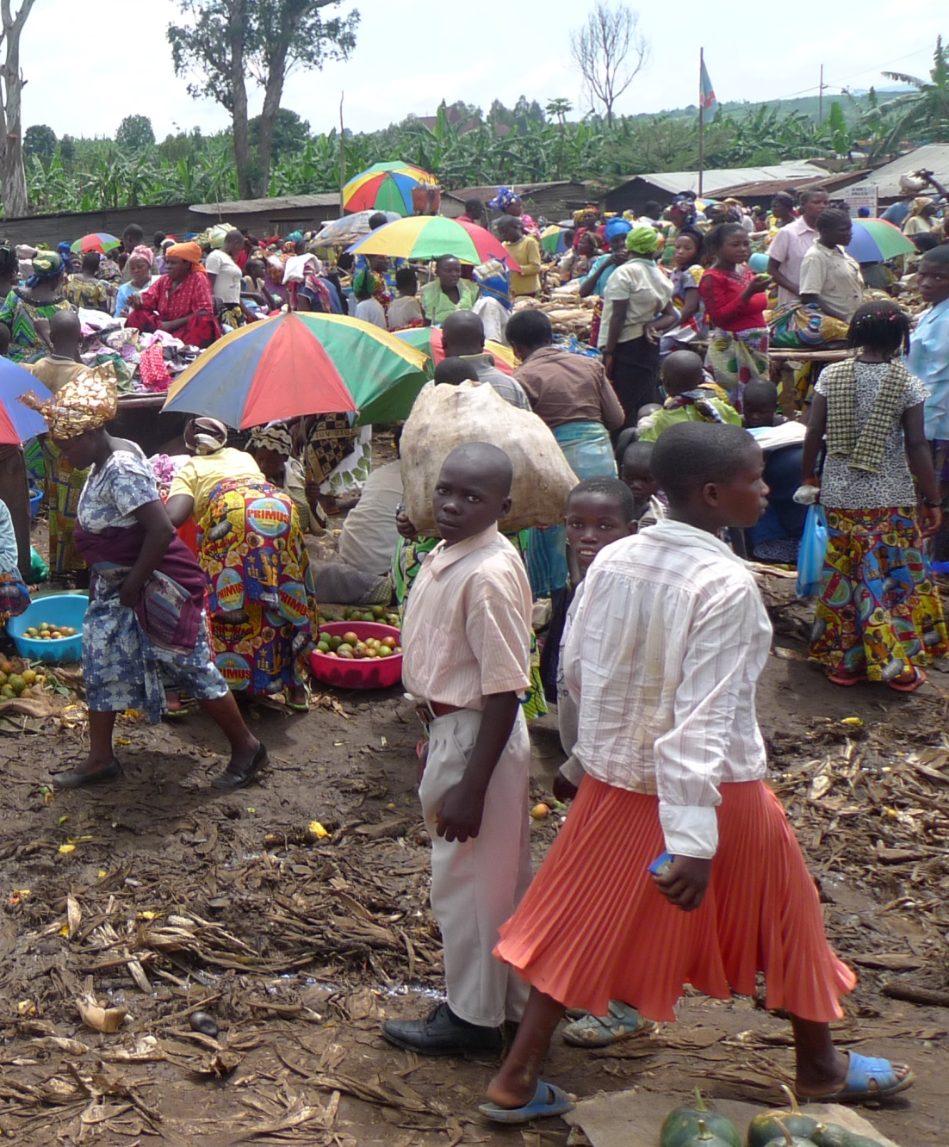
KNOWLEDGE
APPLICATION
Notes:
So at the end, it’s not only about creating knowledge, but to solve local and global challenges by using, sharing and growing knowledge and expertise.

Slide 30
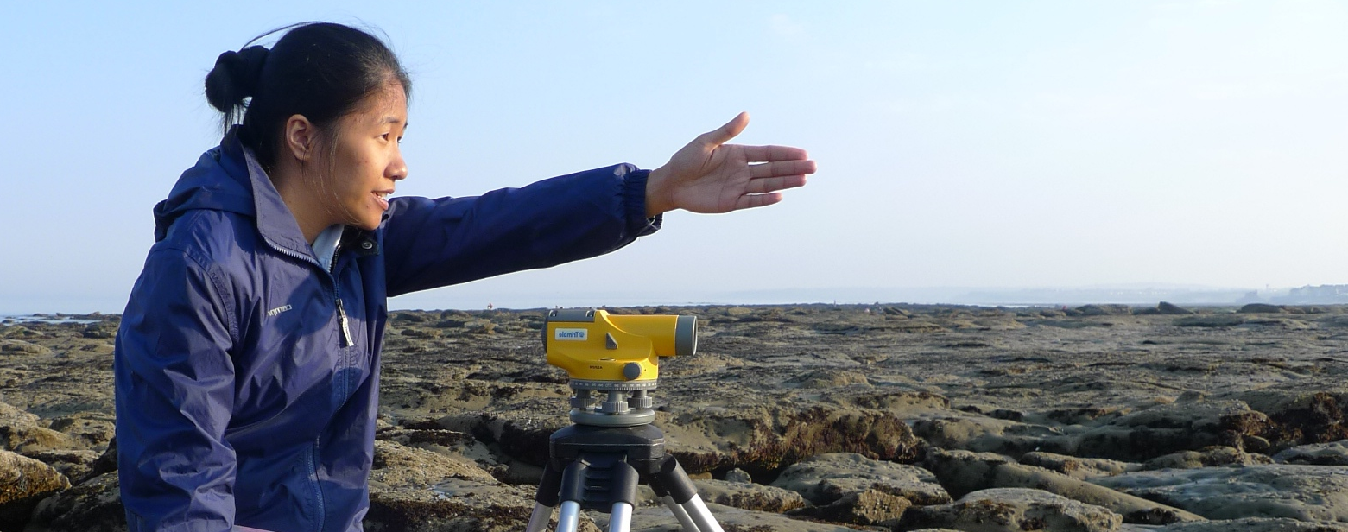

www.vliruos.be

Slide 31
