Slide 1
Session 2
First steps in the LFA

Slide 2
“Change” and the different levels of results

Slide 3
What does « CHANGE » really mean?
exercicse
A DEVELOPMENT ACTION SHOULD LEAD TO CHANGE

Slide 4

Some things to consider about “change”
Is there a change and if yes, is it positive?
For whom exactly? (did we forget something, somebody?)
Is it a change that we (all the stakeholders) were expecting?
Is this change attributable to our action? To others? (who?)
How did we manage to achieve this change? (what was the plan?)
other questions…
Notes:
15

Slide 5
Intervention logic & reach: there is a limit to our influence
What we are accountable for
Project
=
sphere of control
Partners
=
sphere of influence
Beneficiaries
=
sphere of interest
What we are accountable to manage for
Understand the reach of the action !
In the LFM, the intervention logic summarises the pathway to change…
…but we do not control/ influence all levels the same way !
Inputs
Activities
Outputs
Outcomes = changes in behaviour
Impacts = changes in state

Slide 6
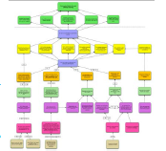
The accountability ceiling
… is the line between the impact level and the long-term outcome of the action
The impact drives the action/project (it is the “reason why”) but is out of its control.
The long term outcome is what the implementing organisations decide to be accountable to manage for.
The position of the line depends on the limits and opportunities of the action, the number and profile of partners involved etc.

Slide 7
Intervention logic, outcome level and accountability ceiling
Outcome level = at the intersection of
the decreasing influence of the action/project
and the increasing ownership by beneficiaries
Influence of the project
Ownership by beneficiaries

Slide 8
We usually present the results chain like this:
Impact (Overall objectives)
Relate to the wider objectives to which the project will contribute
Outcome
(Specific objective)
The sustainable flow of benefits to the project’s target groups(s)
Outputs
The tangible goods and services delivered by the project
Activities
What the project does to produce the outputs (work programme/tasks)
Notes:
15

Slide 9
Example
Results chain: diagram showing how a project will trigger different levels of change from activities to impact
Associated with indicators: their targets, baselines, sources of verification
RESULTS
Inputs
Activities
Outputs
Outcomes
Impact
  Procurement of text books
  Training of teachers
  Text books provided
  Teachers trained
  Increased school completion
  Increased literacy
  Financial input
  Indicator
  Number of
  boys and girls completing school
  Target Y(n+1)
  13000
  8000
  Baseline Y(n)
  11000
  5000
  Source of verification)
  Yearly report Min. Education

Slide 10
A framework for budget support
GOVERNMENT POLICY & SPENDING ACTIONS (STRATEGY)
Inputs to Government policy & spending actions
GBS / SBS inputs
Direct Outputs
Induced Outputs
Outcomes
Impacts
Funds
Policy Dialogue
Capacity Building
Improvement in the relationship between external assistance and the national budget and policy processes
Improved public policies, public spending, public service delivery and public sector institutions
Positive responses by beneficiaries to government policy management and service delivery.
Sustainable Growth, Poverty Reduction, etc.
EXTERNAL FACTORS, CONTEXT FEATURES AND FEED BACK PROCESSES

Slide 11
But… this representation of the results chain can be misleading if not correctly understood
Impact (Overall objectives)
Outcome
(Specific objective)
There are also
intermediary (mini) steps,
processes (drivers), interactions, sequences
Outputs
Activities
Notes:
15

Slide 12
Change, results and the context
Our first glimpse of "change" has shown that defining it correctly is not a straightforward, simple task!
… and our initial theoretical approach to results confirms that contributing to it (change) will not be a linear, smooth process
First step in the LFA is understanding the context…..
Notes:
15

Slide 13
Context analyses
Sector/regional context/thematic area (possibly updating the programming info)
Public Policy Assessment and EU Policy Framework
Stakeholder analysis (with elements of political economy analysis)
Priority areas for support (essential for support to partner strategy)
or
Problem analysis for a thematic or regional action in absence of clear support for a given partner strategy

Slide 14
Public Policy Analysis
Describe main specific objectives of partner’s policy that are to be supported… AND
What the level of preparation of this policy is. Is a performance assessment/ M&E framework in place?
How relevant is the policy? e.g. existing institutional capacities, responding to identified opportunities/challenges?
In line with EU policies/values?
Is it a credible policy? e.g. ownership, outcomes of policy implementation, coherent with government budget, risk informed?
NB Don’t just list relevant policies!

Slide 15
Building from a partner’s policy/strategy
What if?
If the partner’s policy is (relevant and) credible… how do we decide on the focus of our support to that policy? What are the practical consequences? what should we be looking for in particular?
If the partner’s strategy/policy lacks relevance or if there is a lack of credibility, what approach should we take ?

Slide 16
Stakeholder analysis (with elements of political economy analysis)
not just a list of the stakeholders but
an analysis of the strengths and weaknesses (in particular in terms of capacities); capacity to assume mandate? relationship with Government?
their active participation or not, (and if not, why?) in the preparation of the action (the intervention logic)
Elements of PEA …. Will go beyond appearances/declarations and analyse the real interests of key stakeholders, their relative support to (the whole or to part of) the reform… Sustainability?
What are the links between public policy analysis and stakeholder analysis ?

Slide 17
Development processes & stakeholders
Development processes are fundamentally
domestic, political change processes
Hence relationship between State and society is crucial and engagement with CSOs, LAs & private sector, have to move beyond a narrow aid agenda to a broader development agenda
Treat CSOs, LAs & private sector as actors
Analyse State-society relations systematically
Explore and exploit full potential
Government, public sector, local authorities, civil society organisations, not for profit organisations, private sector, experts…
➔Specificities and comparative advantages should be analysed early in the preparation process of projects and programmes.

Slide 18
Assessing Capacity

Slide 19
CRUCIAL to assess capacity and capacity development – WHY?
It is part of stakeholder analysis and helps to:
  Understand the drivers for and against change in our intervention logic
  Identify appropriate partners
  Design relevant and feasible support measures, including for support to capacity development
  Support assessment of governance issues
  Key analysis for programme-based approaches. Success often relies on the way an action fits with existing capacity

Slide 20
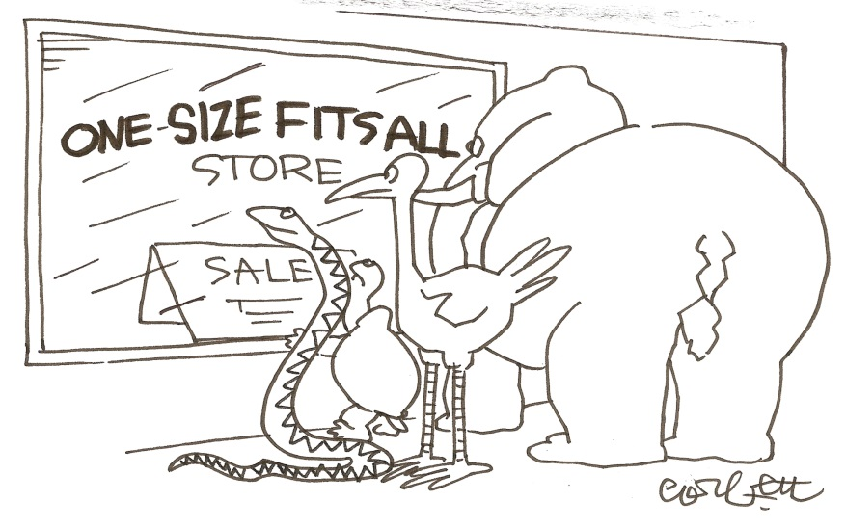
Assessing capacity and capacity development – HOW?
Tools are the same as for stakeholder analysis + inter alia:
  Institutional audits
  Institutional capacity assessment checklist
  (part 6 of the PCM Guidelines)
  Public finance management assessment
  Using outputs (tangible products &
  services) as proxies for capacity
  Accept the need for a
  differentiated approach for tools
  and CD support measures
See also: Backbone strategy, CD toolkit & training on CD

Slide 21
Assessing capacity and capacity development - linking project design to an endogenous CHANGE process
INTERNAL
Capacity
The ability of individuals and organisations to perform tasks and produce outputs
Capacity development
The internal process by which people and organisations create and strengthen their capacity
Support to capacity development
Inputs to capacity development processes delivered by external actors

