Slide 1
Session 13
Monitoring systems &
Results oriented management

Slide 2
Monitoring systems
"In an increasingly performance-oriented society, metrics matter. What we measure affects what we do. If we have the wrong metrics, we will strive for the wrong things."
J.E. Stiglitz, A. Sen, J.P. Fitoussi, "Mis-Measuring our Lives

Slide 3
The logframe matrix as a living tool

Slide 4
Dealing with indicators raises questions…
Who is responsible for their calculation?
What collection mechanism is used to obtain the data?
At what stage of processing is the data provided (draft/final/published)?
Survey data: what is the degree of precision (even theoretical) of the data?
Are successive collections of data made under the same conditions? Is the calculation method the same for two deliveries of the indicator value?
Are variations between two values plausible?
Percentages: what is the value of the unit?
Is the variation trend known? (at least 10 years of observation)
Tool : Annex 3 of the guide on « Performance measurement… »

Slide 5
…and when setting up a monitoring system
How are indicators defined and calculated?
What data will be collected, when, how and who is responsible?
What tool will be used for data collection?
How will data quality be assessed and assured?
What activities need to be completed, when, how and by whom: develop a tracking tool for activities?
Which process will be used to adjust project/ programme for areas that are underperforming?
For more detailed info on monitoring plans, see training on monitoring

Slide 6
Steps for designing a monitoring system
Define the objective and scope of the monitoring system
Identify performance-related questions, information needs and indicators
Plan for data collection and the organisation of information
Plan the activities and processes needed for an efficient linkage between information and decision making (with a view to improving and managing the project/programme)
Plan the information flow and reporting process (how and to whom?)
Plan for the necessary means and skills
Combination of stakeholders, approaches, methods, tools, indicators…
M & E
system

Slide 7
Monitoring system
Documenting indicators
Identification with respect to the action: Indicator « title », relation to the result chain, users of the indicator/ communication flow
Description of the indicator: Measurement unit, periodicity, baseline value
Data collection: nature of basic/elementary data, method of data collection, level at which data will be collected/analysed, responsible bodies for the collection, method of calculation
Means of interpretation: known limits & bias, interpretation of increases/decreases/merits/success,
Targets & milestones
See also
identification sheet of the guide on « Performance measurement… » (§2.7.)
« Designing table » from evaluation manual.

Slide 8
Monitoring system
Key messages
Focus on outcomes and outputs to assess the project/ programme performance
Don’t neglect process and input indicators to assess efficiency and implementation (use of resources and activities)
Build on existing systems and capacities
Identify indicators and the source of information at the same time (reality check). Keep it simple and realistic!!
Involve responsible managers & stakeholders
Balance quantitative and qualitative indicators
+ involve beneficiaries to ensure that indicators are relevant to them as well…

Slide 9
Monitoring and Evaluation
Strategic Evaluations
Project & programme evaluations, ROM
DEVCO Internal monitoring (OMs)
Results Framework
Internal project monitoring by implementing partners

Slide 10
Managing for development results

Slide 11
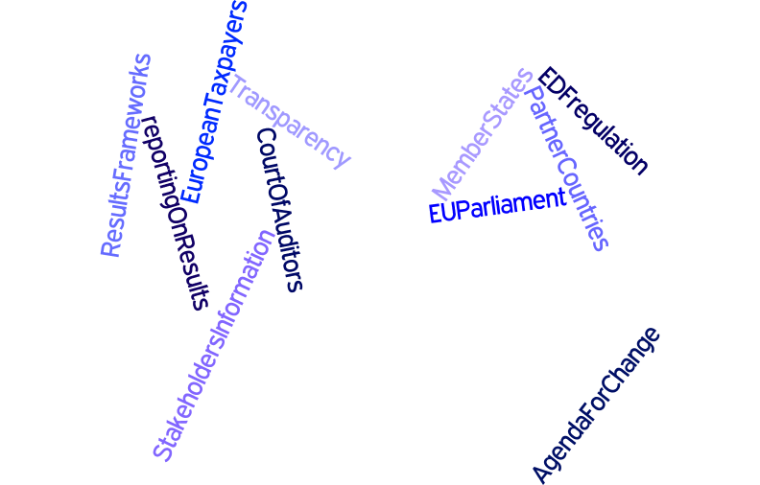

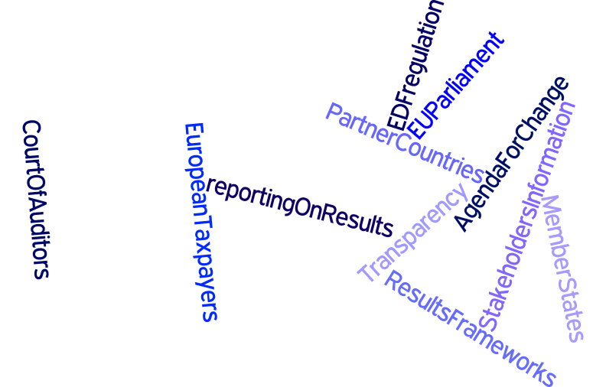
The whole political context is pushing for a focus on results
Focus on results
Global priorities
Community priorities & rules
Citizens and tax payers

Slide 12
Managing for development results
“Managing for development results (MfDR) is a management strategy that focuses on using performance information to improve decision-making. MfDR involves using practical tools for strategic planning, risk management, progress monitoring, and outcome evaluation.” (DAC)
Principles:
  Focus the dialogue on results at every stage of the management cycle
  Base planning, monitoring and evaluation on results
  Keep measurement and reporting simple, based on results
  Management based on results
  Learning and decision making based on results
At the center:
RESULTS = measurable change

Slide 13
Managing for development results
to measurable results
“what can I achieve with the money?”
at all phases of the development process.
This shift has a real impact on the quality of the policy dialogue!
see also Policy dialogue training
Shifting the focus from inputs
“how much money will I get?”
“how much money can I spend?”
.

Slide 14
Managing for development results
A development result
is the output, outcome or impact of a development intervention
Development Outcomes
medium-term effects or results of a development intervention
observable behavioral, institutional and societal changes that take place over 3 to 10 years
usually as a result of coordinated short-term investments in individual and organizational capacity building of key development stakeholders

Slide 15
Managing for development results
Five stages of the “MfDR cycle”:
Setting goals and agreeing on targets and strategies
Allocating the available resources to activities that will contribute to the achievement of the desired results
Monitoring and evaluating whether the resources allocated are making the intended difference
Reporting on performance to the stakeholders
Feeding back information into decision-making

Slide 16
Managing for development results and M&E systems
Growing agreement:
  MfDR should form the basis for country-owned systems that donors and partners are jointly committed to supporting
Essential to this:
  Country-based monitoring and evaluation, and the underlying statistical capacity
The establishment of a stronger “performance culture” remains a challenge not only for developing country governments, but also for donor organisations.

Slide 17
Managing for development results
Tools and techniques
Variety of practical tools/techniques to manage for results:
the theory of change
results-based strategic planning
logic models and logical framework matrices
results frameworks
results-based budgeting
risk management
results-based M&E
For more information:
training courses on monitoring and evaluation
sourcebook on Emerging Good Practice in
Managing for Development Results (DAC)

Slide 18
Elements of reform in DEVCO monitoring
In June 2013 Management approved proposals for reform of monitoring and reporting. The main elements of the reform are:
new design of Results-Oriented Monitoring (ROM) activities focused on support to project management and end of project results reporting → improved support to management → rolled out
the introduction of the "EU International Cooperation and Development Results Framework" → rolled out
the introduction of an annual monitoring and evaluation plan → better organisation and supervision of monitoring → under construction, will be tested soon
introduction of a new annual progress report and completion report. → Replaces the CRIS implementation report first steps
Introduction of a completely new operational information management system → consolidate reporting blocks, improve management → under construction
Discussions on a new IT vision for reporting → under discussion
Production of a new "Action Document Template", for a better design of projects, results oriented, well defined indicators, baselines and measurable results targets → rolled out

Slide 19
Current evaluation plan (annexe to the Annual Management Plan)

Slide 20
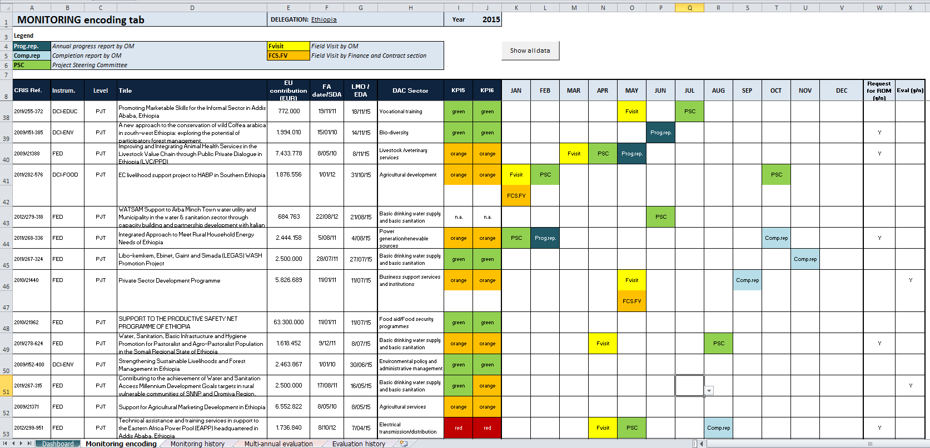

Slide 21
The EU International Development and Cooperation Results Framework, a corporate tool for monitoring results

Slide 22
Introduction
A results framework is a tool that is used to measure results achieved against strategic development objectives.
EU International Development and Cooperation Results Framework (EU RF) dual purpose:
  Accountability - Communicate to stakeholders (e.g. tax payers, EU Institutions) results achieved at country, sector and corporate level.
  Management - Provide reliable information on EuropeAid performance to support decision making.
EU RF is a monitoring tool and not an evaluation tool (monitoring for evaluation).

Slide 23
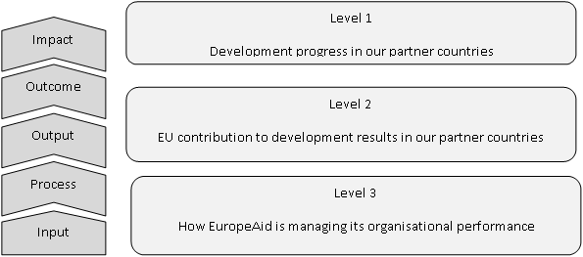
Three - level Structure
RF will be a snapshot of EU cooperation: coverage of EuropeAid operations below 100%

Slide 24
EU RF Data source & data collection
Development progress in partner countries
International statistical database (e.g. United Nations, World Bank, IMF, others)
  A database will be established and updated at HQ level (DEVCO 06) with the latest available international data from the above sources.
Level 1
32 indicators
EU contribution to development result in partner countries
Partner country statistics
Projects and programmes monitoring systems
  Implementing partners (Partner Governments, MS Dev. Agencies, UN agencies, NGOs, others) to collect and transmit results data to EuropeAid (regular progress reporting).
Level 2
32 indicators
Level 3
12 indicators
How EuropeAid is managing its organisational performance
EuropeAid Internal monitoring systems
(such as EAMR, CRIS based reports, others)

Slide 25
RF Indicators: Examples
Provisional list of indicators covering priority areas (i.e. Agenda for Change) validated by EuropeAid Mgmt and Cabinet in January 2014
Examples
  Level 1: Primary education completion rate, Prevalence of stunting
  Level 2: Number of children enrolled in primary education with EU support, Number of women and children benefitting from nutrition related programme with EU support

Slide 26
RF indicators: Methodological notes
To facilitate and ensure coherence in measurement each RF indicator will be accompanied by a methodological note
Issues described: relevance for EU policy, data sources, method of calculation and worked examples
Methodological note template

Slide 27
Matching between RF and
NIPs/MIPs (2014-2020)
NIPs and MIPs indicators screened in terms of number (<15 per sector) and quality (definition, data availability)
No artificial integration of RF into NIPs/MIPs: identification of NIPs/MIPs indicators associated with RF indicators:
  "Matching table" exercise
Matching table for internal use (not legal document)

Slide 28
Coverage
Results reported for Projects and Programmes above 750,000 EUR (bilateral, regional, thematic).
Instruments covered: DCI, EDF, Stability and Peace, Democracy and Human rights, Nuclear safety, Greenland (2014-2020) and corresponding countries for 2007-2013*.
* First years of reporting will reflect actions from previous programming period.
To facilitate and ensure coherence in measurement each RF indicator will be accompanied by a methodological note describing the following issues: relevance for EU policy, data sources, disaggregation, method of calculation and worked examples.

Slide 29
Level 2: Results Reporting
Results reporting (level 2) based on completed projects.
Ongoing reporting possibly to be introduced in the future following upgrade of internal monitoring.
Results data consolidated into Completion Reports by EU operational managers in Delegations and HQ and transmitted to HQ services.
HQ services to perform final quality check and aggregation.

Slide 30
Level 2: Results calculation
Results to be reported as "partner country results supported by the EU" - Contribution approach.
Overall method applied to calculate results: total of results achieved by EU interventions jointly with partners (including BS and other co-funded operations).
Proportional method to be explored in the future.

Slide 31
EURF & Publication of results
Once a year: publication in EuropeAid annual report of aggregated numbers against the corporate results framework (high level numbers)
Occasionally: publication of country pages (more context-specific results)

