Slide 1
OPSYS
A business transformation and digitalisation program for visible impact and enhanced performance around our delivery chains in the external service
DEVCO, NEAR, FPI, EEAS
Brussels, 22 September 2016, 05

Slide 2
WHY do we need a business transformation program for our external actions ?
Europeans want common decisions followed by swift and efficient implementation.”
Claude Juncker, State of the Union Address 2016
The Juncker Commission's strategy sets clear benchmarks (policy guidelines )
The Commission is working to develop a new, stronger performance culture, reinforcing effectiveness and efficiency across all policy areas. (…). The Commission wants to demonstrate the value added of the EU budget and its contribution to the Europe 2020 strategy.” (…) (Juncker Commission)
“The Commission is committed to continuously improving the architecture of better performance management and reporting.”
GEORGIEVA Kristalina - EU Commissioner for Budget Speech before the European Parliament Committee on Budgetary Control, Brussels, 05 November 2014
The CWP for 2016 "No time for business as usual"1 states that "the coherence of the EU's external action and our ability to use all available instruments in a joined up manner to achieve our objectives and complement our internal policies are ever more important".
The DEVCO Annual Management Plan reiterates the importance of results and evaluation
"Evaluation will continue therefore to be part of our effort to build and maintain a culture of accountability and learning. "

Slide 3
WHAT are the key gaps identified from the task force OPSYS
(report April 2015)
Initial vocation to design a new and more performing operational information system to replace the operational part of CRIS as a corporate solution for DEVCO, NEAR, FPI (ECHO)
Acknowledgement that this goes beyond the IT solution into improving the way we do business (BUSINESS TRANSFORMATION)
gaps which had been identified:
Transparency and communication requirements
Monitoring (evaluation) of performance and results (learning and improving from our actions)
Building of a broader dimension of our action beyond organisational boundaries:
  EU –dimension: deliver jointly with other DGs, EEAS, and Member States
  Partnership dimension: deliver jointly with our partner governments, end beneficiaries and implementing partners
Improve our efficiency through better internal collaboration, better management of documents, automating tasks and better time management
Support knowlege management and using better social media to do so

Slide 4


Process Overview with OpSys scope
Legend:
External action specificities
Core value
Contributing value
Transparency, Reporting and Communication
Objectives
Indicators
Targeted Results
Achieved Results
Specific process for: GGDC – special form of budget support -
Specific process for: Budget Support, CBC, Blending..
3 management modes: direct/indirect/shared
Implementation modalities: Procurement, CfP, Contracts and Grant Contracts, Budget support, PAGODA, Blending, PE, Union TF, CBC, Twinning, Taiex, etc.
Policy Making
Multi-Annual Financial Planning
(Indicative) Programming
Identification & Formulation
Financing
Implementation (incl. Audit)
Evaluation
Instrument
Action
Commission Decision: (M)AAP, Measure, CBC Action Programme, Exceptional Assistance Measure etc.
Commission Decision: MIP/ISP/SSF
Programme / Project
Continuous Improvement and Knowledge Management
Individual and Team Productivity:
Internal and External Collaboration and coordination; Time and project management

Slide 5
HOW: iterative and participative along the whole process chain
Business transformation from
as is to be
IT response
Human ressource
Management
Legal Framework
Functional/
Organigram
POLITICAL REQUIRE-MENTS
CHALLENGES
develop and test with user groups
Business process for projects
Leadership => strategic require-ments (strategic program-ming papers, Annual Work Plans
Evaluation
Implemen-tation disburse-ments
Monitoring
Commitment level 2 (tendering/ contracting
Commitment level 1
Programming
Perfor-mance framework
Legal frameworks, agreements
Policy dialogue
Programming/ other strategic ouputs
Perfor-mance framework
Business process for soft processes (negotiations , policy dialogue )

Slide 6
WHEN it will happen
2016 |  |  |  |  |  |  |  | 2017 |  |  |  |  |  |  |  | 2018 |  |  |  |  |  |  |  | 2019
Q1 |  | Q2 |  | Q3 |  | Q4 |  | Q1 |  | Q2 |  | Q3 |  | Q4 |  | Q1 |  | Q2 |  | Q3 |  | Q4 |  | Q1 |  | Q2 |  | Q3 |  | Q4
1. Results management operational entities
2A. Operational backbone / Action and level 1 commitment
Preparation |  |  |  |  | 2B. Operational backbone / Contract and level 2 commitment
 |  |  |  |  |  |  |  | 3. Implementation and evaluation
 |  |  |  |  |  |  |  |  |  |  |  |  | 4. Programming processes and preparation of actions
 |  |  |  |  |  |  |  |  |  |  |  |  |  |  |  |  |  |  |  | 5. Tendering (complementary to 2B)
To be revised after IT Board
CRIS decision and contract
6￼

Slide 7
WH0 IS INVOLVED OPSYS Governance
System owner = DEVCO 05
DEVCO IT SC
Incl. NEAR and FPI rep.
informs
NEAR IT SC
2-3 times / year
endorses
Chair: DEVCO DDG2
Every 2 months + ad hoc
OpSys PSC
DEVCO & NEAR dir. + FPI + DIGIT + ad hoc DGs
Chair: DEVCO 05
Every 2 months
OpSys Programme User Committee (PUC)
HQ & EUD rep. from DEVCO/NEAR/FPI/ECHO/EEAS dir.
OpSys Domain User Groups
Results Management
Contract Management
Other domains and focus group
Chair: BMs
Contract Management
Other domains
Other domains

Slide 8
Achievements to day – on project 1
Europeans want common decisions followed by swift and efficient implementation.”
Claude Juncker, State of the Union Address 2016
Governance structure established – user committee with 6 DEVCO and
5 NEAR Delegations
For project 1 - business requirements on resulst and operational entities (program, project…) with Project User group clarified (notion programme/project)
clarified
R6 is currently working collaboratively with us on technical specifications for project 1
Development of user experience track and related IT solutions (with R6) around typical profiles (program manager; HoC, HoU, Director …)
First Workshop with Delegations at level of User Committee confirmed on 10-12 October

Slide 9
Work to come – focus on Project 1
Europeans want common decisions followed by swift and efficient implementation.”
Claude Juncker, State of the Union Address 2016
03/2017
Pilot phase: with selected EUD/ HQ units (user groups)
Continuous improvement
09/2017
Roll out / first release on results

Slide 10

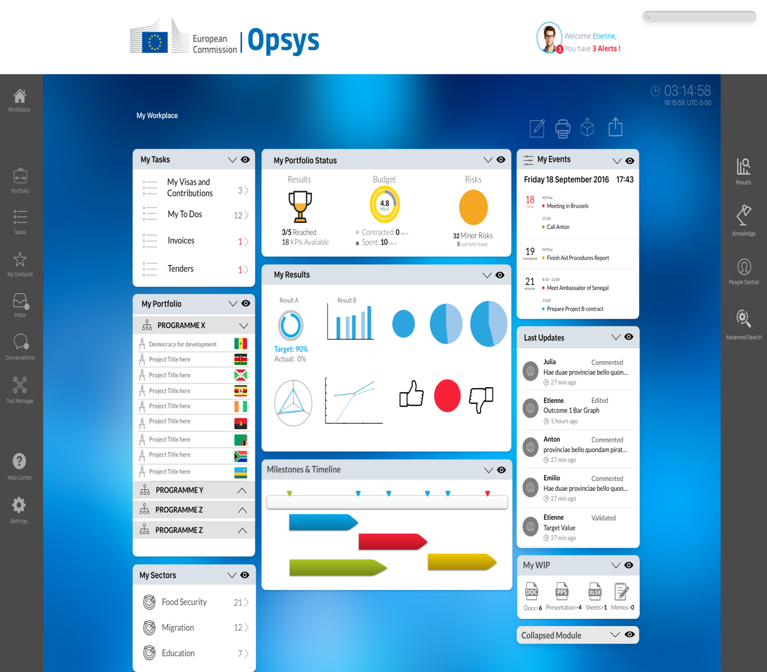
My workplace

Slide 11
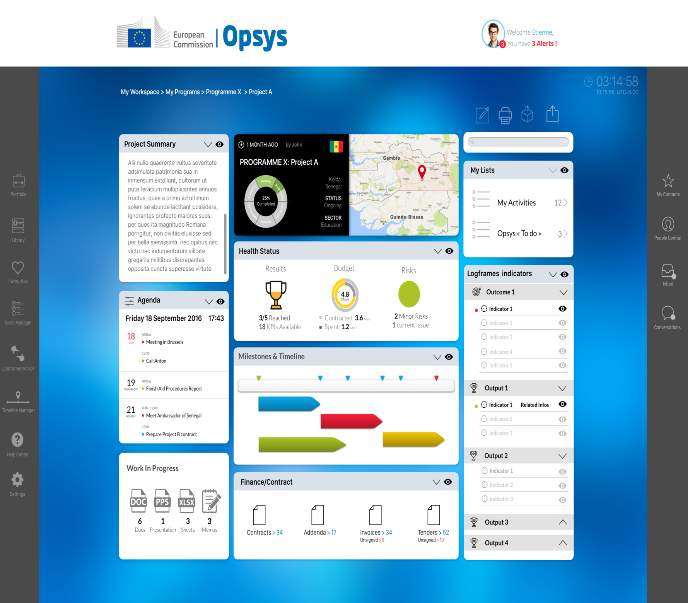
Project page

Slide 12

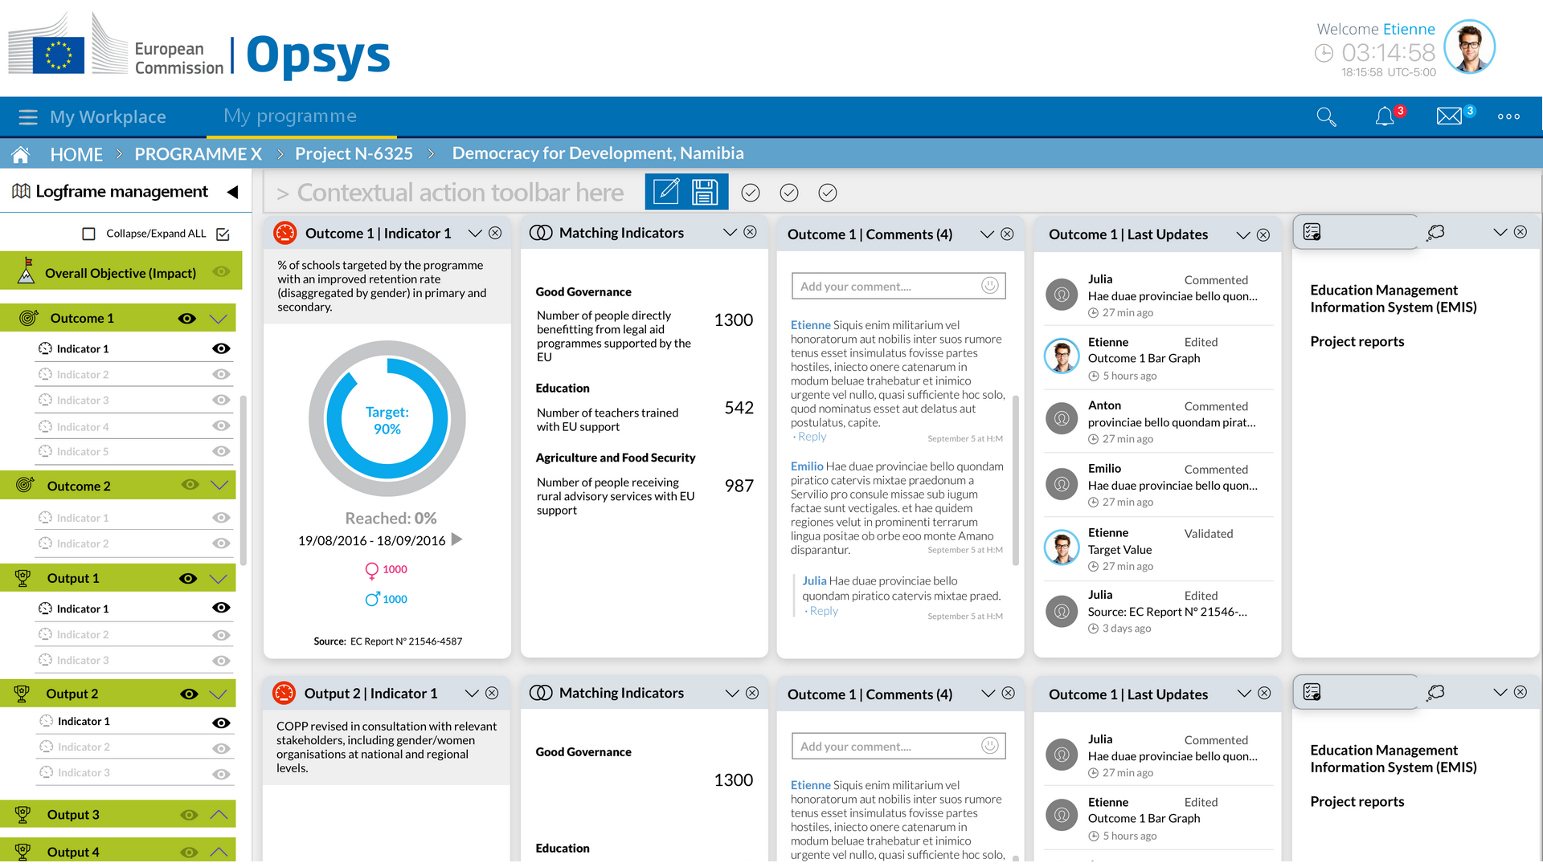
Indicator page

Slide 13
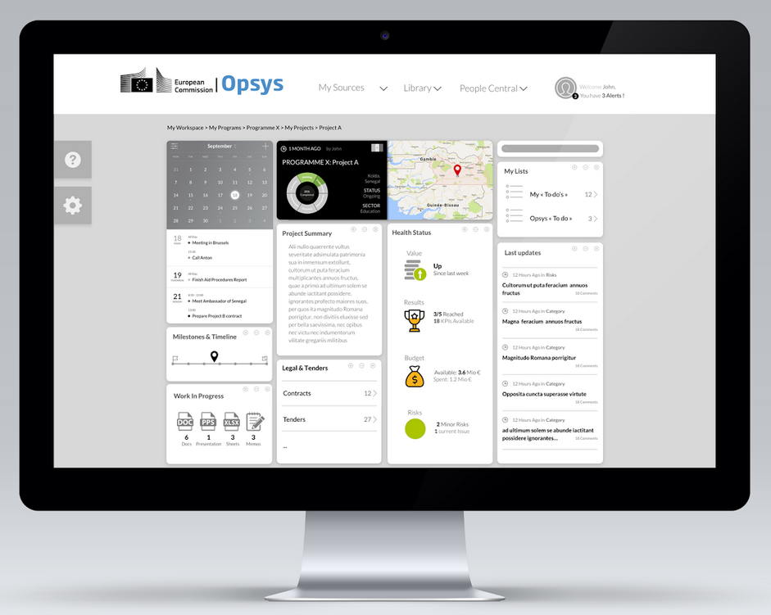
Desktop

Slide 14
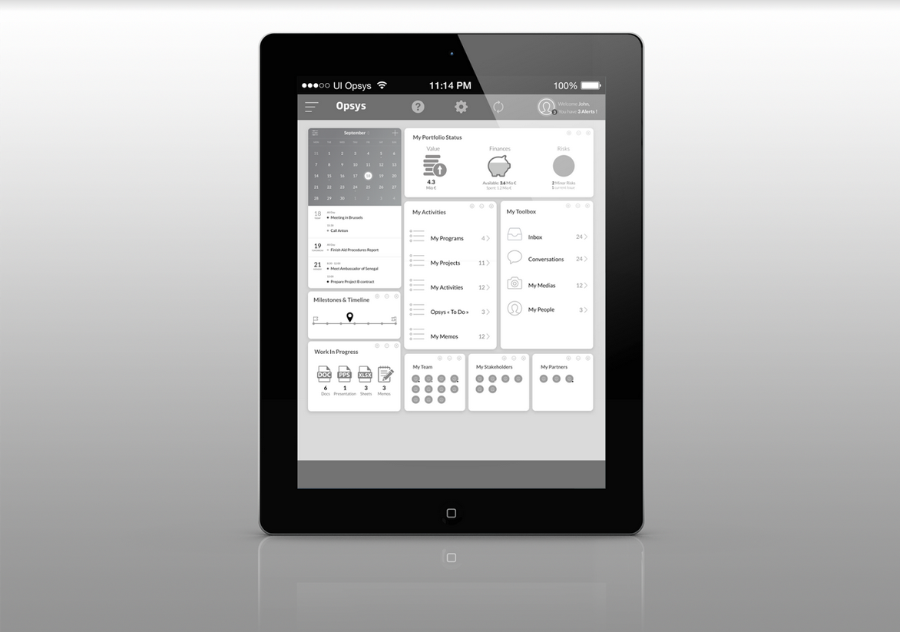
Tablet

Slide 15
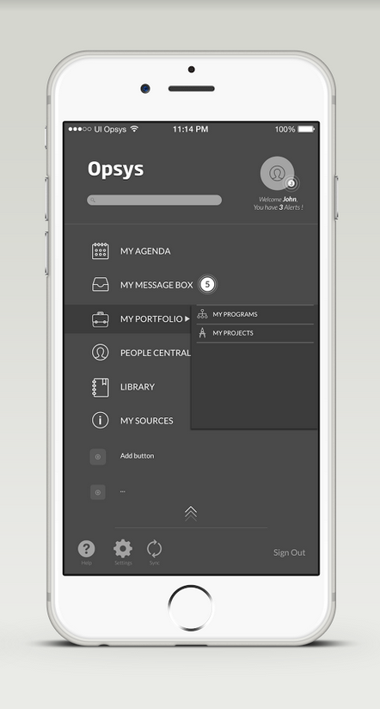
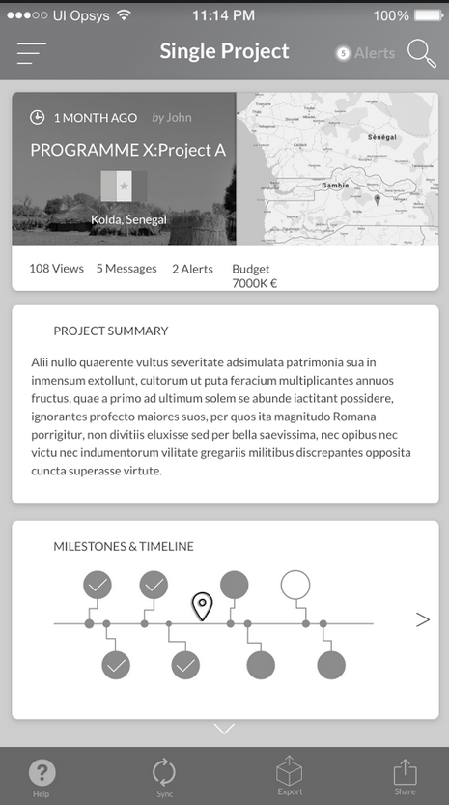
Mobile

