Slide 1

Masterclass
Using Research Synthesis to Make Better Decisions
Philip Davies PhD and Alex Ademokun PhD
P
Oxford Evidentia
EU-AU-IIASA Evidence and Policy Event
Ispra Italy, 30th August – 2nd September 2016

Slide 2
Group Exercise 1
What Constitutes High Quality Evidence?
A

Slide 3
Group Exercise 2: A Policy Scenario:
A
You are a civil servant in the Department Agriculture and Economic Development. Your Minister has been advised that farmer field schools are an effective intervention for increasing agricultural productivity, diffusing knowledge of effective farming, and enhancing food security. Before proceeding further the Minister has asked you for a summary of the evidence on the effectiveness of farmer field schools to increase agricultural productivity. She requires this summary in three days’ time.
Where would you go to find this evidence?

Slide 4
P
Some Features of Evidence
Evidence is information or data that supports, or rejects, a conclusion
Evidence is any thing that increases the estimate of the probability of the truthfulness of a proposition
Evidence is almost always probabilistic
Often disagreement agreement on what counts as ‘evidence’
Evidence can be generalisable or particularistic
Evidence is always contestable/contested
Evidence is rarely self-evident
Not all research is of equal value/sufficient quality
Single studies can misrepresent the balance of evidence
Hence the need for research synthesis.

Slide 5

A
Types of Research Synthesis
Statistical Meta-Analyses
Narrative Systematic Reviews
Rapid Evidence Assessments
Qualitative Systematic Reviews
Evidence Maps and Gap Maps

Slide 6
High Quality Evidence (Quantitative)
Internal Validity: Has the evidence scientific credibility?
Sample size and power, proper execution, low risk of bias, etc.
Adequacy of Reporting:
Appropriate statistics, full reporting of + and – findings, etc.
External Validity: Does the study have relevance to the ‘real world in which you are working?
How similar is the context, the sample(s), the available resources etc.

Slide 7
High Quality Evidence (Qualitative)
Appropriate Sampling:
Purposive sampling, snowball sampling rigorously executed
Appropriate Research Design:
In-depth interviews, focus groups, ethnography, etc.
Sound Data Gathering:
No leading questions, good note taking/recording, etc.
Rigorous Data Analysis:
Reporting of + and – findings, transparency of data, triangulation, etc.

Slide 8
P
Farmer Field Schools – Statistical Meta-Analysis
FFS Knowledge Outcomes for FFS Participants and Neighbours
18 Single Studies
Cumulative Estimate of Effect
5 Single Studies
Cumulative Estimate of Effect

Slide 9
P
Farmer Field Schools-Statistical Meta-Analysis
FFS Pesticide Use For FFS Participants And Neighbours
FFS Participants
22 Single Studies
Cumulative Estimate of Effect
FFS Neighbours
8 Single Studies
Cumulative Estimate of Effect

Slide 10
A
Barriers to, and Facilitators of, Effective Farmer Field Schools
[From Qualitative Synthesis]
The complexity of the curriculum
The nature of the training offered
The observability of FFS practices and their relative advantage compared to other farming practices
Existing levels of social capital
Access to seeds and social networks,
Assistance in marketing produce,
The ways in which FFS programmes are targeted.
The top-down transfer of technology

Slide 11
A
  Some Key Sources for Sound Evidence
3ie Website (www.3ieimpact.org)
Best Evidence Encyclopedia (http://www.bestevidence.org/)
Cochrane Collaboration (www.cochrane.org)
Campbell Collaboration (www.campbellcollaboration.org)
Coalition for Evidence-Based Policy (http://coexgov.securesites.net/index.php?keyword=a432fbc34d71c7)
Collaboration for Environmental Evidence http://www.environmentalevidence.org/
DfID R4D (https://www.gov.uk/dfid-research-outputs)
Evidence Search: Health and Social Care, https://www.evidence.nhs.uk/
National Institute for Health and Clinical Excellence (http: www.nice.org.uk/)
National Library of Health (www.library.nhs.uk/)
National Guidelines Clearinghouse (USA) (www.guidelines.gov)
Social Care Institute for Excellence (http://www.scie.org.uk/)
Social Programs That Work (http://www.evidencebasedprograms.org/)
World Bank IEG (www.ieg.worldbankgroup.org/)

Slide 12
P
Other Types of Research Synthesis
Narrative Systematic Reviews
Provide a narrative account of what the evidence tells us
Provide descriptive and inferential statistics
But on each included study individually, not aggregatively
Provide a summary analysis of what the evidence suggests
Provide the ‘Signal’ and ‘Noise’ of evidence

Slide 13
P
  Key Databases of Sound Evidence
ABI/INFORM Global
Applied Social Sciences Index and Abstracts (ASSIA)
Business Source Complete
EconLit
ERIC (Education)
International Bibliography of the Social Sciences (IBSS)
Medline / PubMed
PAIS International
PolicyFile
PsycInfo
Sociofile
Social Science Citation Index (SSCI)
World Wide Political Science Abstract

Slide 14
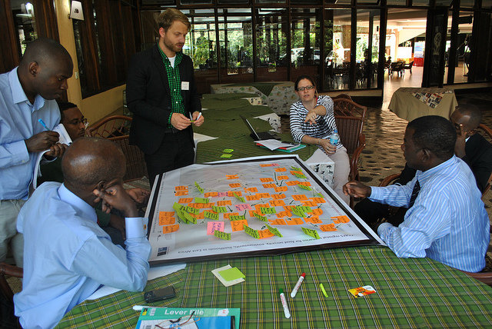
A
Other Types of Research Synthesis
Rapid Evidence Assessments
Scaled down systematic reviews of existing evidence
Timed to meet the needs of policy makers/practitioners (1-3 months)
Strategically using the ‘three arms’ of systematic searching, but less exhaustively
Critical appraisal of identified studies is included
Summary of findings, with caveats and qualifications

Slide 15
A
Rapid Evidence Assessments - Limitations
Not a comprehensive or exhaustive as systematic reviews;
Hence, REAs are more likely to be subject to statistical bias than a full systematic review
We must, therefore proceed with greater caution with REAs

Slide 16
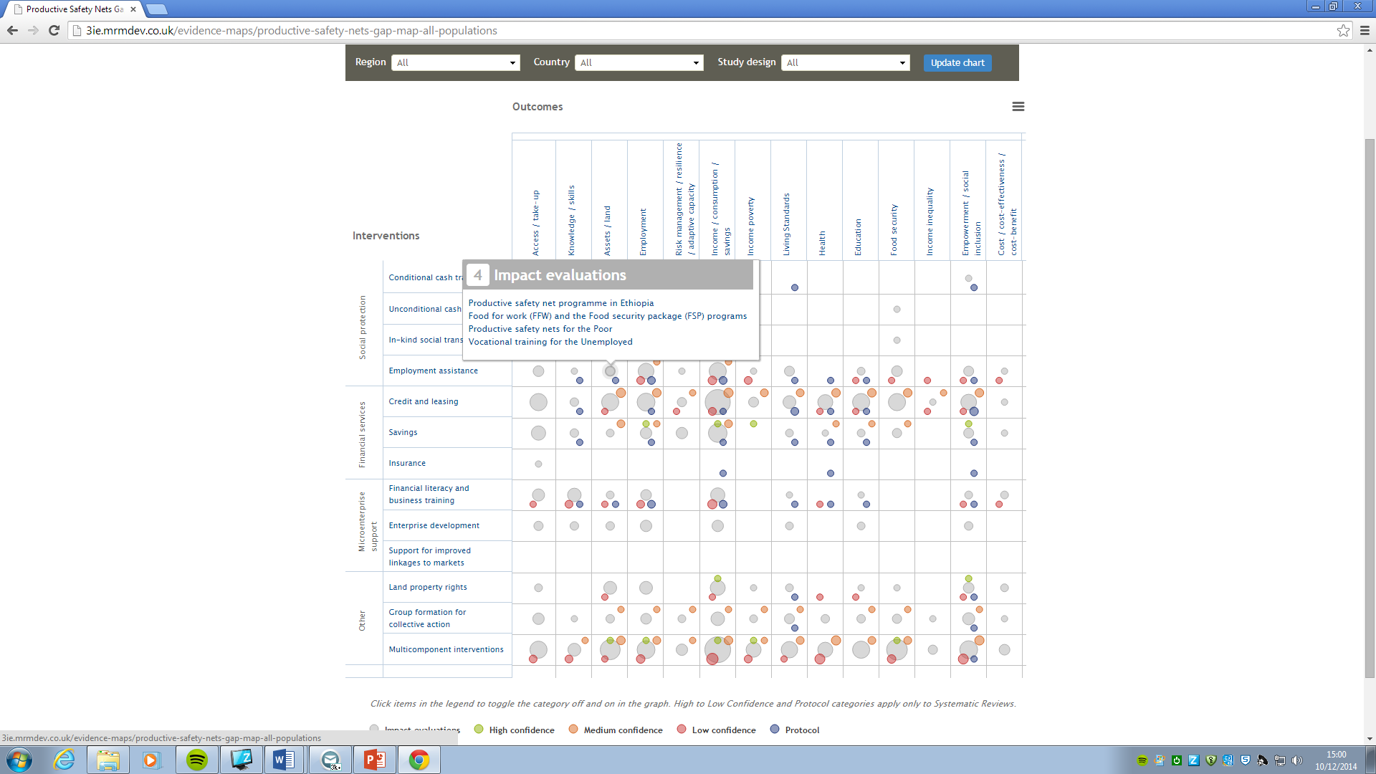
Other Types of Research Synthesis
Evidence Gap Maps
Oxford Evidentia - Making Evidence Accessible

Slide 17
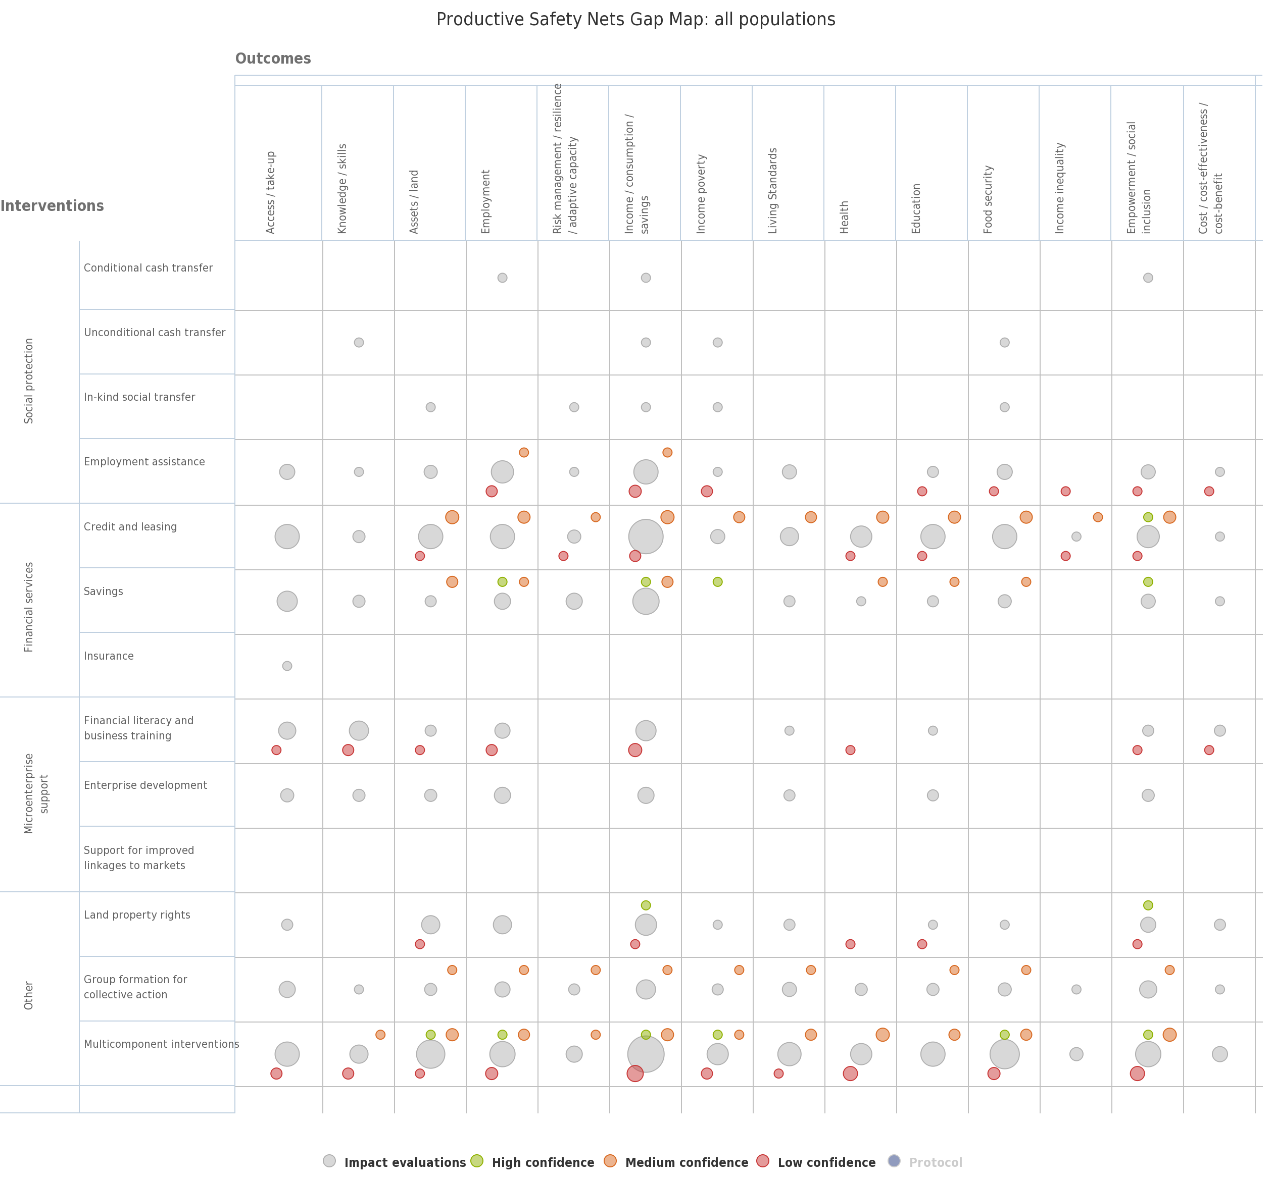

Slide 20
P

Slide 21
Group Exercise:
Group 1 (Policy Makers) This group will read an extract (Chapter 6) from Farmer Field Schools: From Agricultural Extension To Adult Education (Waddington and White, 2014), and report three key findings on the effectiveness of farmer field schools for enhancing food security.
Group 2 (Scientists) – This group will read another extract (Chapter 8) from Farmer Field Schools: From Agricultural Extension To Adult Education (Waddington and White, 2014), and provide their policy colleagues with advice on the quality of the evidence on the effectiveness of farmer field schools.

Slide 22
Contact
Oxford Evidentia
Philip Davies PhD
Ox ford Evidentia Ltd
Tel: +44 (0)1869 347284
Mobile: +44 (0)7927 186074
Email: pdavies@oxev.co.uk
Website: www.oxev.co.uk
Alex Ademokun PhD
DfID UK
Mobile: +44 (0)7876 393 313. Email: A-Ademokun@dfid.gov.uk

