Slide 1
The Narubu game of many voices
JoAnne Bayer
Isayvani Naicker
Piotr Magnuszewski

Slide 2
The fictitious Republic of Narubu
The Ng’ombe River Basin

Slide 3
Republic of Narubu
Politically stable
High economic growth
Agriculture is the mainstay of the economy
Poverty and under-nutrition rates high
High risk of droughts and floods

Slide 4
The Ng'ombe River Basin
Major river (500 km) flowing into Indian Ocean delta
Flow volumes very variable
Periods of water shortages
Sugar cane major crop, large farmers
Majority of basin residents are small rain-fed farmers; fishing also important

Slide 5
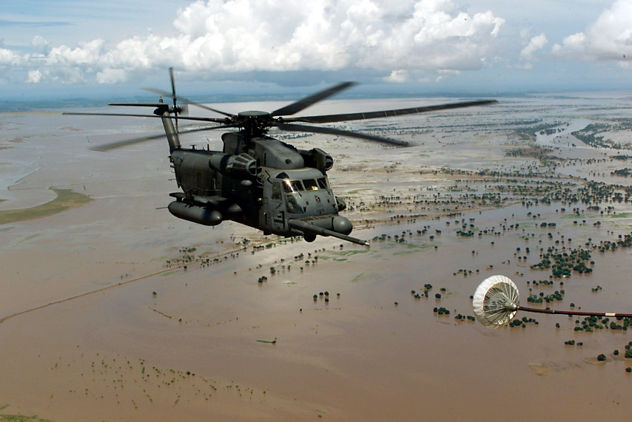
High risk of floods and droughts
No protective levees or dam with flood gates
No effective early warning system
No long-term forecasting
Coping strategies for floods include transportable/stilted housing
Coping strategies for droughts include limited access to irrigation infrastructure
www.rapler.com

Slide 6
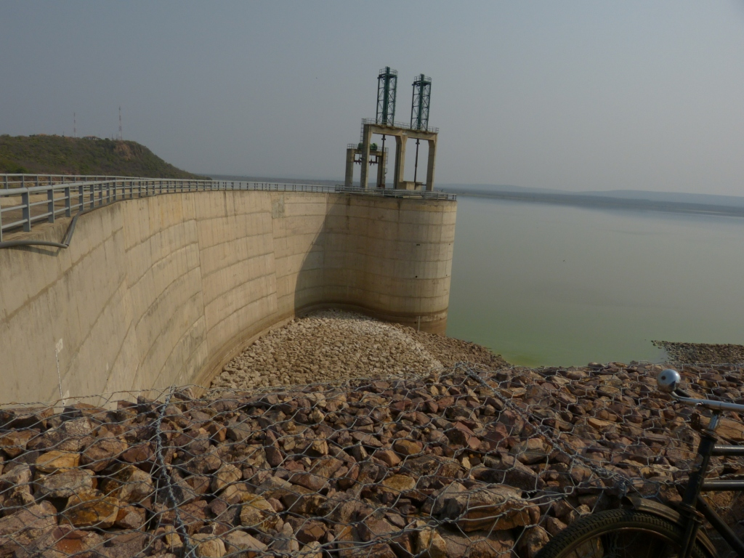
Kokuro Dam

Slide 7
Kokuro dam expansion project
Tentative plans to complete and expand the dam, more than tripling the size of the reservoir
Gates to control flow downstream
Potential financial suport from the World Bank
Expanded reservoir would enable doubling of irrigation for sugar cane, as well as supply water to distant city: Mapaka

Slide 8
Options to address floods and droughts
Complete dam; expand irrigation
Invest in natural water retention: forests, wetlands
Support non-water-intensive and nutritious crops
Invest in early warning, long-range forecasts

Slide 9
The government’s dilemma
The government has a limited budget to invest in the policy options, and has consulted the Ng'ombe River Basin Commission (NRBC) on how to prioritize;
The NRBC has set up a citizen participatory process to advise on the budget allocation. You have been selected to be part of this process.

Slide 10
Your role is to:
Develop your group’s position based on an assigned narrative of the flood and drought problem, and the solutions (20 mins);
Argue your group’s position based on an accompanying “fact sheet” of scientific evidence (15 mins);
Seek a compromise with other groups by jointly preparing recommendations to the Ng’ombe River Commission – the budget game (15 mins).
Discuss lessons (What?, So What?, Now what?) (25 mins)

Slide 11
Let’s get started Have fun!

Slide 12
On heterodox economics
Rejecting the utilitarian outlook which separates considerations of means from those of ends, and judgments of fact from those of value, and which ignores social relations, conflicts and inequalities between the agents, Evolutionary Political Economics appreciates the fact that inquiry is value-driven and policy-orientated, and recognises the centrality of participatory democratic processes to the identification and evaluation of real needs.

Slide 14
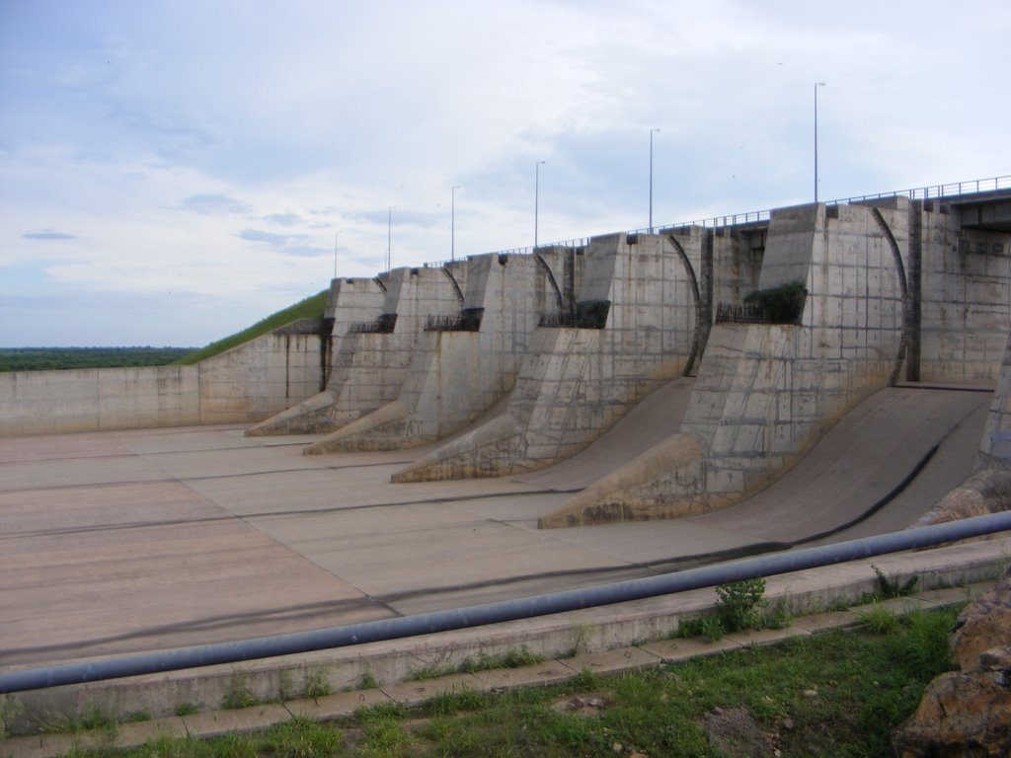

Slide 15
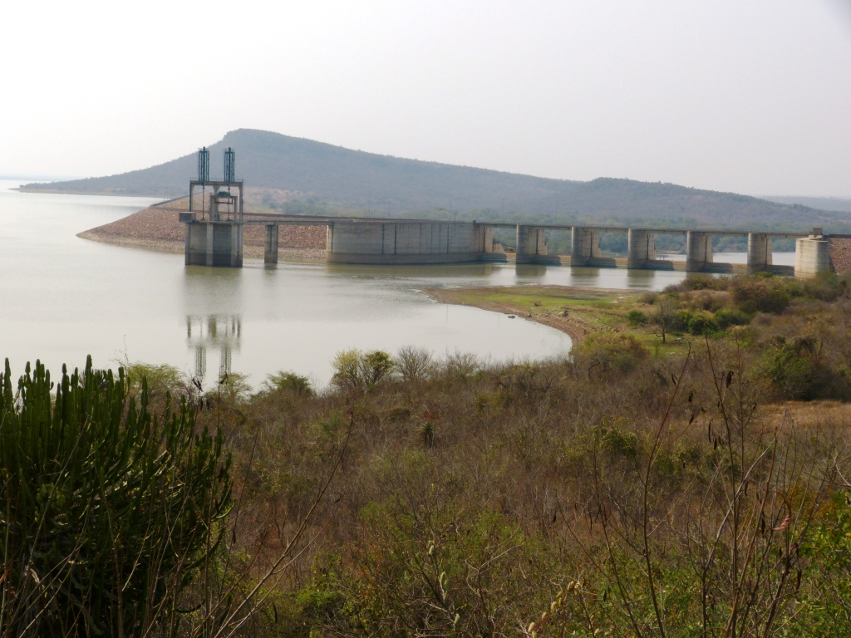
Kokuro dam expansion project

Slide 20
