Slide 1
Module C2
Mainstreaming environment and climate change tools and methods
Notes:
A. Intervention logic as theory of change - LFA here
B. Phases (start with exercise )
Programming
Identification and Formulation
Implementation
Completion/Closure and Follow up
C. Important choices to be made during the phases of development actions (exercise on stakeholder analysis and choice of partners – force field diagram)
Aid modalities as one choice to make
D. Stakeholder analysis (light)
E. Policy dialogue (light)

Slide 2
International Policy
International policy that calls for mainstreaming includes:
Sustainable Development Goals (SDGs)
Rio Conventions
Paris agreement on climate change - COP 21
Multilateral Environmental Agreements
Paris Declaration and Accra Action Plan

Slide 3
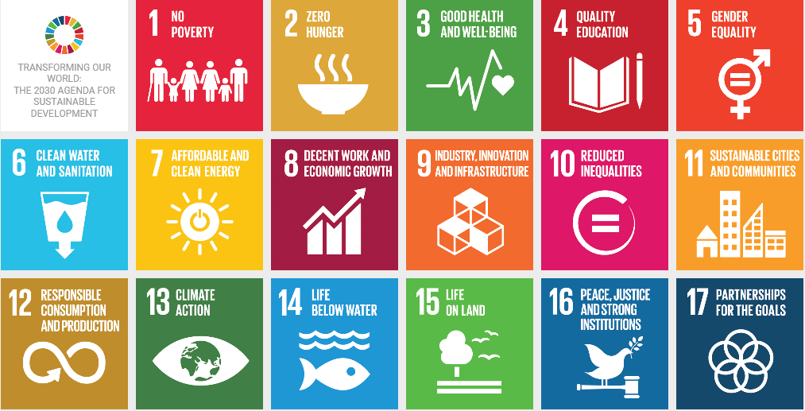
Sustainable development goals

Slide 4
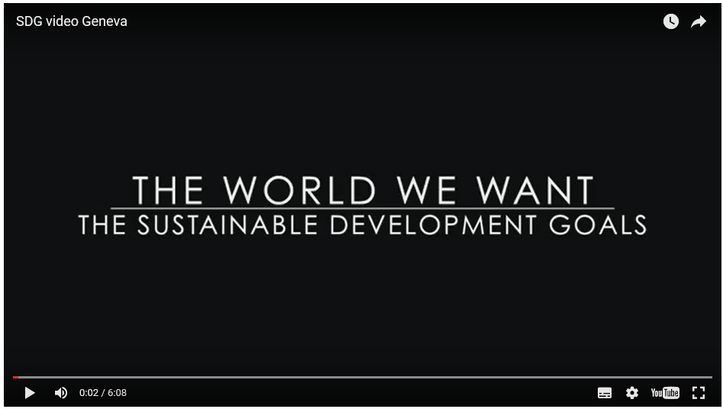
Sustainable development goals – explained
http://www.un.org/youthenvoy/video/sustainable-development-goals-explained/

Slide 5
Mainstreaming contributes to SDGs
 | No poverty - mainstreaming: Creates resilience against climate change related natural disasters such as droughts, floods, storms and pests that affect poor communities least able to cope. Enhances opportunities to harness the inclusive green economy for the benefit of the poor. Improves livelihoods and incomes of the poor through reversing the decline in the productivity of natural resources.

Slide 6

Exercise – take 5 mins in pairs to identify one of the other goals then discuss:
How can mainstreaming contribute to achievement of the goal?
What could be the effect of ignoring environment and climate?
Any other considerations?

Slide 7



The Rio conventions
UN Convention to Combat Desertification – aims to forge a global partnership to reverse and prevent desertification/land degradation and to mitigate the effects of drought in affected areas in order to support poverty reduction and environmental sustainability.
UN Convention on Biological Diversity – aims at the conservation of biological diversity; the sustainable use of the components of biological diversity and, the fair and equitable sharing of the benefits arising out of the utilization of genetic resources.
UN Framework Convention on Climate Change – aims to achieve stabilization of greenhouse gas concentrations in the atmosphere at a level that would prevent dangerous anthropogenic interference with the climate system.
Note also the Montreal Protocol on CFCs that have also contributed to reducing GHGs
Notes:
A chlorofluorocarbon (CFC) is an organic compound that contains only carbon, chlorine, and fluorine, produced as a volatile derivative of methane, ethane, and propane.

Slide 8

COP 21 key points
First-ever universal global climate deal covering all countries.
Outlines a strong shared vision and ambition to engage in a process for a transformation to a low-carbon and climate resilient development pathway.
Provides a confirmation of the collective target by developed countries to provide USD 100 billion by 2020 for climate activities in developing countries from all sources, with a new and higher collective target to be set by 2025.
INDCs – Intended nationally determined contributions

Slide 9
COP 21 – what governments agreed to (1/2)
Mitigation: reducing emissions
a long-term goal of keeping the increase in global average temperature to well below 2°C above pre-industrial levels and, to aim to limit the increase to 1.5°C,…based on INDCs
global emissions to peak soon, noting this will take longer for some countries;
rapid reductions thereafter in accordance with the best available science.
Transparency and global stocktake
come together every 5 years to set more ambitious targets as required by science;
report to each other & public on targets;
track progress towards the long-term goal through a robust system.
Adaptation
strengthen societies' ability to deal with the impacts of climate change;
provide continued and enhanced international support for adaptation to developing countries.

Slide 10
COP 21 – what governments agreed to (2/2)
Loss and damage
recognise the importance of averting, minimising and addressing loss and damage associated with CC
acknowledge the need to cooperate on early warning systems, emergency preparedness and risk insurance.
Support
The EU and other developed countries will continue to support climate action to reduce emissions and build resilience to climate change impacts in developing countries.
Other countries are encouraged to provide or continue to provide such support voluntarily.
developed countries intend to continue their existing collective goal to mobilise USD 100 billion per year by 2020 and extend this until 2025. A new and higher goal will be set for after this period.

Slide 11






Multilateral Environment Agreements
A comprehensive list of MEAs signed by the EU is available on the Commission environment web pages:

Slide 12
EU Instruments, Initiatives and Facilities
Geographic Programmes
Environment and climate change as focal and non focal sectors (NIPS/RIPS)
Thematic programmes
Global Public Goods and Challenges Programme (GPGC)
Disaster Risk Redution and Resilience - Increasing resilience by reducing disaster risk in humanitarian action
Action Plan for Resilience in Crisis Prone Countries 2013-2020
Some flagship initiatives
Global Climate Change Alliance+ (GCCA+)
Forest Law Enforcement, Governance and Trade (FLEGT)
SWITCH TO GREEN
EU Biodiversity for Life+ Initiative (EUBLI)
Investment Facilities (climate windows)
Partnership instrument (climate is a priority)
Notes:
http://ec.europa.eu/echo/files/aid/countries/factsheets/thematic/disaster_risk_reduction.pdf

Slide 13
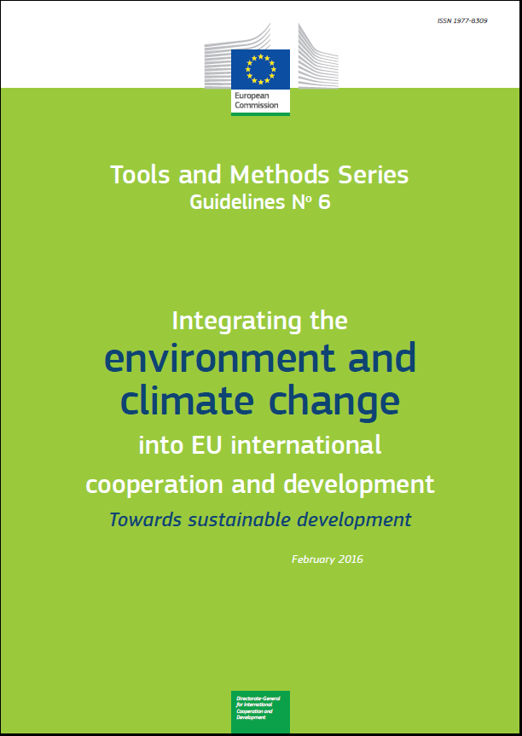
Objectives and background
Rationale
Integration in practice
Annexes
  SDGs and targets relevant for integration
  ToR for a CEP
  Environment and climate change screening
  Guidance for integration in formulation
  ToR for SEA
  ToR for EIA
  Monitoring and indicators
  Rio markers and Aid to Environment marker
  ToR for CRA

Slide 14
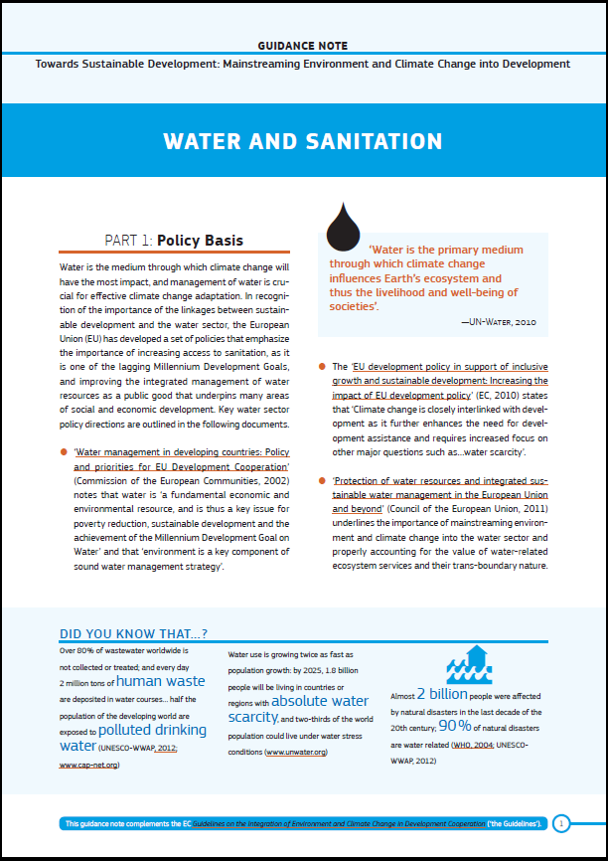
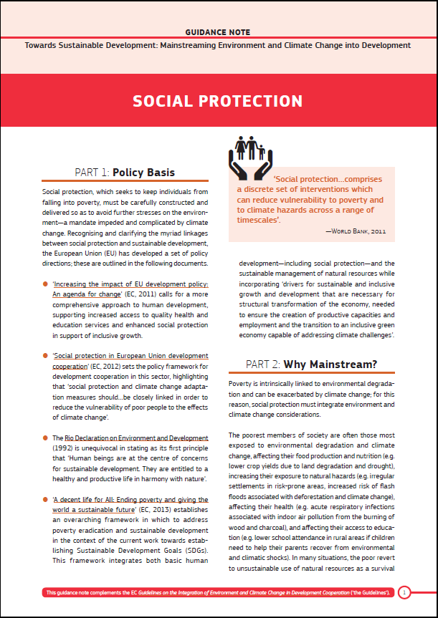
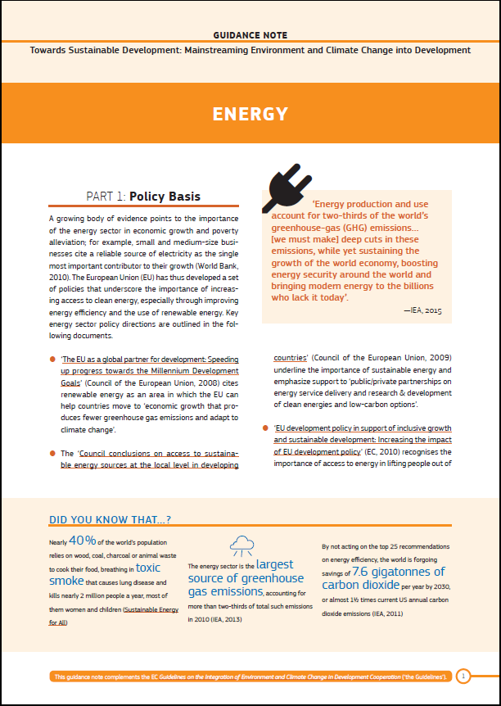
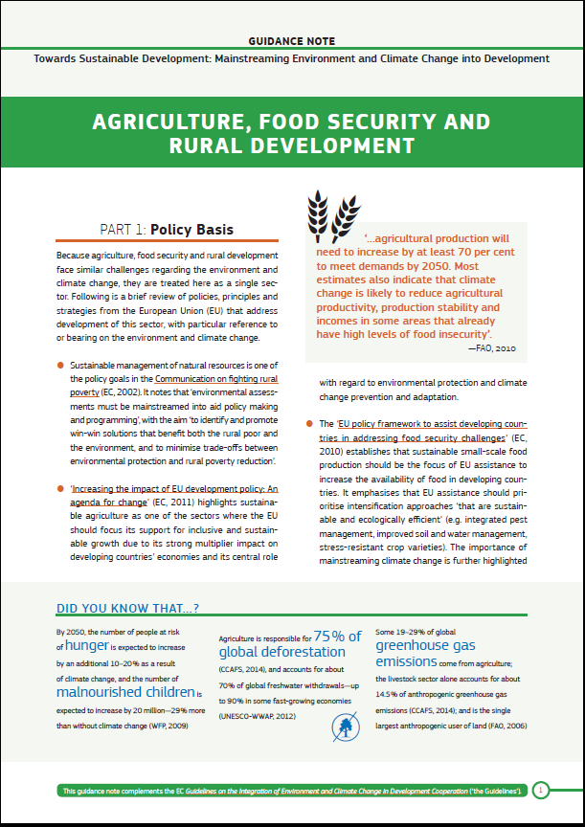
Sector Notes

Slide 15
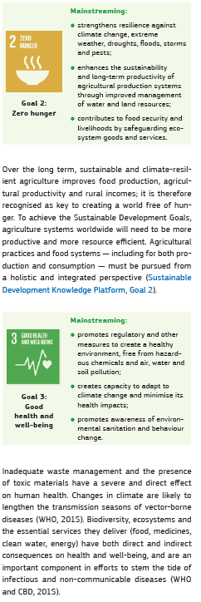
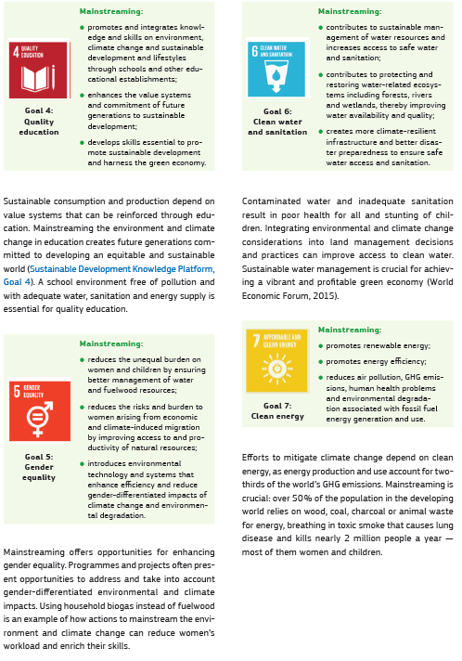
Mainstreaming contributes to SDGs
Notes:
The idea here is that we show that mainstreaming can contribute to all SDGs – the slides simply illustrate that. The participants should have a copy of the guidelines with them.

Slide 16
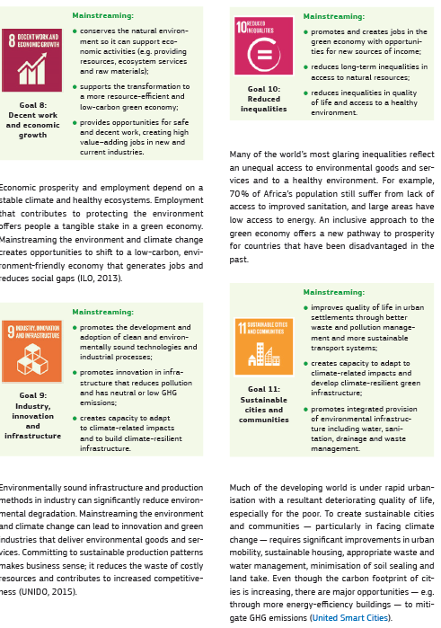
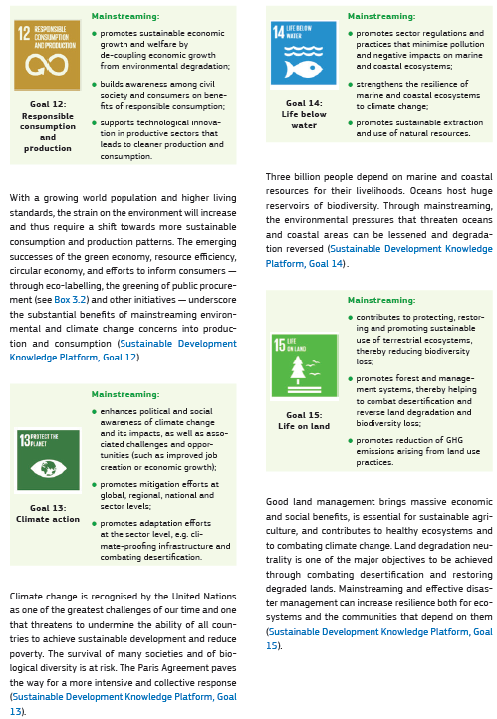
Mainstreaming contributes to SDGs

Slide 17
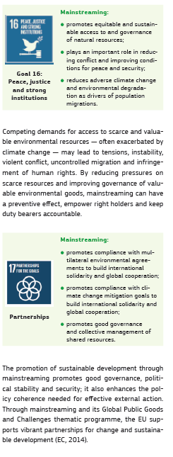
Mainstreaming contributes to SDGs

