Slide 1
Module E
Climate change: planning under uncertainty
Towards Sustainable Development: greening national development

Slide 2
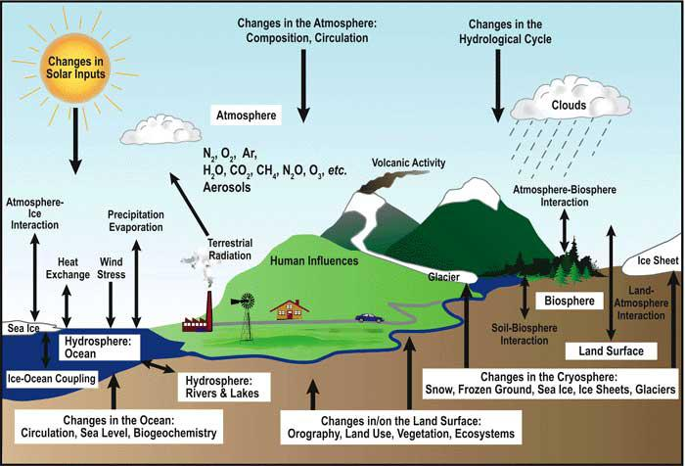
Data used by General Circulation Models
Notes:
We have listed potential impacts – but how to quantify them?
An attempt is through the use of General Circulation Models. GCMs are computer based models for understanding the climate and forecasting climate change.
Numerical models (General Circulation Models or GCMs), representing physical processes in the atmosphere, ocean, cryosphere and land surface, are the most advanced tools currently available for simulating the response of the global climate system to increasing greenhouse gas concentrations.
Improvements are still underway, on the quality of the models and of “downscaling” to specific geographical areas.

Slide 3
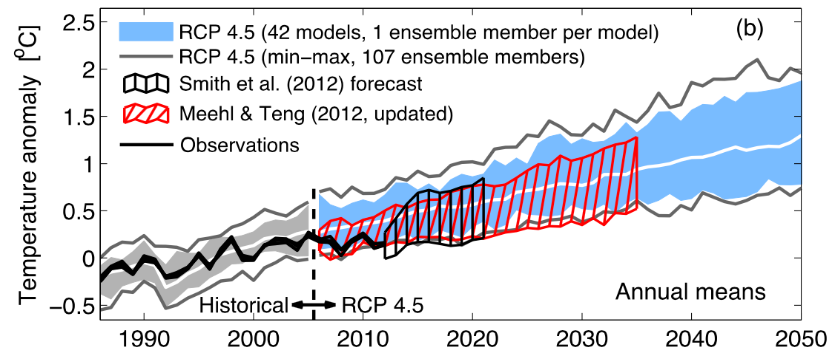
Can we trust GCMs?
Considerable confidence that GCMs provide credible quantitative estimates of future climate change, particularly at continental and larger scales.
Climate models have successfully projected trends.
GCMs developed independently from each other give similar results.
Fig: Various projections of global mean, annual mean surface air temperature 1986–2050; IPCC 2015
Notes:
GCMs are very complex, and inevitably include a degree of error – this can be assessed by sensitivity studies (i.e. systematically changing the model parameters to determine the effect of a specific parameter on model output).
But are more and more reliable - this confidence comes from the fact that the physical laws and observations that form the basis of climate models are well established, and have not been disproven, so we can be confident in the underlying science of climate models.
Additionally, the models developed and run by different research groups show essentially similar behaviour. Model inter-comparison allows robust features of the models to be identified and errors to be determined.
Models can successfully reproduce important, large-scale features of the present and recent climate, including temperature and rainfall patterns.
Finally, assumptions and errors are associated with any model, for example those routinely used in aircraft or building design.
HOWEVER, it must be noted that parameter ‘tuning’ accounts for some of the skill of models in reproducing the current climate. Furthermore, models can only be perfect at reproducing the past climate.
AOGCMs = mathematical representations of the earth’s climatic system, which link the atmosphere, ocean, land, and biosphere both vertically and horizontally in a series of 3-dimensional grid boxes that partition the earth into layers and grids (Jones & Mearns 2004). They simulate future climate change by gradually increasing the level of radiative forcing.
Most impacts studies are based on the predictions of AOGCMS.
There are about 10 major AOGCMs in the world.

Slide 4
Can we trust GCMs?
Even the best models only give one possibility
Models may have done well in the past but what about the future?
There is a need to understand different forms of predictions in projections especially for communication
Notably, predictions cannot be assessed as good everywhere, notably:
  At local level, and…
  …where only a few number of variables are known…
  …notably, when the use of compound parameters is needed to determine exposure…
  ...and the capacity to improve the model ability for predictions is limited…
… but we still need to make decisions !
Notes:
WDR 2010: «Uncertainty: An expression of the degree to which a value (such as the future state of the climate system) is unknown. Uncertainty can result from lack of information or from disagreement about what is known or even knowable. It may have many types of sources, from quantifiable errors in the data to uncertain projections of human behavior. Uncertainty can therefore be represented by quantitative measures, for example, a range of values calculated by various models, or by qualitative statements, for example, reflecting expert judgment. However, in economics, uncertainty refers to Knightian uncertainty, which is immeasurable. This is in contrast to risk, wherein the occurrence of certain events is associated with a knowable probability distribution. »
There is a need to understand different forms of predictions in projections especially for communication - some things are intrinsically uncertain such as throwing die, and proxy indicators might be more dangerous than including uncertainty
Local level: downscaling is an ongoing challenge for GCMs
Predictability is not sufficiently good in many places to base decisions on - knowledge of the regional climate system is simply not good enough
So, what we want to know is what the level of confidence is - how well do the models deal with the “real” dynamics involved in the variable being requested.
Despite this we can not wait for better science before we act - we need to work out how best to use what we have now while informing the direction of model development. Climate forecasts are improving but remain intrinsically uncertain. By using probabilistic techniques we can begin to extract confident statements about some aspects of future climate – but nothing replaces multi-informed decisions!

Slide 5
Predictions according to scenarios
Period | 2046-2065 | 2081-2100
Scenario | Mean and likely range | Mean and likely range
RCP2.6 | 1.0 (0.4 to 1.6) | 1.0 (0.3 to 1.7)
RCP4.5 | 1.4 (0.9 to 2.0) | 1.8 (1.1 to 2.6)
RCP6.0 | 1.3 (0.8 to 1.8) | 2.2 (1.4 to 3.1)
RCP8.5 | 2.0 (1.4 to 2.6) | 3.7 (2.6 to 4.8)
AR5 global warming increase (°C) projections (Representative Concentration Pathways)
Across all RCPs, global mean temperature is projected to rise by 0.3 to 4.8 °C by the late-21st century.
Notes:
SCENARIOS indicate results varying according to parameters.
GCMs were firstly used together with IPCC SRES (Special Report on Emissions Scenarios - SRES) scenarios, which explore future developments in the global environment with special reference to the production of greenhouse gases, in 2000.
A1: a more integrated world
Rapid economic growth.
Pop. 9 billion in 2050, then declines.
Spread of new technologies.
Social and cultural interactions worldwide.
A2: a more divided world
A world of independently operating, self-reliant nations.
Continuously increasing population.
Regionally oriented economic development.
B1: more integrated, more ecological world
Service and information economy.
Population as in A1.
Reductions in material intensity and the introduction of clean technologies.
B2:a world more divided, but more ecological
Local solutions
Intermediate economic development
These scenarios were discussed (difficulties in validating socio-economic scenarios) and superseded by AR5 in 2014 by the RCPS. The RCPs are consistent with a wide range of possible changes in future anthropogenic greenhouse gas (GHG) emissions. RCP 2.6 assumes that global annual GHG emissions (measured in CO₂-equivalents) peak between 2010-2020, with emissions declining substantially thereafter. Emissions in RCP 4.5 peak around 2040, then decline. In RCP 6, emissions peak around 2080, then decline. In RCP 8.5, emissions continue to rise throughout the 21st century. The four RCPs are consistent with certain socio-economic assumptions but are to be substituted with the Shared Socio-economic Pathways which are anticipated to provide flexible descriptions of possible futures within each RCP.

Slide 6
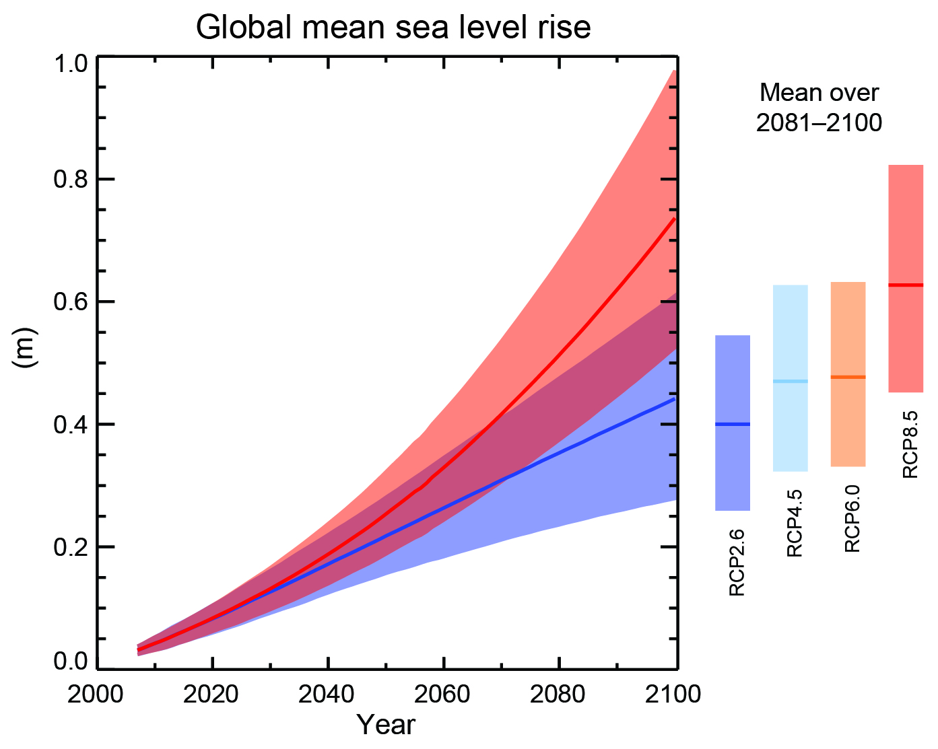
Sea-level rise - uncertainties
IPCC (2013) projections - up to about 0.75 m by 2100
Projections of global mean sea level rise over the 21st century estimates
Notes:
IPCC, 2013: Summary for Policymakers. In: Climate Change 2013: The Physical Science Basis. Contribution of Working Group I to the Fifth Assessment Report of the Intergovernmental Panel on Climate Change [Stocker, T.F., D. Qin, G.-K. Plattner, M. Tignor, S.K. Allen, J. Boschung, A. Nauels, Y. Xia, V. Bex and P.M. Midgley (eds.)].

Slide 7
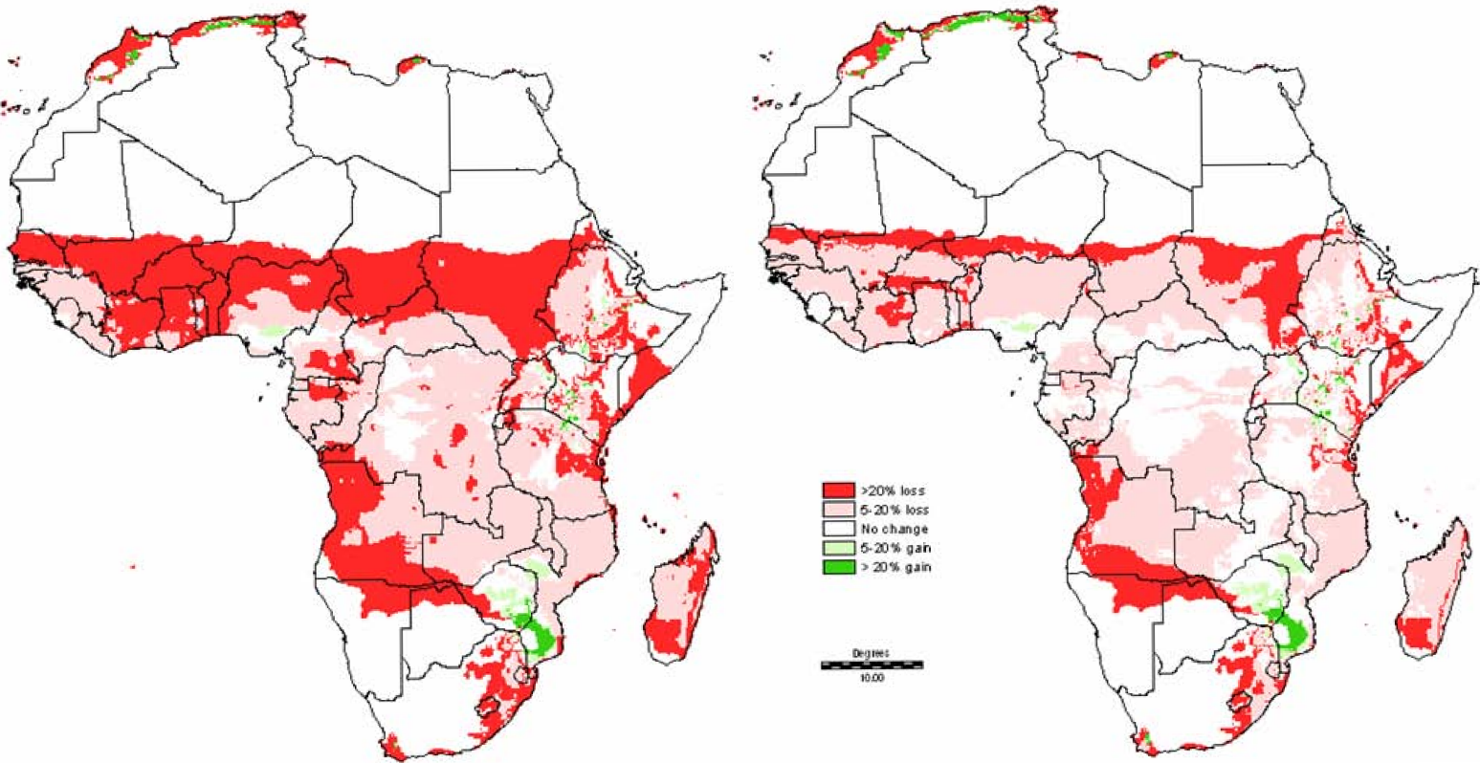
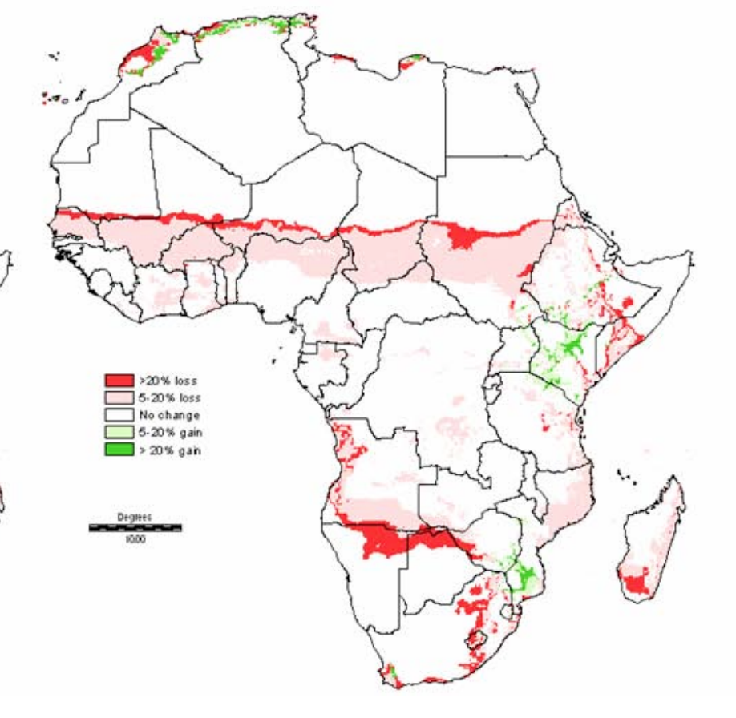
Uncertainty, growing period
One scenario, not alarming
Consensus climate change
Length of growing period change 2000-2050
Notes:
This slide can be used as such as it illustrates uncertainty – it may be adapted to the region of training
Groupwork / discussion
Source: Thornton et al (2006), Figure 7(A)

Slide 8
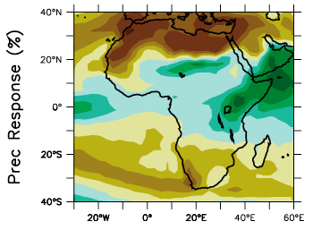
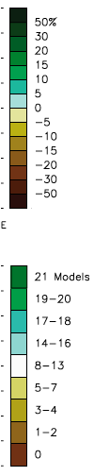
Certainty/Uncertainty
North Africa & Middle East
Most/all models indicate drying
Observed trends indicate drying
High confidence
Sahel
Models may disagree
Some indicate drying, others wetting
Recent trends mixed
Monsoon highly variable
Cannot say how climate will change
Notes:
This slide can be used as such as it illustrates uncertainty –BUT IT SHOULD BE ADAPTED TO THE REGION OF TRAINING, WITH INFORMATION ON CERTAINTY/UNCERTAINTY ON PREDICTIONS

Slide 9
Socio-economic uncertainties
Population (e.g., density, growth)
Economic trends (e.g., income levels, sectoral composition of GDP, or levels of trade)
Social indicators (e.g., education levels, private- and public-sector institutions)
Cultural behaviours, traditions, acceptance
International relations
Group discussion:
What could be practical consequences of socio-economic uncertainties?
Notes:
Projections of these factors for time periods such as the middle of the 21st century are at least as uncertain as projections of future climate; hence, it is probably most advisable to use such information as scenarios of change, or conditioning assumptions (IPCC, 1998). Moreover, culture exerts important influences on socioeconomic processes, problem solving methods, and the like. The formation of coalitions, social movements, and educational programs directed toward changing institutional norms that might influence people’s behaviour concerning climatic change is culturally determined, like other complex social and psychological processes. Cultural processes and economic behaviour, for example, can be modeled to capture some of the complexity of the social processes, structures, and cognitive behaviour involving culture (e.g., Rotmans and van Asselt, 1996; Koizumi and Lundstedt, 1998). Thus, it is simply impossible to predict with high confidence how societies and economies will develop in the future, hence the extent to which they will have the capacity needed for adaptation. The use of scenarios to assess driving forces and adaptive capacity is one way to explicitly acknowledge these kinds of structural uncertainties (e.g., IPCC, 2000). Socioeconomic scenarios, as already noted, are not predictions of future states of the world but consistent and plausible sets of assumptions about issues such as population growth, economic development, values, and institutions.
Although the emphasis on adaptation to reduce vulnerability and take advantage of emerging opportunities is increasing in impact assessment, many uncertainties remain regarding the effectiveness of different options, the relationship between adaptation to short-term climate fluctuations and long-term climate change, and constraints and opportunities that will be imposed by factors such as existing institutional structures, economic and financial limitations, and cultural resistance (IPCC, 1998).

Slide 10
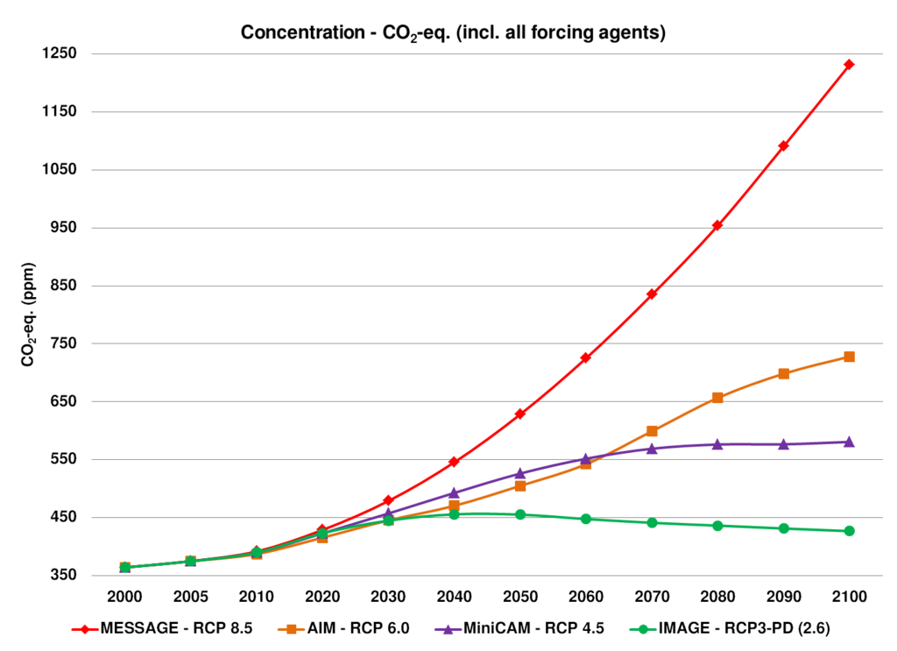
Uncertainties: GHG emission scenarios
Consequences:
  Influence the perception of the level of future GHG emissions
  Therefore influence the perception of the magnitude of climate change and environmental worsening
  Create derived uncertainties about future vulnerability to climate change
Notes:
The focus of this slide should be in the before-mentioned consequences.
BACKGROUND INFO: The four RCPs, RCP2.6, RCP4.5, RCP6, and RCP8.5, are named after a possible range of radiative forcing values in the year 2100 relative to pre-industrial values (+2.6, +4.5, +6.0, and +8.5 W/m², respectively).
Radiative forcing or climate forcing is defined as the difference of insolation (sunlight) absorbed by the Earth and energy radiated back to space. Typically, radiative forcing is quantified in units of watts per square meter of the Earth's surface (logic with GCM above). A positive forcing (more incoming energy) warms the system, while negative forcing (more outgoing energy) potentially cools it. Causes of radiative forcing include changes in insolation and the concentrations of radiatively active gases, i.e.: greenhouse gases and aerosols.

Slide 11
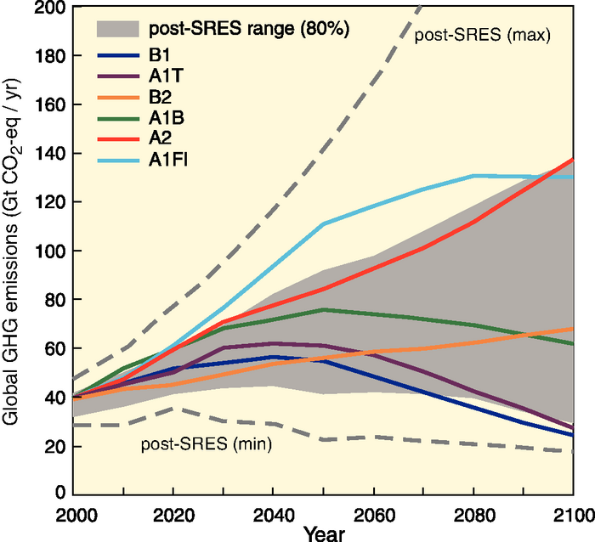
Uncertainties: GHG emission scenarios
(SRES: Special Report on Emission Scenarios)
Notes:
ONLY FOR INFO - SRES SCENARIOS (MADE IN 2000, A1, A2, B1 and B2 ”families”) MAYBE STILL REFERRED TO, BUT ARE NO LONGER USED FOR PROJECTIONS.
They were replaced by RCPs (slide 21), which will be probably replaced by another set of ”Representative Pathways” in 2017.

Slide 12
The cost of inaction
Failure to adapt
Failure to reduce emissions
Wasted investments
Increased vulnerability
More harmful impacts
Higher adaptation costs
Uncertainties surrounding climate change are often invoked to justify inaction (!)
BUT, even with uncertainty, some measures are justified
Notes:
MORE on cost/benefits in module 7, on Projects
Groupwork / discussion
The uncertainties surrounding climate change are often invoked to justify inaction
In a medium- to long-term perspective, however, inaction now is likely to be more costly:
Even in the face of uncertainty, some types of measures are justified
Adaptation – OECD (2009): “The effect of discounting would normally favour a delay in adaptation (...). However, there is also a class of adaptations where early action is cheaper. They include adjustments to long-term development plans and long-lived infrastructure investments (...). In each of these cases, it will be cheaper to make adjustments early, in the design phase of the project, rather than incur the cost and inconvenience of expensive retrofits.” The same applies to land use policies and long-term development plans.
Mitigation – Stern Review: «The benefits of strong, early action on climate change considerably outweigh the costs». What we do in the next 10 or 20 years can have a profound effect on the climate in the second half of this century and in the next. Mitigation must be viewed as an investment to avoid the risks of very severe consequences in the future.
The social cost of carbon under the business-as-usual scenario is about $85/tonne of CO2 – well above marginal abatement costs in many sectors.
If a path towards stabilisation of atmospheric concentration of GHGs at 550ppm CO2e is adopted, then the net present value of benefits over costs is around $2.5 trillion. With a target of 450-550 ppm CO2e, then the social cost of carbon is in the region of $25-30 per tonne of CO5 – about one-third of the cost under the BAU scenario.
The social cost of carbon is likely to increase steadily over time because marginal damages increase with the stock of GHGs in the atmosphere. Policies should thus aim for a gradual intensification of marginal abatement efforts, while supporting the development of technologies that reduce abatement costs.
The annual costs of stabilisation at 500-550ppm CO2e are estimated to be around 1% of GDP by 2050 - a level that is significant but manageable.

Slide 13
Justified measures in the face of uncertainty
‘No-regret’ measures: those expected to produce net benefits for society even in the absence of climate change
‘Low-regret’ measures: those expected to have an acceptable cost for society in view of the benefits they would bring
‘Robust’ (or “win-win”) measures: those that produce net benefits or deliver good outcomes across various possible scenarios
Notes:
Expansion
Examples:
Groupwork / discussion
World Bank (2010):
(No- and) low-regret measures include most of the ‘soft’ adaptation measures, which enhance development and welfare across all or most climate change scenarios including the no-change scenario
‘No-regret’ measures:
those expected to produce net benefits for society even in the absence of climate change (adaptation) or independently of any ‘reward’ for mitigation (zero or negative net cost at a zero carbon price)
‘Low-regret’ measures:
those expected to have a cost for society, but an acceptable one in view of the benefits they would bring if climate change turns out to produce significant effects (adaptation), or to have a low net cost at zero or low carbon prices (mitigation)
.
Robust’ measures: those that produce net benefits or deliver good outcomes across various possible climate change or carbon price scenarios and economic development scenarios (rather than just under the ‘most likely’ scenario)

Slide 14
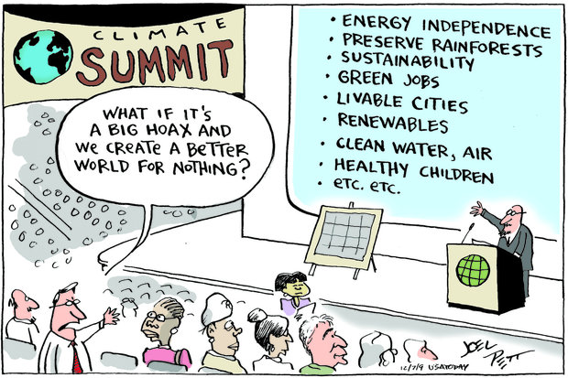

Slide 15
No-regret measures: exercise
Cooperate with the colleague next to you
Identify No-regret measures within your areas of work and for different purposes
Consider both mitigation and adaptation measures
Make a list and present in plenary
If you find the time, you can also discuss Low-regret and Robust measures.
Notes:
Expansion
Examples:
Groupwork / discussion
World Bank (2010):
(No- and) low-regret measures include most of the ‘soft’ adaptation measures, which enhance development and welfare across all or most climate change scenarios including the no-change scenario
‘No-regret’ measures:
those expected to produce net benefits for society
even in the absence of climate change (adaptation) or independently of any ‘reward’ for mitigation (zero or negative net cost at a zero carbon price)
‘Low-regret’ measures:
those expected to have a cost for society, but an acceptable one in view of the benefits they would bring if climate change turns out to produce significant effects (adaptation), or to have a low net cost at zero or low carbon prices (mitigation)
.
Robust’ measures: those that produce net benefits or deliver good outcomes across various possible climate change or carbon price scenarios and economic development scenarios (rather than just under the ‘most likely’ scenario)

Slide 16
No or low regret measures, examples (I)
Built environment: improve water efficiency and help address drought risk e.g. by installing low flow taps, showers and toilets; address the risk of flooding e.g. by installing door guards and air brick covers, location electrical controls, cables and appliances at a higher than normal level; reduce internal heat gain especially during heat-waves e.g. by orientation of roofs and walls.
Land use and planning: reduce the risk of flooding by avoiding building in high risk areas.
Water: improve water efficiency and help address drought risk e.g. by reducing leakage from water utility infrastructure.
Notes:
Expansion
Examples:
Groupwork / discussion
World Bank (2010):
(No- and) low-regret measures include most of the ‘soft’ adaptation measures, which enhance development and welfare across all or most climate change scenarios including the no-change scenario
‘No-regret’ measures:
those expected to produce net benefits for society
even in the absence of climate change (adaptation) or independently of any ‘reward’ for mitigation (zero or negative net cost at a zero carbon price)
‘Low-regret’ measures:
those expected to have a cost for society, but an acceptable one in view of the benefits they would bring if climate change turns out to produce significant effects (adaptation), or to have a low net cost at zero or low carbon prices (mitigation)
.
Robust’ measures: those that produce net benefits or deliver good outcomes across various possible climate change or carbon price scenarios and economic development scenarios (rather than just under the ‘most likely’ scenario)

Slide 17
No or low regret measures, examples (II)
Agriculture: reduce the risk of flooding e.g. by establish holding ditches for excess run-off, plants trees and shrubs to reduce run-off; reduce the risk of soil erosion e.g. by establishing hedgerows as a wind break and ground reinforcement measures.
Forestry: review species suitability and diversity as management plans are renewed, maintain a number of different forest management systems, respond to the risk of wildfire e.g. by completing wildfire training, early warning system.
Natural environment: monitor climate change impacts on biodiversity, avoid fragmenting existing priority habitats.
Notes:
Expansion
Examples:
Groupwork / discussion
World Bank (2010):
(No- and) low-regret measures include most of the ‘soft’ adaptation measures, which enhance development and welfare across all or most climate change scenarios including the no-change scenario
‘No-regret’ measures:
those expected to produce net benefits for society
even in the absence of climate change (adaptation) or independently of any ‘reward’ for mitigation (zero or negative net cost at a zero carbon price)
‘Low-regret’ measures:
those expected to have a cost for society, but an acceptable one in view of the benefits they would bring if climate change turns out to produce significant effects (adaptation), or to have a low net cost at zero or low carbon prices (mitigation)
.
Robust’ measures: those that produce net benefits or deliver good outcomes across various possible climate change or carbon price scenarios and economic development scenarios (rather than just under the ‘most likely’ scenario)

Slide 18
Planning options (all sectors)
Assess the risk of extreme events and develop related contingency plans.
Favouring reversible and flexible options enabling amendments to be made;
Adding ‘‘safety margins'' to new investments to ensure responses are resilient to a range of future climate impacts;
Promoting soft adaptation strategies, which could include building adaptive capacity to ensure an organisation is better able to cope with a range of climate impacts (e.g. through more effective forward planning);
Reducing decision time horizons (e.g. the forestry sector may choose to plant tree species with a shorter rotation time, see Hallegatte, 2009).
Notes:
Different types of options are available that decision-makers can use in planning adaptation under climate change. The most appropriate option will depend on the nature of the decision being made, the sensitivity of that decision to specific climate impacts and the level of risk which can be tolerated. Options include the following

Slide 19
References
Gobal CirculationModels, National Institute of Water and Atmospheric Research, New Zealand
“Summary for Policymakers”, in: “Climate Change 2013: The Physical Science Basis. Contribution of Working Group I to the Fifth Assessment Report of the Intergovernmental Panel on Climate Change”, IPCC, 2013
"Can natural disasters have positive consequences? Investigating the role of embodied technical change”, Stéphane Hallegatte & Patrice Dumas, 2009.
"No Regrets" Approach to Decision-Making in a Changing Climate: Toward Adaptive Social Protection and Spatially Enabled Governance, Paul B. Siegel, The World Bank - Washington, D.C. USA
"Stern Review on The Economics of Climate Change (pre-publication edition). Executive Summary". Stern, N. (2006).

