Slide 1
Module G
Mainstreaming at the project level
Towards Sustainable Development: greening national development
Notes:
Participants are familiar with key tools to identify and analyse a project’s vulnerability to climate change and its potential impacts on the environment
Participants are aware of tools available to compare project alternatives from an environmental impact and climate change resilience point of view
110 min (25’ presentation + 25’ case studies + 60’ role-play)
Climate risk screening (show example of a tool e.g. Cristal)
Climate vulnerability assessment (CVA)
Environmental Impact Assessment (EIA)

Slide 2
A major issues in climate action: impact and risk management
  Assess vulnerability and risk
  Assess potential benefits of action
    Notably, reduced target risk (avoided damages)
  Assess costs of action
    Actual costs
    Take into account! opportunity cost = forgone benefits
    Countervailing risks
  Some uncertainty remains…
    Value of information – increase chance of choosing decision that is best for actual conditions

Slide 3
Types of Analyses
Vulnerability / Impact analysis
Risk analysis
Financial/Economic assessments
  Benefit-cost analysis
  Cost-effectiveness analysis
Others
  Multi-criteria analysis

Slide 4
Why use a vulnerability analysis?
The main goal is “to identify the degree of future risks from climatic change and to identify vulnerable areas to provide a solid foundation for climatic change mitigation planning” (IPCC).
In practice, it is used to:
Help in setting management and planning priorities
Assist in informing adaptation strategies
Enable more efficient allocation of scarce resources
Notes:
Additional notes:
Assessing vulnerability also underlines the contribution of public action to resilience
- This can be done by contrasting the information given by the Vulnerability Assessments with the policy and programme response to climate change, at two levels:
Screening of plans with a specific focus on climate change response: Assessing to which extent specific climate change adaptation policies and plans have integrated recommendations from Vulnerability Assessments. These may include: climate change action plans, dedicated climate change programmes within sector programmes (e.g. agriculture, forestry, fisheries, water management), disaster risk reduction plans, projects originating from NAPAs, other climate change related projects. In this approach, the analysis seeks to determine responsiveness and which component is responsiveness to use this data for weighting allocations and expenditures.
Screening of climate relevant action in a developmental approach: There is also a need to verify if the issues raised in the Vulnerability Analysis are covered by policies and programmes that have a developmental focus, as they also may contribute to increasing resilience to climate change. This verification should also include the general development strategies and plans that were designed at sub-national level. In that case, the analysis seeks to identify the additional benefit of those programmes when climate change happens, and should be considered under the Benefit Cost Ratio approached.
Responses: projects/programmes: Should the costs of a specific vulnerability be identified based on past events, and there has been a response to this vulnerability in the programme, the estimated reduced damages should be counted as future benefits. Valuation : one theme of this session.

Slide 5
Vulnerability and CC adaptation… are dynamic concepts
Climatic conditions
Characteristics of natural and human systems
Exposure
Sensitivity
Resource use options
Risk management
Potential impact (stressors)
interpretation
Adaptive capacity
Response
Vulnerability
learning
Notes:
IMPORTANT NOTE: in this scheme, response focuses in CLIMATE CHANGE ADAPTATION
It is expected that Exposure increases, therefore potential vulnerability also.

Slide 6
Some terminology…
Vulnerability is the degree to which a system is susceptible to, or unable to cope with, adverse effects of climate change, including climate variability and extremes. Climate vulnerability depends on exposure, sensitivity, and adaptive capacity.
Exposure depends on the extent and magnitude of climatic events.
Sensitivity is the degree to which the area of concern is susceptible to a climate impact.
Adaptive capacity it the ability of the area of concern to adjust or respond to the changing conditions.
NOTE: Affected communities usually care less about these technical definitions than in the impact of changing climate and environmental conditions on important aspects of their lives.
Notes:
NOTE: some affected communities may put themselves in a position where they have increased sensitivity to climatic events, e.g.: deforestation in mountainous areas, settlements in flood prone areas, … but may keep focusing on impacts (they may not change their damaging practices to the environment per lack of alternatives)

Slide 7
Vulnerability analysis
Collect existing knowledge on situation, complement with studies
Identify stakeholders and their interests (key areas of concern)
Identify risks, problems, negative factors and threats related to environment and climate
Identify strengths, positive factors and opportunities
Discuss cause-effect diagrams to analyse the linkages between the factors and understand the logics of the area
Integrate potential alternatives within the causal chain of the intervention
Prioritise actions to be implemented or monitored by intervention, including environmental safeguards
Notes:
Identifying project ideas consistent with partner country’s and EC’s objectives and strategies
Assessing relevance and feasibility
Pre-selecting options that look worth financing and will be subject to more detailed formulation
Climate risk screening (show example of a tool e.g. Cristal)
Climate vulnerability assessment (CVA)
Environmental Impact Assessment (EIA)
Overview of project comparative analysis tools: cost-benefit analysis, cost-effectiveness analysis, multi-criteria analysis

Slide 8

Examples of tools: Community-based Risk Screening Tool – Adaptation & Livelihoods (CRiSTAL)

Slide 9
CRiSTAL
Promotes the integration of risk reduction and climate change adaptation into community-level projects. Strategies are based on local conditions, strengths and needs.
Is an entry point for discussing local observations of climate variability and the impacts of climate change in a participatory manner, encouraging communities to look for opportunities to enhance their adaptive capacities.
For project planners and managers, CRiSTAL provides a useful framework for understanding the links among climate, livelihoods and project activities.
Notes:
It is a tool that helps GATHER and ORGANISE existing information on climate consequences, and help communities defining their own solutions.

Slide 10
CRiSTAL - steps
Describe your project (objectives, activities)
Describe livelihoods context, and resources important to livelihoods
Summarize information on observed and projected climate change, including current and potential future climate hazards
Analyze climate risk
Identify and assess existing response strategies Evaluate and prioritize new project activities Identify opportunities and barriers to project implementation
Identify key elements for your monitoring and evaluation framework
Project evaluation summary report

Slide 11
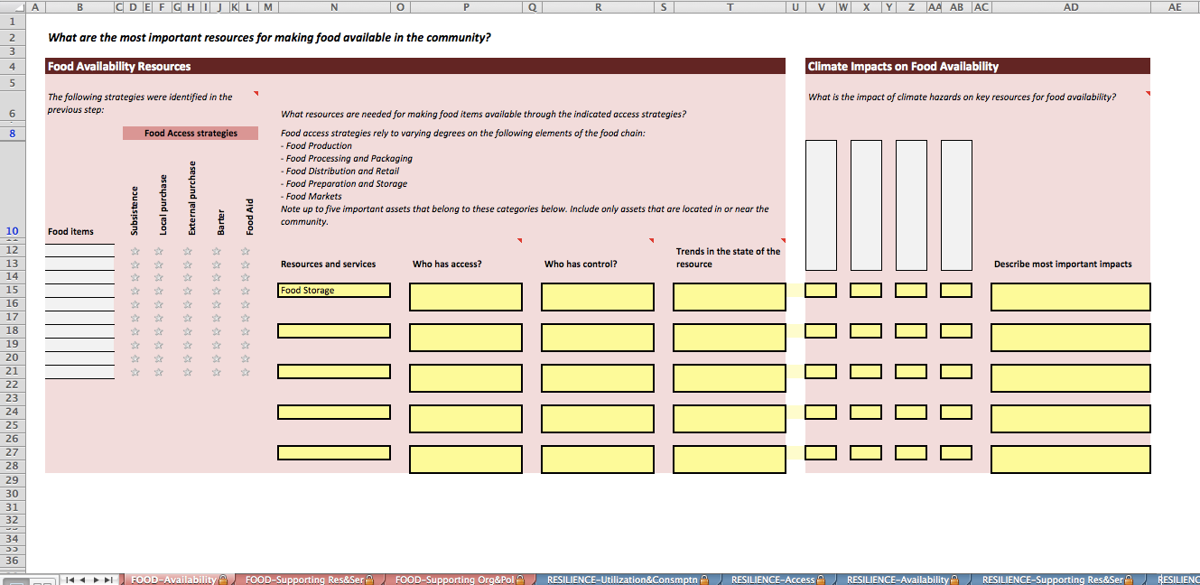
CRiSTAL is available for different sectors, Food Security, Forests, Adaptation
It is based on information given by the user(s)
It requires some judgment and priorities to be made
It requires many information. It mostly structures a group discussion.

Slide 12
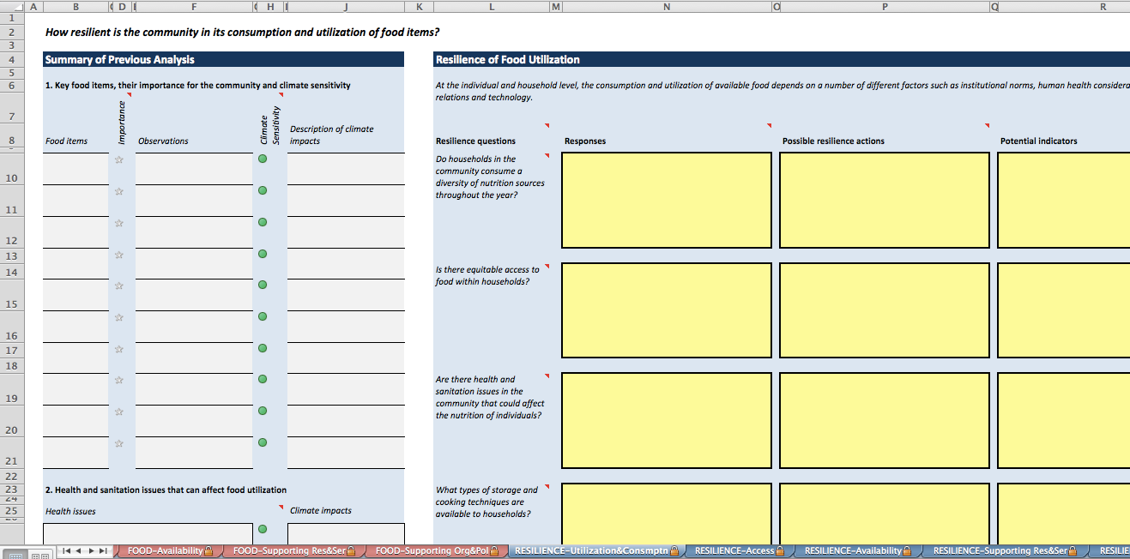
It is a step-by-step process, leading to action.
Previous analysis is re-used in next steps
The reporting is a summary of the existing information in the system

Slide 13
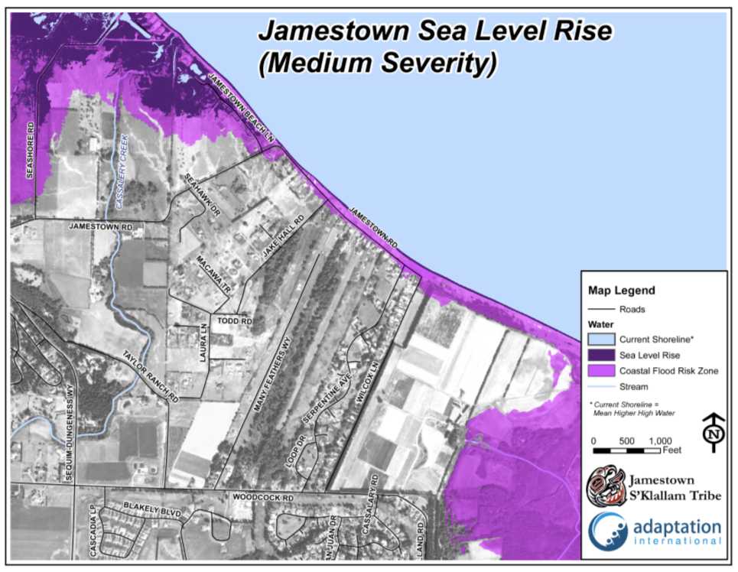
Other tools can be used to support discussions
Jamestown Beach (USA) medium-severity sea level rise (about 70 cm).
Inundation and storm surges are projected to occur between 2055 and 2090.
Notes:
Maps are rich in informatino and can be designed for education and outreach.

Slide 14
Prioritisation criteria
Magnitude of Impacts – the scale and intensity of the climate impact;
Timing of Impacts – when the impact is likely to occur;
Persistence and Reversibility – how long lasting or irreversible the impacts are;
Likelihood of Impacts – how likely is it for the impact to occur;
Distributional Nature of Impacts – whether specific groups or the whole community would be impacted;
Importance of System at Risk – the cultural, economic, or social value of the system affected; and
Potential for Adaptation – the availability and feasibility of actions to prepare for or respond to the climate impacts.
Intergovernmental Panel on Climate Change 2007
Notes:
Discussions can only be fruitful if some degree of prioritisation is made.
It is unlikely that information is available for all key concerns in all criteria. Some judgment to be done in close consultation with the affected communities.

Slide 15
Environmental Impact Assessment
“the process of identifying, predicting, evaluating and mitigating the bio- physical, social, and other relevant effects of development proposals prior to major decisions being taken and commitments made.”
– IAIA (International Association for Impact Assessment)
Notes:
is also to ensure that the public are given early and effective opportunities to participate in the decision making procedures.
Environmental Impact Assessment should not be a barrier to growth and is to be applied to a proportion of projects, where env’l impacts are likely.

Slide 16
Key objectives of EIA
Ensure environmental considerations are explicitly addressed and incorporated into the decision-making process
Anticipate and avoid, minimise and offset the adverse significant biophysical, social and other relevant effects of development proposals
Protect the productivity and capacity of natural systems and the ecological processes which maintain their functions
Promote development that is sustainable and optimises resource use and management opportunities.
(IAIA)

Slide 17
Key aspects around EIA
Widely established world-wide
Applicable to projects with potential significant adverse impacts on the environment
Decision-informing in development consent procedures
Traditionally impact-centered
Often also addresses socio-economic impacts
Key recent developments:
  Ecosystem services focus
  Climate change considerations

Slide 18
EIA Process
SCREENING
Initial Environmental
Examination (IEE)
IEE
Review
Screening
EIA
Required
Scoping/
Terms of
Reference
EIA Not
Required
Full-Scale
EIA
EIA
Approved
EIA
Review
Decision
Making
Monitoring
Environmental
Evaluation
EIA Not
Approved
Evaluate
Options
Notes:
Purpose of screening:
Identify those projects or activities that may cause potential significant impacts
Identify special conditions/analyses that may be required by international funding bodies
Categorize the project as one where:
Full-Scale EIA required
Some further environmental analysis required
No further environmental analysis required

Slide 19
EIA Process
Public Participation
Screening
Positive lists
Scoping
Participatory
Assessment
Different techniques
Screening criteria
Mainly quantitative
Beyond compliance
Inter-disciplinary
Define ‘mitigation measures’
Avoid, minimise impact
Calculate residual impact
Maximise positive impacts
Prepare Environmental Management Plan
Public enquiry
Formal, additional to other opportunities
Decision
Go
Monitoring
Control and verification
Key aspects, methodologies, approach
Implementation / follow-up of EMP
No-go
Conditional
Notes:
Purpose of screening:
Identify those projects or activities that may cause potential significant impacts
Identify special conditions/analyses that may be required by international funding bodies
Categorize the project as one where:
Full-Scale EIA required
Some further environmental analysis required
No further environmental analysis required

Slide 20
EIA principles
Early
Transparent
Participatory
Independent
Rigorous
Objective
Clear

Slide 21
Common shortcomings in EIA systems
‘Catch-all’ approaches
Limited participation
Manipulation of data
‘Salami-slicing’
Unclear/un-precise
Little or no follow-up

Slide 22
Typical interventions requiring Full-Scale EIA
Infrastructure projects
Large-scale industrial activities
Resource extractive industries and activities
Waste management and disposal
Substantial changes in farming or fishing practices

Slide 23
Climate Risk Assessment
The main purpose of a Climate Risk Assessment (CRA) is to identify and describe in detail risks related to climate change that may affect the success of a development intervention, to develop appropriate responses.
Climate Risk Assessments are increasingly important in development planning, as development agencies, governments and other bodies concerned with development seek to integrate considerations of climate change into their work.

Slide 24
CRA structure
Screening
Identify potential climate risks
Is a full Climate Risk Assessment required?
ToR
Which issues should the CRA address?
What expertise is needed?
Climate Risk Assessment study
Scoping: how to do a CRA, where to focus?
Study: what are the risks? which measures can be taken?
Management plan: how and when are risk reduction and adaptation measures implemented?
M&E: monitor climate risk, intevention assumptions, and its actual results. Ensure there is an effective feedback mechanism to improve ongoing and/or future management.
Notes:
Where screening identifies risks that need to be considered during the preparation of the project, the Identification team needs to indicate if it will be able to address these risks at Formulation stage, or if a full CRA is required. In this case, all the steps in Figure 1 will be followed.

Slide 25
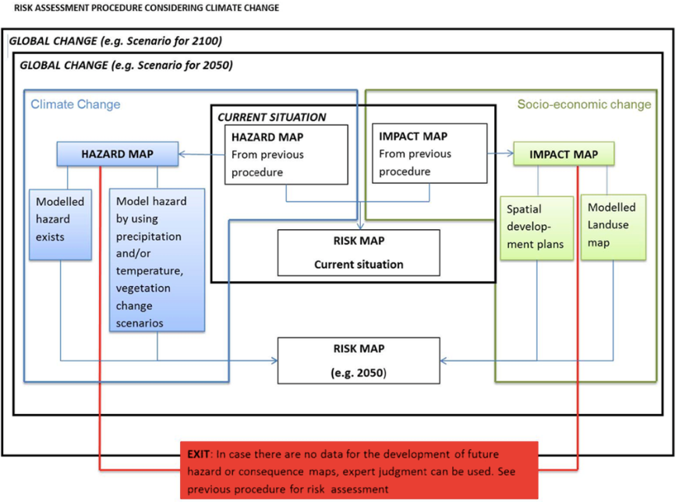

Slide 26
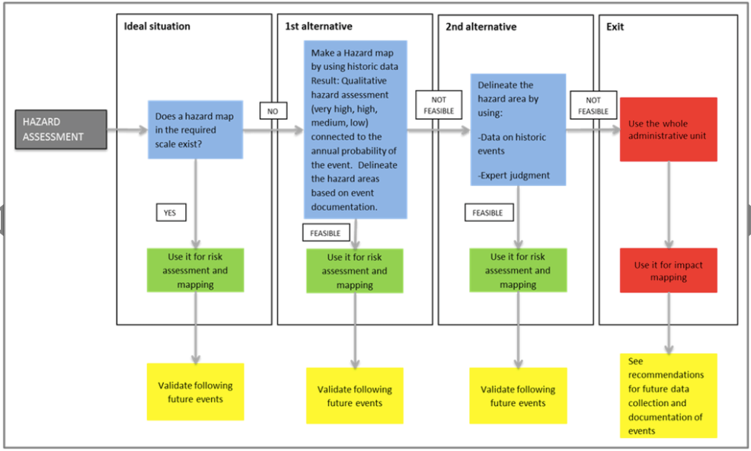
Notes:
Quantitative IMPACT ASSESSMENT, using alternatives

Slide 27
Climate-proofing infrastructure
Example
What are the characteristics of the weather events for the given return period expected under climate change?
Probability (%)
Return period for design

Slide 28
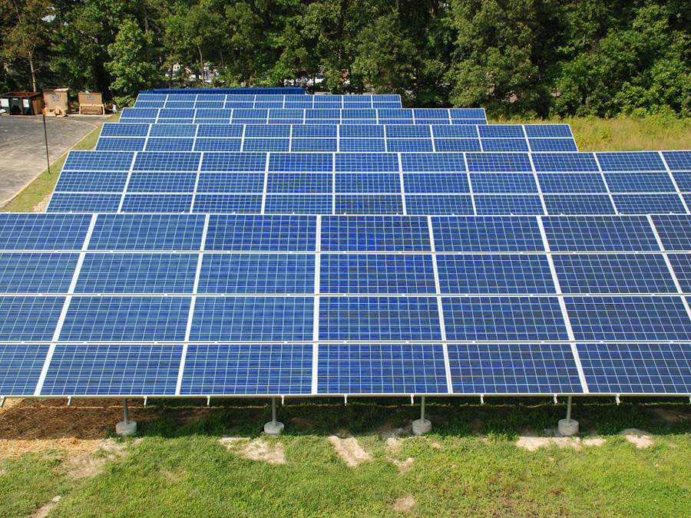
Anguilla Solar PV Project
Example
1 MW grid-connected, ground mounted Solar PV Project
EIB Required
A CVA to evaluate potential impacts from climate change on and identify options to increase its resilience, to be incorporated in the design following cost-benefit analysis.
Source: Deeb (2016)

Slide 29
Example
Summary of the Findings CVA (Anguilla)
Wind
PV Plant most sensitive to wind
Data show wind gusts up to 140 mph
Extreme Precipitation
Expected increase in extreme rainfall events
Difficult to design for a 100 year event such as recent hurricane
Heat
1⁰ C temperature increase during 25 year life of the equipment
In the context of the solar PV plant the projected change is insignificant.
Corrected for climate change based on local study gives projected gusts of 155 mph
Other data show increase in Category 4 and 5 hurricanes
Thus, design for the above 1 in 150 year events
Flooding and minor erosion possible
Data suggest design for a 25 year event
Could damage system components
Source: Deeb (2016)

Slide 30
Benefit-Cost Analysis (BCA)
Benefits and costs measured in a common unit, typically monetary
But…some benefits & costs may be difficult to measure in monetary units
Non-quantifiable factors may receive inadequate attention

Slide 31
Relative to CC
Adaptation
Costs: extra costs incurred compared with the ‘business-as-usual’ scenario
Benefits: avoided damage and losses, extra developmental benefits compared with ‘business-as-usual’ scenario
Mitigation
Costs: extra costs incurred compared with ‘business-as-usual’ scenario, reduced economic growth opportunities
Benefits: cost savings, sales of carbon credits, positive environmental and related health/livelihoods outcomes (+ difficult to value: strategic and competitive advantages)
Notes:
Niang-Diop & Bosch (2004): costing requires identification, quantification then valuation.
The costs potentially associated with climate mitigation include:
* investment in new technologies and infrastructure, possibly more expensive than other, more emission-intensive available options;
* in some cases, increased operation & maintenance costs associated with new technologies/infrastructure (however, the opposite may be true);
* reduced economic growth opportunities, and the foregone benefits and jobs of development options abandoned or downscaled for the purpose of reducing emissions.
On the other hand, the following benefits may arise from the adoption of mitigation measures:
* cost savings (e.g. from energy efficiency);
* positive environmental outcomes (where mitigation options are also ‘greener’ than alternatives) and associated health outcomes;
* reduced dependence on imported fuels/energy;
* earlier adoption of the technologies of the future (=> competitive advantage and higher growth and employment in the medium- to long-term);
* access to additional financial resources (carbon finance).

Slide 32
Cost-Benefit Analysis (1)
  Quantifies all the costs and benefits of an intervention (with benefits including both ‘positive’ benefits and avoided losses) over the entire lifetime of the intervention
  A ‘discount rate’ is applied to all costs and benefits to represent ‘preference for the present’ or simply the opportunity cost of capital -> calculation of ‘present value’
    The higher the discount rate, the smaller the present value
    The further away in the future, the smaller the present value
    Significant controversies over the ‘right’ discount rate for assessing long-term options
Notes:
Actually the ‘incremental’ costs and benefits, i.e. the difference in costs/benefits between a ‘with intervention’ and a ‘no intervention’ scenario

Slide 33
Cost-Benefit Analysis (2)
Outputs of cost-benefit analysis:
Cost-benefit ratio (CBR)
Ratio of costs to benefits calculated at their present value (the smaller, the better – should be <1)
Net present value (NPV)
Benefits minus costs calculated at their present value (the larger, the better)
Internal rate of return (IRR)
The discount rate at which NPV = 0
A measure of the ‘benefit-generating power’ of the option or intervention (the larger, the better)

Slide 34
Cost-Effectiveness Analysis (CEA)
Benefits measured in “natural” (non-monetary) units
  Health effect (e.g., "lives saved," asthma cases averted)
    QALYs, DALYs
  Exposure (e.g., peak ozone concentration)
  Emissions (e.g., tons of CO₂)
    Allows comparison of costs per unit benefit (efficiency), comparison with ‘benchmark costs’ for similar interventions, where available
Judgment of whether benefits justify costs (and optimal level of control) is external to analysis

Slide 35
Example: land-based mitigation options
Atmosphere
CO₂
CO₂
CH₄
N₂O
Forests
Net sink (tree biomass + soil organic matter)
Peatlands
Largest & most efficient terrestrial store of carbon biomass
Grasslands
  Net carbon sink if not degraded
Cultivated systems
Both a sink and a source of GHGs, net balance depends on cultivation methods
Notes:
Curbing deforestation is considered one of the most cost-effective ways of reducing GHG emissions. So is the conservation and restoration of peatlands.
According to McKinsey (2009):
*approx. 33% of total potential for reducing GHG emissions at a cost not exceeding €60 per tCO₂e is related to land use (forestry and agriculture)
*90% of the abatement opportunities associated with these sectors are located in developing countries
*agriculture- and forestry-related measures generally have low capital intensity (i.e. do not require particularly high extra upfront investment), while also entailing low (sometimes negative) abatement costs

Slide 36
CBA or CEA?
Compared with CBA, CEA:
  is suitable where it is difficult to assign a monetary value to benefits
  but requires identifying a single, all-encompassing measure of benefits – which may be both difficult and reductive

Slide 37
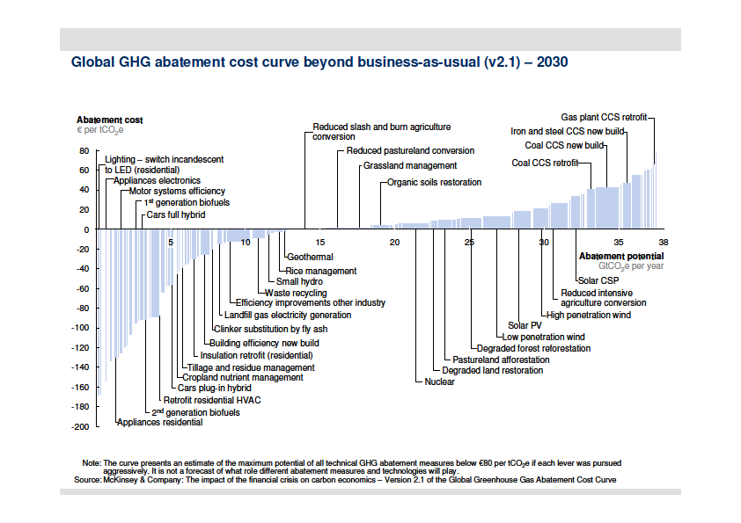
Example of a CEA
Source: McKinsey (2009), Exhibit 8, p. 17
Notes:
Summarises technical options for reducing GHG emissions in 3 areas:
* energy efficiency;
* low-carbon energy supply;
* terrestrial carbon (avoided emissions/sinks).
Options are ranked from the least expensive (per tonne of CO₂e abated) to the most expensive.
* The cost range is from –90€ to +60€ / tCO₂e.
* All options with a negative cost are ‘no-regret’ since the savings they generate are greater than their costs.
The width of the bar corresponding to each option indicates the abatement potential of this option (in gigatonne CO₂e per year), compared with ‘business-as-usual’, if implemented at full potential.
The curve shows that emissions ~11 Gt CO₂e/year could be avoided only by implementing options that provide a net financial benefit.
Reducing emissions just enough to contain global warming below 2°C could cost only €200-350 billion/year until 2030, i.e. <1% of global GDP.

Slide 38
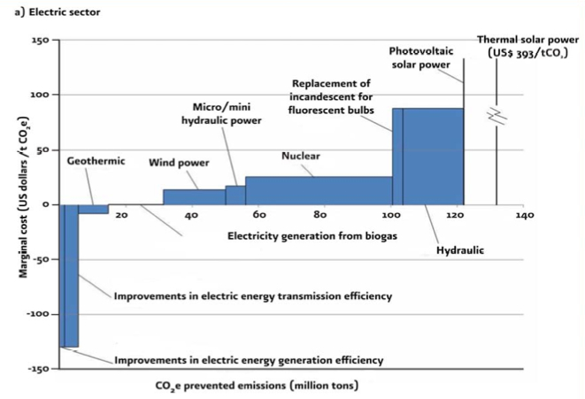
Source: SEMARNAT

Slide 39
Financial and economic analysis
Basis for private sector decision making
Both CBA and CEA support:
  financial analysis: considers the ‘monetary’ costs and benefits (or equivalent) accruing to parties directly concerned by a project or programme, at their ‘face value’
  economic analysis: broadens the analysis to more accurately reflect costs and benefits to society
Basis for public sector decision making

Slide 40
Tools for prioritising and selecting adaptation and mitigation measures

Slide 41
Supporting decision making
CBA/CEA support the financial and economic assessment of adaptation/mitigation options
  They help identify measures that offer the best ‘value for money’ – a key aspect in situations of budgetary constraints
Other types of assessment and other criteria (e.g. technical, social, environmental) are required to fully inform decision makers
Multi-criteria analysis (MCA) helps integrate various criteria

Slide 42
Multi-criteria analysis (1)
An approach to decision support that uses
more than one criterion to assess performance and rank various options or interventions
The term actually covers a wide range of methods
Typically:
  various options or interventions are assessed against a pre-determined set of criteria
  qualitative ratings or quantitative scores are given
  rules are then applied to rank options/interventions
    Numerical scores can be added up to calculate a total score (with the possibility of applying different weights to different criteria)

Slide 43
Multi-criteria analysis (2)
MCA is a useful complement to CBA/CEA
It allows combining financial/economic criteria with technical, environmental and social ones
It can be used on its own, or in combination with CBA/CEA:
Allows reducing the number of options to which CBA/CEA is applied
MCA before CBA/CEA
CBA/CEA helps eliminate financially or economically unviable options, then MCA allows for final selection based on extra criteria
MCA after CBA/CEA

Slide 44
Example of MCA grid
Option | Effective-ness | Cost or CBR ^{(*)} | Technical feasibility | Social & cultural acceptability | Environmental impacts | Total score
Option 1
Option 2
Option 3
Option 4
Scores: from 1 (poorest performance) to 4 (highest performance). As far as cost is concerned, a scale should be established, with scores corresponding to a given cost range or cost/unit range.
^{(*)} CBR = cost-benefit ratio
Adapted from USAID (2007), Exhibit 12, p. 18

Slide 45
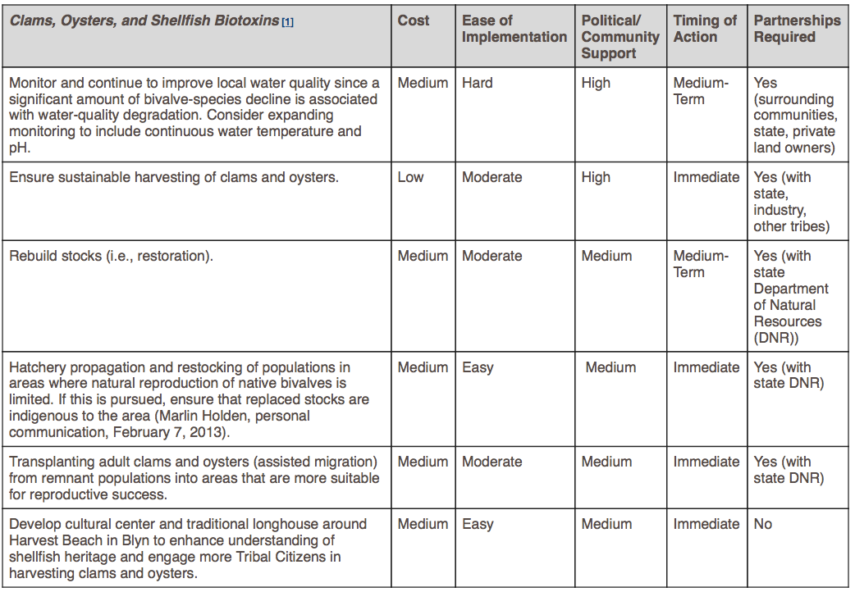
Adaptation International, 2013
Notes:
An example of result of a climate vulnerability review: Resilience strategies for clams and oysters. This table provides a selection/ list of key actions to increase resilience, as well as a number of criteria to be used in the evaluation, prioritization, and selection of strategies.
discuss relevant “best practice” adaptation methods taken from the literature, case studies, and personal experience;
tailor these strategies to the local context.

Slide 46
References
A guide to Climate Change Vulnerability Assessment, Glick et al. (2011)
A Common Methodology for Risk Assessment and Mapping of Climate Change Related Hazards—Implications for Climate Change Adaptation Policies, University of Vienna (2016)
A cost curve for greenhouse gas reduction, Per-Anders Enkvist, Tomas Nauclér, and Jerker Rosander, McKinsey&Company, 2009
Jamestown Climate Vulnerability Assessment and Adaptation Plan, Adaptation International, 2013
CRiSTAL tool, https://www.iisd.org/cristaltool/

