Slide 1
OpSys
4th Programme User Committee
28 September 2016

Slide 2
Agenda
(10.30) Validation of the agenda + minutes of meeting
(10.35) Update on Opsys programme
    key achievements since PUC 3, current priorities,
    key events to come: meetings calendar
(10.50) Project 2B – state of play of the preparation
    Technical choices and tentative planning
    Next steps with focus on contracts management harmonisation
(11.15) business transformation track
(11.40) EU del 10-12 October workshop
  Draft agenda, objectives, participants, PUC role, content
  Re-activating Opsys business transformation track
(12.10) wrap-up

Slide 3
Key achievements/events since May 2016
Programme update
Project 1
  Approval of project charter, moving on detailed specifications
  User experience (mock up)
Project 2A
  clarification relation with ABAC (JaGate)
  Project charter with a clear scope
Project 2B
  Green light and support from IT Board
  Business case preparation
Opsys team (Daria, PMO, Particip)
3

Slide 4
Current priorities
Programme update
Addressing turn over issues and progressively completing the team
Delivering user experience and pilot for project 1
Paving the way for implementation of project 2B
Budget & planning: progressive clarification
Scoping of and engaging in change management
4

Slide 5
Preparation IT SC of 14/10/2016
Programme update
Adoption of project charter 2A
  Clarifications given on technical choices for ABAC interface
  IT Budget: suggested to unblock a first part
  April 2017: final planning, budget and BUDG position
Opsys state of play
  Further clarification on Opsys overall budget (per year); work in progress
  Needs for 2017: IT =7.2+1.9=9.1 M€, Business: 3.3 M€
  Decision with Business schema directeur 2017-2018
5

Slide 6
Opsys meetings calendar Q4 2016
Programme update
EU Del workshop: 10-12 October
  Joint meeting with PUC members on Tuesday 11/10 at 16.00
DEVCO ITSC: 14/10/2016; two Opsys topics
  Approval project charter 2A
  State of play of Opsys
1st half of November (tbc): PUC 5 (business requirements project 2B, poss Opsys governance)
November: DEVCO IT SC (budget for 2017-18)
November: IT BOARD (way to implement project 2B)
6

Slide 7
Project 2B – Contract Management
Technical Choices
Reuse of SYGMA, Compass, JaGate, Prospect,…
Development of specific modules (Sector tagging, Deviations & Prior Approval,…)
Decision to postpone implementation of Award phase for Procurement
7

Slide 8
Project 2B – Contract Management
Work in Progress:
  Detailed Planning
  Partnership Agreement
  Business case & Project Charter
  Migration strategy
  User Group set up
  New business processes definition
  Pilot exercise definition
8

Slide 9
Project 2B – Contract Management
  New Business processes definition
    Validation workflows for contracts
    Contract templates
    Budget Support
    Workshops to be organised – dedicated expert group to be set up
9

Slide 10
Project 2B – Contract Management
  Pilot exercise definition
    Focus on Framework contracts – Post Award process
    Technical and Business outcomes
    Draft scope:
      Request an offer to preselected entities
      Receive offers from interested entities
      Evaluate received offers
      Notify the results of the evaluation
      Manage Specific contract (signature, reports, invoices)
    Scope, planning to be further detailed
10

Slide 11
HOW: iterative and participative along the whole process chain
POLITICAL REQUIRE-MENTS
CHALLE-NGES
(Juncker Commission: performance culture -> added value;
IT response
(investment)
Human ressource
Management
Business transformation from
as is to be
Legal Framework
Functional/
Organigram
Leader-ship/ strategic require-ments
develop and test with user groups
Business process for projects
Evaluation
Implementation
Commitment level 2
Commitment level 1
Programming
Perfor-mance frameworks
Other Business processes…..
for trade negotiations, policy dialogue
Humanitarian aid
Blending ….

Slide 12
HOW: dual track approach
Continuous review of business processes / improvement
Proposals for ways of working, legal requirements, institutional set up
IT development/ testing
Evaluation
Implementation
Commitment level 2
Commitment level 1
Programming
Perfor-mance frameworks

Slide 13
Context and objectives
Workshop
10-12 October 2016
Context
  Milestone for project 1 "results management & operational entities"
  First interaction with EU Delegations
  Momentum to think about the bigger picture: how do we really ensure the transformation towards a performance culture
Objectives
  User experience taste in 2020 around typical profiles
  User experience in 2017 on results management
  Benchmarking and reflection on improvement of results management process and impact on performance
Outcome
  Reviewed/ improved solutions for user experience
  Tracks and actions for business process review on result management identified and follow up agreed
13

Slide 14
Workshop 10-12 October 2016 Agenda
DRAFT
Day 2 – October 11
Day 1 – October 10
Time | Agenda item | Format | Who
09.00 09.30 | Participants welcome, coffee |  | 05
09.30 09.45 09.45 10.30 | Opening by DEVCO DDG2 + NEAR General overview OPSYS process What is Project 1 about | Plenary | Ms Jager Denis Giuliano
10.30 - 11.15 | Vision 2020 Preparation working sessions | Plenary | Lucile
11.15 – 11.45 | Coffee break
11.45 – 12.30 | Vision 2020 | Plenary | Lucile
12.30 – 14.00 | Lunch time
14.00 – 15.30 | Vision 2020 - My Worplace - Project and program management | 4 groups Thematic working sessions | Lucile Giuliano Catherine Daria
15.30 – 16.00 | Coffee break
16.00 – 17.30 | Vision 2020 -Logframes and indicators -Prioritisation quick wins | 4 groups Thematic working sessions | Lucile Giuliano Catherine Daria
Time | Agenda item | Format | Who
09.00 - 09.15 | Participant walk in and welcome (recap day 1) | Plenary | Daria
09.15 10.30 | Project 1 Business transformation: Improve our accountability and transparency through result reporting | Plenary | 06 NEAR FPI
10.30- 11.00 | Coffee break
11.00 – 12.45 | Project 1 Business transformation: result management in 2020 The current ways of doing result management: challenges and opportunities benchmarking with other organisations / EUTF | Plenary | Dele-gations / Mehdi EU TF
12.45 – 14.15 | Lunch time
14.15 – 15.30 | Project 1 result management | Plenary | Giuliano
15.30 – 16.00 | Coffee break
16.00 – 17.30 | Recap + updated Vision 2020 Conclusions | Plenary | Ms Jager Denis

Slide 15
Participants
Workshop
10-12 October 2016
EU Delegations
  17 participants (10 Ops + 7 FCA; 7 DEVCO, 10 NEAR)
  Brazil, Afghanistan, Malawi, Peru, Ethiopia, Pakistan
  Bosnia, Ukraine, Morocco, Georgia, Turkey
HQ
  Max 5 participants (FPI, NEAR, DEVCO 06)
  Joint recap meeting with the all PUC on Tuesday 11 at 16.00
  Opening and recap sessions with senior managers
15

Slide 16

Approach
2020 Vision
2020 Digitally-enabled Business Scenarios
3 days in the life of …
An operational manager
Day1: in the office
Day 2: in the office and at a ministry
Day 3: site visit
A set of emergencies …
Collaborative work with the other personas for problem-solving
People centric design - Behavioural analysis and User Experience with graphical designer and UX
Taste-testing with worldwide people with roles of the personas
Enterprise architecture principles for UX, personalisation, etc.
A set of personas
EC staff and externals:
  Operational manager
  Financial manager
  HoC/HoU/HoS
  Director
  implementing partner
  etc
Higher productivity
Larger portfolio of project and programmes
For the workshop: RESULT focused work
Iteratively defining
A Digital Workplace on an Ecosystem Platform
New business processes and global change management

Slide 17

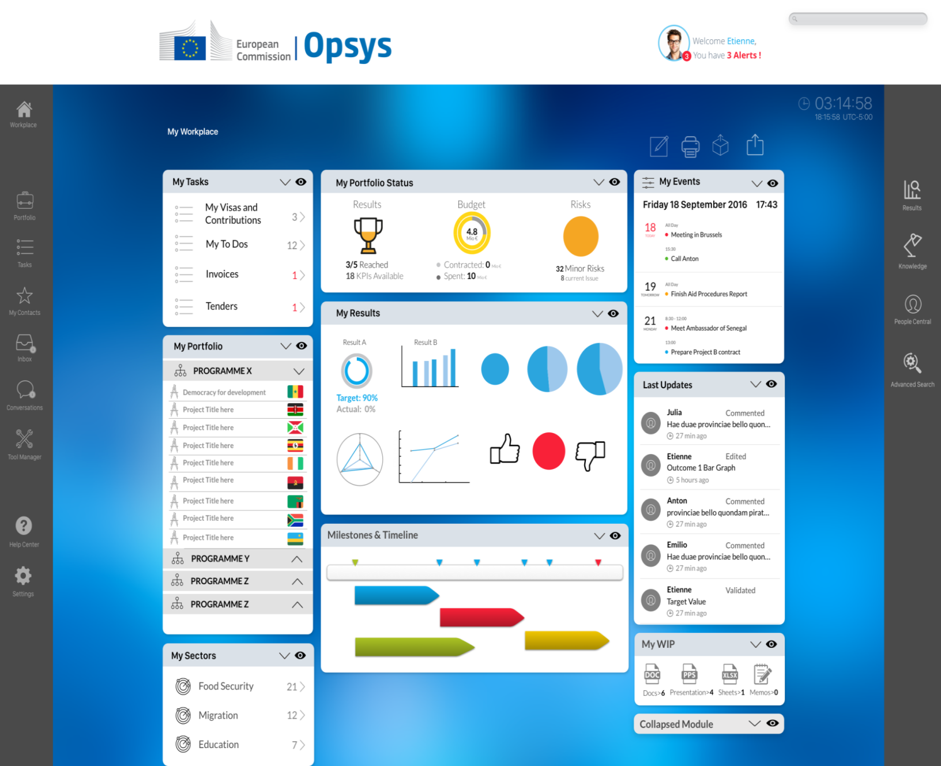
My workplace

Slide 18
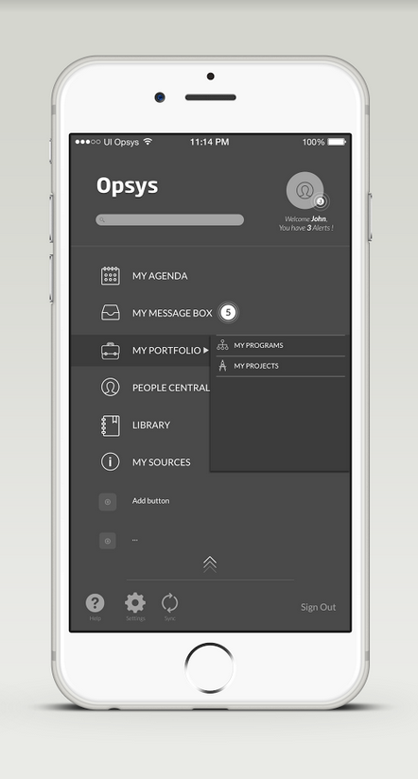
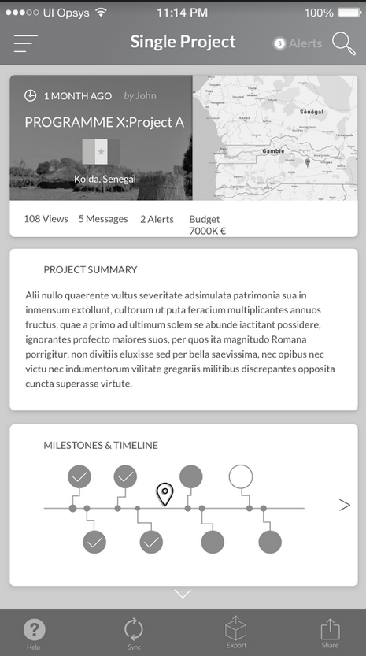
Mobile

Slide 19
Slides

Slide 20
Slides Daria business transformation

Slide 21
Need for more information?
Link for Opsys DEVCO intranet page:
https://myintracomm.ec.europa.eu/dg/devco/resources-procedures/opsys/Pages/index.aspx
Link for Capacity for Dev
http://capacity4dev.ec.europa.eu/opsys/dashboard
  Send us an e-mail : DEVCO OPSYS
    NEAR OPSYS
21

Slide 22
Annexes
Not for presentation

Slide 23
OPSYS SCOPE
Result management and operational entities
1
Dependencies
Action management and
level 1 commitment
2A
ABAC
Contract management and level 2 commitment
2B
Hermes, Decide, SEDIA
Implementation & Evaluation
MIS
3
Eval Rom
Prospect
Programming process and preparation of actions
4
Tendering
GIS
5
TRANSVERSAL PROJECTS/ WORKSTREAMS
Business Architecture (process, data)
Architecture foundation
(Integration, reuse)
Content migration
New ways of working
(Ux, enabling)
Change management
23

Slide 24
OPSYS VISION
Opsys programme will gradually offer* IMPROVED OPERATIONAL PROCESSES AND TOOLS to DEVCO/NEAR/FPI staff from end users to top managers in order to manage efficiently their portfolio of projects/programmes throughout the cycle of operations.
Our staff will be able to do COLLABORATIVE WORK, get input from EXTERNAL PARTNERS and to feed reporting and communication tools for a greater transparency.
Through a FLEXIBLE AND AUTOMATED SYSTEM, our staff will be able to easily access information on projects/programmes, prepare, validate and monitor them as well as manage results with ‘no re-encoding’ principle.
* Requires an agile approach

Slide 25


Process Overview with OpSys scope
Legend:
Process overview
External action specificities
Core value
Contributing value
Transparency, Reporting and Communication
Objectives
Indicators
Targeted Results
Achieved Results
Specific process for: GGDC – special form of budget support -
Specific process for: Budget Support, CBC, Blending..
3 management modes: direct/indirect/shared
Implementation modalities: Procurement, CfP, Contracts and Grant Contracts, Budget support, PAGODA, Blending, PE, Union TF, CBC, Twinning, Taiex, etc.
Policy Making
Multi-Annual Financial Planning
(Indicative) Programming
Identification & Formulation
Financing
Implementation (incl. Audit)
Evaluation
Instrument
Action
Commission Decision: (M)AAP, Measure, CBC Action Programme, Exceptional Assistance Measure etc.
Commission Decision: MIP/ISP/SSF
Programme / Project
Continuous Improvement and Knowledge Management
Individual and Team Productivity:
Internal and External Collaboration and coordination; Time and project management

Slide 26
Opsys vs process overview re-use candidates
GIS
EAMR Del+HQ, DWH
Next-Europa, Open data portal
Transparency, Reporting and Communication
Objectives
Indicators
Targeted Results
Achieved Results
Internal and External Collaboration
DECIDE
ABAC, Sygma/Compass, e-procurement
ABAC
DECIDE
Budget Support
, Procurement, CfP and
Contracts (direct/indirect)
PAGODA, PE, Union TF
Blending, CBC, Twinning, Taiex
GGDC
Budget Support, CBC, Blending
Policy Making
Multi-Annual Financial Planning
Programming
Identification & Formulation
Financing
Evaluation
Implementation
Prospect, SAP BPC, MIS, ROM, Audit, i-Perseus
Eval
Instrument
Commission Decision: MIP/ISP/SSF
Action
Commission Decision: (M)AAP, Measure, CBC Programme, Exceptional Assistance Measure etc.
(Lead) Programme / Project
Individual and Team Productivity:
Collaboration and coordination
Time and project management
Cap4Dev
SEDIA, SharePoint2013,
Adobe Connect (screensharing), Enterprise search
E-PRAG, e-Companion
Continuous Improvement and Knowledge Management
HERMES
GMS EMPP module

Slide 27
GOVERNANCE
System owner = DEVCO 05
DEVCO IT SC
Incl. NEAR and FPI rep.
informs
NEAR IT SC
DGs level
endorses
DDG level
EU Del: (first time) BRAZIL/S AFRICA & NEAR area
OpSys PSC
DEVCO & NEAR dir. + FPI + DIGIT + ad hoc DGs
Technical level
EU Del: ETHIOPIA, MALAWI, PERU, BRAZIL, AFGHANISTAN, PAKISTAN & NEAR area
OpSys Programme User Committee (PUC)
HQ & EUD rep. from DEVCO/NEAR/FPI/ECHO/EEAS dir.
Technical level
Business needs and testing
EU Del to be identified
OpSys Domain User Groups
Results Management
Contract Management
Other domains and focus group
Contract Management
Other domains
Other domains
27
Notes:
OpSys system owner: DEVCO.05

Slide 28
Project 1 scope
Results and
operational entities
Strategic Objectives
Increasing productivity (efficiency, processes)
Improving quality (data/operations)
Shifting to a result orientation mind-set
Transparency/ Connecting to external partners
Vision
Users will shape their operational portfolio and manage automated results
1- Operational entities (prerequisite)
Programming – access data
Action, Contract – access data
Projects/programmes – create and manage
6- External access (first phase)
Implementing partners will be able to provide direct inputs on results
2- Results
Logframes; EU indicators
Baseline and target
Achieved results
5- User experience
Internal portal for a single access to operational systems
Harmonised and intuitive user interface
USER
3- Monitoring (first phase)
Monitoring outputs and activities from the implementing partner
Plan and monitor key events and activities from the EC Operational manager
4- Integration & interoperability
Data legacy
Progressive integration with EU websites,
EAMR, GIS, ROM, EVAL, etc.

Slide 29
PROJECT 2A - SCOPE
Strategic Objectives
Increasing productivity (efficiency, processes)
Improving quality (data/operations)
Improving user-friendliness
Shifting to an operational approach
Vision
Users will manage Actions & Level-1 commitments and their related Portfolio
1 - Programming
Create and manage a MIP
Part of validation process
Define stakeholders
Amendments
6 - Interoperability
Data legacy (complexity – no 1-to-1 matching CRIS-OPSYS)
Interoperability/Integration with OpSys project 1, ABAC, AUDIT, ROM, EVAL, BPC, MIS, DWH, ARES/HERMES
2 - Actions
Create and manage an Action
Define stakeholders
Part of validation process
Manage Operational data from the Action documents & Financing agreements
Manage Action programmes (corresponding to Commission Decision)
Link to Deviations & Prior aprovals
Amendments
5 – Tagging, Statistics and reporting
New data collection process for reporting, statistics & exchange of best practices (ex: sector + free tagging)
USER
3 - Level-1 commitments
Creation of one/several L-1 commitment(s) and link it to Action
Manage L1 commitments not related to an Action
ABAC data
Validation and responsibilities (one single workflow)
4 - Main budgetary functionalities
Flexible Budget allocation management
Automatic budgetary follow-up (Paid, Contracted, RAC, RAL…)
29

Slide 30
PROJECT 2B - SCOPE
Vision: Users will manage Contracts & L2 commitments and their related Portfolio
1 – Contract preparation
Including forecasting
2 – Contract Award
Link with award procedure (Prospect)
3 - Level-2 commitments
Creation of one/several L-2 commitment(s)
Manage L2 commitments not related to an Action / a L1 commitment
ABAC data
Validation and responsibilities
6 - Interoperability
Data legacy (complexity – no 1-to-1 matching CRIS-OPSYS)
Interoperability/Integration with Opsys project 1, ABAC, AUDIT, ROM, EVAL, BPC, MIS, DECIDE
USER
EC, Partner Country, Contracting Party
4 – Contract Implementation
Flexible Budget allocation (Analytical breakdown)
Link to Deviations & Prior aprovals
Management of subcontracting (// Iperseus)
Expert Management
Payments
Deliverables
Report Management
Correspondence management
Amendments
Stakeholders management
5 – Sector Tagging
New data collection process for reporting, statistics & exchange of best practices (ex: sector + free tagging)
30

Slide 31
Planning
Some expected benefits
2016 |  |  |  |  |  |  |  | 2017 |  |  |  |  |  |  |  | 2018 |  |  |  |  |  |  |  | 2019
Q1 |  | Q2 |  | Q3 |  | Q4 |  | Q1 |  | Q2 |  | Q3 |  | Q4 |  | Q1 |  | Q2 |  | Q3 |  | Q4 |  | Q1 |  | Q2 |  | Q3 |  | Q4
1. Results management operational entities
2A. Operational backbone / Action and level 1 commitment
Preparation |  |  |  |  | 2B. Operational backbone / Contract and level 2 commitment
 |  |  |  |  |  |  |  | 3. Implementation and evaluation
 |  |  |  |  |  |  |  |  |  |  |  |  | 4. Programming processes and preparation of actions
 |  |  |  |  |  |  |  |  |  |  |  |  |  |  |  |  |  |  |  | 5. Tendering (complementary to 2B)
Sept 2017:
Each manager will create its project and programme perimeter
Link between instrument MIP action project
Results follow up at each level
Integration ROM EAMR GIS
Access external partners
User experience, search and portal
April 2019:
Phase out CRIS
Actions, contracts and financial transactions managed
Capturing action document, financing agreement
No double visa circuit (eg CRIS/ARES)
Sector tagging, information tagging
Document managed in ARES/HERMES, search
Personnal parametrisation/ user preference
Guidance on the screen
To be revised after IT Board
CRIS decision and contract

Slide 32

Phasing vs processes
OpSyS
1. PROGRAMMING
2. IDENTIFICATION FORMULATION
3. IMPLEMENTATION
Document mngt.
Contract
Programme/Project
Create and manage MIP
Create & manage Action
Procurement and call management
Results management
Collabo
-ration
Create and manage sector intervention framework
Create and manage Level 1 commitment
Prepare & sign contract
Monitoring
Create initial Logframe
Create and manage Level 2 commitments
ROM and evaluation
Time mng.
Review and approve MIP
Review and approve A.D./Action Programme
Communication and Knowledge sharing
Decision-making process
Manage deliverables
Decision-making process
Invoices and payments
Manage amendments
Manage amendments
Interoperability
Manage amendments
Contract audit
Country plans
Action forecast
Contract forecast
Project 1: Operational entities & Results management
Project 2A: Action & Commitment level 1
Project 2B: Contract & Commitment level 2
PLANNING AND FORECASTING
Project 3: Implementation & evaluation
Project 4: Programming processes
Project 5: Tendering

Slide 33
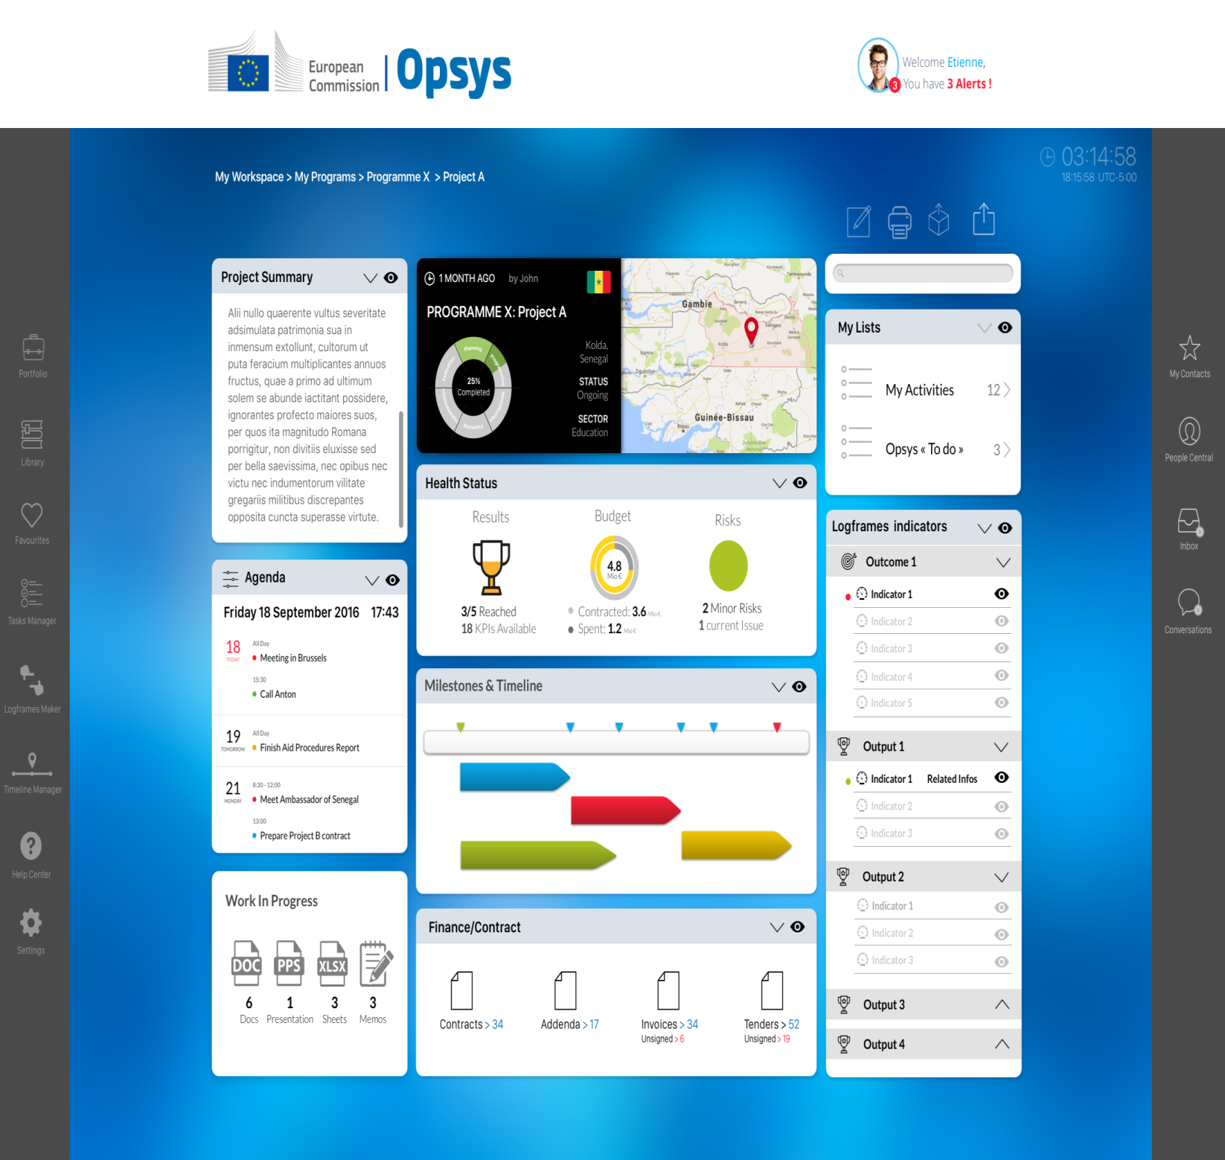
Project page

Slide 34

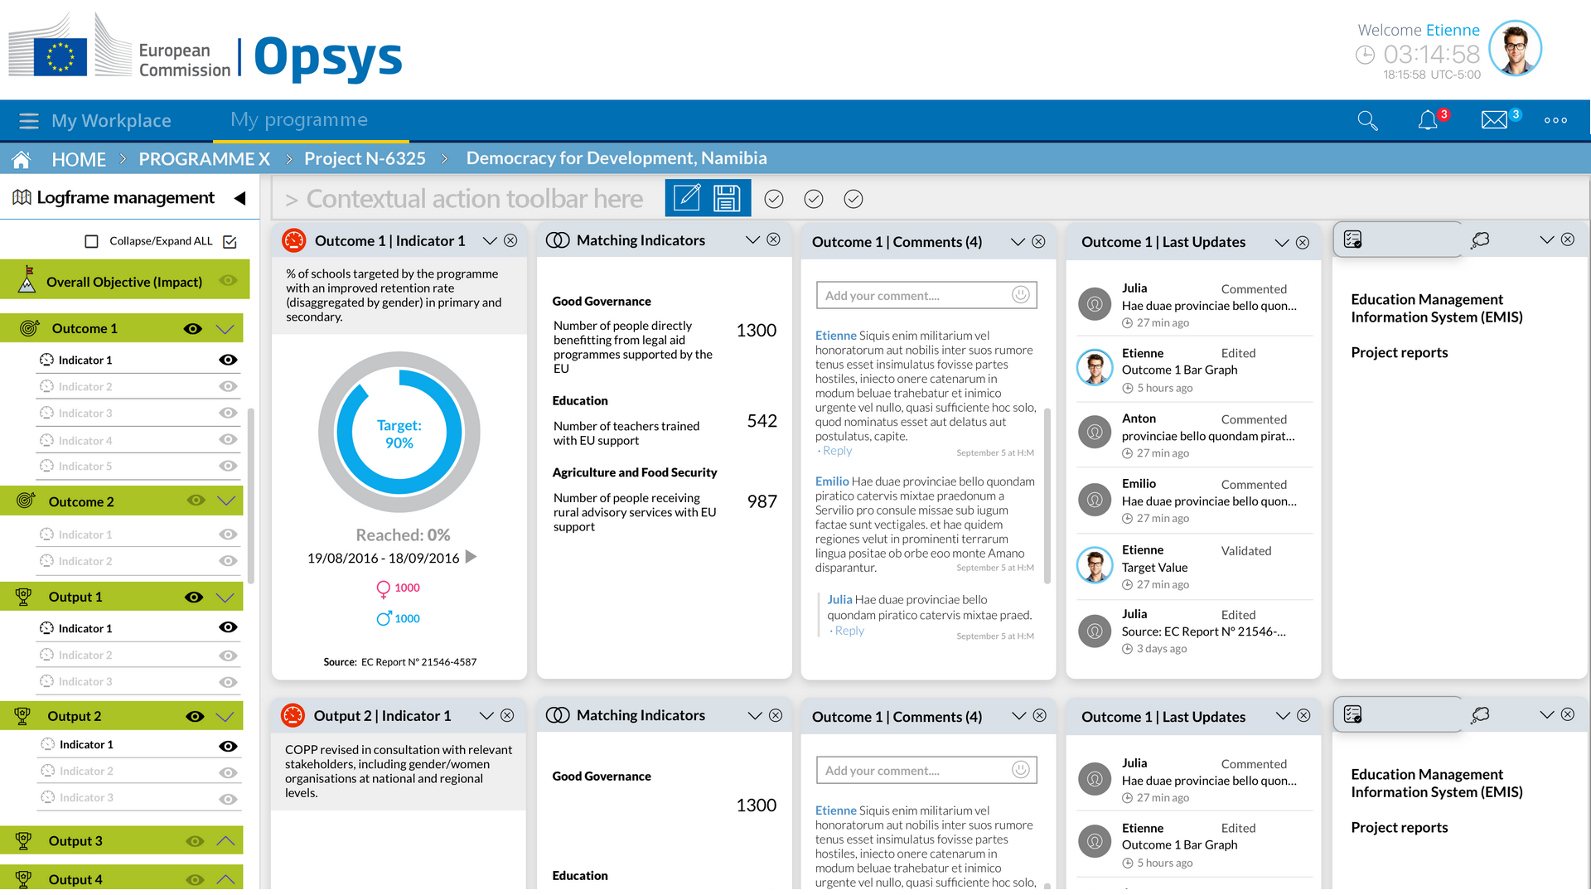
Indicator page

Slide 35
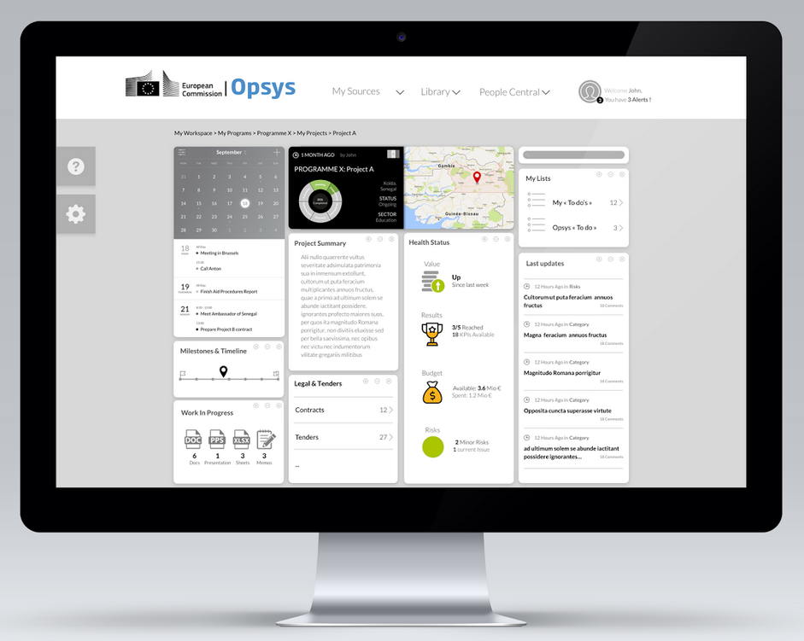
Desktop

Slide 36
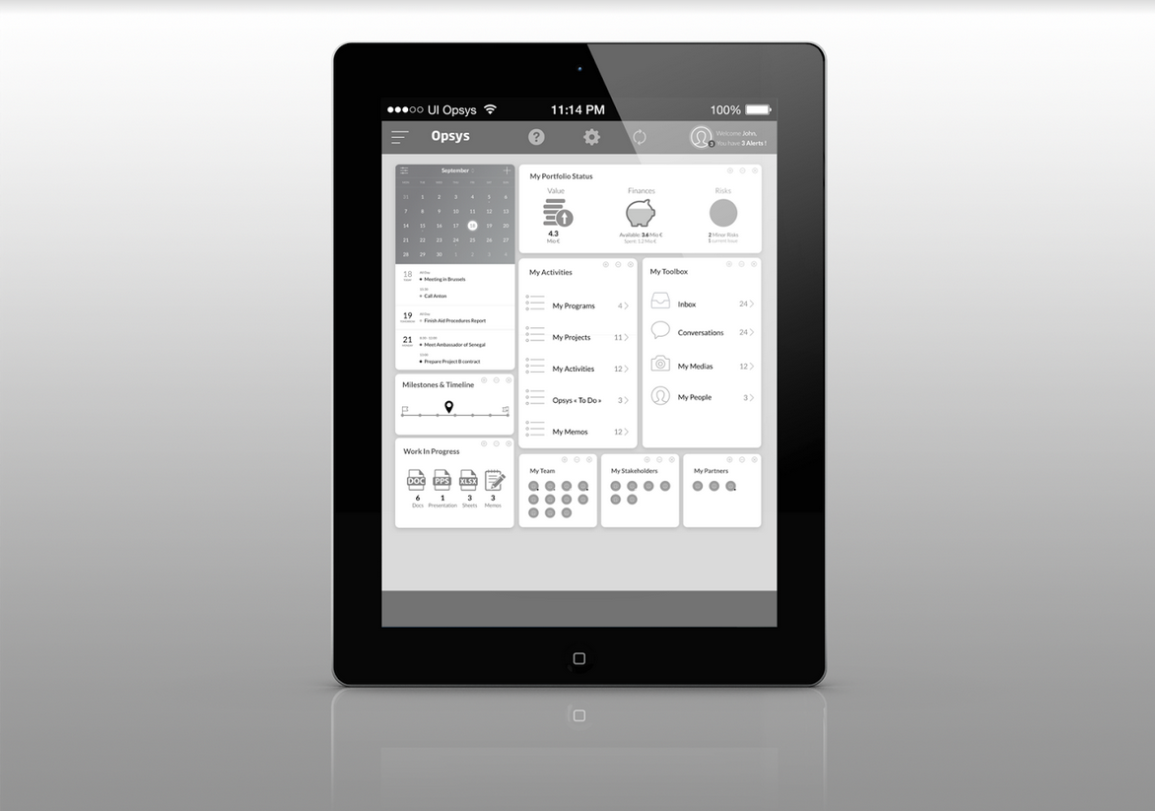
Tablet

