Slide 1
PROJUVEN
Non-profit Association
Agency for Mobility
and
International Education

Slide 2
Who we are
Asociación PROJUVEN is a Spanish non-profit organization born in 2015. Our name stands for Proyecto Juvenil (Youth Project).
Asociación PROJUVEN was recognized as a University organization of the University of Málaga in 2016
(PROJUVEN office is located inside the University of Málaga).
We are an intermediary organization among European Universities and Companies.
For our professional team, being part of our project, means being social entrepreneurs and keeping the passion for social purposes.

Slide 3
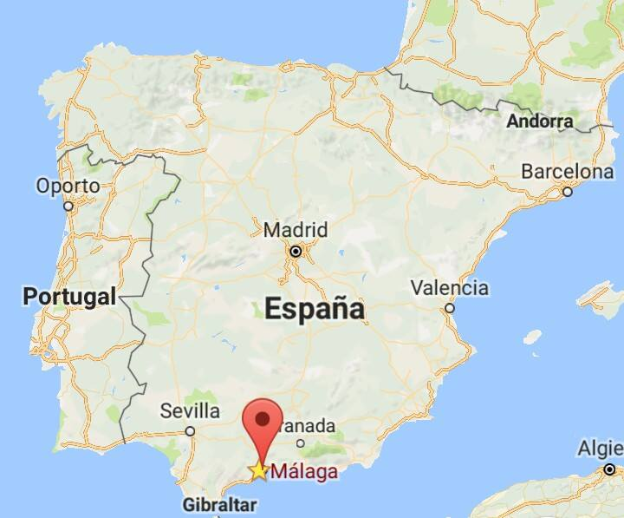
Where we are
Association PROJUVEN is situated in the University of Málaga.
Málaga, capital of the province of the same name, is the fifth most populated city in Spain.
It is located in the south of the Iberian Peninsula, in a privileged spot.

Slide 4
Social Aims
PROJUVEN promote the Erasmus Plus Programme and provide educational training at local and European level.
Promote intercultural understanding, equal opportunities, active citizenship and solidarity.
Our main goal is to enrich the educational, social and cultural life of young people living in our country and in Europe.

Slide 5
Our goals
Individual Youth Development
European Connections
European Mobility for Young People
Acquirement of New Professional Skills
Experience and Training
Changing Europe for better!

Slide 6
Areas of action
European and Social Project management
Erasmus for entrepreneurs/placement sending/
host organisation
Cultural and technological events
Digital divide awareness and reduction
Languages Learning and ICT education
Social Media Management and social skills
EVS (European Voluntary Service)
PROJUVEN International Network on Refugees (PINOR)

Slide 7
PROJUVEN INTERNATIONAL PROJECT FOR REFUGEES - PINOR
Projuven International Network on Refugees (PINOR)is our new informative project towards migrant inclusion, a new mission for us.
Our directions:
Lobby and advocacy
Networking and cooperation
Raising awareness
Training programmes

Slide 8
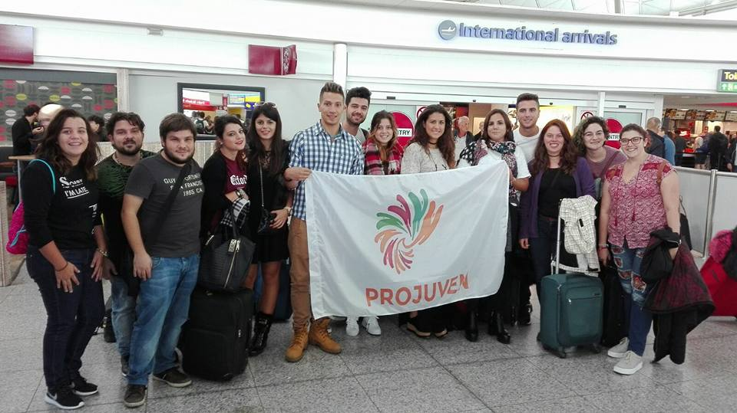
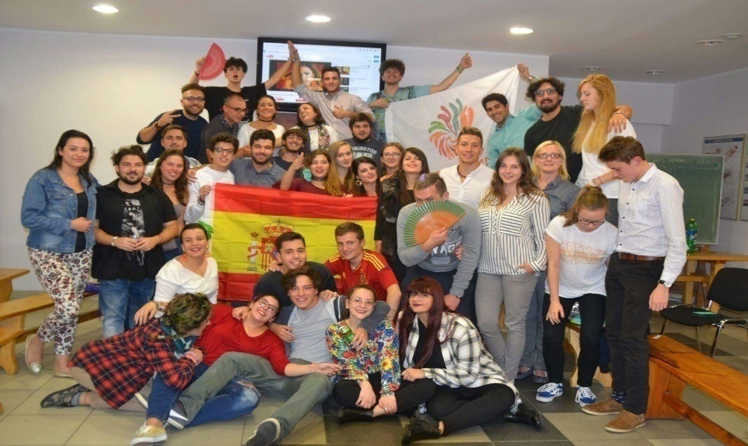
Intercultural exchange
We promote young mobility, training course, intercultural exchange, volunteer and social cooperation among youngsters.

Slide 9
Internships
We support students from the University of Málaga for their internships in Andalucia and abroad, in order to encourage European mobility and help young people to gain new experience and knowledge for personal and professional development.

Slide 10
Erasmus for Young Entrepreneurs
We promote the European
Programme "Erasmus for Young
Entrepreneurs “ to set up projects
entrepreneurial cooperation both in sending and in hosting, thanks to the partnership with the local
contact point Fundacion CEEI Albacete.

Slide 11
Erasmus+ Traineeship
Association PROJUVEN works as
intermediator between foreign
Universities and spanish
organisations, in order to promote
the international mobility of
students and the creation of
internship opportunities in Spain.

Slide 12
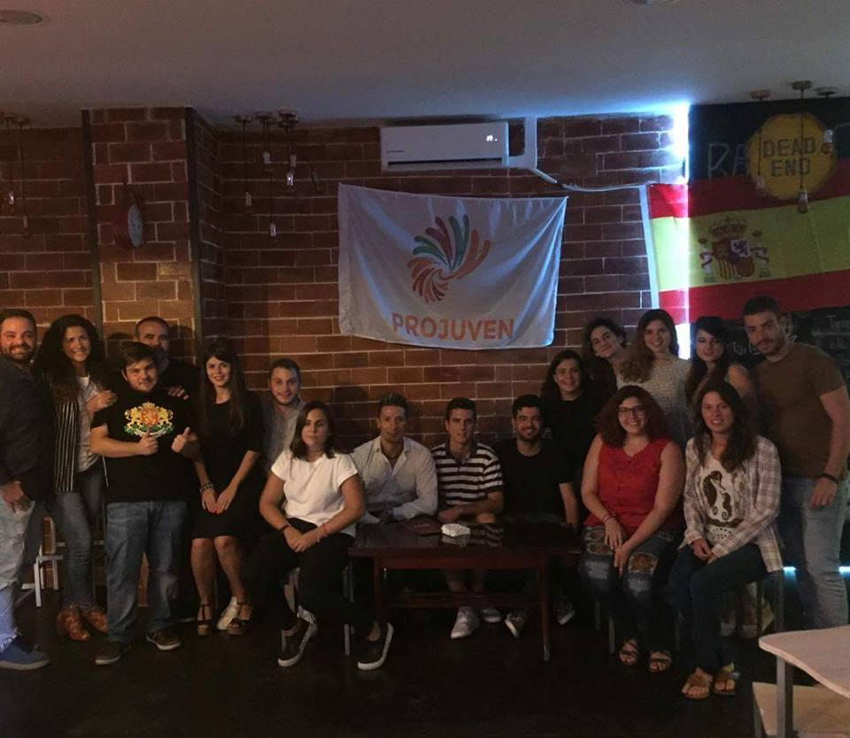
Local cultural events
Asociación PROJUVEN
We organize also Language Exchanges,
when you can improve your English, meet new people and enjoying a great atmosphere in an international environment.

Slide 13
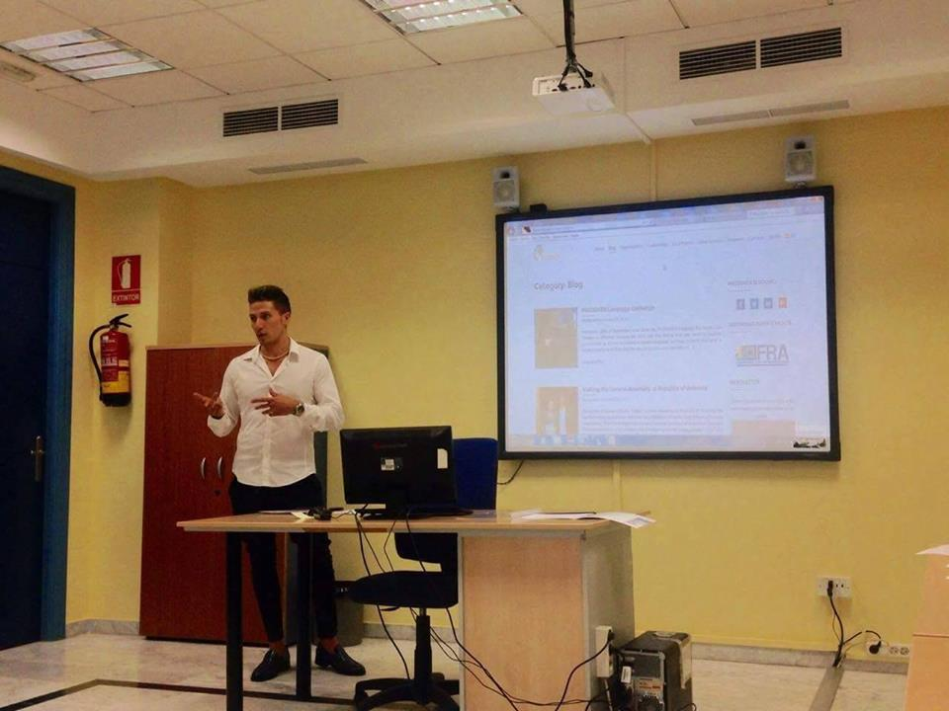
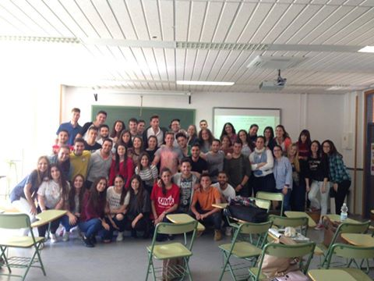
European awareness
We want to enrich the educational, social and cultural life of young people living in our country. PROJUVEN organize a public talks in Universities and other public institution.

Slide 14
Other services
International Network: Thanks to our stable network we can connect different professional profiles in various international projects.
Research: Research is one of the axes of our organization. We engage in research dealing with a wide variety of Europe-related topics.
Visibility, Coordination and Project: offers structural relations with European and Latin American networks; it makes possible to carry out strategic events as well as visibility actions but also to identify, formulate, present, manage, monitor and execute projects.

Slide 15
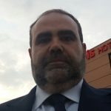
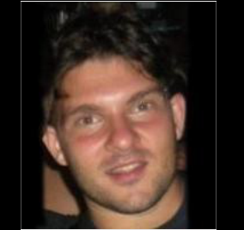
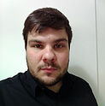
Our Executive team
Dr. Francesco Ruberto
President & project designer
Dr. Prof. Juan Carlos Alvarez Cortes
Research Team responsible
Antonio Stigliano
ICT Expert
Salvatore Stigliano
Project Manager
project-manager@projuven.org
president@projuven.org jcalvarez@uma.es ict-expert@projuven.org

Slide 16
Contacts
Website: www.projuven.org
Facebook: https://www.facebook.com/ProjuvenNGO/
E-mail:info@projuven.org
Phone: +34 951 952 953 /+34 633884707
National ID Code:G93460558
PIC Number: 923156373

Slide 17
Thank you for your
attention!

