Slide 1
EC Staff Seminar on Democracy From electoral assistance to mainstreaming democracy
Practical use of analytical tools for EU democracy support
by Jean Bossuyt (ECDPM)

Slide 2
“ IF YOU WISH TO DEFEAT POVERTY,
PREPARE TO ADDRESS THE POWER AND THE
POLITICS THAT KEEPS PEOPLE POOR.
THAT IS WHY POLITICS MATTER ”
[Adrian Leftwich, 2012]

Slide 3
Integrating politics into development: an ongoing challenge

Slide 4
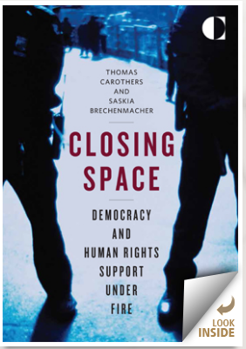

Slide 6
the phenomenon of GLOBAL PROTEST
And the rise of NEW SOCIAL MOVEMENTS and forms of CITIZEN ACTION

Slide 7
The development effectiveness agenda and the EU policy/results framework for development cooperation …
Make a diligent use of context analysis more compelling

Slide 8
Core implications for EUD? (1)
AGREEING ON WHAT CONTEXT ANALYSIS MEANS
A PROCESS BY WHICH THE EU GATHERS, APPRECIATES AND USES RELEVANT KNOWLEDGE …
ABOUT THE WIDER CONTEXTUAL FACTORS…
THAT AFFECT THE DOMESTIC REFORMS IT SEEKS TO SUPPORT
IN ORDER TO DETECT WINDOWS OF OPPORTUNITIES TO PUSH FOR CHANGE (e.g. to MAINSTREAM “DEMOCRACY WITH A SMALL “d”)

Slide 9
Overview of key lessons learnt with context analysis
Risk of superficial or overtly technocratic analyses
Tendency to use context analysis in a partial and largely instrumental way
The challenge of integrating ‘politics’
The difficult passage from ‘analysis to action’
Limited guidance on “when to use what tool”
Capacity constraints and institutional disincentives

Slide 10
What is a stakeholder analysis?
Set of techniques to MAP and UNDERSTAND
The positions, perspectives and power of the actors or “stakeholders”
That have and “interest in” and/or are likely to be “affected by” a particular reform or programme

Slide 11
What is the added value of a stakeholder analysis?
Highly focused analysis = stakeholders in a particular policy process, reform or project
Understanding prospects for reform or success of the programme
Identifying suitable ways for an external agency to influence the outcomes of the reform/project

Slide 12
POWER of stakeholders
+
-
+
INTERESRTS of stkaeholder
-

Slide 13
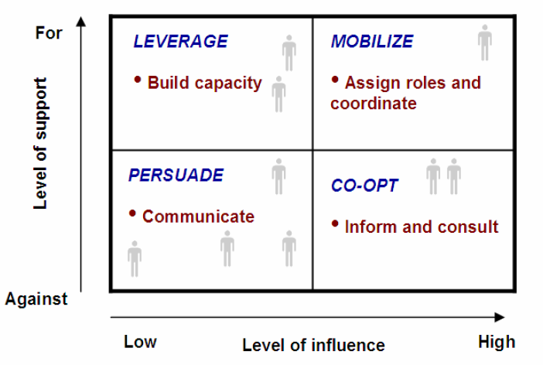
The crucial role of “brokerage” :
Different types of actors may need to be handled differently and “coalitions” nurtured

Slide 14
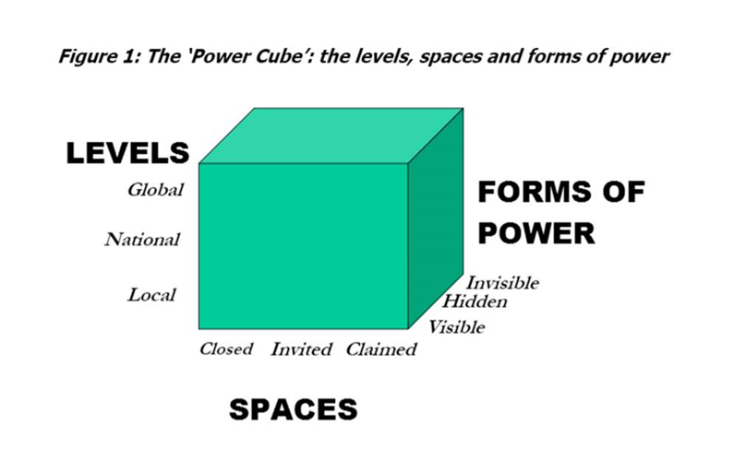

Slide 15
WHAT IS
POLITICAL ECONOMY ANALYSIS?

Slide 16
First step: explain what PEA does NOT stand for…
It is NOT the same as a “governance analysis”
It is NOT the same as a “political analysis”
It is NOT the same as a “policy analysis”
PEA specific added value: focus on power-politics-economy (“follow the money”)
This ‘missing link’ pushed several donors to embrace PEA (Dfid, SIDA, Netherlands, etc.)

Slide 17
LOOKING BEHIND THE FAÇADE …

Slide 18
Make the iceberg visible

Slide 19
The visible word: national strategies, action plans, formal institutional structures, etc.
Political processes: contestation and negotiation of power, wealth and goods
Why do reforms fail to take root?
Need for a systemic approach with a specific focus on:
Economic and financial processes, and their link with politics
Formal and informal institutions
Relations, incentives and interests of actors « under the surface »

Slide 20
PEA is NOT a normative approach !!!
In a normative approach we focus on “what is missing” and “what should be done” (to arrive at the desirable state of affairs….
In a PEA approach we focus “what is there”, “why the situation is what it is” and “what could be done considering this context”

Slide 21
POTENTIAL BENEFITS ?

Slide 22
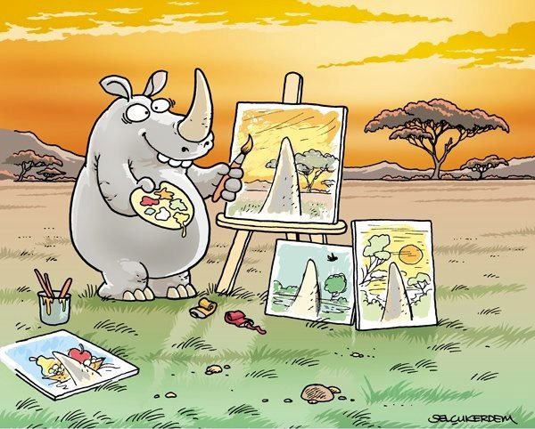
Extending our perspective on reality…
Notes:
Daprès les engagements internationaux, les agences externes ont un rôle minimal et ne doivent pas interférer. A Accra, principe de “country ownership”, a Busan “democratic ownership”. Mais les PTF ne sont pas juste des acteurs qui donnent un appui financier et technique; ils ne sont pas neutres. Ils ont le potentiel d’être des agents de changement.

Slide 23
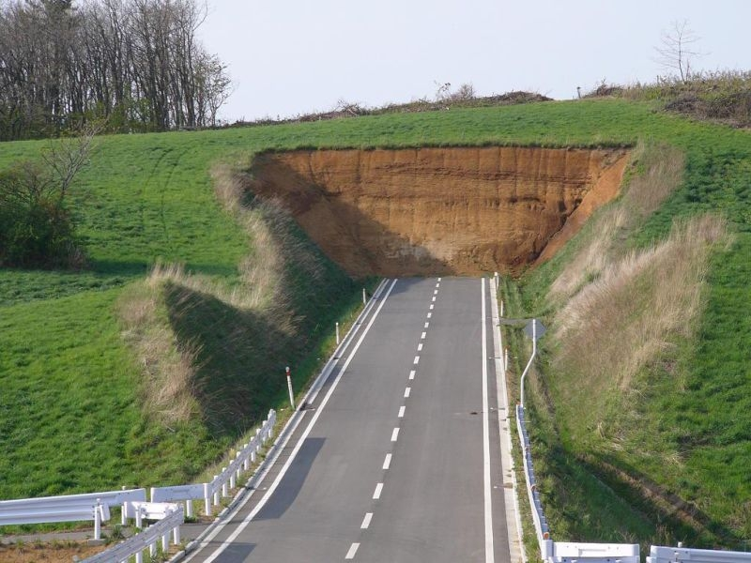
Understanding WHY so many reform attempts stopped halfway or never got anywhere…

Slide 24
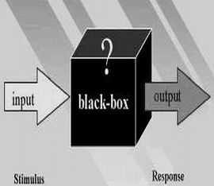
The black box of change processes: how solid are our ASSUMPTIONS and ‘theory of change’?

Slide 25
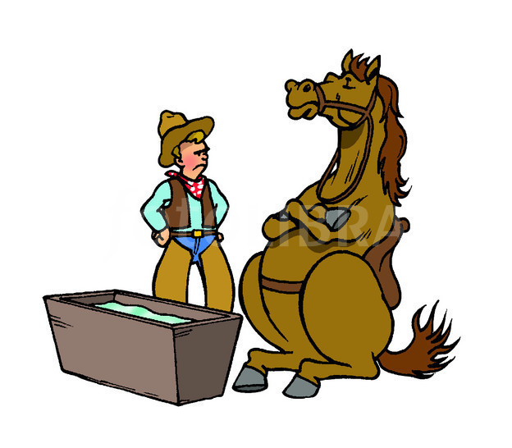
“Nudging unwilling actors into action…”

Slide 26
What incentives could accelerate change?

Slide 27
A better understanding of the (limited) scope and potential triggers for positive changes

Slide 28
Assessing the risks

Slide 29
Some methodological challenges
Getting EVIDENCE for the PEA (using existing material + informal sources
“HEAVY” or “LIGHT” PEA?
PEA of DONOR INTERESTS AND AGENCY
CONNECTING ANALYSIS TO “ACTION”
* Feasible operations given EXISTING space
* Seeking to EXPAND space for progressive change

Slide 30
How to manage a PEA? Some practical ‘process tips’
Clearly define rationale and added value PEA (“why do you need it?”)
Carefully consider mix of skills required, including question to “keep it internal” or “to use consultants”
Communicate, dialogue and share with local actors IF POSSIBLE

Slide 31
Strengths and limitations
Integrating PEA in all aspects of cooperation
(= different way of thinking and doing)
Much depends on quality PEA study and process
(= can the analysis be turned into action?)
Avoid too rigid focus on “the economics of politics”
(= also look at the “inner politics of development”)
Managing the “politics” of PEAs (= how to overcome resistances to PEA?)
PEA provides “navigation tool”… not a panacea for quick decision-making/planning

Slide 32
To “think and act politically” can be a risky job

