Slide 1

DEVELOPMENT RESULTS
The Case of the
Spanish Cooperation

Slide 2
Topics
JP of course YES; however…….
The Spanish Cooperation Development Results model
The CPF/MAP of the Spanish Aid
Country Programs of AECID
Study for development results of the Spanish Cooperation
Conclusions

Slide 3
JP OF COURSE yes; however…….
Bilateral programming offers:
  International Relations mechanisms
  Sound process with a dregree of quality ensured:
    Im going to explain why……

Slide 4
The Spanish Cooperation model
Level | Characteristics | Time Span | Main Responsible | Attribution | Instrument
Level 1 Development Results | Improvements in quality of life of people | Long/Medium term | Partner Country | Parcial (Relevant Contribution) | MAP/CPF SC
Level 2 Intermediate Results | Changes in behaviour or in key institutional stakeholders | Medium term | Partner country – Spanish Cooperation | Medium (Relevant attribution) | MAP/CPF Country Program
Level 3 Direct Results | Activities, services goods provided | Short/Medium term | Spanish Cooperation | High (complete attribution) | Country Program

Slide 5
Planning and formulation
Implementation and following up
Evaluation

Slide 6
So….what are the CPF/MAP
Shared partnership strategy at country level that aims towards common goals and visions of human development and poverty eradication.
Main bilateral instrument of the Spanish Cooperation to ensure effectiveness development cooperation and strategic implementation of policy guidelines.

Slide 7
Main Characteristics
Agrees on a Common Development Results framework with the partner country based on National Development Plan.
Aligned to the partner’s political cycle.
It is inclusive and incorporates as many stakeholders as possible with potential impact on development.
Close dialogue and joint work with partner countries (government, institutions, parliaments and civil society) as well as with the donor community.
Coordination among the different actors (Spanish Cooperation)
  Other Ministries
  Regions
  Civil society
  Private sector
Estimation of budget

Slide 8
Main Characteristics
100% of partner countries CPF signed
http://www.exteriores.gob.es/Portal/es/SalaDePrensa/Multimedia/Publicaciones/Paginas/Cooperacion/Planificacion.aspx
http://www.cooperacionespanola.es/en/geographic-priorities
It is field driven and capital coordinated (MoFAC, AECID)
  In order to provide homogeneity
  While respecting our partner development goals.
  Establishes a triangular cooperation
Follows a methodology that ensures common aid effectiveness standards and vision of the Spanish Cooperation.
http://www.cooperacionespanola.es/sites/default/files/map-metodologia_2013_sgcid.pdf
  Follows an equivalent work schema for all processes
Coordination in the field is during implementation and follow-up in close relation with our counterparts
  Working committee throughout the whole process (GEC – Stable Coordination Group)

Slide 9
Effectiveness in the CPF/MAP
The main effectiveness for development values that Spanish Cooperation is trying to promote through the CPF are:
  Strategic association
  Predictability
  Alignment
  Ownership
  Harmonization
  Results-based approach
  Mutual accountability (via follow-up and evaluation).
These agreements are based on partner’s needs, requirements, and development results as defined in national and/or sector plans and linked with one or more of Spain’s strategic guidelines
Revised mid-term and evaluated jointly upon completion.

Slide 10
Spain DAC OECD Peer Review
Spain clearly applies the principles of aid effectiveness.
The Country Partnership Frameworks (CPFs) are:
  developed in-country
  in close consultation with partners
  aligned with the planning cycles of Spain’s partner countries and territories.
  CPFs include a four-year indicative budget which, together with flexibility in budgeting and programming in countries and in headquarters, helps Spain to be more predictable and responsive to the needs of its partners.
Each CPF includes the development results to which Spain aims to contribute. It also includes operational and results indicators, targets and baselines that draw on country results frameworks and national statistics.
This capacity to adapt to the specific needs of a country also helps Spain develop and implement programmes in fragile contexts in a pragmatic manner – without requiring specific approaches or tools.
Synthesis report of mid-term reviews/evaluations published in 2015: http://www.cooperacionespañola.es/sites/default/files/sintesis_evaluaciones_map.pdf

Slide 11
Spanish Cooperation CPF
The intention of making Country Partnership Frameworks whole-of-country strategies, supported by in-country co-ordination mechanisms, is positive.
The Ambassador of Spain in each country leads co-ordination efforts by, for example, chairing the permanent co-ordination groups that oversee Spanish development co-operation actors in partner countries and territories.

Slide 12
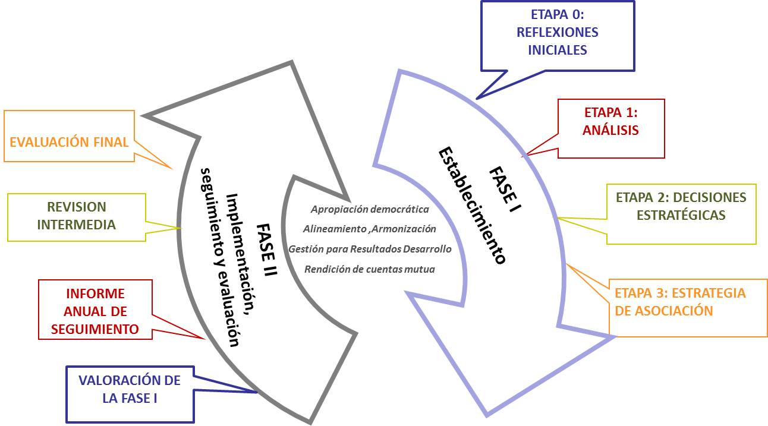

Slide 13
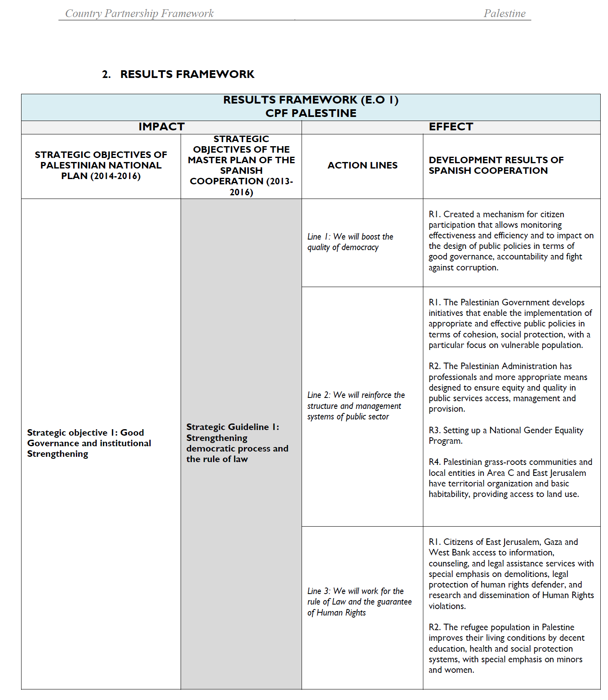

Slide 14
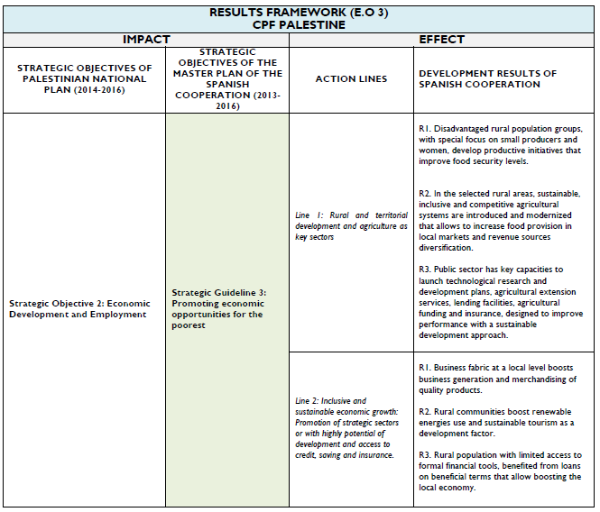

Slide 15
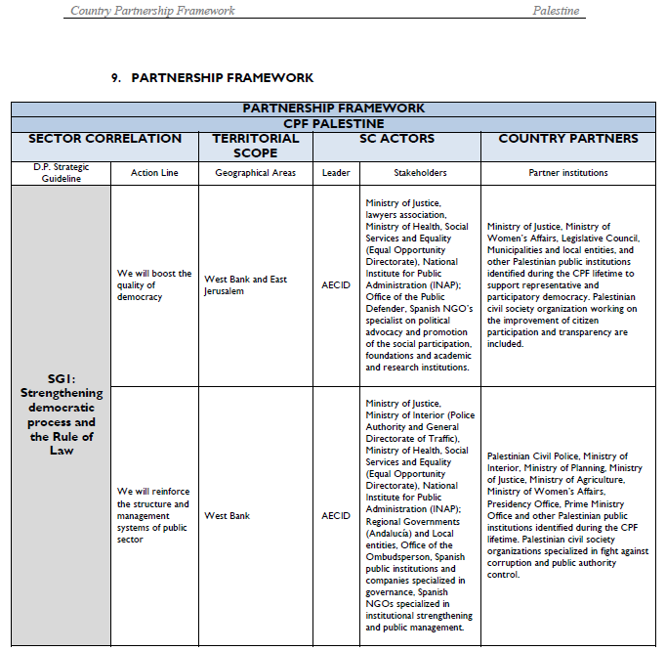

Slide 16
MAP |  | CALENDARIO
 | FECHA FIRMA | Periodo MAP (sombreado ), Comienzo PC ( > ), Evaluación MAP (X)
 |  | 2010 | 2011 | 2012 | 2013 | 2014 | 2015 | 2016 | 2017 | 2018 | 2019 | 2020 | PC | COMENTARIOS
CENTROAMÉRICA Y CARIBE
Cuba | 14/06/2014 |  |  |  |  |  |  | X |  |  |  |  | NO
El Salvador | 30/11/2015 |  |  |  |  | X |  | > |  | X |  |  | SI
Guatemala | 05/06/2013 |  |  |  | > |  |  | X | > |  |  |  | SI | Estrategia PC finalizada.
Haití | 16/06/2015 |  |  |  |  |  |  |  | X > |  |  |  | SI
Honduras | 30/09/2014 |  |  |  |  |  |  |  | X | > |  |  | SI
Nicaragua | 12/03/2015 |  |  |  |  |  |  |  | X | > |  |  | SI
República Dominicana | 03/02/2014 |  |  |  |  |  |  | X |  |  |  |  | NO
AMÉRICA DEL SUR
Bolivia (MAP extendido) | 08/11/2010 |  |  |  |  |  |  | X | > |  |  |  | SI | Borrador de Estrategia de PC
Colombia | 24/11/2015 |  |  |  |  | X |  |  |  | X |  |  | NO
Ecuador | 12/11/2014 |  |  |  | X |  |  |  | X |  |  |  | NO
Paraguay (MAP extendido) | 28/10/2011 |  |  |  |  | > |  |  | X? |  |  |  | SI | Borrador de Estrategia de PC
Perú | 26/04/2013 |  |  |  |  |  | X |  |  |  |  |  | NO

Slide 17
MAP |  | CALENDARIO
 | FECHA FIRMA | Periodo MAP (sombreado ), Comienzo PC ( > ), Evaluación MAP (X)
 |  | 2010 | 2011 | 2012 | 2013 | 2014 | 2015 | 2016 | 2017 | 2018 | 2019 | 2020 | PC | COMENTARIOS
NORTE DE ÁFRICA
Marruecos | 16/06/2014 |  |  |  |  |  |  | X > |  |  |  |  | SI | Borrador de Estrategia de PC
Población Saharaui |  |  |  |  |  |  |  |  |  |  |  |  | NO
ÁFRICA SUBSAHARIANA
Etiopía | 23/07/2011 |  |  |  |  |  | X | > |  |  |  |  | SI | Estrategia PC finalizada. 2ª vuelta 2016
Guinea Ecuatorial |  |  |  |  |  |  |  |  |  |  |  |  | NO
Mali | 11/12/2015 |  |  |  |  | > |  |  |  | X |  |  | SI | Estrategia PC finalizada.
Mauritania | 05/06/2014 |  |  |  |  |  |  | X > |  |  |  |  | SI
Mozambique | 21/11/2014 |  |  |  |  |  |  | X > |  |  |  |  | SI
Níger | 17/09/2014 |  |  |  |  | > |  | X |  |  |  |  | SI | Borrador de Estrategia de PC
Senegal | 02/12/2013 |  |  |  |  | > |  | X |  |  | > |  | SI | Estrategia PC finalizada.
ORIENTE PRÓXIMO Y ASIA
Palestina | 12/01/2015 |  |  |  |  |  |  |  | X> |  |  |  | SI | Borrador de Estrategia de PC
Filipinas | 23/03/2014 |  |  |  |  |  |  | X | > |  |  |  | SI

Slide 18
Lessons Learnt
21 CPF that define Development Results for the 21 (23) partner countries.
  In total 312 Development Results agreed.
DAC Peer Review and other evaluation documents praise the approach but state the need for further progress to measure results.
We face difficulties for the follow up, these being the main reasons:
  Each Result Framework formulated in an ad-hoc way
  No feasibility for measuring progress consistently
  Diversity of stakeholders /actors participating with different levels of involvement
  The need for standardised Frameworks and Results
  It is a complex process that needs political committment
Development Results in the 3 levels are been revised.
  The chain is being re/structured to make follow up feasible.
  Field Offices demand training and support in this revision.
Identified the challenges for our next planning cycle

Slide 19
  Peer Review OECD 2015
Spain is developing a promising approach in planning for results.
AECID is starting to build a results culture across the agency by creating a network on the effectiveness and quality of aid. It is in the process of integrating its monitoring systems, focusing on development results (corporate, country & intervention levels).
At the moment, the absence of such an integrated results monitoring mechanism affects strategic oversight and transparency: results indicators are not monitored and therefore not used for decision making. Accelerating the move towards managing for results will require a mature results culture, the right tools and monitoring.
There is scope for further progress in both transparency and communication by providing more up-to-date data, detailed information at project level and, once the relevant monitoring mechanisms are in place, by communicating results and risks.

Slide 20
So……what are we doing to progress?
Developed further the model in a twofold manner:
  The AECID country program:
    Operative results (level 2 and 3)
    Based on MAP/CPF
  A complete study for standardised Frameworks and Results for the Spanish Cooperation

Slide 21
Country Partnership Framework (4 years)
Programs
M
COUNTRY PROGRAMM (4 years)
Framework Results established in a consecutive step as soon as the CPF is signed.
Content:
Results Framework
Baseline and indicators
Risk managment
Budget (*)
2014
2015
2016
2017
M
RESULTS FROAMEWORK COUNTRY/PROGRAM

Slide 22
6 pilots in Technical Offices:
Colombia, Ecuador, Guatemala, Honduras, Senegal, Mozambique,
Follow up: Guatemala, Honduras, Senegal
In process: Bolivia (together with JP), El Salvador, Haití
¿Where we are with the whole process for Country Programs?

Slide 23
The study for standard results and indicators
Develops the 3 levels with the definition of a common results and indicators framework
  Based on the 2030 Agenda SDG/CPF/CP/vision
  Results for each level
  Indicators for each (detailed form for the main ones)
9 month consulting exercise
Triangular work
  MoFAC/AECID field and headquarters
  Experts networks consulted
Different objectives:
  Planning tool
  Homogeneity
  Measuring results
  Decision making
  Transparency and communication

Slide 24
The study for standard results and indicators
The study is allowing to provide robustness to our actions which have been so far based on budget and not in development results (let alone in an standard or aggregated manner)
The exercise and the tools are started to be used and valued by Technical offices
Shared with other cooperations for JP
Diffusion of exercise

Slide 25
Study for standard results and indicators
Domain
Institutional building (mainstreamed)
Decent work
Education
Food Security and nutrition
Rural economic Sustainable Development
Gender in Development
Health services
Water and sanitation
Environment and Climate Change
Access to Justice
Public Finance Management

Slide 26
An example
Results Development
(Level 1)
Changes in quality of life
Los jóvenes encuentran empleo en el sector formal
Youngsters find employment in the formal sector
Intermediate Results
(Level 2)
Changes in behaviour in key stakeholders.
RI1. Los servicios públicos de empleo proporcionan una orientación e intermediación laboral eficaz
RI2. El sistema de formación profesional proporciona competencias adecuadas a la demanda laboral existente
RI3. El sistema de formación profesional facilita el acceso de los colectivos desfavorecidos
Direct Results / products
(Level 3)
Achievement after interventions. Goods/services provided (availability and use)
1.1. Nuevo protocolo de intermediación y orientación en funcionamiento
2.1. Nuevas especialidades profesionales incluidas en los currículos formativos
3.1. Ciclos de nivelación académica para jóvenes sin estudios primarios
1.2. Oficinas de orientación e intermediación habilitadas
2.2. Laboratorios y talleres de formación profesional modernizados y equipados
3.2. Programas de formación ocupacional en vigor
Programa de Apoyo Presupuestario Sectorial
1.3. Observatorio sobre tendencias del mercado laboral en funcionamiento
2.3. Prácticas de jóvenes en empresas vigente
3.3. Sistema de becas disponible para jóvenes de bajos ingresos
1.4. Información disponible para jóvenes y empresarios sobre los servicios de orientación e intermediación
2.4. El profesorado de los centros de formación actualiza sus competencias profesionales
3.4. Instalaciones e infraestructuras adaptadas para personas con movilidad reducida
Proyecto de mejora de la orientación e intermediación laboral en la Región X
3.5. Horarios de formación adaptados a condiciones de mujeres jóvenes con responsabilidades familiares
Asistencia técnica Ministerio de Trabajo
Proyecto de ONG en X

Slide 27
Conclusions
Complex process
  Entails long term vision and planning
  Requires Political commitment and will
  Technical know how both in the planning and in the execution
  Requires flexibility and yet consistency
  Communication and training
It brings about numerous benefits
  Alignment with partner needs while working in the areas of comparative advantage
  Consistency
  Predictability
  Follow-up
  Transparency
  Information for accountability, decision making, communication
  Coherence
Constraints/Challenges
  The sectoral/silos approach vs. SDG approach
  Maintain the momentum through changes
  Coordination of all stakeholders
  Be realistic, learn by doing, step by step……

Slide 28
Questions?
eva.delhoyo@maec.es

Slide 29

MUCHAS GRACIAS

