Slide 1
Delegation workshop – Vision 2020 – Monday 23/11/2020

Slide 2
Meet Etienne, Operational Manager in Gondwana

Slide 3


Slide 4


Slide 5
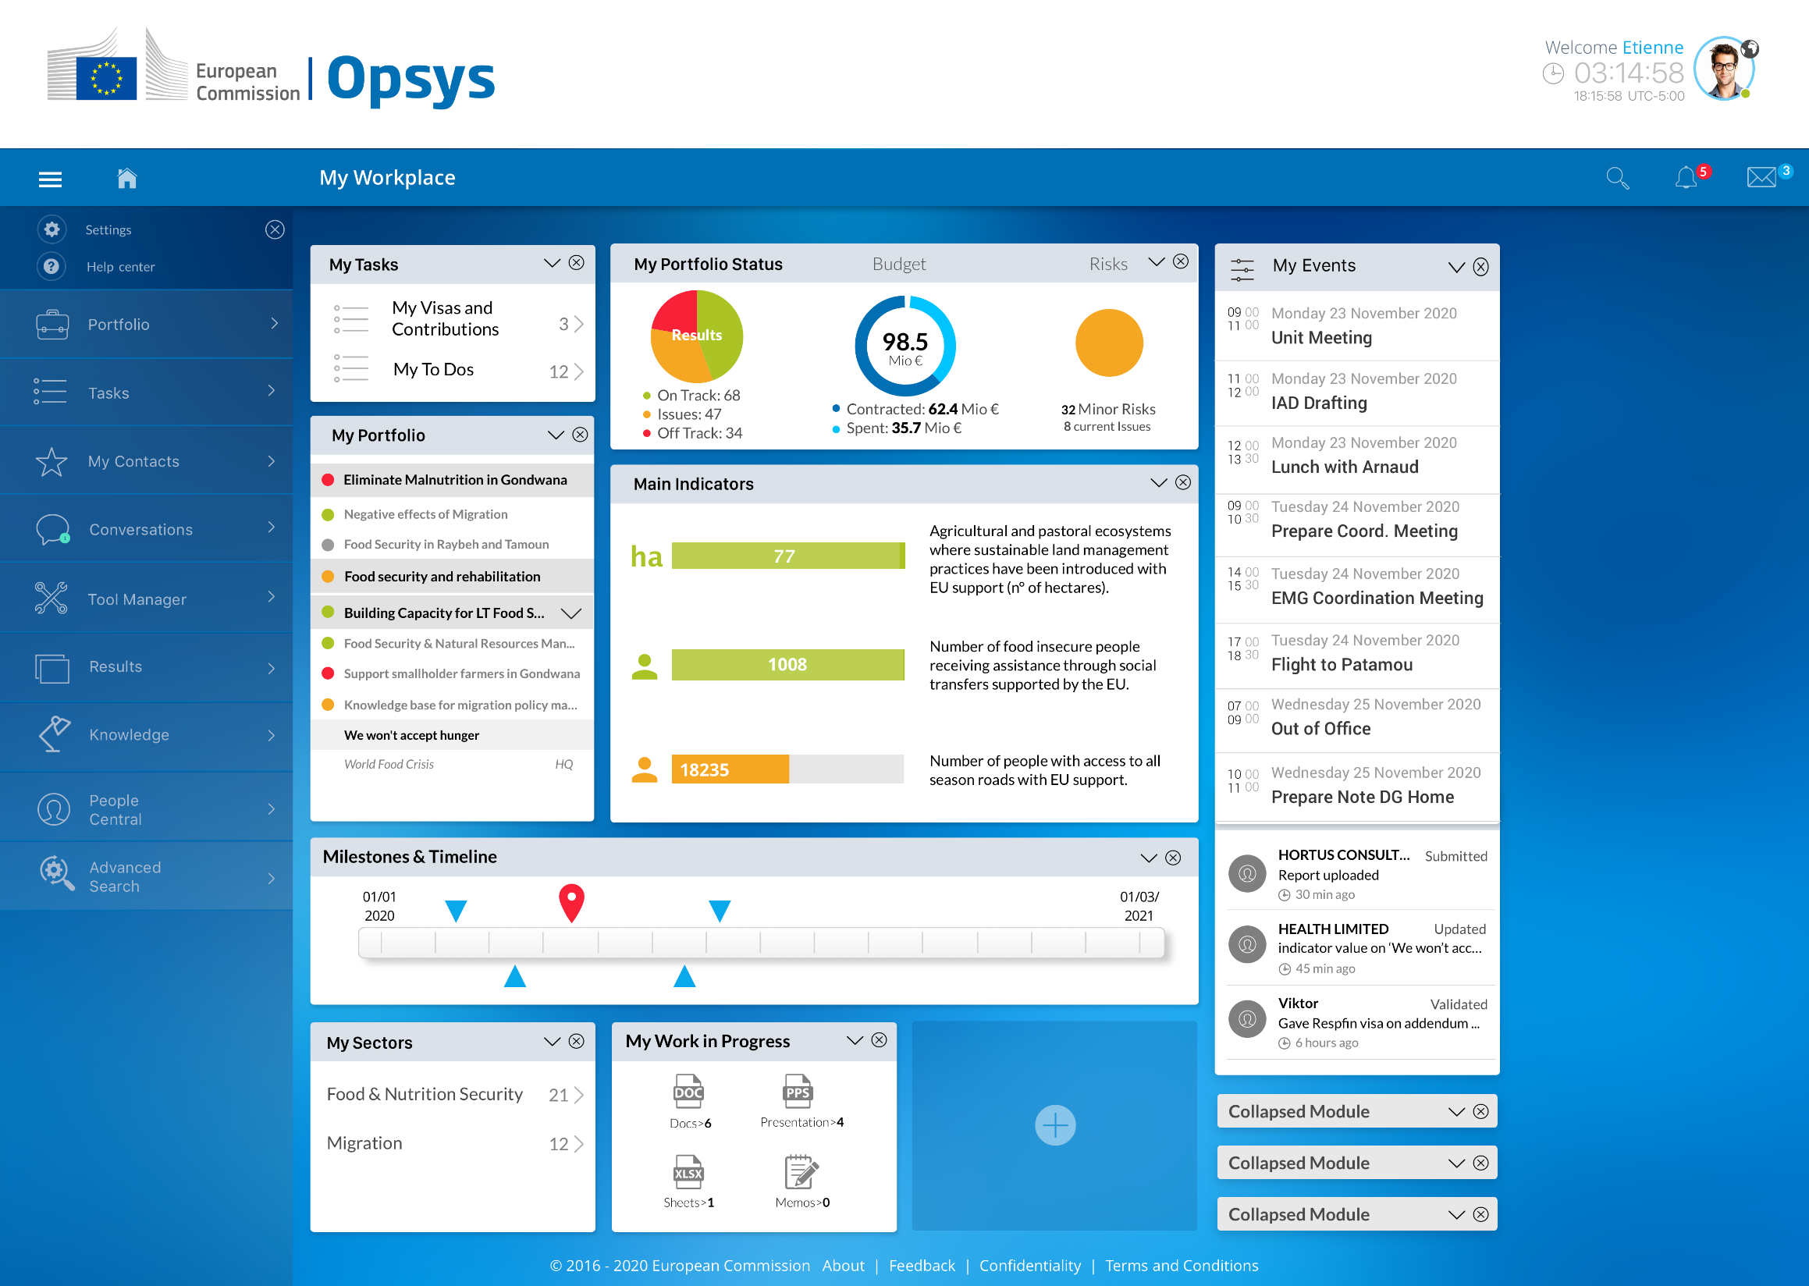

Slide 7


Slide 10
Etienne is alerted on urgent tasks he has to act on

Slide 11
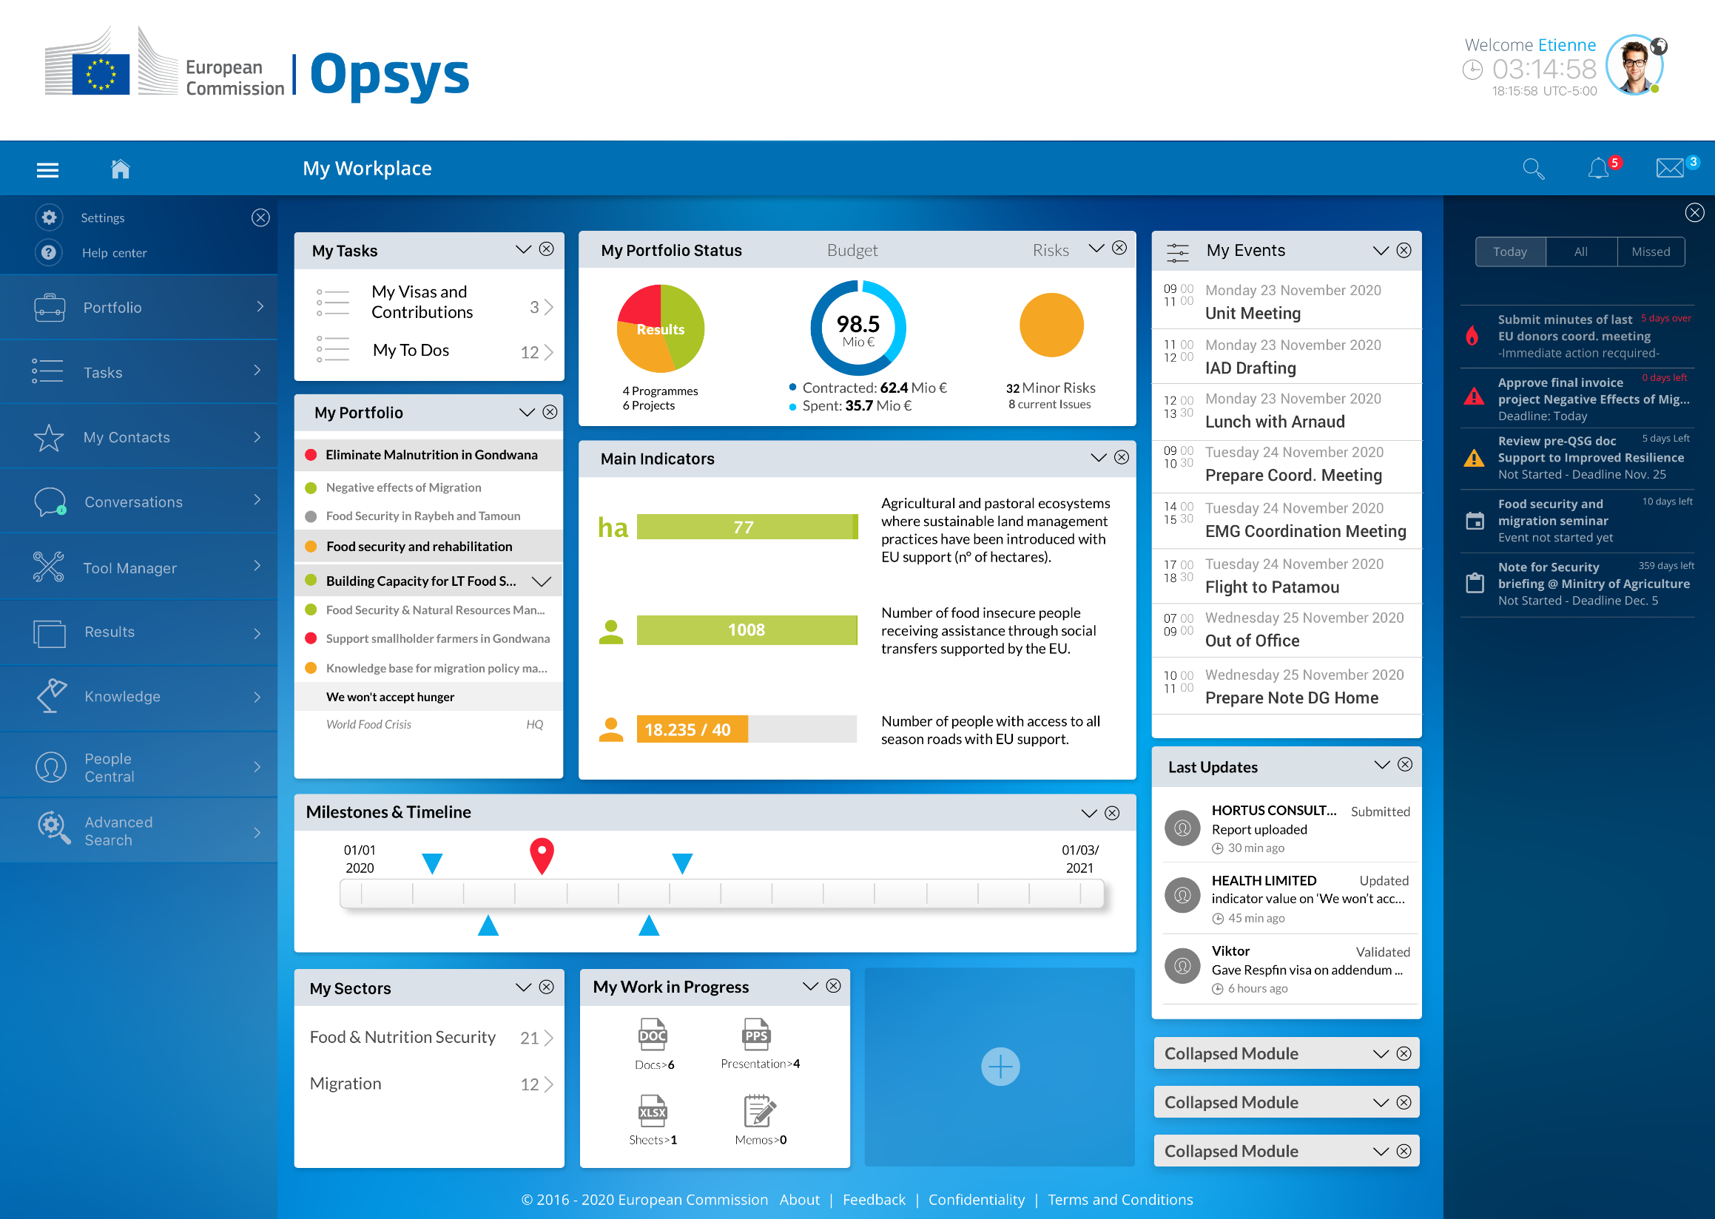

Slide 12


Slide 13
Lunchtime

Slide 14
After acting on the day’s urgency, Etienne continues to prepare his coordination meeting on the Programme ‘Eliminate Malnutrition in Gondwana’ (EMG)

Slide 15
Etienne consults the EMG Programme Page from his Workplace

Slide 17
Etienne checks the Programme’s Health Status

Slide 18
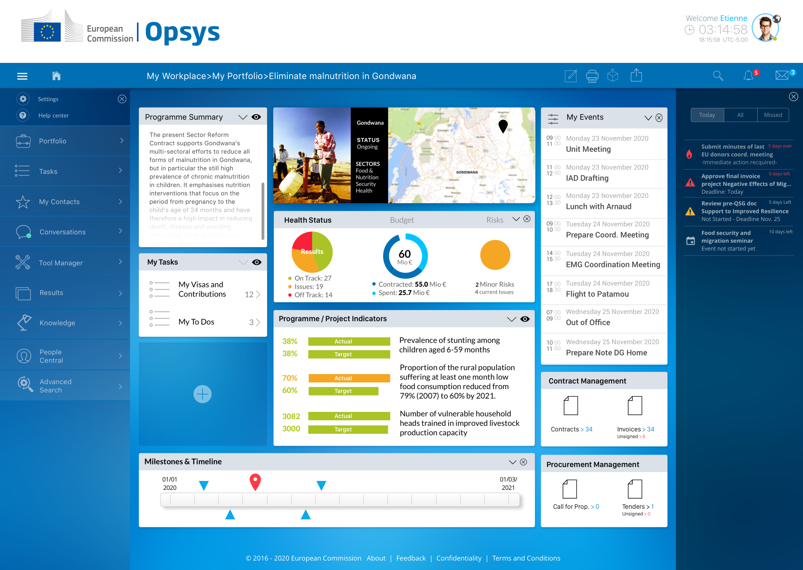

Slide 20
In order to better understand why one of the key indicators is orange, Etienne drills down into the key indicators and prints the logframe as part of his coordination meeting preparation

Slide 21
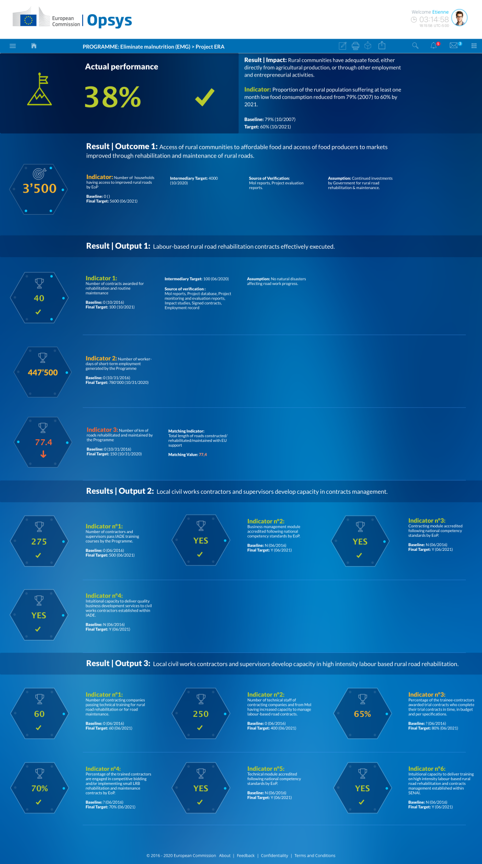

Slide 23
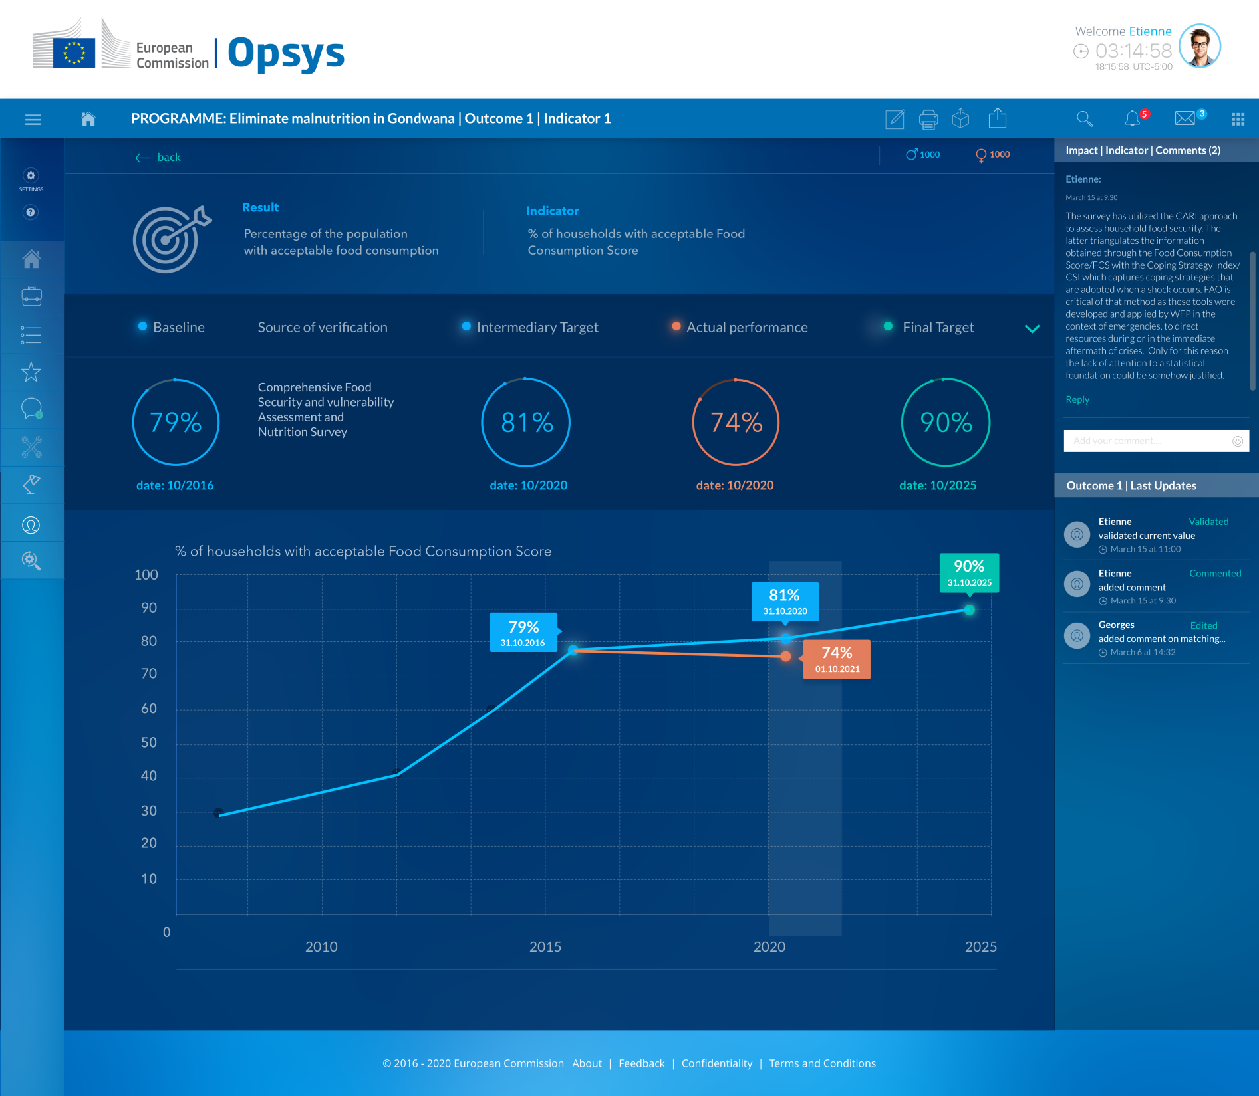

Slide 26
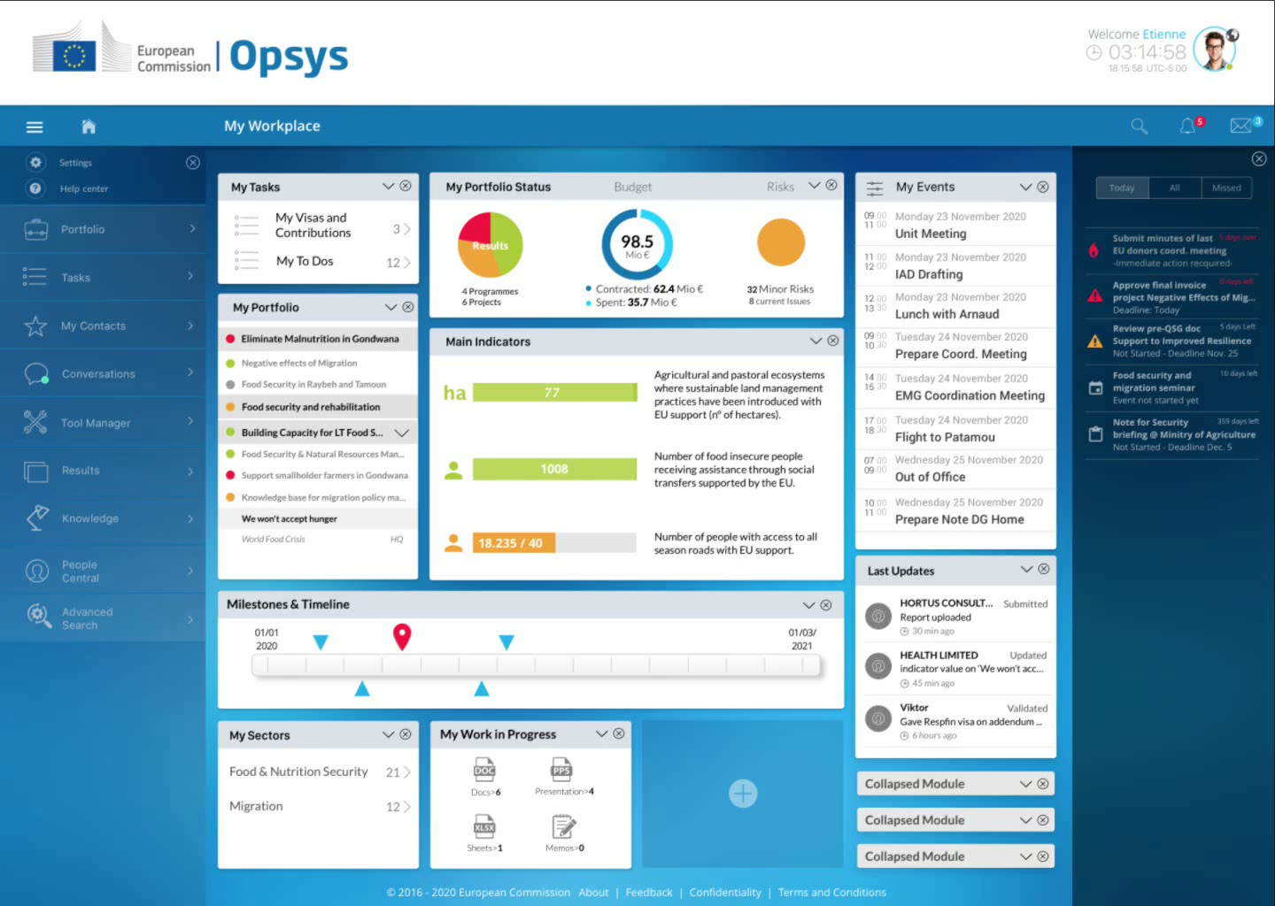

Slide 27
Etienne is interrupted by a disturbing call from a technical assistant at the Ministry of Agriculture
Specially disturbing as the budget support variable tranche is soon to be submitted

Slide 28


Slide 29


Slide 30
Anyhow, before he leaves, he has to approve an outstanding invoice

Slide 31
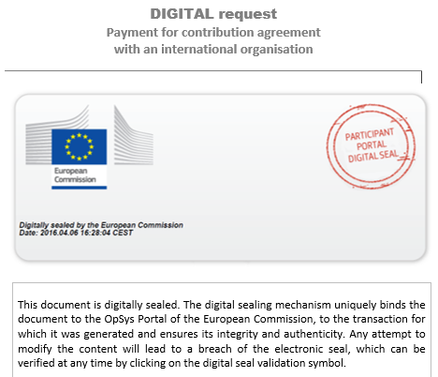

Slide 32
