Slide 1
Delegation workshop – Vision 2020 – Tuesday 24/11/2020

Slide 2
Etienne logs in and continues the preparation of his coordination meeting

Slide 3
He starts preparing his briefing. Opsys automatically extracts for Etienne country- and sector-level information and populates the briefing template

Slide 4
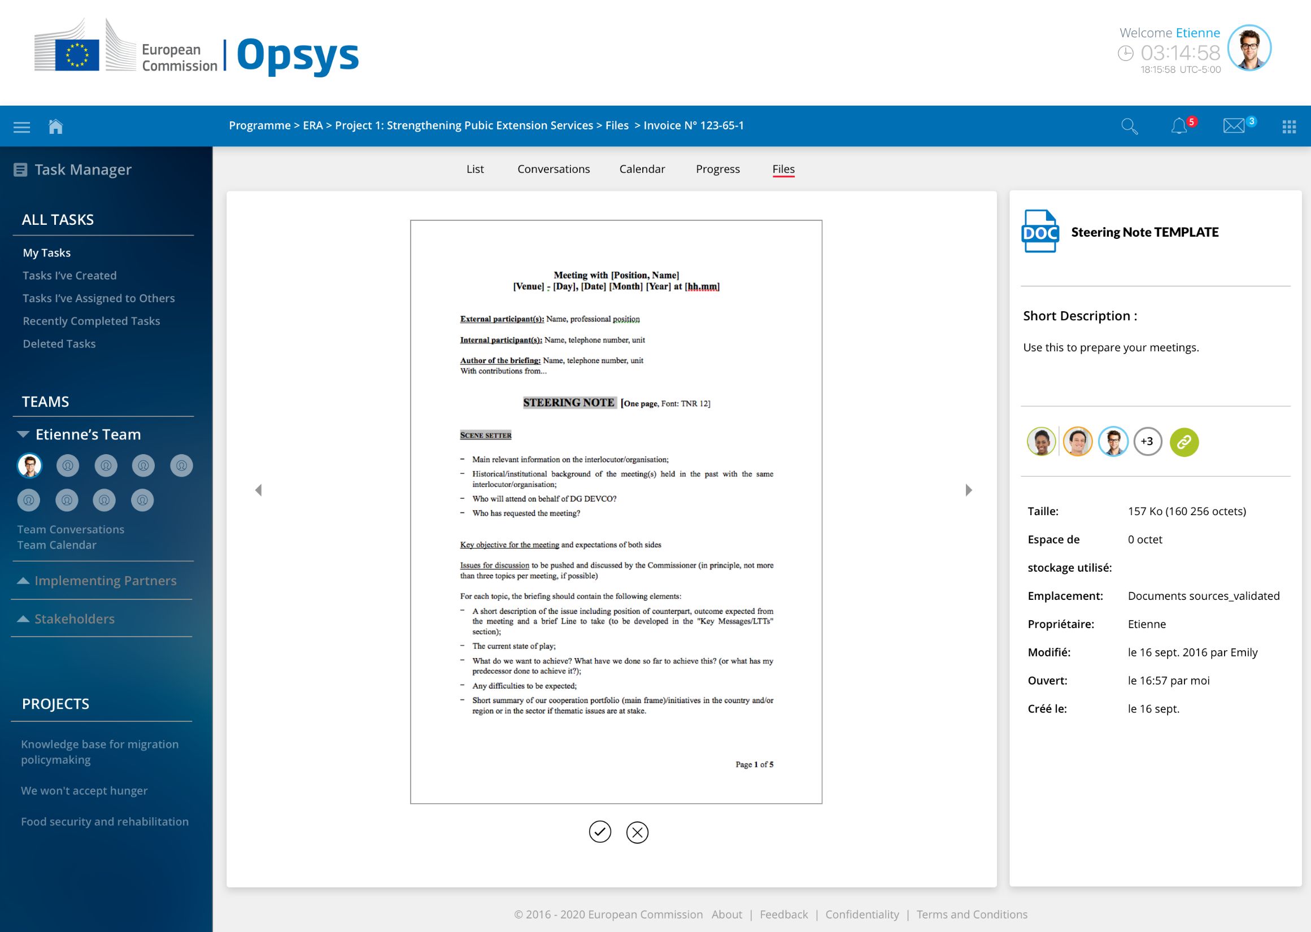

Slide 5
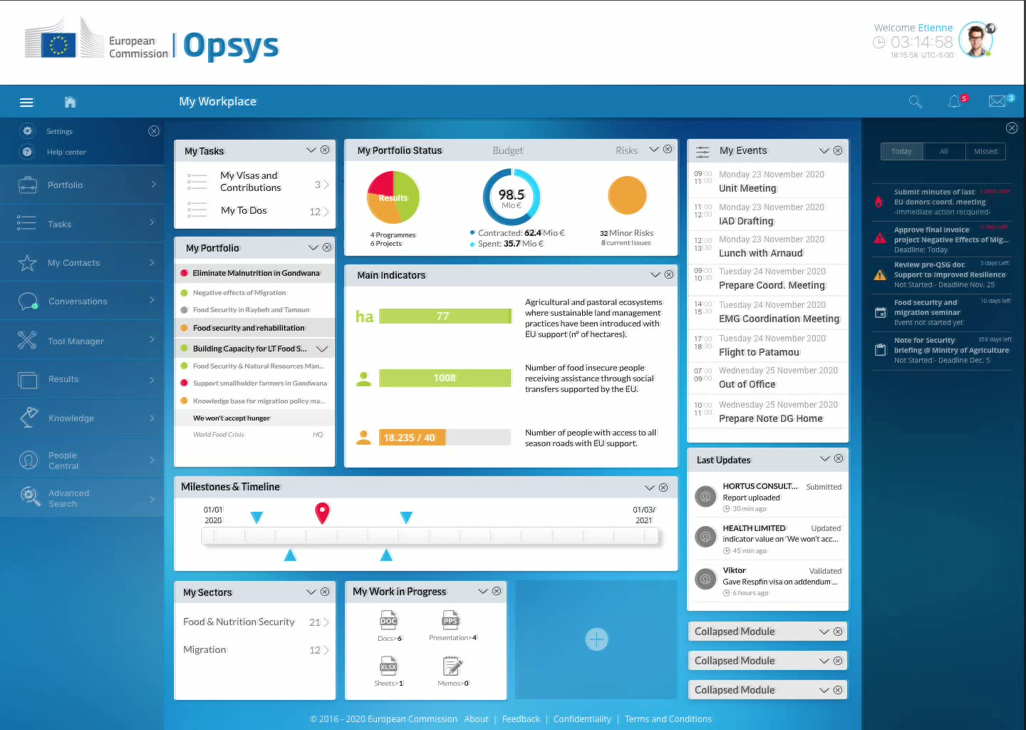

Slide 6
Etienne is interrupted by an unexpected … yet not unusual event

Slide 7
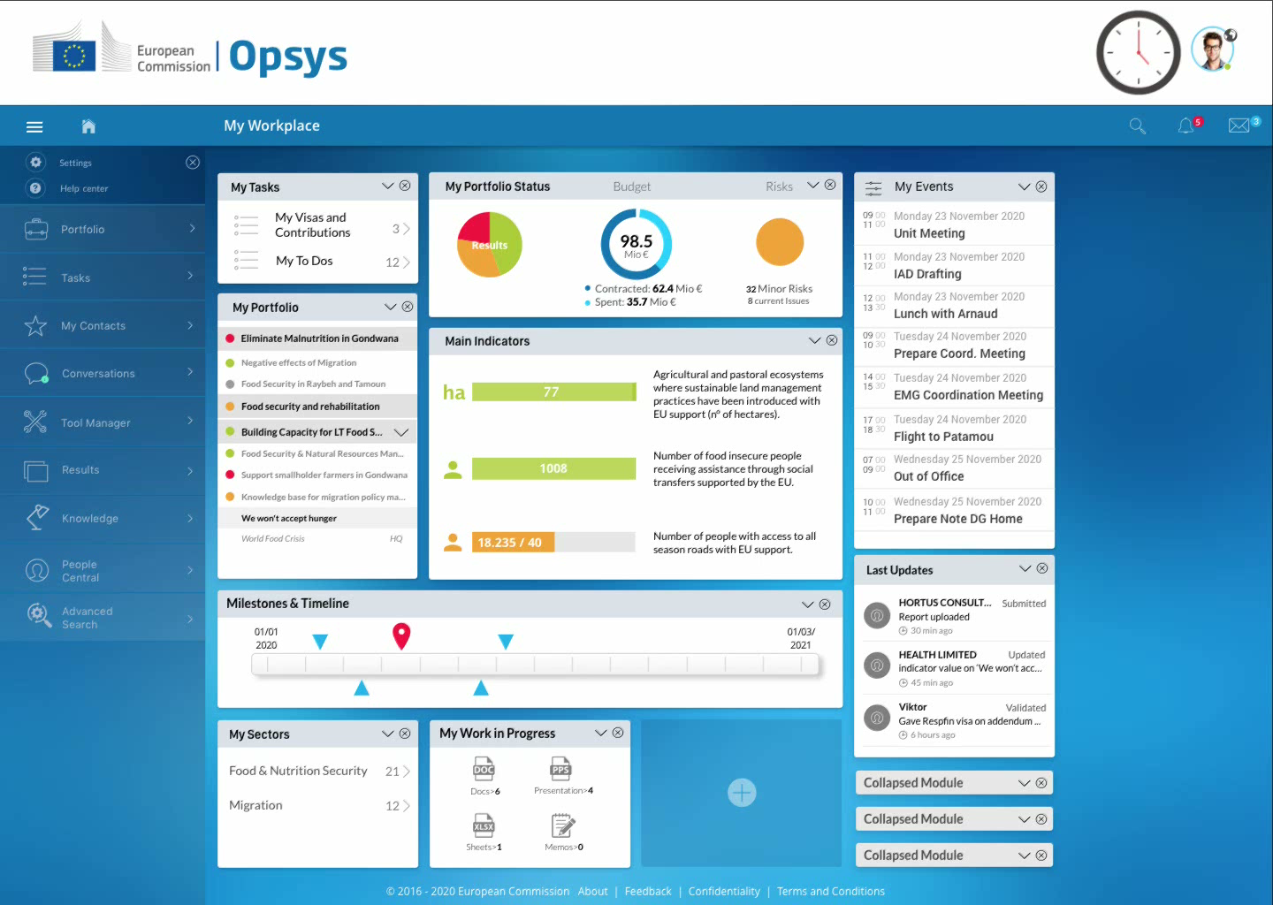

Slide 8
Etienne inserts a reminder in his to-dos and checks his calendar

Slide 9
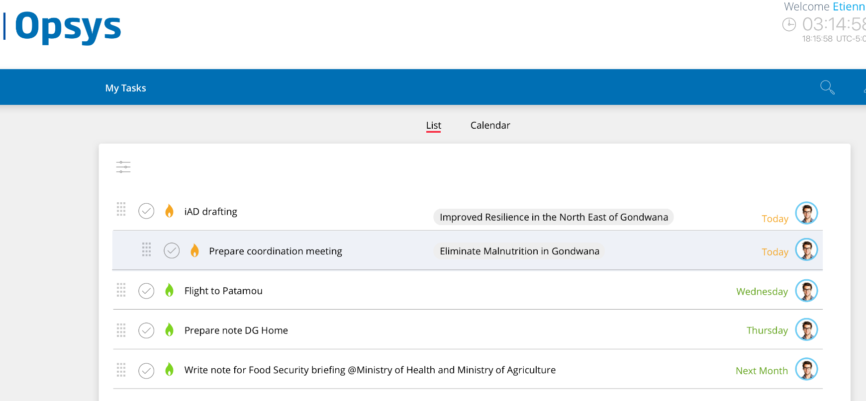

Slide 10
Etienne leaves for his meeting at the Ministry

Slide 11


Slide 12
The meeting is delayed by 1,5 hours
Etienne accesses Opsys from his iPad in his car

Slide 13
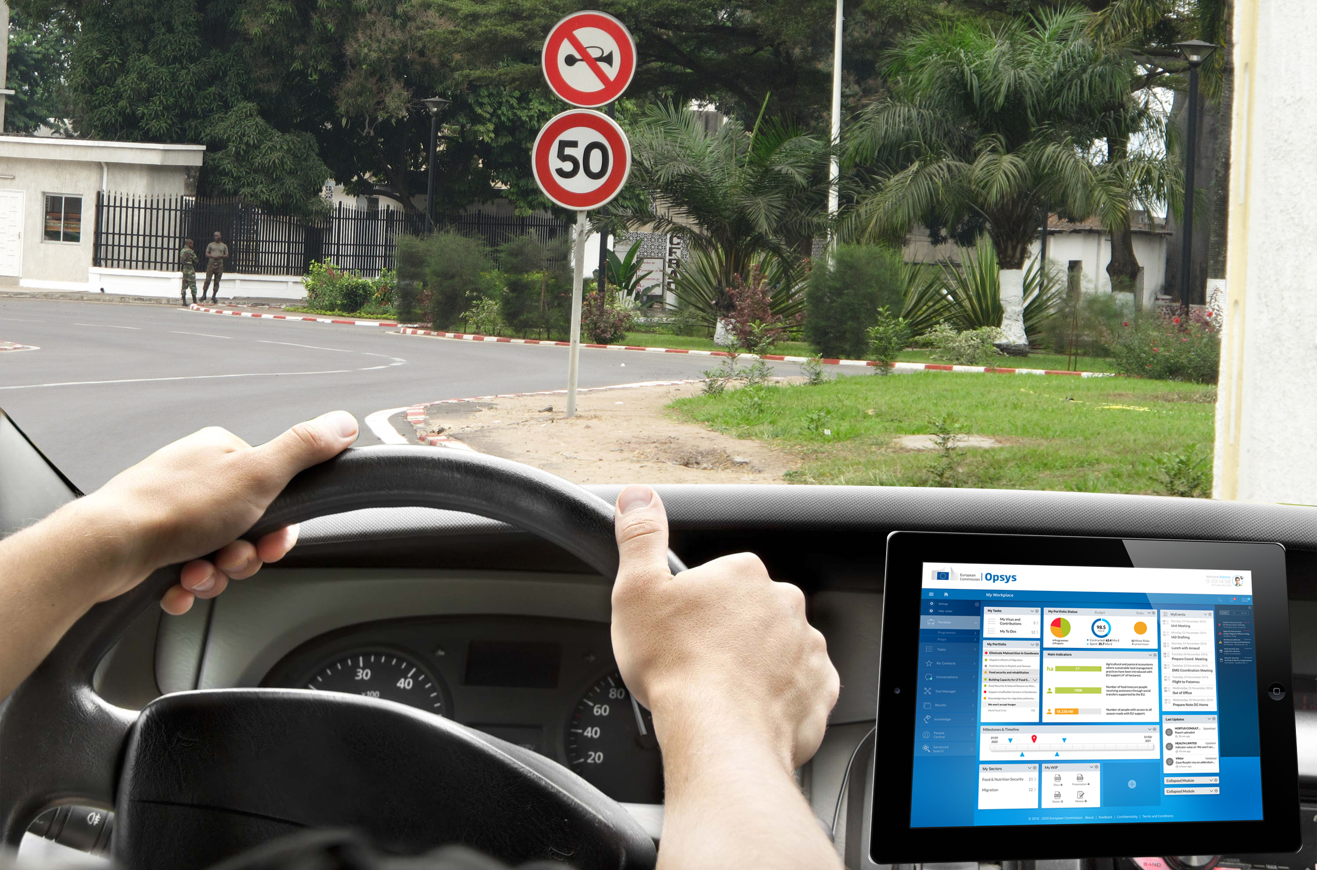

Slide 14
Etienne starts looking for experts to solve the food security alert issue and asks Anton, HQ Thematic Expert for his advice on the short-listed food safety experts

Slide 15
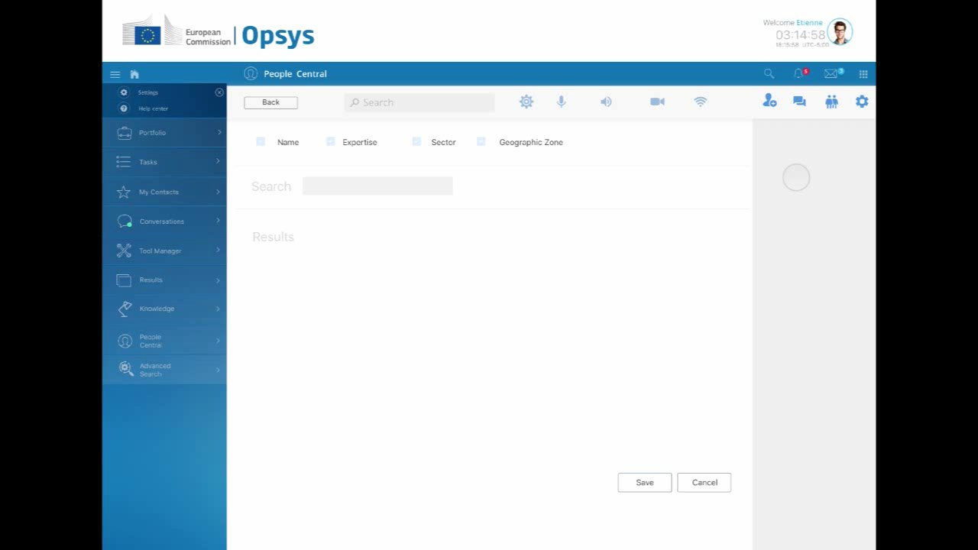

Slide 16
Etienne joins his meeting and starts taking notes

Slide 17
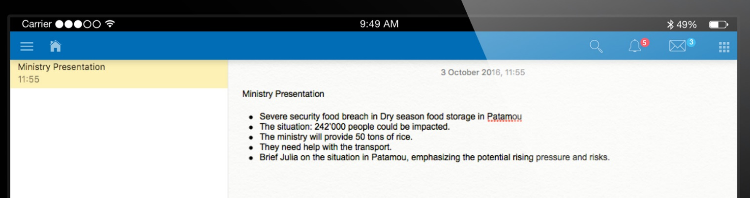

Slide 18
Due to the criticality of the food shortage situation and the suspicion of a crop-eating pest surge, Etienne sends his meeting notes to Julia, Anton and stakeholders

Slide 19


Slide 20
Etienne boards his flight for the Patamou region

Slide 21


