Slide 1
Delegation workshop – Vision 2020 – Wednesday 25/11/2020

Slide 2
Arriving on site for his visit, Etienne logs into Opsys from his smart phone and checks his conversations

Slide 3
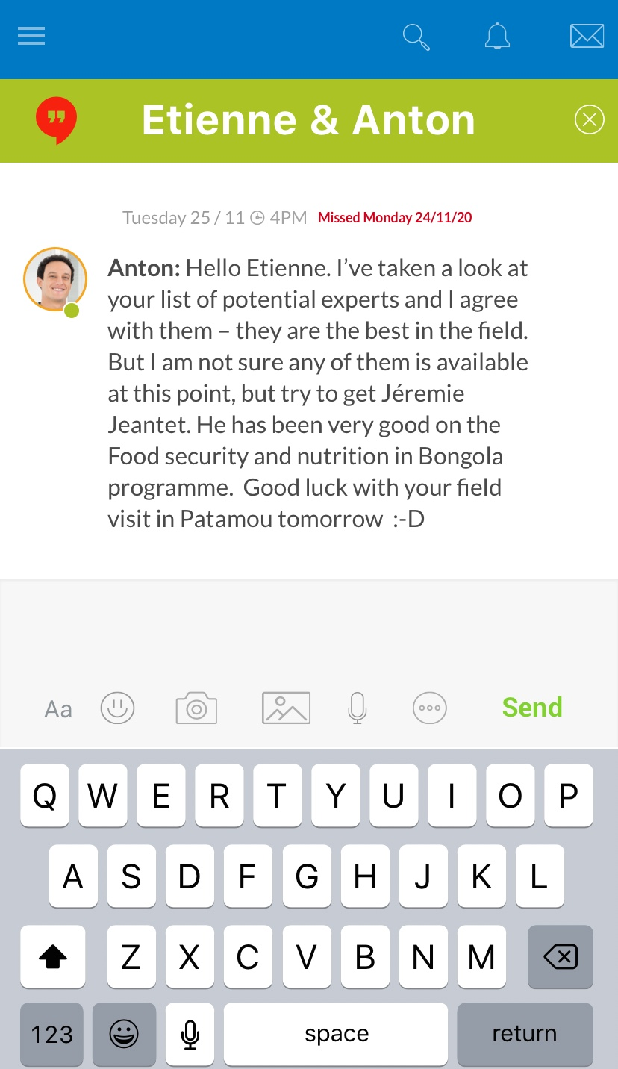

Slide 4
Etienne starts drafting terms of reference based on a template available in the task manager

Slide 5
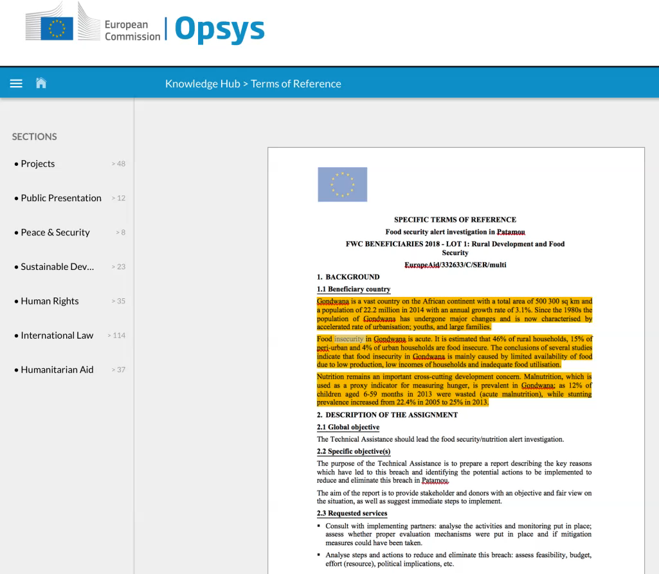

Slide 6
Etienne resumes the purpose of his visit
He observes progress towards expected results and takes pictures and uploads them to the Project into Opsys

Slide 7
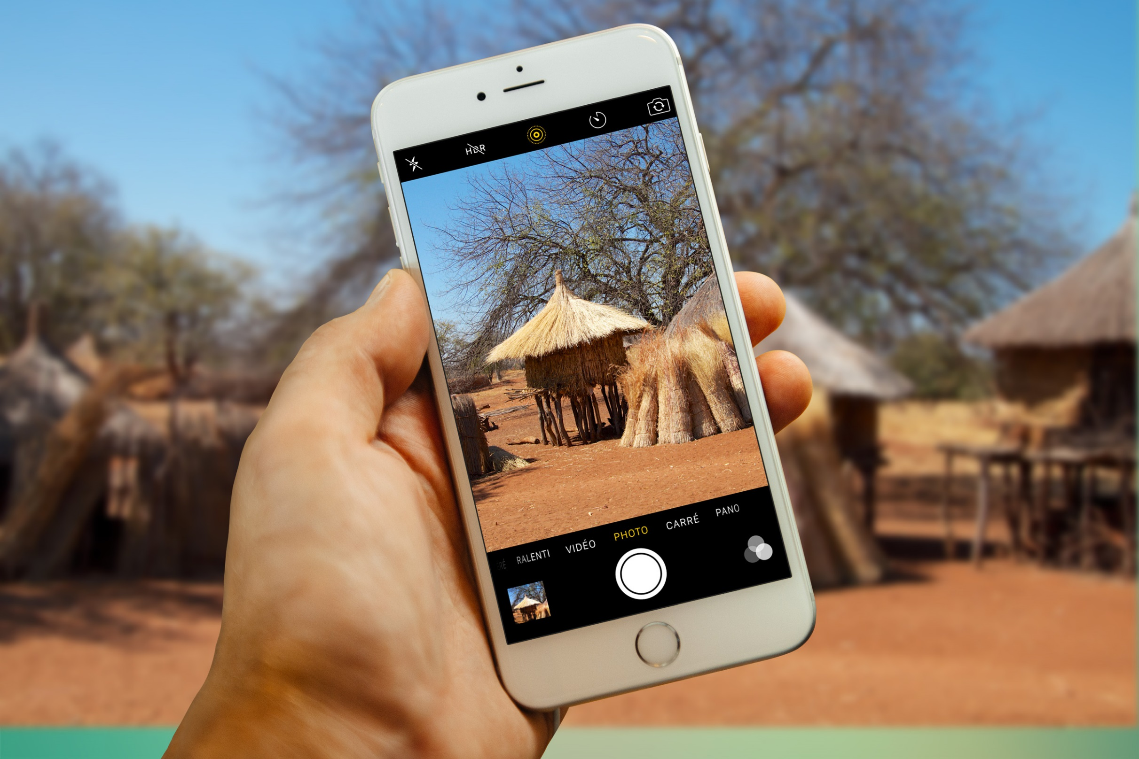

Slide 8
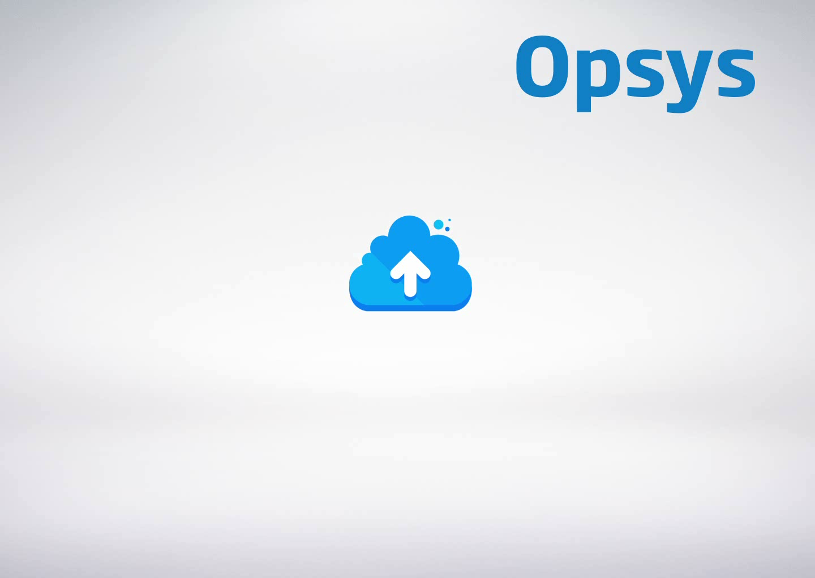

Slide 9
Etienne has now finished his day and logs off before going back home

Slide 10


Slide 11
To summarize, Opsys helped Etienne to

Slide 12

Focus on Results
Manage a large portfolio
Put his energy and enthusiasm to secure and increase quality
Leverage the full benefits of collaboration – with local stakeholders, implementing partners, external experts, peers and hierarchy
Work anywhere and anytime if the urgency of the situation or his personal preferences call for it
Feel confident in tackling issues he is not an expert in

Slide 13
Opsys also played its role to increase Aid impact on citizens in a context of growing complexity
Increased Productivity
Improved Transparency
Meet an increased demand for aid (poverty in conflict zones, migrants, etc.)…
…while operating with reduced staff numbers
Addressed communication gaps
Improve Aid Transparency rating (current ranking: #15) with missing data, reporting frequency
Increased Effectiveness
Strategic focus on results and performance
Improved decision making & monitoring
Maximization of implementing partners’ contributions
Knowledge Sharing
Improved Collaboration
Better projects and programmes
Faster problem-solving
Increased internal collaboration
Best implementing partners and experts
Increased external collaboration with the ecosystem:
- EU dimension: EC DGs, EU Member States,
- Partner gov. other donors and implementing partners

Slide 14


