Slide 1
Pacific Regional Training on EU Budget support and blending modalities 24-28 October 2016
Module 2
BS Operations in the Pacific
Notes:
This presentation covers chapters 2 and section 5.1. of the BS Guidelines

Slide 2
Financial implementation: a better spread of disbursements throughout the year …
Notes:
Role of BSSC: strategic guidance, continuous policy steering at senior management level, better policy coherence across countries and regions, focus on risk management, risk mitigation mechanisms and policy dialogue.
BSSC has increased our internal governance and has treated complex cases, such as Ghana (non-disbursement due to persisting macro-economic and budgetary imbalances), Uganda (human rights issues due to discriminatory legislation) or Guyana (Money-Laundering).

Slide 3
… and faster disbursements

Slide 4
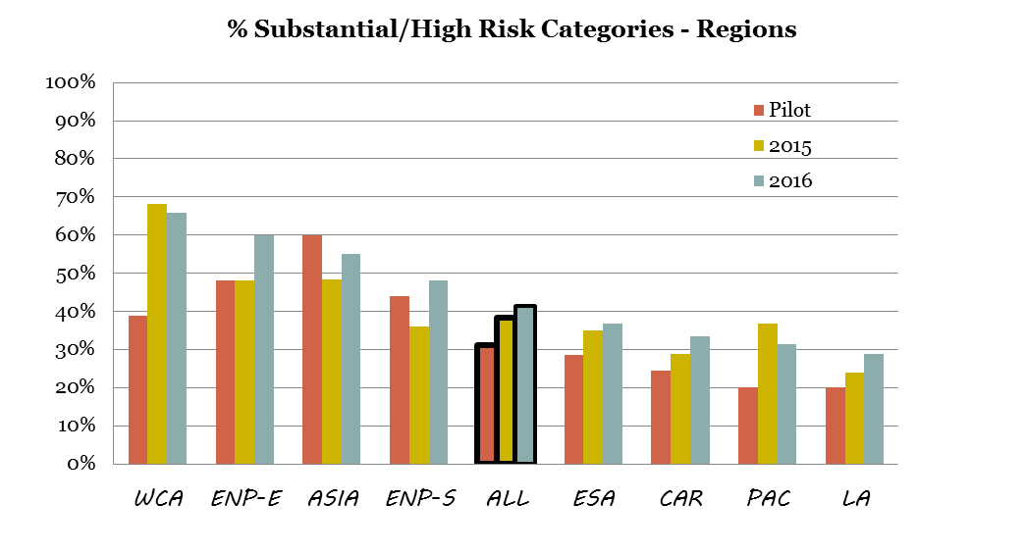
RMF- Risk categories

Slide 5
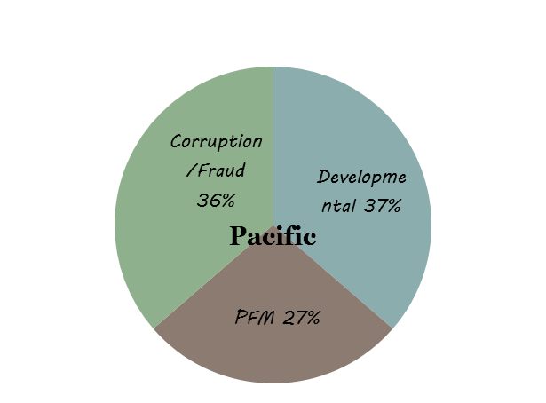
Distribution of substantial/high risk categories: All regions and Pacific

Slide 6
Assessing eligibility criteria for OCTs
Use of the Risk Management Framework when risks are low and moderate
Analysis by Commission in consultation with MS covering macro-economic risks, developmental risks, public finance management risks, corruption and fraud
Political risk analysis excluded

Slide 7
Assessing eligibility criteria for OCTs
When risks are substantial and/or high: eligibility assessed in accordance with guidelines and annexes 3, 4, 5 and 6.
A relevant and credible sector policy remains essential.

