Slide 1
Budget Support Seminar for the Pacific Region – Blending Module
October 2016
Suva, Fiji

Slide 2
2 Objectives:
1. Introduction to blending
2. Present elements on the complementarity of modalities "budget support" and "blending"

Slide 3

Blending is defined as …..
THE STRATEGIC USE OF A LIMITED
AMOUNT OF GRANTS TO MOBILISE
FINANCING FROM PARTNER FIs
AND THE PRIVATE SECTOR TO ENHANCE THE
DEVELOPMENT IMPACT OF INVESTMENT PROJECTS (or even make them possible)
LEVERAGE
Partner FI loans
Grant

Slide 4
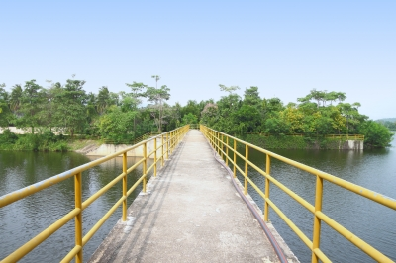
Rational of Blending: "Bridge the Gap"
Massive needs for development funding vs constraints in public finances result in significant funding needs.
Investment needs in emerging and developing country estimated at USD 2 trillion a year over next decade – rougly USD 1 trillion more than what is currently spend!* Only roughly 10% are expected to be covered by ODA.
*Bhattacharya/Romani, 2013, "Meeting the Infrastructure Challenge – the Case for a New Developoment Bank"

Slide 5
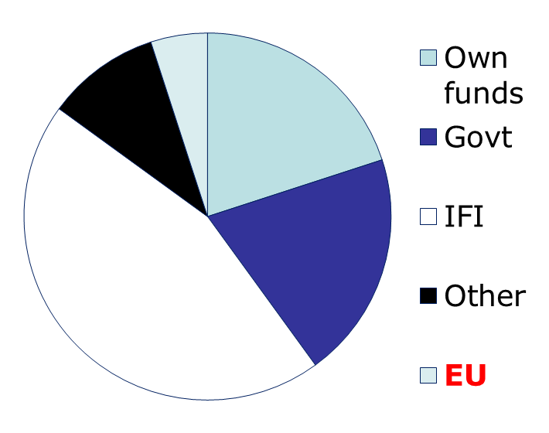
The grant is part of a financing package
Project financing mix
Equity/Own funds (beneficiary)
Government Financing
Finance institutions (IFIs) Loans ++
Other (Grant donors and/or Private)
EU grant resources
Average EU grant size €5-10 million

Slide 6
Blending was 4% of EU aid 2007-13
Funding Instrument | Countries covered | Total funding available 2007-2013
European Neighbourhood and Partnership Instrument | 17 | € 11.2 billion
European Development Fund | 79 | € 22.68 billion
Development Co-operation Instrument | 47 | € 10.06 billion
Thematic instruments | all | € 5.6 billion
 | TOTAL | €49.5 billion
Total blending approvals up to end-2014 (on funding envelopes 2007-2013): €1.8 billion (less than 4% of total EU programmes), so far financed out of regional programmes.
Source: EU website

Slide 7
This may grow to 10%, depending on the use of blending in the NIP's
 | LAIF | AIF | IFCA | NIF
Indicative (RIP) 2014-2020 allocation | € 320 million | € 320 million | € 140 million | € 2.1 billion (incl. NIP)
 | AfIF | CIF | IFP
Indicative (RIP) 2014-2020 allocation | c. € 1 billion | € 135 million | € 20 million

Slide 8
2007-2015 Blending operations
Annual grant approvals (in € million)
Grant approvals by sector (in %)
Allocated resources
c. € 2.7 billion
mobilise
EFIs resources of
€ 23 billion
support
278 projects with
total est. budget of
€ 50 billion

Slide 9
Average leverage is c. 20x
At least €23 billion provided by lead public finance institutions

Slide 10
3 ‘types’ of partners, always a LEAD FI
Multilateral European Finance Institutions (e.g. EIB,…).
European National development finance institutions from Member States (e.g. AFD, KfW, AECID, CDP, …)
Non-European regional banks: can act as lead (e.g. AfDB in AfIF; IaDB, CDB in CIF), as co-financiers in others.
‘Lead’ FI
(entrusted
with budget implementation tasks)
Usually, supporting FIs. Under certain circumstances: Lead FI
Notes:
"Lead FI" according to our blending terminology is the FI signing the delegation agreement with the Commission. It may actually be a junior partner in a financing consortium.
Non-European lead possible when gap left by European Fis in terms of presence, expertise etc. Relevant for the Pacific region where only the EIB is really active!

Slide 11
Blending arises when…..
Projects have issues:
  Affordability problems
  Poor financial performance
  Perceived risk/market failure
  Pricing issues
  Multi-component
  And/or
Countries are:
  Too ‘rich’ for all-grant (LMICs, MICs)
  Too poor for all-commercial loan (DSF concessionality & limits)
  And/or
Actors:
  Financiers have constraints and specific policy objectives
  Beneficiaries ‘shop’ for best deal
  Capital intensity
  New technology
  Pioneering new approach
  Issues beyond sponsor
  Public goods

Slide 12
Blending aims to achieve additionality (think: 1+1 = 3)
From Guidance Notes: 10 areas
  Economic
  Financial
  Social
  Project scale
  Project timing
  Project quality & standards
  Innovation
  Sustainability
  Environment (climate)
  Other

Slide 13
Concept of IRR (FRR) and ERR
Financial institutions are primarily driven by financial rate of returns.
If the IRR is low, a project may not be interesting from a financial point of view.
A blending contribution can increase the IRR and thus, make a project more interesting from a financial point of view.
Blending makes sens for investments with a high economic rate of return which takes into account not only financial, but social and development aspects, too.

Slide 14
Financial returns; the IRR (FRR)
$/€
Project net cash flow
+
Profit/positive cash flow
0
Time
years
Investment costs
-
Definition: the IRR is the rate which discounts to 0 the present value of net profits accruing to the project
Use: compare the project’s IRR to a ‘cut-off’ or ‘hurdle’ rate. If >, financing could be approved.

Slide 15
Economic benefits; the ERR
$/€
Total net benefits to project and country
+
Positive cash flow plus economic benefits
0
Time
years
Investment & economic costs
-
Definition: the ERR is the rate which discounts to 0 the present value of net benefits accruing to the project and the country
Use: compare the project’s ERR to a ‘cut-off’ or ‘hurdle’ rate. If >, financing could be approved.

Slide 16
Blending takes one of 5 forms :
BLENDING GRANT TYPE | …WHICH CAN ELIMINATE A KEY PROBLEM
Direct Investment Grant | Reduce cost to end users or beneficiary country by partly financing the total investment cost
Interest Rate Subsidy Grant | Reduce cost to end users or beneficiary country by reducing interest cost and/or avoiding IMF debt-ceilings
Technical Assistance Grant | To boost management, speed, project design, feasibility/preparation and quality i.e. address risks
Risk Capital | To address perceived high risk by providing funding which absorbs some of this risk and thereby lowers investors' risk perception (often with the objective of mobilising private capital)
Guarantee | To address perceived high risk by partly guaranteeing certain types of investments (often with the objective of mobilising private capital)
Notes:
Mention that the Commission is not really keen on Interest Rate Subsidies because the total amount is difficult to predict in advance (-> depends on the market) and FIs are not really transparent in their calculation of the premium to the market rate.

Slide 17
The Investment Grant - example
Hypothetical Road Project
 | Year 1 | Year 2 | Year 3 | Year 4 | Year 5 | Year 6 | Year 7 | Year 8 | Year 9 | Year 10
REVENUE
Toll from highway | 0 | 0 | 0 | 10 | 15 | 20 | 30 | 35 | 40 | 45
COSTS
Construction (investment) | 30 | 25 | 15 | 0 | 0 | 3 | 0 | 0 | 2 | 0
Maintenance | 0 | 0 | 0 | 1 | 5 | 8 | 10 | 12 | 14 | 16
Staff & other | 0 | 0 | 0 | 1 | 3 | 3 | 4 | 5 | 5 | 6
TOTAL COSTS | 30 | 25 | 15 | 2 | 8 | 14 | 14 | 17 | 21 | 22
INVESTMENT GRANT | 5 | 3
NET REVENUE | -25 | -22 | -15 | 8 | 7 | 6 | 16 | 18 | 19 | 23
Total investment | 70 62
Total net benefits | 97

Slide 18
The Investment Grant
Direct Investment Grant
E.g. A reduction in consumer price per KW
€
KW price solar
KW price thermal
time

Slide 19
The Interest Rate Subsidy (IRS)
Interest rate subsidy
Increase concessionality
Debt servicing without grant
€
IMF limits
More concessionality with grant
time

Slide 20
Technical Assistance
Feasibility
Management support
Policy analysis
Technical support
Monitoring & evaluation
1 Financial returns
to attract financiers
6 Competent management to ensure success
‘Green lights’ for project financing
2 Economic / social / environmental returns to make it worthwhile
5 Risk management to ensure appropriate implementation and repayments
3. Adequate policy framework & operating environment to facilitate impact and success
4 Beneficiaries commitment to provide ownership

Slide 21
Risk capital is equity – “first loss”
MIFA
‘A’ SHARES Private investors & lenders
‘B’ SHARES Public Finance Institutions
‘C’ SHARES First loss tranche (EU & BMZ*)
Sequence of absorbing any losses that may arise
* German Ministry for Economic Development

Slide 22
Guarantees – definition and features
Definition | Main features
Guarantees are funds set aside for covering potential future losses (subject to a number of agreed events happening) They are disbursed to FIs and then ‘earmarked’ but not disbursed by the FI until there is an actual loss (i.e. efficient). Undisbursed amounts returned to EU upon closure. | Provide lender with added protection – are ‘risk sharing’ Typically cover only part of first loss – around 50-70% - to avoid ‘moral hazard’ First loss typically capped at 10-15% of guaranteed portfolio Can be free or remunerated Should generate leverage, and improve access to finance

Slide 23
How blending amounts are calculated
BLENDING GRANT TYPE | Basis of calculation
Direct Investment Grant | Should be linked to a quantified target e.g. reducing a tariff by 5% or 10% etc. It could also be used to finance additional project components/ attain higher quality standards etc.
Interest Rate Subsidy Grant | Whenever the interest rate charged for a loan is lower than the market rate, the difference reflects the concessional or subsidy element. This is often required where debt sustainability analyses point to limits in the Government's capacity to absorb additional public or publicly guaranteed debt
Technical Assistance Grant | Bottom-up estimate of what grant support is needed to improve the design, quality, timing, sustainability, innovation, impact and/or scale of a project
Risk Capital | Calculation based on financial ratios e.g. desired debt/equity ratio and/ or risk protection required by typically private investors (could be high e.g. 30-40%)
Guarantee | Guarantees often have a maximum amount (‘cap’), an absolute figure, to limit the cover and potential costs for the EU, which is based, inter alia, on the expected loss percentages, as calculated by the financial institutions.

Slide 24
ECA's Special Report (2014) - Operations
  RECOMMENDATIONS:
  Ensure that allocation of EU grants is based on documented assessment of added value: Guidelines /EU delegations/Mature projects /Reviewing need of provisional approval
  Disburse funding only when funds are actually needed by the beneficiary
  Improve monitoring of EU grant implementation: Results-measurement framework/Instructions on monitoring to EUD/ROM: include ITF and adapt methodology
  Increase efforts to ensure appropriate visibility of EU funding.
Notes:
The EC endeavours to further engage EU Delegations in the preparation and follow-up of blending projects.
The issue of complete info relates in particular to the added value and the determination of the grant amount.

Slide 25
There is a long list of challenges
POLICY DIALOGUE; leverage the support given through blending PROJECT PIPELINE; ‘upstream’ coordination & quality pipeline, Delegations' role, migrating good experiences, using ‘model projects’ COMPLEXITY & EFFICIENCY; ‘best practice’; Guidelines, transaction costs ADDITIONALITY: demonstrate and quantify MONITORING & COORDINATION: Delegation's role, ROM, with partner FIs DEBT ASPECTS : avoid ‘contributing to’ debt issues IMPACT: avoid the creation of market distortions, measure sustainable results PROFILE & VISIBILITY: reap the benefits of potential

Slide 26
Blending operations involve two ‘levels’ of Commission financing decisions
Allocation of EU funds to the 7 blending Facilities through AAP, based on sectors and priorities defined in the programming exercise
BLENDING FACILITY (7)
Complementary decision on specific projects selected under Blending Governance Structure – no financial implication
BLENDED PROJECTS

Slide 27
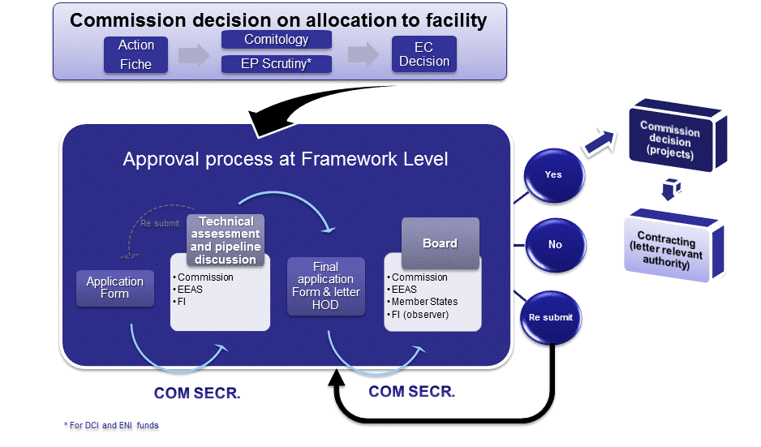
With different documents & inputs
Notes:
Pacific region (EDF): request for financial allocation by Regional Authorizing Officer (RAO) necessary
Identification process: Delegations + RAO should be involved (-> building of a project pipeline)
Formulation is the responsibility of the Financial Institution BUT Delegations and RAO should be consulted
Endorsement letters of concerned Delegations are necessary before submission to the Board; endorsement letters of concerned authorities are necessary before contracting

Slide 28
Contributions from bilateral NIP
to Regional Facilities
Note ARES(2015)5442791
Allocation of funds:done via regional AAP
Cross reference to be inserted
  in bilateral AAP
  in the title of the decision of the regional allocation
  in the facilities annual allocation AD which is annexed to the regional decision
The use of the NIP Fund formalized by a letter from HoD to HoU H2 (model as for QSG)

Slide 29
Use of the funds:
In case the total budget of the projects recommended by the Board for this Country is lower, the Commission may consider financing other eligible projects in other countries covered by the facility. The funds for the concerned Country will be postponed to the next year.
Need to do:
Non - substantial riders on both decisions!

Slide 30
The Facilities’ project cycle has 7 steps
The Blending Facilities project cycle
Identification | Preparation | Peer review & screening (Technical Assessment Meeting - TAM) | Board Opinion (Board meeting) & complementary Com Decision | Contracting | Monitoring | Evaluation
Generating the pipeline’– ideally so there is a chance to select from multiple projects | Ensuring that the project meets criteria and info is complete | Testing the project to see if it meets all the standards | Recommend whether to approve the grant – and on which conditions, followed by formal COM decision | Getting going and implementing in compliance with regulations | Obtaining the right information to ‘steer’ and manage | Checking to see if the objectives were met and feeding findings into future designs

Slide 31
More on the Delegations' role in the identification process
Active consideration: blending as one possible implementation modality for activities funded under bilateral and regional focal sectors
Dialogue with Financial Institutions operating in the country
Encourage dialogue among Financial Institutions in view of coordination/formation of consortia

Slide 32
TAM participants also provide feedback on the project pipeline
Feedback objectives: provide guidance to lead Financial Institutions on whether or not it is worthwhile to pursue a full project proposal
Feedback via traffic light system.
Feedback based on discussion during TAM. Delegations consulted beforehand.
Elements considered may include: geographical balance, coherence with EU policies and priorities, complementarity with other projects etc.

Slide 33
Quick presentation of the traffic light system introduced by Directorate H
Green | Go ahead with the formulation of a full project proposal. DEVCO H considers the project to be in line with RIP (or MIP where applicable) priorities, and implementation perspectives to be good. The project has a solid chance to be adopted. For a project to be attributed the colour green, concerned Delegations have to have expressed their support.
Yellow | The formulation of a full project proposal could go ahead after certain concerns have been addressed (to be specified during the TAM discussion, and summarized under the "comments" column of the pipeline table).
Red | Under current circumstances, the project is considered to have a limited implementation perspective, and consequently, very few chances to be adopted. Formulation should thus not go ahead, and the project taken off the pipeline.

Slide 34
A word on contracting:
HQ's responsibility (geographical Unit). After first payment, contract is devolved to and managed by concerned Delegation.
Format: PAGODA 2, complemented by Framework Agreement negotiated with the Financial Institutions (exception: EIB, where PAGODA is not applicable and all is based on a framework agreement).

Slide 35





A Word on:
European External Investment Plan (EIP)
Contribute to sustainable development
Contribute to jobs and growth
Tackle root causes of migration
Goals:
3 pillars:
Investment Fund
(EFSD)
Technical
assistance
Cooperation programmes & political dialogue
Africa Investment Platform
EU Neighbourhood Investment Platform
To support local authorities and companies in submitting projects to the Fund
To improve the investment climate and overall policy environment in countries concerned
Supported by
new guarantee
to reduce risk
A one-stop-show for public and private investors
Impact:
€ 3.35 billion
from EU budget and European Development Fund (EDF)
€ 44 billion
expected to be mobilised through the EIP
€ 88 billion
if EU Member States match EU contribution to EIP
#InvestGlobal
Notes:
External Fund for Sustainable Development
Regional Investment Facility + New guarantee to increase leverage regrouped in regional investment platforms (Africa + Neighbourhood only for the time being)
Platforms = "one stop shop" for investors (financial institutions + other private + public)
EFSD complemented by TA (to develop fundable projects) + Dialogue (investment climate)

Slide 36
Budget Support and Blending
Two distinct instruments:
  Primary objective of BS is to support policy reform
  Primary objective of BS is to promote (priority) investments in areas where funding via financial markets is not yet possible (or too expensive, or only to a lesser extend)
The objective of blending funds is not to fund TA under accompanying measures to budget support

Slide 37
Complementarity of Budget Support and Blending
Blending…
…complements policy reforms supported via budget support with capital intensive investments
…adds leverage to sector dialogue with strategic importance to our partner countries (energy, transport, water etc.)
…mobilises additional public and private resources for enhanced development impact
…improves cooperation with European and non-European financing institutions for extended policy dialogue

Slide 38
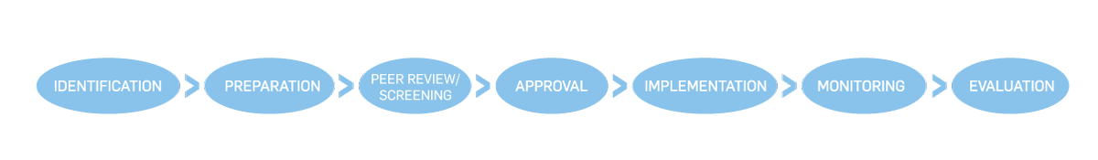
Remember: Involvement of the Delegation is key throughout the lifecycle of a blending project.
In this context: don't forget to ask support from budget support managers:
Budget support managers who are sector specialists: involvement in identification, preparation, approval, implementation and monitoring of blending projects in the sector in question. Watch out for: coherence and complementarity with sector budget support; coherence in sector policy dialogue + priority investments.
Budget support managers who are PFM or macroeconomic specialists: involvement in identification, preparation, and approval. Watch out for project's contribution to public debt as well as coherence with Public Investment Programme; alert if debt sustainability is an issue.
Notes:
Needless to say that if budget support managers are managers of blending projects, too, they need to be involved in every stage of the project lifecycle.

