Slide 1
Pacific Regional Training on EU Budget support and blending modalities 24-28 October 2016
Module 6
Budget Support and Civil Society Organisation (CSO/NSA)
Notes:
This presentation covers chapters 2 and section 5.1. of the BS Guidelines

Slide 2
Outline
Key EU communications
Rationale for CSO/NSA involvement
Promotion of multi actors dialogue
Stakeholders analysis
Key factors and specific entry points for promoting CSO participation to policy and budget process

Slide 3
Key EU communications
COM. The future approach to EU BS to third countries (13/10/2011):
Promote transparency and accountability and greater scrutiny of the Budget by CSO and other stakeholders.
COM. The roots of democracy and sustainable development: Europe’s engagement with civil society in external relation (12/09/2012):
Role of CSO in policy making and promoting domestic transparency and accountability (CSO role in budget processes)
COM. Empowering Local Authorities in partners countries for enhanced governance and more effective development outcomes (15/05/2013):
Cooperation between local authorities and civil society (for more inclusive and accountable development processes)- CSO oversight role at local level..
Notes:
CSO potential role in budget process: analyzing and contributing to budget proposals , monitoring and tracking of public revenues and expenditures, supporting citizens” budget literacy…
Promote SCO oversight role at national and local levels
In case of weak Civil Society Organisation’s capacity: NSAs are not organised or able to represent their consistencies for lack of capacity => EU specific support should be considered

Slide 4
Outline
Key EU communications
Rationale for CSO/NSA involvement
Promotion of multi actors dialogues
Stakeholders analysis
Key factors and specific entry points for promoting CSO participation to policy and budget process

Slide 5
Overall Rationale for CSO/NSA involvement
Development processes fundamentally are domestic, political change processes
Hence relationship between State and Society is crucial and engagements with NSAs have to move beyond a narrow aid agenda to a broader development agenda
Treat CSO/NSAs as actors
Analyze state-society relations systematically
Explore and exploit full potential within BS aid modality

Slide 6
Overall Rationale for CSO/NSA involvement
It is through CSO that citizens can:
Engage in policy dialogue
Voice their opinions and rights
Hold authorities accountable

Slide 7
Outline
Key EU communications
Rationale for CSO/NSA involvement
Promotion of multi actors dialogues
Stakeholders analysis
Key factors and specific entry points for promoting CSO participation to policy and budget process

Slide 8
EU through BS should encourage multi-actor dialogues
Stakeholders live with the consequences of the policies and may not see benefits for years
Their representation is key for the:
- Legitimacy & credibility of the process;
- Implementation of the reform (‘buy in’);
- Informing and basing PD on evidence (cross checking information with M & E)
Donors and technical agencies should ensure that they help all stakeholders to debate
Notes:
The role of the donor is not neutral: policy implementation and reform facilitation
Policy reform occurs when decision-makers recognise a feasible solution to a policy challenge and demonstrate the political will to make a change. It follows from this that policy dialogue -as a tool to push forward reform agendas- requires a set of enabling factors to be effective:
A Public Policy is in place or under elaboration, either through pilot projects that allow to experiment and develop new aspects of the public policy, regulatory work or comprehensive policy formulation.
Lead government actors' political will to engage in dialogue with a variety of actors: This depends on the political economy. Indeed, actors must perceive that they can reach better results by engaging in dialogue. However, not all governments are equally open to dialogue with other national actors or with donors.
Actor legitimacy, capacity and credibility: most policy dialogues involve multiple stakeholders with different interests, positions, levels of legitimacy and influence. Their capacity to engage is critical and requires capacity development (at a technical and skills level) and an enabling environment (e.g. and possible need for a legal framework, clear mandates, etc.).
The development effectiveness agenda clearly emphasizes the lead role of partner countries in defining policies and managing their own affairs. Yet this does not mean that donors are ‘neutral’ actors, whose role is limited to providing financial and technical support.

Slide 9
From government to country ownership
Multi actor and multi level policy processes
Implement reforms & achieve results: ensure feasibility and stimulate ‘buy in
Increase the legitimacy of reforms
Gradually improve domestic accountability

Slide 10
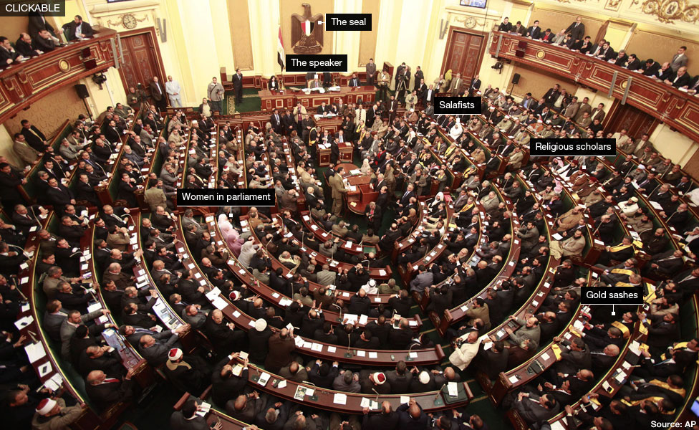
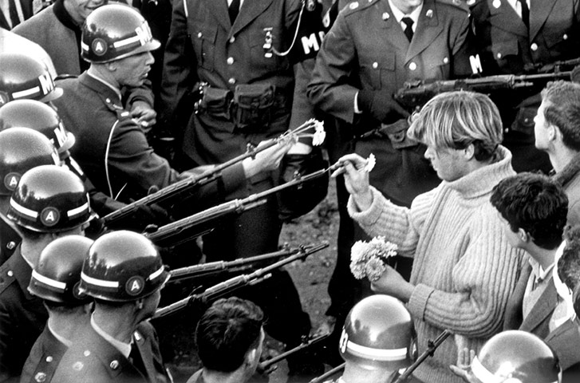
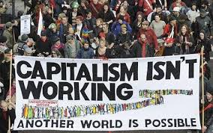
Citizens and policy actors outside governments can also participate to make policy proposals, improve domestic accountability, support or block a reform
Indirectly (e.g. parliament, councils)
When they speak in public
and media
Elections
Access and re-use
information
e.g. Where does
my money go?
Consultations and participatory planning and budgeting
When they protest and take the streets
Notes:
Citizens and policy actors outside governments can also participate to make policy proposals, improve domestic accountability, support or block a reform

Slide 11
Treat CSO/NSAs as actors
NSAs represent a complex and constantly evolving field of actors
This field is highly ‘political’: environment with numerous conflicts (resources, interests, access to state)
NSAs are autonomous actors, with differing and own agendas, histories,
NSAs respond to multiple impulses/demands from state and citizens;

Slide 12
What does that mean in practice?
Recognise the diversity of NSA roles, agendas, functions and structures
Resist the temptation of narrowing the NSA agendas and “instrumentalise” them for narrow donor purposes
Analyse the conflicts, interests, incentives, capacities, values and organic growth

Slide 13
Outline
Key EU communications
Rationale for CSO/NSA involvement
Promotion of multi actors dialogues
Stakeholders analysis
Key factors and specific entry points for promoting CSO participation to policy and budget process

Slide 14
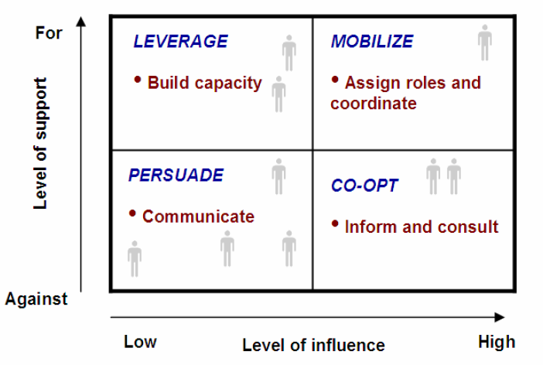
Different types of stakeholders may need to be handled differently

Slide 15
Identifying Stakeholders
Dealing with the right stakeholders implies taking time to know them, map their interest and capacity
Understanding the institutional set-up of the State , the structure of the government, and the assigned responsibilities is necessary at national and local level…
Key stakeholders may include: legislature or special committees, political parties, agencies, line ministries and sector lead ministry, MoF..
Outside the government: target groups, civil society organisations, media, private sector associations, users associations, trade unions…

Slide 16
Working with stakeholders
Stakeholders have a different perspectives on resources allocations
Conflicting priorities: mediate and structure a process
Making budgets more responsive to the needs as well as promoting the rights of all sectors of society
Donors can contribute to structuring and supporting the dialogue technically rather than engaging directly in it
Making the budgeting process much more transparent: domestic accountability
Notes:
In addition to analysis of the institutional framework, a wider PEA and actor mapping is necessary. It assesses the relative power of the different actors, their accountability relations and the constituencies they represent. The analysis should therefore provide an overview of their interests and incentives to enter in policy dialogue. Consensus on reforms cannot be expected since they are always highly political and contested by different groups that may lose or gain. As a result, understanding the power relations among actors is critical for donors to make informed decisions.
Useful tool: a stakeholder analysis: Set of techniques to MAP and UNDERSTAND the positions, perspectives and power of the actors or “stakeholders” that have and “interest in” and/or are likely to be “affected by” a particular reform or BS programme
Allow:
A highly focused analysis = stakeholders in a particular policy process, reform or project
Such analysis can be structured around 3 steps:
STEP 1 :
Clarify the reform agenda or programme objective and outline intended consequences
STEP 2:
Identify all relevant stakeholders interested in or concerned by reform or programme objective
STEP 3
Map and classify the various stakeholders in terms of their INTEREST and POWER in relation to the issue
“STAKEHOLDERS”
Political structures, government departments, organisations, groups, networks, coalitions, media and opinion leaders, individuals
“INTEREST”
Measures the degree of importance attached to the issue by the various stakeholders and how they are likely to be affected by it
“POWER”
Measures the influence stakeholders have and the degree to which they may help achieve or block the reform

Slide 17
Outline
Key EU communications
Rationale for CSO/NSA involvement
Promotion of multi actors dialogues
Stakeholders analysis
Key factors and specific entry points for promoting CSO participation to policy and budget process

Slide 18
Key factors for CSO participation in policy and budget process (I)
Access to budget and public policy information in a timely manner and accessible formats:
Open Budget Survey/PEFA (Pillars 2, 6 & 7) and related government reform road maps
Open data portals
Publication of citizen budgets
Information campaigns
Free and independent media
Notes:
Based on EC Tools and Methods Series n°18, May 2014 “ Promoting CS participation in policy and budget processes”.
Open Government Partnership

Slide 19
Key factors for CSO participation in policy and budget process (II)
Opportunities for participating in agenda setting and decision-making
Cooperation or participatory policymaking and budgeting process
Institutionalisation and/or conducive legal environment (strategy, charters…) for CSO involvement in policy process
Participatory budgeting (often a local level) or consultation fora including by statutory oversight bodies
CSO contentious strategies (shadow budget, independent studies & research to develop proper evidence base for advocacy)
Notes:
BTransparency
Open Government Partnership

Slide 20
Key factors for CSO participation in policy and budget process (III)
Existence of vertical/social accountability mechanisms and processes
Social accountability work/monitoring at service delivery units and third party verification by CSOs.
ICT developments and positive impact on developing tools for evidence based advocacy and promoting accountability (real time data collection, aggregation at higher scale)
Authorities/public service provider monitoring/evaluation tools: social audits and citizen auditing, scorecards (quality assessment), PETS..
Notes:
Relationships between citizens and decisions makers including capability issues.
Evidence based advocacy: ICT positive impact ipact cllect rela time

Slide 21
Entry points for EU support to CSO participation in policy and budget process (I)
EU Portfolio approach:
mix of policy dialogue and operational support/capacity development
Measures targeted at reinforcing CSOs and/or authorities capacities
Promote transparency and accountability
Promote greater scrutiny of the Budget by CSO and other stakeholders.
Notes:
Based on EC Tools and Methods Series n°18, May 2014 “ Promoting CS participation in policy and budget processes”.

Slide 22
Entry points for EU support to CSO participation in policy and budget process (II)
Authorities | CSO
EU Policy dialogue Promote more conducive legislation for budget transparency/access to budget information Promote adherence to regional& global initiatives (EITI, Open Government Declaration…) Promote establishment of proper formalised policy dialogue fora for CSO/Authorities (involvement of CSO in BS dialogue…) | EU Policy dialogue: EU structured policy dialogue with CSOs
 | EU Operational Support Capacity development for evidence-based advocacy actions: negotiation & communication skills, engagement with Parliament, research and analytical work to monitor, follow, interact on/with national authorities
EU Operational Support: Capacity development for open data initiatives, publication and dissemination/disclosure policy, quality improvement of published data. | Support to alliance building Support horizontal/vertical alliances across sectors at local/sub-national and local/national levels, Promote networking activities between Community Based Organisations and CSO
Notes:
Based on EC Tools and Methods Series n°18, May 2014 “ Promoting CS participation in policy and budget processes”.
WB BOOST initiative example…

