Slide 1
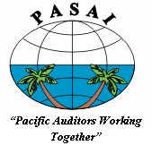
EU Workshop
PASAI’s ROLE
Ihlen Joseph
Chairman of PASAI & Public Auditor, Pohnpei State (FSM)
28 October 2016

Slide 2
PASAI – what it is
Official association of supreme audit institutions (government Audit Offices and similar organisations, known as SAIs) in the Pacific region.
one of the regional working groups belonging to the International Organisation of Supreme Audit Institutions (INTOSAI).*
Objectives
  Strengthen understanding, cooperation, coordination between members
  Advocate interests of good governance
  Build and sustain public auditing capacity
  Assist members perform their auditing functions, through technical advice
  Serve as regional working group
  Encourage cooperation with other regional working groups
Notes:
PASAI is the official association of supreme audit institutions (government Audit Offices and similar organisations, known as SAIs) in the Pacific region. It is one of the regional working groups belonging to the International Organisation of Supreme Audit Institutions (INTOSAI).

Slide 3
INTOSAI
operates as an umbrella organisation for the external government audit community
autonomous, independent and non-political organisation; and non-governmental organisation with special consultative status with the Economic and Social Council (ECOSOC) of the United Nations
Notes:
[Just read the slide]

Slide 4
*INTOSAI – Regional Working Groups
OLACEFS | Organization of Latin American and Caribbean Supreme Audit Institutions | established in 1965
AFROSAI | African Organization of Supreme Audit Institutions | established in 1976
ARABOSAI | Arab Organization of Supreme Audit Institutions | established in 1976
ASOSAI | Asian Organization of Supreme Audit Institutions | established in 1978
PASAI | Pacific Association of Supreme Audit Institutions | established in 1987
CAROSAI | Caribbean Organization of Supreme Audit Institutions | established in 1988
EUROSAI | European Organization of Supreme Audit Institutions | established in 1990
Notes:
As covered in an earlier slide, PASAI is one of the 7 regional working groups in the world that was created to enhance regional cooperation and coordination in the work of public sector auditors in the pacific region.
It was established as the South Pacific Association of Supreme Audit Institutions (SPASAI) but changed to PASAI in 2008 following the inclusion of members from the northern Pacific.
It now has 28 members which include the Pacific SAIs, the New Zealand Audit Office, the Australian National Audit Office (ANAO) and its eastern states (Queensland, New South Wales, Victoria and Australian Capital Territory (ACT) and the two French states, New Caledonia and French Polynesia.

Slide 5
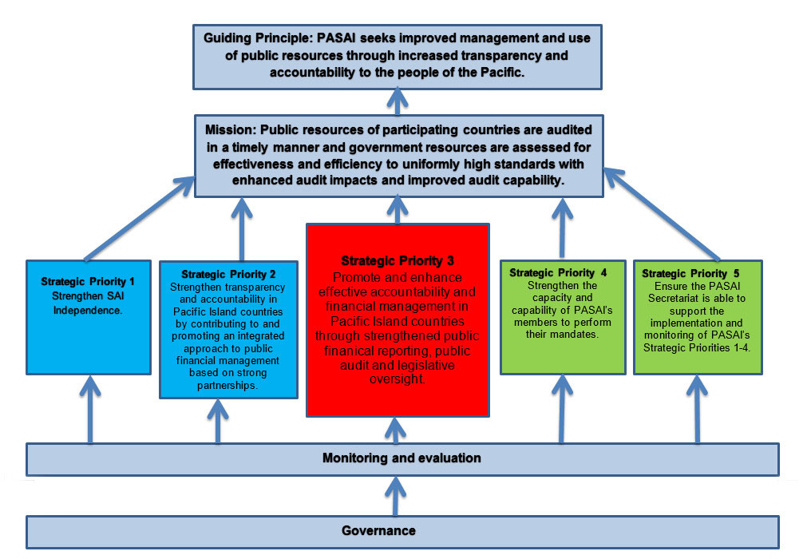
Notes:
The diagram illustrates PASAI’s 10 year strategy for the period 2014-2024. The guiding principle of the strategy is PASAI seeks improved management and use of public resources through increased transparency and accountability to the people of the Pacific. The mission of PASAI is “Public resources of participating countries are audited in a timely manner and government resources are asses for effectiveness and efficiency to uniformly high standards with enhanced audit impacts and improved audit capability.
The most important for PASAI in the 10 years is the red block – strategic priority (SP) 3 which is ensuring that the cycle of public financial management is operating effectively and efficiently. That includes the public accounts being prepared on time for audit; the audit institution completes its assurance work on time; and the legislative oversight (Public Accounts Committee) is able to scrutinise the accounts and hold the government to account for the use of public resources. I’ll cover the other strategic priorities in the next few slides.
PASAI has a monitoring and evaluation framework that makes sure that our performance are monitored and addressed if necessary.
The governance arrangements include the PASAI Governing Board meeting twice a year and the PASAI annual congress.

Slide 6
SP1 – Strengthen SAI independence
Independent SAIs consistent with UN General Assembly Resolution, Lima and Mexico Declarations
SAI independence supported by adequate resources and capability
  Appointment of staff; determination of budget
SAI demonstrate and communicate their independence & relevance to citizens and stakeholders
SAI share information and promote independence within their SAI and support other SAIs to meet challenges to their independence
Notes:
In the first strategic priority says, for a SAI to contribute effectively to good public financial management, it needs to have the required independence. The UN General Assembly Resolution, Lima and Mexico Declarations provide the basis for stronger and independent audit institutions. Some of these include: independent allocation of resources, appointment of staff, determination of staff.
Secondly, SP1 wants SAIs to demonstrate and communicate their independence and relevance to citizens.
Also, SAI share and promote independence within their SAI and support other SAIs to meet challenges to their independence.
PASAI has continuously provided support to member SAIs on reviewing their audit legislations to ensure the independence principles are embedded. 65% of SAIs (50% in 2011) have reviewed their Audit legislation against the best practice on independence provided by Lima and Mexico declarations

Slide 7
SP2 – Strengthen transparency and accountability
PASAI regularly reports on the contribution made by auditing public resources to accountability and transparency (A&T)
SAI is seen in their country system and across the region, as a credible source of independent and objective insight and guidance on the management of public resources
Strong partnerships are developed with regional organisations with an interest in enhanced A&T
SAI advocates for improvements in the public financial management systems adopted by their countries
PASAI identifies and promotes good practice by SAIs to other SAIs
Notes:
The next strategic priority (SP2) is for PASAI to strengthen transparency and accountability. That includes:
PASAI members reporting regularly on their contribution to accountability and transparency;
SAI is seen as a credible source of independent and objective insight and guidance on the management of public resources
PASAI building strong partnerships with regional organisations with an interest in enhanced accountability and transparency
SAI advocates for improvements in public financial management systems
SAI promote good practice to colleagues/ other SAIs.
PASAI has carried out workshops to Public Accounts Committee (PAC) amd Parliamentarians in 4 countries so far (Cook islands, Solomon Islands, Tonga, and Vanuatu) to imrpove their awareness of the legislative oversight role of PACs. PASAI will continue with other countries as per scheduled programs.

Slide 8
SP3 – Promote/enhance accountability and effective financial management through strengthened public financial reporting, audit and legislative scrutiny
Up-to-date Financial Statement of Government (FSG) or Whole of Government (WOG) reports are audited using appropriate standards
SAIs produce high quality financial audits in accordance with national/ international standards
SAIs produce high quality performance audits of government and regional programmes
SAI is audited annually to set example to public entities in the Pacific
Notes:
As covered in the earlier slide, the focus is on the efficient public financial management (PFM) system: the completion in the preparation of the public accounts; the audit; and, the scrutiny by the legislative oversight.
For PASAI, the most important under this strategic priority (SP3) is the completion of the audit of the whole of government (WOG) accounts. This has improved over the last 6 years. About 71% of SAIs in the region had prepared their Whole of government accounts (Public Accounts/Govt financial statements) within the respective statutory timeline. An improvement from 50% in 6 years back.
Also important is the use of international standards in the audits, which raises the quality of audited accounts.
PASAI will continue with high quality performance audits, which is concerned not only with financials, but the efficiency and effectiveness of government programmes in the Pacific.
PASAI members are audited annually, to set example to other public entities.

Slide 9
SP4 – Strengthen capacity/capability of PASAI members
SAIs develop and implement their own comprehensive and realistic strategic plans
SAIs adopt and apply the INTOSAI performance measurement framework (PMF)
Partnerships and twinning arrangements are developed between SAIs within PASAI and globally
  NZ/Samoa, Fiji/Kiribati, ANAO/PNG, QAO/PNG, VAGO/Tuvalu, Cook Islands/ WA
SAIs plan for and use PASAI training resources and programmes
  Tier 1-4 audit training; communications, International Public Sector Accounting Standards (IPSAS)
Notes:
Because one of the main challenges of SAIs in the region is lack of capacity within SAIs, SP4 provides strategies for strengthening capacity and capability of PASAI members. These include:
- SAI develops and implements realistic strategic plans (and communication plans)
- SAI adopts and apply the INTOSAI performance measurement framework (PMF)
- PASAI encourages partnerships and twining arrangements between PASAI and the Australasian region - It has started already for NZ/Samoa, Fiji/Kiribati, Australian National Audit Office (ANAO)/PNG, Queensland Audit Office (QAO)/PNG, Victoria Auditor Generals Office (VAGO)/Tuvalu, Cook Islands/ Western Australia (WA) Audit Office.
SAI uses PASAI training resources and programmes
- More than 500 auditors in SAIs in the region been participated in various capacity programs mentioned above. The Secretrariat is continuously monitor and follow up with SAIs on how these staff transform what they learned to improving the quality of work of the SAIs, and also how SAIs are utilising these staff to practice what they have learned through allocating of audit tasks. This is an ongoing but crucial review process.

Slide 10
SP5 – PASAI Secretariat is capable of supporting SP1-4
Skilled and well resourced Secretariat
Adequate funding to implement the strategy
Effective operational plan
Implementation of strategy is regularly monitored and evaluated
Notes:
SP5 is about improving the PASAI Secretariat.

Slide 12
Questions

